Slide 1
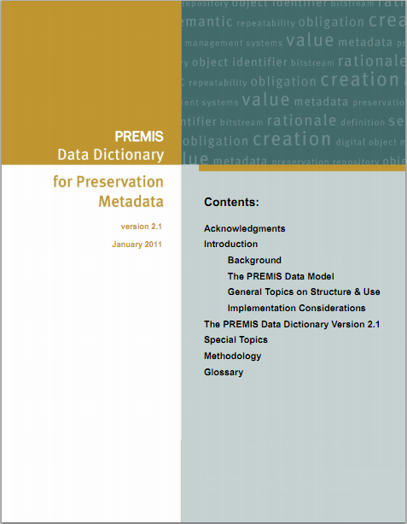


WORKSHOP
Universitätszentrum Wall

Slide 2



Thanks to the Organizers and Sponsors
for providing support to this PREMIS tutorial
Presenter
Angela Di Iorio
Digital Library
http://sapienzadigitallibrary.uniroma1.it/
some of content’s materials were excerpted from
“PREMIS Tutorials and Implementation Panel Presentations for Public Use”
http://www.loc.gov/standards/premis/tutorials.html
…and properly contextualized for the objectives and duration of this workshop

Slide 3
SUMMARY
Background and context
Data model and internal connections
Data dictionary and defined entities
Implementation approaches and issues
Working with PREMIS
PREMIS evolution

Slide 4
Background and context of PREMIS
The LONG TERM DIGITAL PRESERVATION connection:
The existence of a digital record depends on its correct preservation
The correct digital preservation starts from the born of digital resource
The more the awareness of digital community is growing around the preservation, and the more the implementation initiatives had highlighted the need of a standardized metadata framework

Slide 5
Background and context of PREMIS
Pre-2002: various preservation metadata element sets released
  Different scopes, purposes, underlying models/assumptions
  No international standard; little consolidation of expertise/best practice
June 2002: Preservation Metadata Framework
  International working group (jointly sponsored by OCLC, RLG)
  Comprehensive, high-level description of types of preservation metadata
  Used OAIS reference model as starting point
  Set of “prototype” preservation metadata elements
  Consensus-based foundation for developing formal preservation metadata specifications … but not an “off-the-shelf, ready to implement” solution
Post-2002: Need implementable preservation metadata, with guidelines for application and use, relevant to a wide range of digital preservation systems and contexts
  Motivated formation of the PREMIS Working Group

Slide 6
Background and context of PREMIS
PREMIS Working group
  June 2003: OCLC, RLG sponsored new international working group:
  - PREMIS: Preservation Metadata: Implementation Strategies
  Membership:
  - more than 30 experts from 5 countries, representing libraries, museums,
  archives, government agencies, and the private sector
  - Co-Chairs: Priscilla Caplan (FCLA), Rebecca Guenther (LC)
Objective 1: Identify and evaluate alternative strategies for encoding, storing,
managing, and exchanging preservation metadata
- PREMIS Survey Report (September 2004)
Objective 2: Define implementable, core preservation metadata, with guidelines/recommendations for management and use

Slide 7
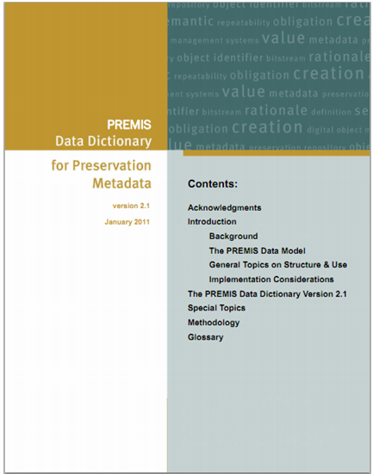
PREMIS Data Dictionary
May 2005: Data Dictionary for Preservation
Metadata: Final Report of the PREMIS Working Group
March 2008: PREMIS Data Dictionary for Preservation Metadata, version 2.0
January 2011: PREMIS Data Dictionary for Preservation Metadata, version 2.1
  http://www.loc.gov/standards/premis/v2/premis-2-1.pdf

Slide 8
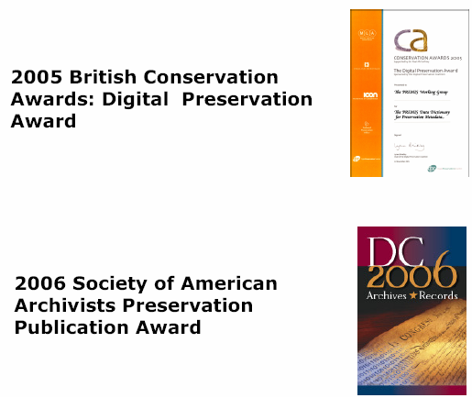
PREMIS acknowledgements

Slide 9
PREMIS Data Dictionary
The initial conceiving of the Data Dictionary it was to define a set of preservation metadata that:
Supports the viability, renderability, understandability, authenticity, and identity of digital objects in a preservation context;
Represents the information that most preservation repositories need to know to preserve digital materials over the long-term;
Emphasizes “implementable metadata”: rigorously defined, supported by guidelines for creation, management, and use, and oriented toward automated workflows; and
Embodies technical neutrality: no assumptions made about preservation technologies, strategies, metadata storage and management, etc.
Data Dictionary for Preservation Metadata: PREMIS version 2.1 [PREMISDD-2.1] : p. 1
The PREMIS Data Dictionary defines “preservation metadata” as the information a repository
uses to support the digital preservation process.
[PREMISDD-2.1] : p. 3

Slide 10
PREMIS core preservation metadata
    “Implementable, core preservation metadata”
things that most working preservation repositories are likely to
need to know in order to support digital preservation
[PREMISDD-2.1] : p. 3
Expands a number of the categories typically used to differentiate types of metadata: administrative (including rights and permissions), technical, and structural.
Documents as much as possible the digital provenance (the history of an object)
Documents the relationships among different objects within the preservation repository
Descriptive
Metadata
Preservation
Metadata
PREMIS
Detailed Info on Agents,
Rights, Media
or Hardware
Repository
Business
Rules
Format-specific
Technical
Metadata
Understanding PREMIS by Priscilla Caplan for the Library of Congress,
http://www.loc.gov/standards/premis/understanding-premis.pdf pp. 4-5

Slide 11
PREMIS Data Dictionary
    “Implementable, core preservation metadata”
things that most working preservation repositories are likely to
need to know in order to support digital preservation
CORE
- absolutely required under any circumstances;
applicable to any type of repository implementing any type of preservation strategy;
does not necessarily mean mandatory
IMPLEMENTABLE
- rigorously defined;
- supported by usage guidelines/recommendations;
emphasis on automated workflows (automatically supplied and processed by the Repository)
coded values from an authority list are preferred over textual descriptions
multi-level technical neutrality: no assuptions about system, data management, preservation strategies
Because of the emphasis on the need to know rather than
the need to record or represent in any particular way,
the group preferred to use the term “semantic unit” rather than “metadata element.”
The Data Dictionary names and describes semantic units.
[PREMISDD-2.1] : p. 4

Slide 12
PREMIS Data Dictionary
What PREMIS DD is
Common data model for organizing/thinking about preservation metadata
Guidance for local implementations
Standard for exchanging information packages between repositories
Reference for core preservation metadata
What PREMIS DD is not
Out-of-the-box solution: need to instantiate metadata elements in repository system
All needed metadata: excludes business rules format specific technical metadata,
descriptive metadata for access, non core preservation metadata
Lifecycle management of objects outside repository
Rights management: limited to permissions regarding actions taken within repository

Slide 13
PREMIS Data Dictionary
BENEFITS
supplies a critical piece of the digital preservation infrastructure, and is a
building block with which effective, sustainable digital preservation
strategies can be implemented;
is the first comprehensive technical specification for preservation metadata
produced from an international, cross-domain, consensus-building process;
is widely applicable across all sorts of institutions, digital preservation contexts, and
system implementations;
is oriented toward practical implementation;
is supported by the PREMIS Maintenance Activity, which provides a central destination
for PREMIS related information and resources, and hosts
the PREMIS Implementers’ Group discussion list.

Slide 14
PREMIS Maintenance Activity
  Web site
  Permanent Web presence, hosted by Library of Congress
  Central destination for PREMIS-related info, announcements, resources
  Home of the PREMIS Implementers’ Group (PIG) discussion list
  PREMIS Editorial Committee
  Set directions/priorities for PREMIS development
  Considers proposals for changes
  Coordinates revisions of Data Dictionary and XML schema
http://www.loc.gov/standards/premis/

Slide 15
PREMIS Data Model
Entities, “things” relevant to digital preservation that are described by preservation metadata
(Intellectual Entities, Objects, Events, Rights, Agents) [boxes]
Properties of Entities (semantic units)
Relationships between Entities [arrows]
Intellectual
entities
Rights
Objects
Agents
Events

Slide 16
PREMIS Data Model
Understanding PREMIS by Priscilla Caplan for the Library of Congress,
http://www.loc.gov/standards/premis/understanding-premis.pdf p. 8
Intellectual Entities
Rights
Content that can be described as unit
(e.g. books, article, databases).
Assertion of rights and permissions.
Objects
Agents
Discrete units of information in digital form. Can be files, bitstreams, or rapresentations.
People, organizations,
or software.
Events
Actions that involve an Object and an Agent known to the system.

Slide 17
Intellectual entity
Intellectual Entities
Intellectual Entity: a set of content that is considered a single intellectual unit for purposes of management and description: for example, a particular book, map, photograph, or database.
An Intellectual Entity can include other Intellectual Entities;
for example, a Web site can include a Web page;
a Web page can include an image.
An Intellectual Entity may have one or more digital representations.
Content that can be described as unit
(e.g. books, article, databases).
Examples:
  The Chamber by John Grisham(an ebook)
  “Maggie at the beach” (a photograph)
  The Library of Congress Website (a website)
  Not fully described in PREMIS DD, but can be linked to in metadata describing digital representation… this will change in forthcoming version 3.0

Slide 18
Object entity
Objects
Discrete units of information in digital form. Can be files, bitstreams, or rapresentations.
Object (or Digital Object): a discrete unit of information in digital form
Objects are what are actually stored and managed in the preservation repository.
Most of PREMIS is devoted to describing digital objects.
The information that can be recorded includes:
a unique identifier for the object (type and value),
fixity information such as a checksum (message digest) and the algorithm used to derive it,
the size of the object,
the format of the object, which can be specified directly or by linking to a format registry,
the original name of the object,
information about its creation,
information about inhibitors,
information about its significant properties,
information about its environment (see below),
where and on what medium it is stored,
digital signature information,
relationships with other objects and other types of entities.

Slide 19
Object entity
Objects
The Object entity has three subtypes: file, bitstream, and representation.
A file is a named and ordered sequence of bytes that is known by an operating system. A file can be zero or more bytes and has a file format, access permissions, and file system characteristics such as size and last modification date.
A bitstream is contiguous or non-contiguous data within a file that has meaningful common properties for preservation purposes. A bitstream cannot be transformed into a standalone file without the addition of file structure (headers, etc.) and/or reformatting the bitstream to comply with some particular file format.
A representation is the set of files, including structural metadata, needed for a complete and reasonable rendition of an Intellectual Entity. For example, a journal article may be complete in one PDF file; this single file constitutes the representation. Another journal article may consist of one SGML file and two image files; these three files constitute the representation. A third article may be represented by one TIFF image for each of 12 pages plus an XML file of structural metadata showing the order of the pages; these 13 files constitute the representation.
Discrete units of information in digital form. Can be files, bitstreams, or rapresentations.
Examples:
a PDF file
a book composed of several XML
files and many images
TIFF file containing a header and
2 images
a ZIP file
chapter01.pdf
file
chapter01.pdf
bitstream
book.pdf
representation
filestreams
file01.tar
embedding file
chapter01.pdf
chapter02.pdf
img01.jpg
img02.jpg

Slide 20
Agent entity
Agents
Agent: person, organization, or software program/system associated with Events in the life of an Object, or with Rights (permission statement) attached to an Object.
People, organizations,
or software.
Agents are associated only indirectly to Objects through Events or Rights
Not defined in detail in PREMIS DD because is not considered core preservation metadata beyond identification
Examples:
Angela Di Iorio (a person)
Università di Roma la Sapienza (an organization)
Sapienza Digital Library System (a system)
BRI-DGE version 2.0 (a software program)

Slide 21
Event entity
Events
Event: an action that involves or impacts at least one Object or Agent associated with or known
by the preservation repository.
Actions that involve an Object and an Agent known to the system.
Helps document digital provenance. Can track history of Object through the chain of Events that occur during the Objects lifecycle
Determining which Events are in scope is up to the repository (e.g., Events which occur before ingest, or after de-accession)
Determining which Events should be recorded, and at what level of granularity is up to the repository
Examples:
Validation Event: use JHOVE tool to verify that chapter01.pdf is a valid PDF file
Ingest Event: transform an OAIS SIP into an AIP (one Event or multiple Events?)
Migration Event: create a new version of an Object in an up-todate format

Slide 22
Rights entity
Rights
Rights: assertions of one or more rights or permissions pertaining to an Object and/or Agent.
Assertion of rights and permissions.
An agreement with a rights holder that grants permission for the repository to undertake an action(s) associated with an Object(s) in the repository.
Not a full rights expression language; focuses exclusively on permissions that take the form:
Agent X grants Permission Y to the repository in regard to Object Z.
Rights may be associated with copyright, license or contract
Example:
Dario Fo´ grants Sapienza Digital Library archival system permission, for preservation purposes, to make three copies of the archival records that are under his ownership.

Slide 23
Rights entity
RightsBasis: copyright, statute, license
If case of... copyrightInformation container must be present
In case of... licenseInformation container must be present
In case of... statuteInformation container must be present
4.1.3 copyrightInformation (O, NR)
4.1.3.1 copyrightStatus (M, NR)
4.1.3.2 copyrightJurisdiction (M, NR)
4.1.3.3 copyrightStatusDeterminationDate (O, NR)
4.1.3.4 copyrightNote (O, R)
4.1.4 licenseInformation (O, NR)
4.1.4.1 licenseIdentifier (O, NR)
4.1.4.1.1 licenseIdentifierType (M, NR)
4.1.4.1.2 licenseIdentifierValue (M, NR)
4.1.4.2 licenseTerms (O, NR)
4.1.4.3 licenseNote (O, R)
4.1.5 statuteInformation (O, R)
4.1.5.1 statuteJurisdiction (M, NR)
4.1.5.2 statuteCitation (M, NR)
4.1.5.3 statuteInformationDeterminationDate (O, NR)
4.1.5.4 statuteNote (O, R)
4.1.6 rightsGranted (O, R)
4.1.6.1 act (M, NR)
4.1.6.2 restriction (O, R)
4.1.6.3 termOfGrant (M, NR)
4.1.6.3.1 startDate (M, NR)
4.1.6.3.2 endDate (O, NR)
4.1.6.4 rightsGrantedNote (O, R)
4.1.7 linkingObjectIdentifier (O, R)
4.1.7.1 linkingObjectIdentifierType (M, NR)
4.1.7.2 linkingObjectIdentifierValue (M, NR)
4.1.7.3 linkingObjectRole (O, R)
4.1.8 linkingAgentIdentifier (O, R)
4.1.8.1 linkingAgentIdentifierType (M, NR)
4.1.8.2 linkingAgentIdentifierValue (M, NR)
4.1.8.3 linkingAgentRole (O, R)
4.2 rightsExtension (O, R)
  Changes and integration to the Rights entity will be provided in forthcoming version 3.0

Slide 24
Semantic units
A semantic unit is a property of an Entity
Something you need to know about an Object, Event, Agent, Right
Piece of information most repositories need to know in order to
carry out their digital preservation functions
Two kinds of semantic unit:
Container: groups together related semantic units
Semantic components: semantic units grouped under the same
container
Example:
semantic
components
<objectIdentifier>
<objectIdentifierType>hdl</objectIdentifierType>
<objectIdentifierValue>loc.music/gottlieb.09601</objectIdentifierValue>
</objectIdentifier>
container

Slide 25
Extension containers
PREMIS defines an Extension container to extend PREMIS if you need
  more granular description
  specific semantic units (non-core information)
  out of scope semantic units (not grounded in preservation)
Extensions are empty containers
  Its semantic components are whatever you need
  One schema per extension; if more schemas are needed, the extension element needs to be repeated
  Mechanism in PREMIS XML Schema: <mdSec> element
Data in the container may
replace, refine or be additional
to the appropriate PREMIS semantic unit

Slide 26
The extensibility mechanism
The set of semantic units where the extensibility is supported by the XML schemas is the following:
significantProperties [Object entity]
objectCharacteristics [Object entity]
creatingApplication [within objectCharacteristics, Object entity]
environment [within objectCharacteristics, Object entity]
signatureInformation [Object entity]
eventOutcomeDetail [within eventOutcomeInformation, Event entity]
rights [Rights entity]
agent [Agent entity] (was added in version 2.1)

Slide 27
The PREMIS use of Identifiers
Identifiers used to
  identify unambiguously an object, agent, event, rights statement…
    [entity]Identifier
  and link it to another entity
    linking[entity]Identifier
All identifiers have
  An identifierType (category of identifier)
  An identifierValue (the identifier itself)
IdentifierType should contain sufficient information to indicate:
  How to build the value
  Who is the naming authority
  The domain under which the identifier is unique
  Examples: URL, DOI, ARK, local…
If all identifiers are local to the repository system, identifierType does not necessarily have to be recorded for each identifier in the system
  BUT it should be supplied when exchanging data with others

Slide 28
HowTo express Relationships
Relationships
Many different types of information relevant to preservation can be expressed as relationships:
e.g., “A is part of B”, “A is scanned from B”, “A is a version of B”
PREMIS Data Dictionary supports expression of relationships between:
Different Objects
Across same level or different levels
Structural: relationships between parts of a whole
Derivation: relationships resulting from replication or transformation of an Object
Different Entities
Relationships are established through reference to
Identifiers of other Objects or Entities

Slide 29
Relationships between Objects
Relationships between Objects: Which, How, Why
WHICH Objects are related?
relatedObjectIdentification: type, value
relatedObjectSequence: documents “ordered” relationships: e.g., pages, chapters, slide #
HOW are the Objects related?
relationshipType: structural, derivation
relationshipSubType: “is part of”, “is source of”, “is derived from”
WHY are the Objects related?
Was relationship result of an Event? (e.g., “migration”, “replication”)
relatedEventIdentification: type, value
relatedEventSequence: ordered sequence of Events
Event 1: Convert Excel spreadsheet to ASCII tab-delimited file
Event 2: Convert ASCII file to new spreadsheet format
Avoids numerous bilateral format-to-format conversions

Slide 30
Relationships between Objects
Structural relationships show relationships between parts of objects. The structural relationships between the files that constitute a representation of an Intellectual Entity are clearly essential preservation metadata.
index.html
structural
somefile.pdf
somefile.jpg
html
representations
pdf
structural
structural
index.html
chapter01.pdf
chapter02.pdf
theChamber.pdf

Slide 31
Relationships between Objects
Derivation relationships result from the replication or transformation of an Object. The
intellectual content of the resulting Object is the same, but the Object’s instantiation, and possibly its format, are different.
When file A of format X is migrated to create file B of format Y, a derivation relationship exists between A and B.
TIFF
jpeg
jpeg

Slide 32
Relationships between Objects
A dependency relationship exists when one object requires another to support its function,
delivery, or coherence of content. An object may require a font, style sheet, DTD, schema, or
other file that is not formally part of the object itself but is necessary to render it. The Data
Dictionary handles dependency relationships as part of the environment information, in the
semantic units dependency and swDependency.
In this way requirements for hardware and software are brought together with requirements for dependent files to form a complete picture of the information or assets required for the rendering and/or understanding of the object.
file.xml
file.xsl

Slide 33
Relationships between different Entities
Identifiers are used to link related Entities together:
- linkingIntellectualEntityIdentifier
- linkingRightsStatementIdentifier
linkingEventIdentifier
linkingAgentIdentifier
linkingObjectIdentifier
For example, an Object can link to one or more
Intellectual Entities, Rights statements, and
Events via “linking” semantic units
The Chamber
Intellectual entity
relationships between different types of entities
html
representations
pdf
structural
structural
index.html
chapter01.pdf
chapter02.pdf
theChamber.pdf

Slide 34
Relationships between different Entities
objectCategory
storage
preservationLevel
environment
Intellectual Entity
significantProperties
signatureInformation
linkingIntellectualEntityIdentifier
objectCharacteristics
relationship
Object Entity
originalName
objectIdentifier
linkingEventIdentifier
linkingObjectIdentifier
eventIdentifier
linkingObjectIdentifier
Event Entity
linkingRightsStatementIdentifier
eventType
linkingEventIdentifier
eventDateTime
rightsStatementIdentifier
linkingAgentIdentifier
Rights Entity
linkingRightsStatementIdentifier
eventDetail
linkingAgentIdentifier
agentIdentifier
eventOutcomeInformation
rightsStatement
Agent Entity
rightsExtension
agentName
agentType
agentNote
agentExtension

Slide 35
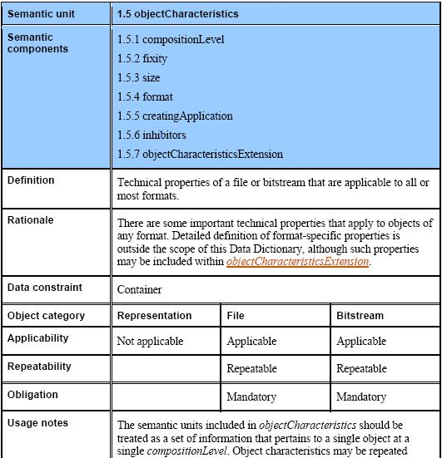
Semantic units in Data Dictionary

Slide 36
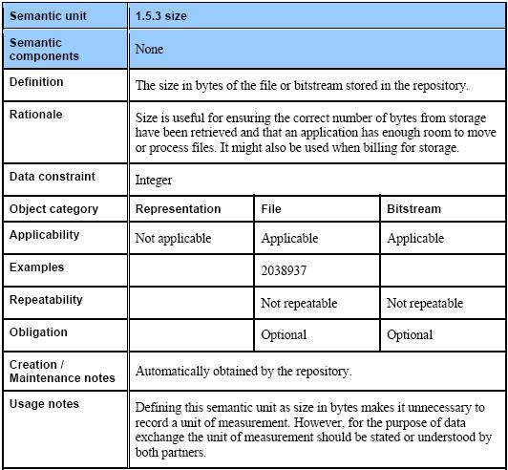
Semantic units in Data Dictionary

Slide 37
Implementation example
Let´s have a look to the example:
http://www.loc.gov/standards/premis/louis-2-1.xml

Slide 38
PREMIS conformance
The importance of technical neutrality as a design principle for the Data Dictionary implies that any conformance requirements associated with the Dictionary will necessarily be lightweight.
But this is not to say that conformance is unimportant in a PREMIS context; in fact, there are a number of use cases where establishing shared expectations in regard to a PREMIS
implementation is of practical benefit, including:
Inter-repository data exchange
Repository certification
Shared registries
Automation/reusable tools
Vendor support
[PREMISDD-2.1] : pp. 15

Slide 39
PREMIS conformance
PRINCIPLES OF USE (SEMANTIC UNIT): A conformant implementation of a PREMIS semantic unit must follow all requirements and constraints prescribed in the latest version of the Data Dictionary for that semantic unit.
Specifically:
If a metadata element shares the name of a PREMIS semantic unit, it must also share its definition. If a metadata element shares the definition of a PREMIS semantic unit but does not share its name, the repository must establish a mapping between the metadata element and its corresponding PREMIS semantic unit.
Usage requirements specified in the Data Dictionary for a particular semantic unit must be observed. Repeatability, obligation (i.e., whether a semantic unit is mandatory), and applicability (bit stream, file, and representation) requirements can be made more stringent, but not more relaxed.
An implementation of a PREMIS semantic unit that fails to observe any of these principles is considered non‐conformant.
The conformance statement is available at:
http://www.loc.gov/standards/premis/premis-conformance-oct2010.pdf

Slide 40
PREMIS conformance
PRINCIPLES OF USE (DATA DICTIONARY): A conformant implementation of the PREMIS Data Dictionary at the minimum must:
Include the mandatory semantic units for any Data Model Entity (Objects, Events, Agents, or Rights) supported by the repository.
Be able to recover all of the information specified in the mandatory PREMIS semantic units from the repository system (regardless of its specific implementation), and associate it with its corresponding Entity.
A repository’s implementation of the PREMIS Data Dictionary that fails to observe any of these principles is considered non‐conformant.
The conformance statement is available at:
http://www.loc.gov/standards/premis/premis-conformance-oct2010.pdf

Slide 41
PREMIS conformance internal/external
INTERNAL CONFORMANCE: PREMIS conformance as it relates to PREMIS‐based information residing within a repository.
A repository that satisfies the Principles of Use at both the semantic unit and Data Dictionary levels is considered internally conformant.
EXTERNAL CONFORMANCE: PREMIS conformance as it relates to the exchange of PREMIS‐based information between repositories. There are two forms of external conformance: import and export.
Import: A repository that is import conformant must be able to accept PREMIS‐conformant information in the form provided by another repository, parse it, and allocate the information to its corresponding metadata elements in the local repository system, as well as associate it with the appropriate Entities.
Export: A repository that is export conformant must be able to extract PREMIS‐conformant information from its local system, and provide it to another repository in an agreed‐upon form, and associate it with its appropriate Entity.

Slide 42
PREMIS conformance degrees of freedom
Naming: A repository is free to implement PREMIS semantic units using names different from those defined in the Data Dictionary. (However, remember that if a metadata element does share the name of a PREMIS semantic unit, it must share its definition; see Principles of Use (Semantic Unit) above.)
Granularity: A repository is free to implement PREMIS semantic units at higher or lower levels of granularity than what is defined in the Data Dictionary. Put another way, a metadata element implemented by a repository can incorporate information from more than one PREMIS semantic unit, or alternatively, encompass only part of the information defined in a PREMIS semantic unit (e.g., if the information from a PREMIS semantic unit is distributed over multiple metadata elements).
Level of Detail: A repository is free to record more detailed information for a PREMIS semantic unit than what is defined in the Data Dictionary (although the information defined in the Data Dictionary should be a subset of the more detailed information recorded by the repository).

Slide 43
PREMIS conformance degrees of freedom
Explicit Recording of Information: A repository is not required to explicitly record in its metadata management system the information populating a particular PREMIS semantic unit that it has implemented. However, this information must be recoverable in some way when it is needed (for example, to create an information package for exchange with another repository).
Use of Controlled Vocabularies: A repository is free to use (or not use) controlled vocabularies to populate PREMIS semantic units. If the repository chooses to use controlled vocabularies, it is free to use either internally defined vocabularies, or externally‐defined, standardized vocabularies.
        Preservation Vocabularies
        (see http://id.loc.gov/)
Preservation Events
Preservation Level Role
Cryptographic Hash Functions

Slide 44
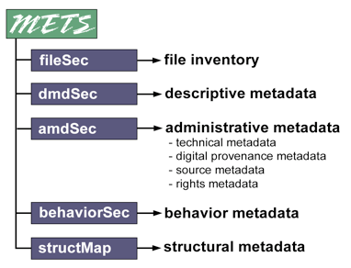
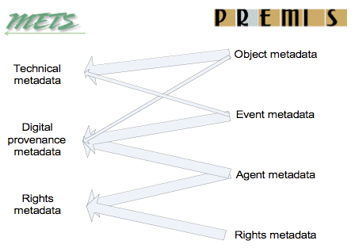
METS/PREMIS relationships
Mapping PREMIS entities to METS metadata sections. Thick arrows show applicable subsection in METS for the named PREMIS entities; the thin arrow shows links from one PREMIS entity to another METS subsection.
http://www.dlib.org/dlib/july08/guenther/07guenther.html

Slide 45
Supporting documentation
Let´s take a tour on:
http://www.loc.gov/standards/premis/
PREMIS WEB SITES, TOOLS AND E-MAIL
PREMIS maintenance activity Web site: http://www.loc.gov/standards/premis/.
PREMIS Implementers' Group discussion list: pig@loc.gov.
To subscribe, send e-mail to
listserv@loc.gov with the message, "subscribe pig [your name]“
Please send comments and questions to premis@loc.gov.

