Slide 1
An introduction to PREMIS

Slide 2
Plan
Background
Data model and key concepts
Object
Event
Agent
Rights
PREMIS evolutions
Some implementation considerations
Tue, Nov 1st, 2011
An introduction to PREMIS

Slide 3
Background
Need for a common reference for core preservation metadata:
  core elements of information
  guidelines on how they should be recorded
2003: OCLC / RLG PREMIS working group
  PREservation metadata:implementation strategies
  Based on the OAIS information model
  Goal: core preservation metadata
  Data dictionary with implementation guidelines
Tue, Nov 1st, 2011
An introduction to PREMIS

Slide 4
PREMIS: birth, state-of-the-art and next steps
Before
May 2005: PREMIS 1.0 Data Dictionary & XML Schema
March 2008: PREMIS 2.0 Data Dictionary & XML Schema
Now
Jan. 2011: PREMIS 2.1 Data Dictionary & XML Schema
This tutorial is based on PREMIS 2.1
What’s next?
Oct. 2011: publication of a draft OWL ontology
  Based on the 2.1 Data Dictionary
Coming soon: PREMIS 3.0 Data Dictionary & XML Schema
Tue, Nov 1st, 2011
An introduction to PREMIS

Slide 5
What’s in PREMIS?
"Things" you have to describe
  PREMIS Data model
What you want to say about these "things"
  PREMIS Data dictionary
How you want this information to be encoded and implemented
  In XML → PREMIS XML schema
  In RDF → OWL ontology
  Or any other way you like it
Tue, Nov 1st, 2011
An introduction to PREMIS

Slide 6






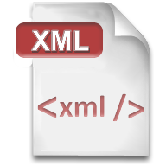




The data model: 5 interacting entities
Intellectual Entity
identifier
Rights
identifiers
identifiers
identifiers
Agent
Object
identifiers
identifiers
Event
Tue, Nov 1st, 2011
An introduction to PREMIS
Notes:
Data model includes:
Entities: “things” relevant to digital preservation that are described by preservation metadata (Intellectual Entities, Objects, Events, Rights, Agents)
Properties of Entities (semantic units)
Relationships between Entities
Why have data model?
Organizational convenience (for development and use)
Useful framework for distinguishing applicability of semantic units across different types of Entities and different types of Objects
But: not a formal entity-relationship model; not sufficient to design databases

Slide 7
From the data model to the data dictionary
Data model: defines Entities and relationships between them
Data Dictionary: for each Entity lists its semantic units
  A semantic unit is a property of an entity:
  Something you need to know about an Object, Event, Agent, Right
  A piece of information most repositories need to know in order to carry out their digital preservation functions
Two kinds of semantic unit:
  Container: groups together related semantic units
  Semantic components: semantic units grouped under the same container
Example:
ObjectIdentifier [container]
ObjectIdentifierType [semantic component]
ObjectIdentifierValue [semantic component]
Tue, Nov 1st, 2011
An introduction to PREMIS

Slide 8
Identifiers in PREMIS
Identifiers used to
  identify unambiguously an object, agent, event, rights statement…
    [entity]Identifier
  and link it to another entity
    linking[entity]Identifier
All identifiers have
  An identifierType (category of identifier)
  An identifierValue (the identifier itself)
identifierType optimally should contain sufficient information to indicate:
  How to build the value
  Who is the naming authority
  The domain under which the identifier is unique
  Examples: URL, DOI, ARK, local…
If all identifiers are local to the repository system, identifierType does not necessarily have to be recorded for each identifier in the system
  BUT it should be supplied when exchanging data with others
Tue, Nov 1st, 2011
An introduction to PREMIS

Slide 9
PREMIS identifiers in action
Intellectual Entity
Rights
rightsStatement Identifier
linking
IntellectualEntityIdentifier
linkingRightsStatement
Identifier
linkingAgentIdentifier
relatedObject
Identifier
linkingObjectIdentifier
linking
RightsStatement
Identifier
Agent
agentIdentifier
Object
objectIdentifier
linkingEventIdentifier
linkingObjectIdentifier
linkingEventIdentifier
linkingAgentIdentifier
Event
eventIdentifier
Tue, Nov 1st, 2011
An introduction to PREMIS
Notes:
Data model includes:
Entities: “things” relevant to digital preservation that are described by preservation metadata (Intellectual Entities, Objects, Events, Rights, Agents)
Properties of Entities (semantic units)
Relationships between Entities
Why have data model?
Organizational convenience (for development and use)
Useful framework for distinguishing applicability of semantic units across different types of Entities and different types of Objects
But: not a formal entity-relationship model; not sufficient to design databases

Slide 10
Extension containers in PREMIS
PREMIS is core preservation metadata
PREMIS defines an Extension container to extend PREMIS if you need
  more granular description
  specific semantic units (non-core information)
  out of scope semantic units (not grounded in preservation)
Extensions are empty containers
  Its semantic components are whatever you need
  One schema per extension; if more schemas are needed, the extension element needs to be repeated
  Mechanism in PREMIS XML Schema: <mdSec> element
Data in the container may replace, refine or be additional to the appropriate PREMIS semantic unit
Tue, Nov 1st, 2011
An introduction to PREMIS

Slide 11

3 categories of objects
Objects are what repositories actually preserve
FILE: named and ordered sequence of bytes that is known by an operating system
REPRESENTATION: set of files that, taken together, constitute a complete rendering of an Intellectual Entity
BITSTREAM: data within a file with properties relevant for preservation purposes (but needs additional structure or reformatting to be stand-alone file)
FILESTREAMS (files within files)
are considered files since they can be rendered alone
Tue, Nov 1st, 2011
An introduction to PREMIS

Slide 12
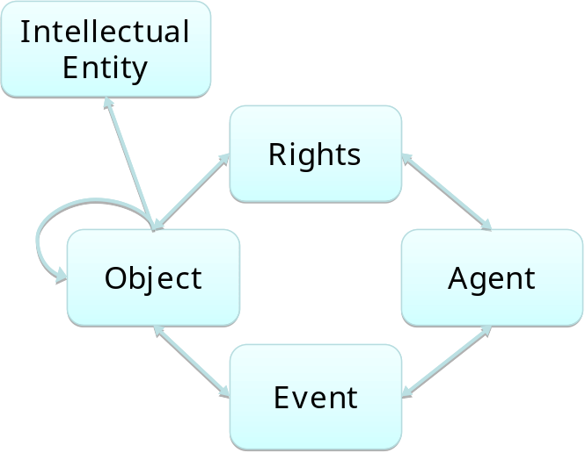
Intellectual Entities
Set of content that is considered a single intellectual unit for purposes of management and description (e.g., a book, a photograph, a map, a database)
Has one or more digital representations
May include other Intellectual Entities (e.g. a website that includes a web page)
Not fully described in PREMIS DD, but can be linked to in metadata describing digital representation
THIS WILL CHANGE IN 3.0
Examples:
Les Fleurs du Mal by Charles Baudelaire (a book)
“Maggie at the beach”
(a photograph)
The Library of Congress Website (a website)
Tue, Nov 1st, 2011
An introduction to PREMIS

Slide 13


Example: one content, 3 digital representations
Representation 1
Intellectual entity ➔
Representation 2
…
Files
page1.tif
page2.tif
page3.tif
…
page1.xml
page2.xml
page3.xml
Files
Part1.pdf
Part2.pdf
Representation 3
File
Part3.pdf
Partn.pdf
Book.epub
Tue, Nov 1st, 2011
An introduction to PREMIS

Slide 14
Object: high level semantic units
what technical information on it?
what is my preservation strategy for this object?
which object is it?
preservationLevel
objectCharacteristics
objectIdentifier
ark:/12148/btp6k102002g/f1
TIFF
10Mb
what kind of object?
objectCategory
what software or hardware should be used to handle the object?
where is it stored?
on which media?
storage
environment
which of its characteristics do I want to preserve in it?
significantProperties

Slide 15
Object: high level semantic units
objectIdentifier (M,R)
objectCategory (M,NR)
preservationLevel (O,R) [representation,file]
significantProperties (O,R)
objectCharacteristics (M,R) [file,bitstream]
originalName (O,NR)
storage (O,R) [file,bitstream]
environment (O,R)
signatureInformation (O,R) [file,bitstream]
Relationship (O,R)
linkingEventIdentifier (O,R)
linkingIntellectualEntityIdentifier (O,R)
linkingRightsStatementIdentifier (O,R)

Slide 16

Relationships between Objects
structural
relationship
  relationshipType structural / derivation
  relationshipSubType : is part of, is source of…
  relatedObjectIdentification
    relatedObjectIdentifierType
    relatedObjectIdentifierValue
    relatedObjectSequence
1
is part of
2
2
has sibling
is part of
derivation
is source of
Tue, Nov 1st, 2011
An introduction to PREMIS

Slide 17










objectCharacteristics [for file or bitstream]
what checksum?
what’s its size in bytes?
what format?
fixity
format
0a7d048211f3c4dce3a85c9c89a65651
size
15484580
what application was used to create it?
access restrictions on this object?
(password, encryption…)
creatingApplication
inhibitors
do I need to express
format specific information?
is the object directly renderable?
objectCharacteristicsExtension
compositionLevel
…
Tue, Nov 1st, 2011
An introduction to PREMIS

Slide 18
objectCharacteristics [for file or bitstream]
compositionLevel (M, NR)
fixity (O, R)
messageDigestAlgorithm (M, NR)
messageDigest (M, NR)
messageDigestOriginator (O, NR)
size (O, NR)
format (M, R)
creatingApplication (O, R)
creatingApplicationName (O, NR) creatingApplicationVersion (O, NR)
dateCreatedByApplication (O, NR)
creatingApplicationExtension (O, R)
inhibitors (O, R)
objectCharacteristicsExtension (O, R)

Slide 19


compositionLevel
sometimes there is more than one layer of characteristics
chapter1.pdf
chapter1.pdf.gz
compositionLevel = 0
format = PDF
size = 500,000 bytes
messageDigest = [something]
compositionLevel = 1
format = gzip
size = 324,876 bytes
messageDigest = [something else]
Tue, Nov 1st, 2011
An introduction to PREMIS

Slide 20
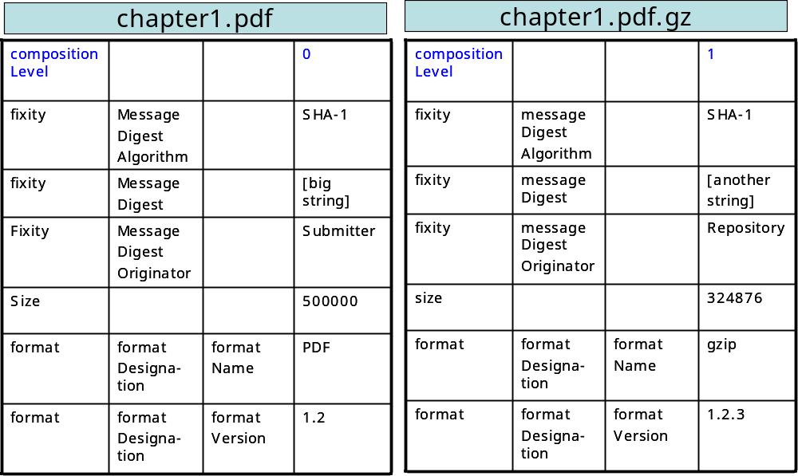
= different compositionLevels
Number of operations needed to access the primary data object
Tue, Nov 1st, 2011
An introduction to PREMIS

Slide 21
format
Features:
Basic information about the format
Link to some more detailed description in a format registry
semantic units
sample description
format
  formatDesignation (O,NR)
    formatName (M,NR)
    formatVersion (O,NR)
  formatRegistry
    formatRegistryName (M,NR)
    formatRegistryKey (M,NR)
    formatRegistryRole (O,NR)
  formatNote (O,R)
image/tiff
6.0
PRONOM
fmt/353
format specifications
http://www.nationalarchives.gov.uk
Tue, Nov 1st, 2011
An introduction to PREMIS

Slide 22
objectCharacteristicsExtension: an example
<premis:mdSec>
<premis:mdWrap MDTYPE="TEXTMD" MIMETYPE="text/xml">
<premis:xmlData>
<textmd:textMD xmlns:textmd="info:lc/xmlns/textMD-v3">
<textmd:character_info>
<textmd:charset>ISO-8859-1</textmd:charset>
<textmd:byte_order>little</textmd:byte_order>
<textmd:byte_size>8</textmd:byte_size>
<textmd:character_size>1</textmd:character_size>
<textmd:linebreak>CR/LF</textmd:linebreak>
</textmd:character_info>
<textmd:markup_basis version="1.0">XML</textmd:markup_basis>
<textmd:markup_language>http://www.loc.gov/standards/alto/ns-v2</textmd:markup_language>
</textmd:textMD>
</premis:xmlData>
</premis:mdWrap>
</premis:mdSec>
Tue, Nov 1st, 2011
An introduction to PREMIS

Slide 23
Event examples
An action that involves or impacts at least one Object or Agent associated with or known by the preservation repository
Helps document digital provenance. Can track history of Object through the chain of Events that occur during the Objects lifecycle
Determining which Events are in scope is up to the repository (e.g., Events which occur before ingest, or after de-accession)
Determining which Events should be recorded, and at what level of granularity is up to the repository
Examples:
Validation Event: use JHOVE tool to verify that part1.pdf is a valid PDF file
Ingest Event: transform an OAIS SIP into an AIP (one Event or multiple Events?)
Tue, Nov 1st, 2011
An introduction to PREMIS

Slide 24
Event: high level semantic units
eventIdentifier (M,NR)
eventType (M,NR)
eventDateTime (M,NR)
eventDetail (O,NR)
eventOutcomeInformation (O,R)
linkingAgentIdentifier (O,R)
linkingObjectIdentifier (O,R)
Tue, Nov 1st, 2011
An introduction to PREMIS

Slide 25
eventOutcomeInformation
Sample description
validation event
eventOutcomeInformation
eventOutcome
eventOutcomeDetail
eventOutcomeDetailNote
eventOutcomeDetail Extension
This event has an outcome.
it has processed sucessfully.
but how precisely?
here is the machine response in plain text.
or here is the response in structured fashion
validation process successful
well-formed and valid
(or)
<Whole XML output of JHOVE>
Tue, Nov 1st, 2011
An introduction to PREMIS

Slide 26
Agent examples
Examples:
Sébastien Peyrard (a person)
French national library (an organization)
JHOVE version 1.5 (a software program)
Not defined in detail in PREMIS Data Dictionary:
Not considered core preservation metadata beyond identification
Tue, Nov 1st, 2011
An introduction to PREMIS

Slide 27
Agent: semantic units
Sample description
agentIdentifier
agentIdentifierType
agentIdentifierValue
agentName
agentType
agentNote
agentExtension
URI
info:bnf/spar/agent/jhove_1_5
JHOVE 1.5
software
Release notes: http://sourceforge.net/projects/jhove/files/jhove/JHOVE%201.5/RELEASENOTES
Tue, Nov 1st, 2011
An introduction to PREMIS

Slide 28
Rights statement examples
An agreement with a rights holder that grants permission for the repository to undertake an action(s) associated with an Object(s) in the repository.
Not a full rights expression language; focuses on permissions that take the form:
  Agent X grants Permission Y to the repository in regard to Object Z.
Basis for rights may be copyright, license or statute
Tue, Nov 1st, 2011
An introduction to PREMIS

Slide 29
Rights statement: high level semantic units
rightsStatement
  rightsStatementIdentifier
  rightsBasis
  copyrightInformation
  licenseInformation
  statuteInformation
  rightsGranted
  linkingObjectIdentifier
  linkingAgentIdentifier
rightsExtension
Either rightsStatement or rightsExtension must be present
Tue, Nov 1st, 2011
An introduction to PREMIS

Slide 30







rightsStatement: 3 possible rights bases
legislation
intellectual property statute
statute
agreement with the rightsholders
copyright
license
What does this mean in the repository?
rightsGranted
Notes:
copyright, license, statute are 3 distinct bases:
What’s the intellectual property statute of the document?
What’s the legal context?
What’s been agreed upon with the rightsholders?
→ High level legal considerations
rightsGranted is the application (implementation) of these rights
What action is allowed?
On which conditions?
For what period of time?

Slide 31
rightsBasis → copyright, statute, license
If the basis is copyright, copyrightInformation must be present
If the basis is license, licenseInformation must be present
If the basis is statute, then statuteInformation must be present
rightsStatement
  rightsStatementIdentifier
  rightsBasis
  copyrightInformation
  licenseInformation
  statuteInformation

Slide 32
rightsGranted
Sample description
rightsGranted
act
restriction
termOfGrant
startDate
endDate
what action is allowed?
on which conditions?
from when to when?
dissemination
rightsholder must be notified
2010-05-05
2015-05-04

Slide 33
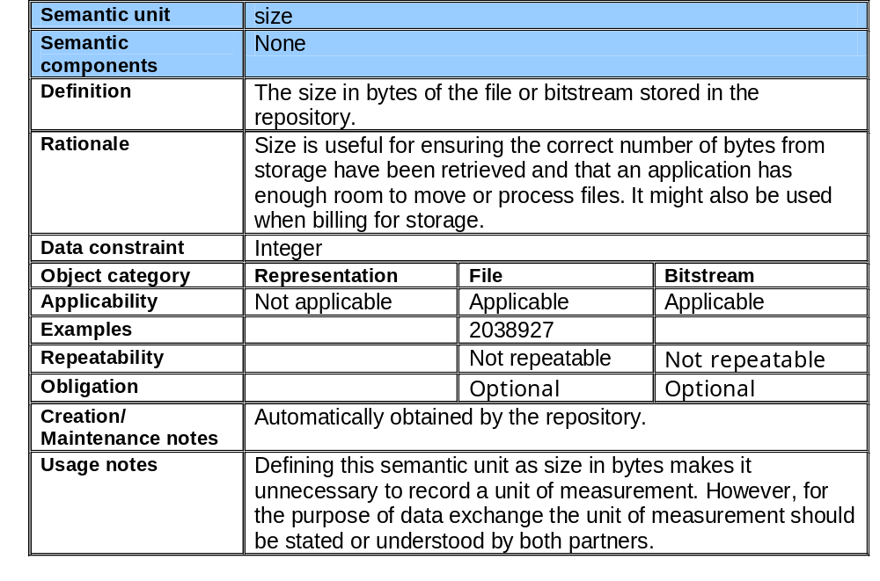
Sample data dictionary entry
Is it a container
unit?
What does it
contain?
Why should it
be recorded?
How should it be recorded? constraints and examples
How should
it be provided?
Some
implementation
guidelines
Tue, Nov 1st, 2011
An introduction to PREMIS

Slide 34
What’s next?
PREMIS OWL ontology
PREMIS 3.0 evolutions
Tue, Nov 1st, 2011
An introduction to PREMIS

Slide 35

PREMIS OWL ontology in a nutshell
Purpose
  Providing the community with an RDF serialization of the PREMIS data model and dictionary
  While remaining as close as possible to the data dictionary’s clearly defined semantics
RDF modelling in 3 words:
Everything modelled under the form of
    subject-verb-object
But what objects? what verbs? what objects?
  → role of vocabularies & ontologies
property
Class
Object
Class
linkingEvent
Event
subProperty
subProperty
(sub)Class
File
OWL modelling (very) briefly
Tue, Nov 1st, 2011
An introduction to PREMIS

Slide 36
PREMIS ontology: key decisions
Intellectual Entity
RightsStatement
derivationalRelationship
linkingRightsStatement
structuralRelationship
linkingIntellectualEntity
linkingRightsStatement
linkingObject
Copyright Information
License Information
linkingAgent
relationship
Agent
Object
Statute Information
linkingSourceObject
linkingObject
linkingOutcomeObject
linkingAgent
Representation
Bitstream
Event
File
linkingEvent
linkingEvent

Slide 37
PREMIS 3.0: evolution of the data model
Intellectual entities become a category of object
Intellectual Entity
Rights
Agent
Object
Event
Tue, Nov 1st, 2011
An introduction to PREMIS
Notes:
Data model includes:
Entities: “things” relevant to digital preservation that are described by preservation metadata (Intellectual Entities, Objects, Events, Rights, Agents)
Properties of Entities (semantic units)
Relationships between Entities
Why have data model?
Organizational convenience (for development and use)
Useful framework for distinguishing applicability of semantic units across different types of Entities and different types of Objects
But: not a formal entity-relationship model; not sufficient to design databases

Slide 38
PREMIS 3.0: rights changes (work in progress)
rightsStatement
rightsBasis
copyrightInformation
copyrightDocumentationIdentifier
licenseInformation
licenseDocumentationIdentifier
statuteInformation
statuteDocumentationIdentifier
otherRightsInformation
otherRightsBasis
otherRightsApplicableDates
rightsGranted
act
restriction
termOfGrant
startDate
endDate
termOfRestriction
startDate
endDate
Ability to declare other rights bases, e.g. the policy of a particular institution
  Addition of an otherRightsInformation semantic element
  Mechanism: if rightsBasis = other → use otherRightsInformation
Ability to link to documentation supporting some rights statement
Addition of a termOfRestriction
  termOfGrant gives the period during which the permissions are granted
  termOfRestriction gives the time period during which a restriction applies (useful for embargoes)
New in PREMIS 3.0
Tue, Nov 1st, 2011
An introduction to PREMIS

Slide 39
Implementing PREMIS: toolbox
Tue, Nov 1st, 2011
An introduction to PREMIS

Slide 40
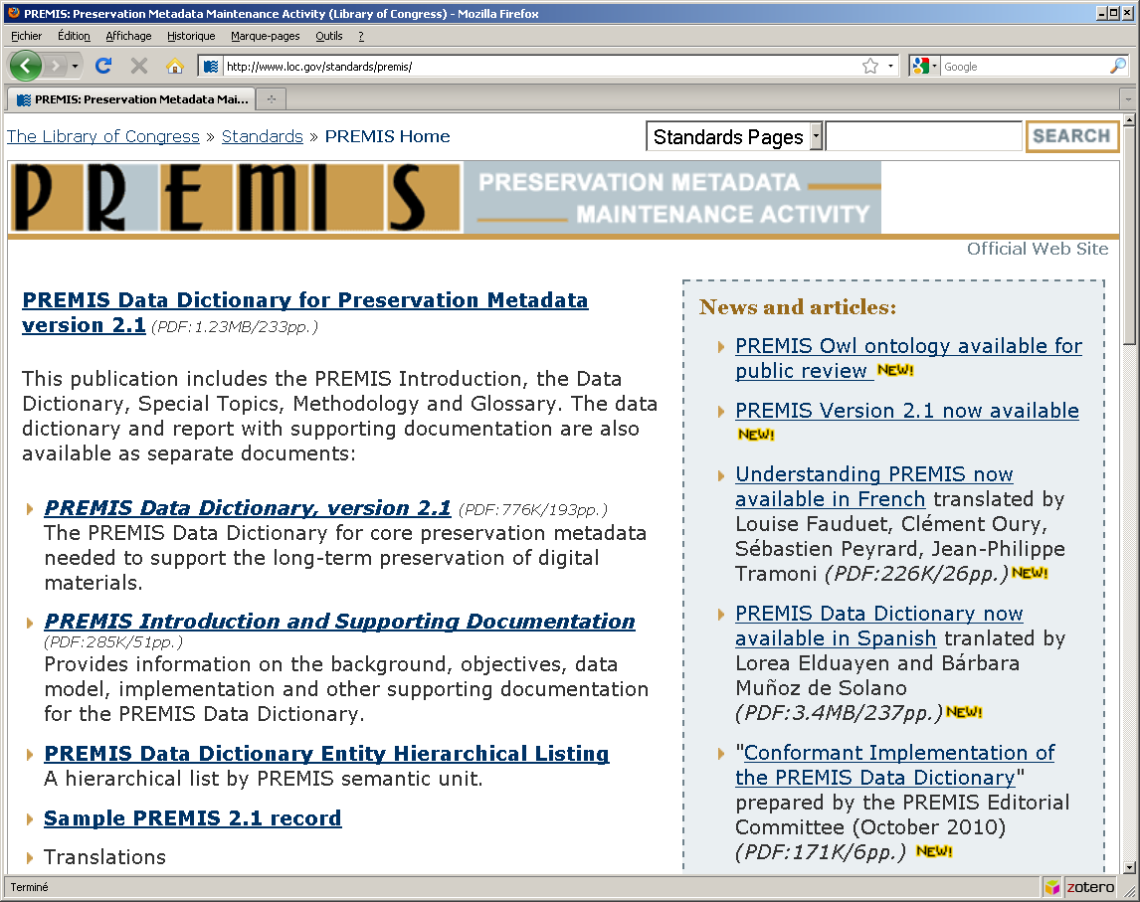
PREMIS Maintenance Activity
Web site:
  Permanent Web presence, hosted by
Library of Congress
  Central location for PREMIS-related
info, announcements, resources
  Home of the PREMIS Implementers’ Group (PIG) discussion list
PREMIS Editorial Committee:
  Set directions/priorities for PREMIS development
  Considers proposals for changes
  Coordinates revisions of Data Dictionary and XML schema
  http://www.loc.gov/standards/premis/
Notes:
Membership has changed; previously we had a representative from Los Alamos National Labs, National Archives in Scotland and National Library of Australia.

Slide 41

PREMIS Conformance
Conformant Implementation of the PREMIS Data Dictionary http://www.loc.gov/standards/premis/premis-conformance-oct2010.pdf
What does "being conformant to PREMIS" mean?
Conformant at which level?
  semantic unit: conformant implementation of the information defined in a particular semantic unit
  data dictionary: conformant implementation of all semantic units
Conformant from what perspective?
  internal: conformant implementation at semantic units and data dictionary levels
  external (exchanging PREMIS descriptions):
    import = the repository can manage PREMIS conformant information
    export = the repository can provide others with PREMIS conformant information
Tue, Nov 1st, 2011
An introduction to PREMIS

Slide 42
PREMIS conformance – degrees of freedom
What am I free to do now?
  naming: using different names from the data dictionary
  granularity:
    a single metadata element can aggregate semantic units
    information from a semantic unit can be split in multiple metadata elements
  level of detail: adding more detailed information than the data dictionary
  explicit recording of mandatory semantic units: need not be recorded BUT this information must be recoverable
  use of controlled vocabularies: it is recommended but not mandatory to use controlled vocabularies, defined internally or externally

Slide 43
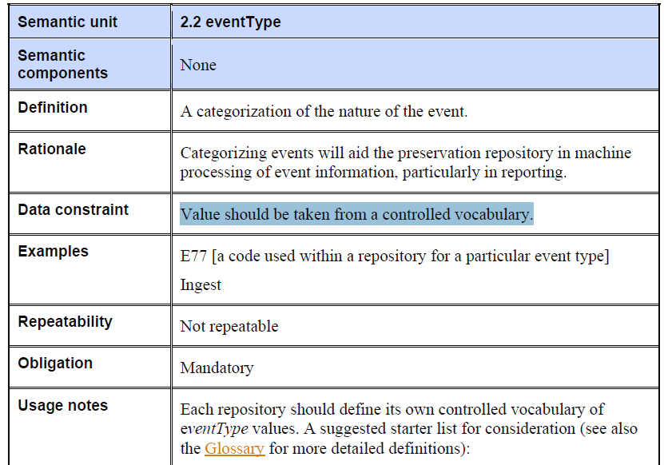
Some externally controlled vocabularies
Tue, Nov 1st, 2011
An introduction to PREMIS

Slide 44
Controlled vocabularies
Library of Congress is establishing databases with controlled vocabulary values for standards that it maintains
Controlled lists are represented using SKOS as well as alternative syntaxes
http://id.loc.gov
Some lists are relevant for PREMIS:
  Preservation events
  Cryptographic hash algorithms
  Preservation level role
Will be adding additional PREMIS controlled vocabularies in the near future

Slide 45
Questions?
sebastien.peyard@bnf.fr

