Slide 1
Secure Text Encryption and Decryption Using Images and OpenCV
CAPSTONE PROJECT
Presented By: Prethish D
Student Name : Prethish D
College Name & Department :
Er. Perumal Manimekalai College of Engineering(Autonomous) , Department of Artificial Intelligence and Data Science

Slide 2
OUTLINE
Problem Statement
Technology used
Wow factor
End users
Result
Conclusion
Git-hub Link
Future scope

Slide 3
Problem Statement
With the rise of digital communication, securing confidential information is a major concern.
Traditional encryption methods, such as text-based ciphers, can be easily detected.
This project aims to solve this problem by embedding secret messages inside an image, a technique known as steganography.
The hidden message can only be retrieved using a correct passcode, adding an extra layer of security.
This method ensures that even if someone gains access to the image, they won’t be able to read the hidden text without the correct password.
It is an effective way to securely transmit sensitive information.

Slide 4
Technology used
Programming Language:
Python
Libraries:
OpenCV (cv2): For image processing and modifying pixel values.
OS Module: To handle file operations and open the encrypted image.
Concepts Used:
Steganography: Hiding information inside an image.
Pixel Manipulation: Encoding characters into pixel values.
Password Protection: Restricting access to hidden messages.

Slide 5
Wow factors
🔹 Invisible Encryption: The message is hidden within the pixel values, making it unnoticeable to the human eye. 🔹 Password Protection: Only users with the correct password can decrypt the message. 🔹 No Extra Storage Required: Unlike traditional encryption methods, the message is stored within an image without increasing its file size significantly. 🔹 Simple Yet Effective: Uses basic image processing techniques without the need for complex encryption algorithms.

Slide 6
End users
Students & Researchers: For learning about image processing and steganography.
Cybersecurity Enthusiasts: As an introduction to data hiding techniques.
Organizations & Individuals: For securely transmitting confidential messages.
Journalists & Activists: To communicate sensitive information without attracting attention.

Slide 7
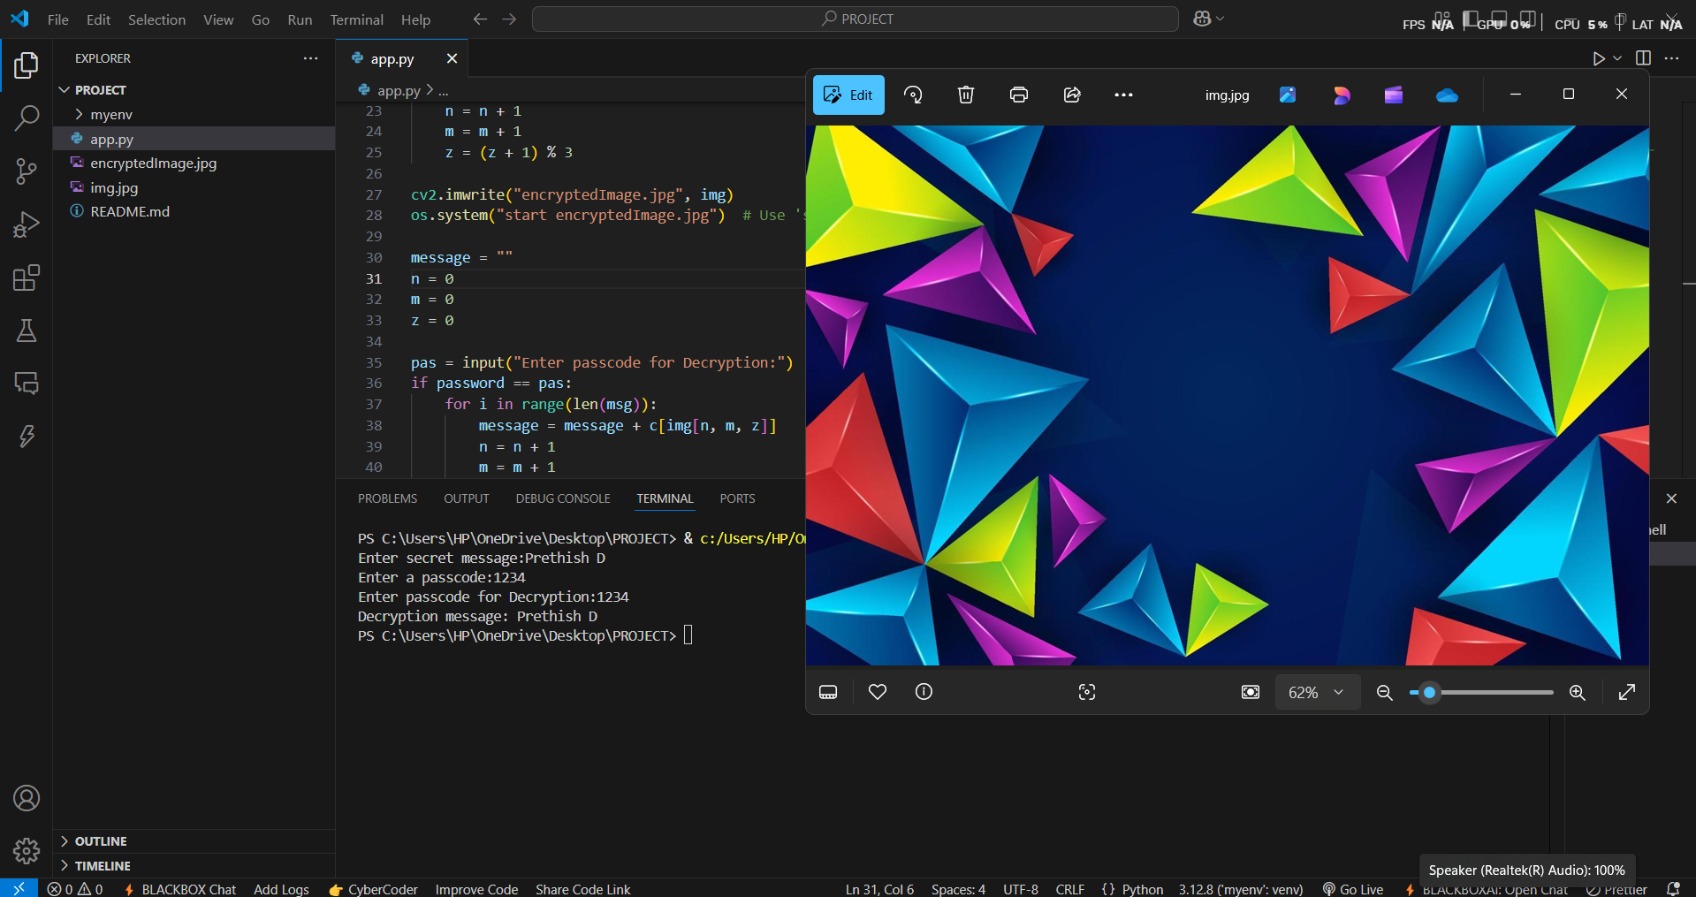
Results

Slide 8
Conclusion
This project demonstrates how steganography can be used for secure message transmission by embedding text into images.
The integration of password protection ensures an additional security layer.
It provides a simple yet effective way to hide sensitive information without raising suspicion.
The project can be further expanded by integrating more advanced encryption techniques to enhance security.

Slide 9
GitHub Link
https://github.com/PRETHISH108/PROJECT

Slide 10
Future scope
Enhanced Security: Implementing encryption algorithms like AES along with steganography. Support for More Image Formats: Expanding support beyond JPEG to PNG, BMP, etc. Larger Message Storage: Using advanced encoding techniques to store longer messages. Graphical User Interface (GUI): Developing a user-friendly interface for non-programmers. Mobile Application: Creating a mobile version for Android/iOS to make it more accessible.

Slide 11
THANK YOU

