Slide 1

Teaching Networks
Are you a good professor?

Slide 2





Mathematically
$$x$$
$$l^{1}$$
$$l^{2}$$
$$l^{3}$$
$$y$$
Notes:
Treat each layer as a vector

Slide 3


Vectors & matrices
$$l^{1}$$
$$l^{2}$$
-5.6
0.5
-2.3
-1.5
2.8
-1.5
0.5
-1.9
3.1
0.9
3.7
4.3
-0.8

Slide 4
Vectors & matrices
$$l^{1}$$
$$l^{2}$$
-5.6
-2.3
7.5
-1.5
-2.5
0.5
6.8
0.9
-3.9
3.7
6.1
4.3
-0.8

Slide 5













Mathematically: forward
$$x$$
$$∗W^{1}$$
$$l^{1}$$
$$∗W^{2}$$
$$l^{2}$$
$$∗W^{3}$$
$$l^{3}$$
$$∗W^{4}$$
$$y$$
$$l^{1}=W^{1}x$$
$$l^{2}=W^{2}l^{1}$$
$$l^{3}=W^{3}l^{2}$$
$$y=W^{4}l^{3}$$
Notes:
Some neurons may be consistently too large/small, so we add a bias

Slide 6







Mathematically: forward
$$+b^{1}$$
$$+b^{2}$$
$$+b^{3}$$
$$x$$
$$∗W^{1}$$
$$l^{1}$$
$$∗W^{2}$$
$$l^{2}$$
$$∗W^{3}$$
$$l^{3}$$
$$∗W^{4}$$
$$y$$
$$l^{1}=W^{1}x+b^{1}$$
$$l^{2}=W^{2}l^{1}+b^{2}$$
$$l^{3}=W^{3}l^{2}+b^{3}$$
$$y=W^{4}l^{3}+b^{4}$$
Notes:
Need to add complexity: linear transform twice is itself a linear transform

Slide 7




Mathematically: forward
$$+b^{1}$$
$$+b^{2}$$
$$+b^{3}$$
$$x$$
$$∗W^{1}$$
$$l^{1}$$
$$∗W^{2}$$
$$l^{2}$$
$$∗W^{3}$$
$$l^{3}$$
$$∗W^{4}$$
$$y$$
$$l^{1}=σ(W^{1}x+b^{1})$$
$$l^{2}=σ(W^{2}l^{1}+b^{2})$$
$$l^{3}=σ(W^{3}l^{2}+b^{3})$$
$$y=σ(W^{4}l^{3}+b^{4})$$
Notes:
With non-linear activation function sigma, the complexity of the system can not be simplified to a single layer.

Slide 8
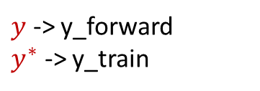
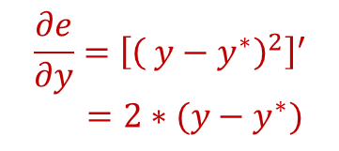
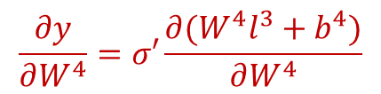
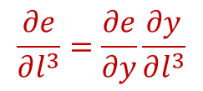
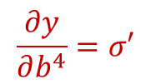

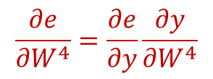
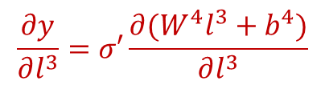
Mathematically: backward
$y$ -> y_forward
$y^{∗}$ -> y_train
$$\frac{∂e}{∂y}={\left[{\left( y−y^{∗}\right)}^{2}\right]}^{′}$$
$=2∗(y−y^{∗})$
$$+b^{1}$$
$$+b^{2}$$
$$+b^{3}$$
$$x$$
$$∗W^{1}$$
$$l^{1}$$
$$∗W^{2}$$
$$l^{2}$$
$$∗W^{3}$$
$$l^{3}$$
$$∗W^{4}$$
$$y$$
$$l^{1}=σ(W^{1}x+b^{1})$$
$$l^{2}=σ(W^{2}l^{1}+b^{2})$$
$$l^{3}=σ(W^{3}l^{2}+b^{3})$$
$$y=σ(W^{4}l^{3}+b^{4})$$
$$\frac{∂e}{∂l^{3}}=\frac{∂e}{∂y}\frac{∂y}{∂l^{3}}$$
$$\frac{∂e}{∂W^{4}}=\frac{∂e}{∂y}\frac{∂y}{∂W^{4}}$$
$$e={\left( y−y^{∗}\right)}^{2}$$
$$\frac{∂y}{∂l^{3}}=σ′\frac{∂(W^{4}l^{3}+b^{4})}{∂l^{3}}$$
$$\frac{∂y}{∂W^{4}}=σ′\frac{∂(W^{4}l^{3}+b^{4})}{∂W^{4}}$$
$$\frac{∂y}{∂b^{4}}=σ′$$
Notes:
Using chain rule, we step by step calculate the derivative of the error function in terms of all intermediate variables.
Then, we use gradient descent to update all parameters.

Slide 9
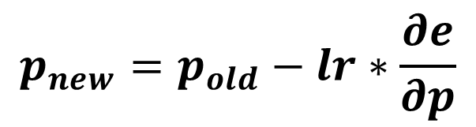
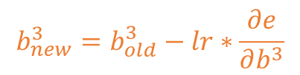

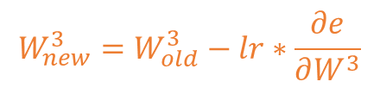
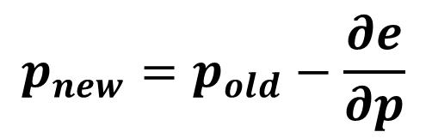
Mathematically: update
$$p_{new}=p_{old}−\frac{∂e}{∂p}$$
$$p_{new}=p_{old}−lr∗\frac{∂e}{∂p}$$
$$b_{new}^{3}=b_{old}^{3}−lr∗\frac{∂e}{∂b^{3}}$$
$$+b^{1}$$
$$+b^{2}$$
$$+b^{3}$$
$$x$$
$$∗W^{1}$$
$$l^{1}$$
$$∗W^{2}$$
$$l^{2}$$
$$∗W^{3}$$
$$l^{3}$$
$$∗W^{4}$$
$$y$$
$$l^{1}=σ(W^{1}x+b^{1})$$
$$l^{2}=σ(W^{2}l^{1}+b^{2})$$
$$l^{3}=σ(W^{3}l^{2}+b^{3})$$
$$y=σ(W^{4}l^{3}+b^{4})$$
$$W_{new}^{3}=W_{old}^{3}−lr∗\frac{∂e}{∂W^{3}}$$
$$e={\left( y−y^{∗}\right)}^{2}$$
Notes:
We update the parameters by subtracting the gradient, times the learning rate.

Slide 10
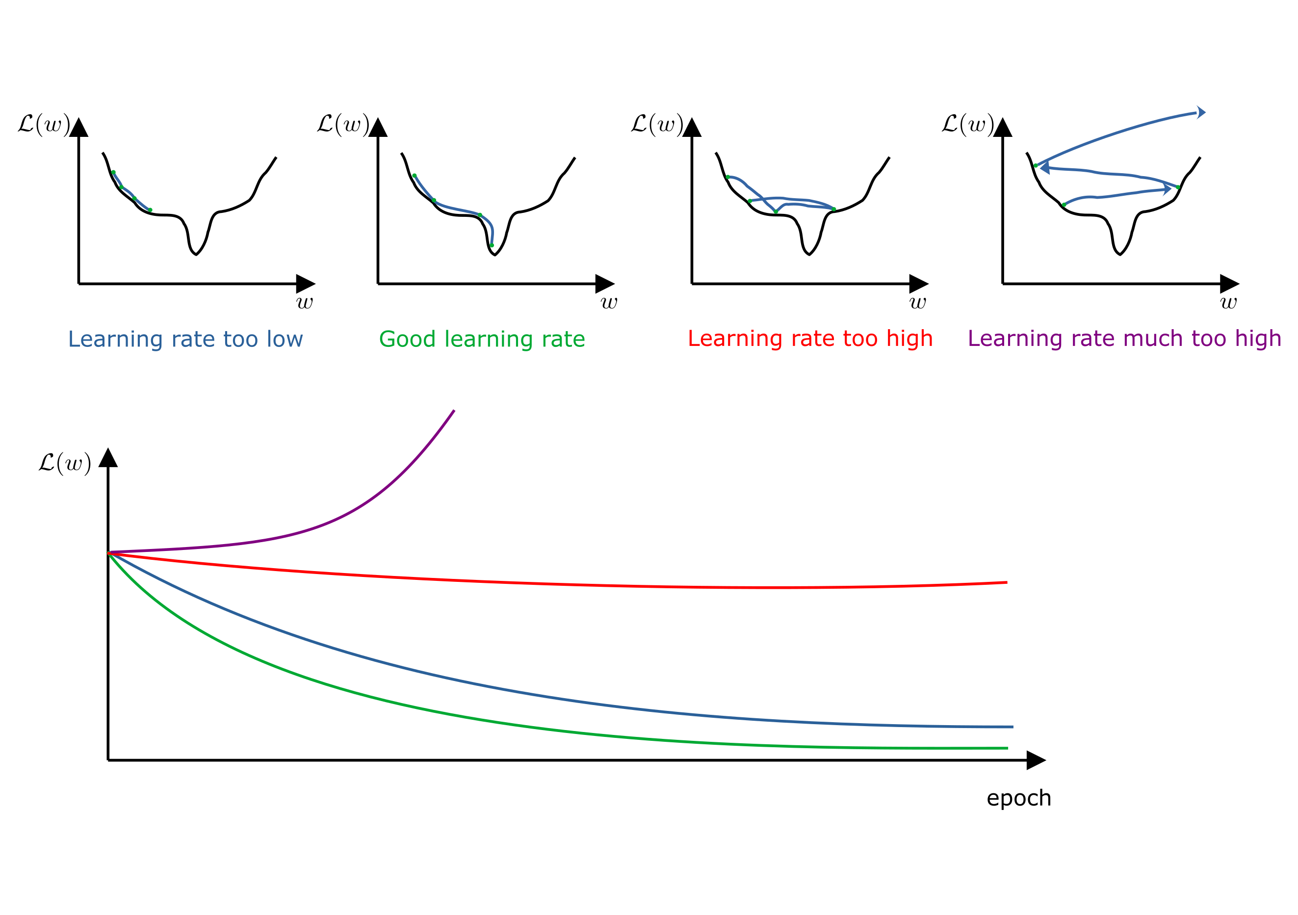
Learning Rate

Slide 11
Training steps
Create a network with random weights
Feed one piece of data (for which you know the desired output)
Calculate the error
Backpropagate the error to all intermediate variables
Update the parameters

