Slide 1
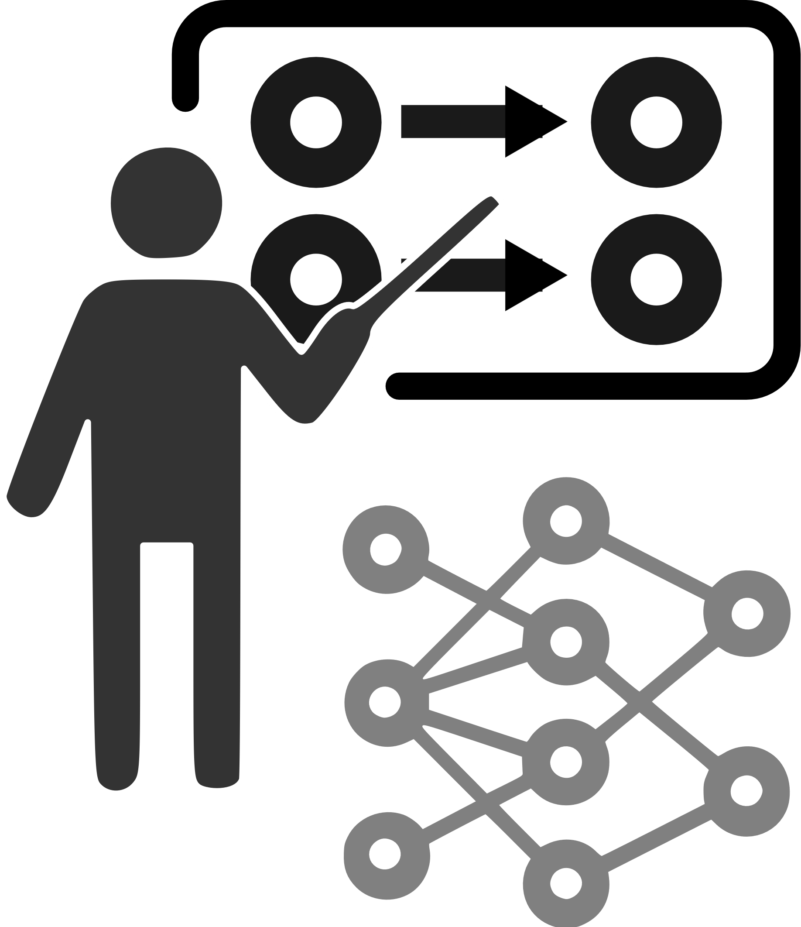
Teaching Networks
Are you a good professor?

