Slide 1
Data Analysis 101
Welcome!

Slide 2
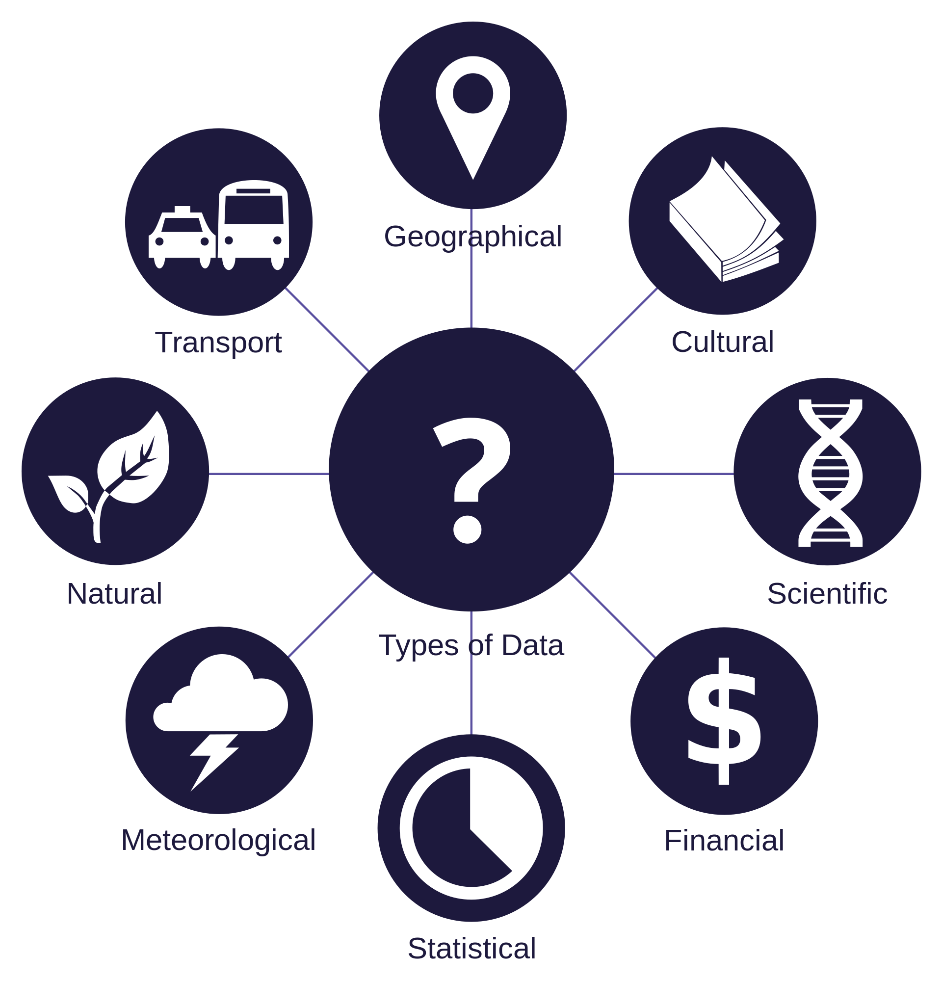
A world of data
Meta
Sensors
Personal
Connection
Logs
Text messages
Voice
Images

Slide 3
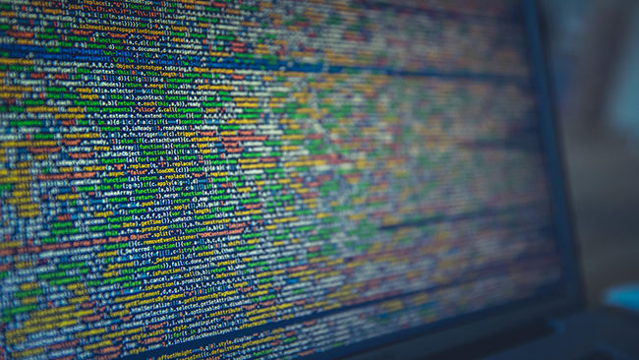

Massive data
How to make some sense out of it?

