Slide 1
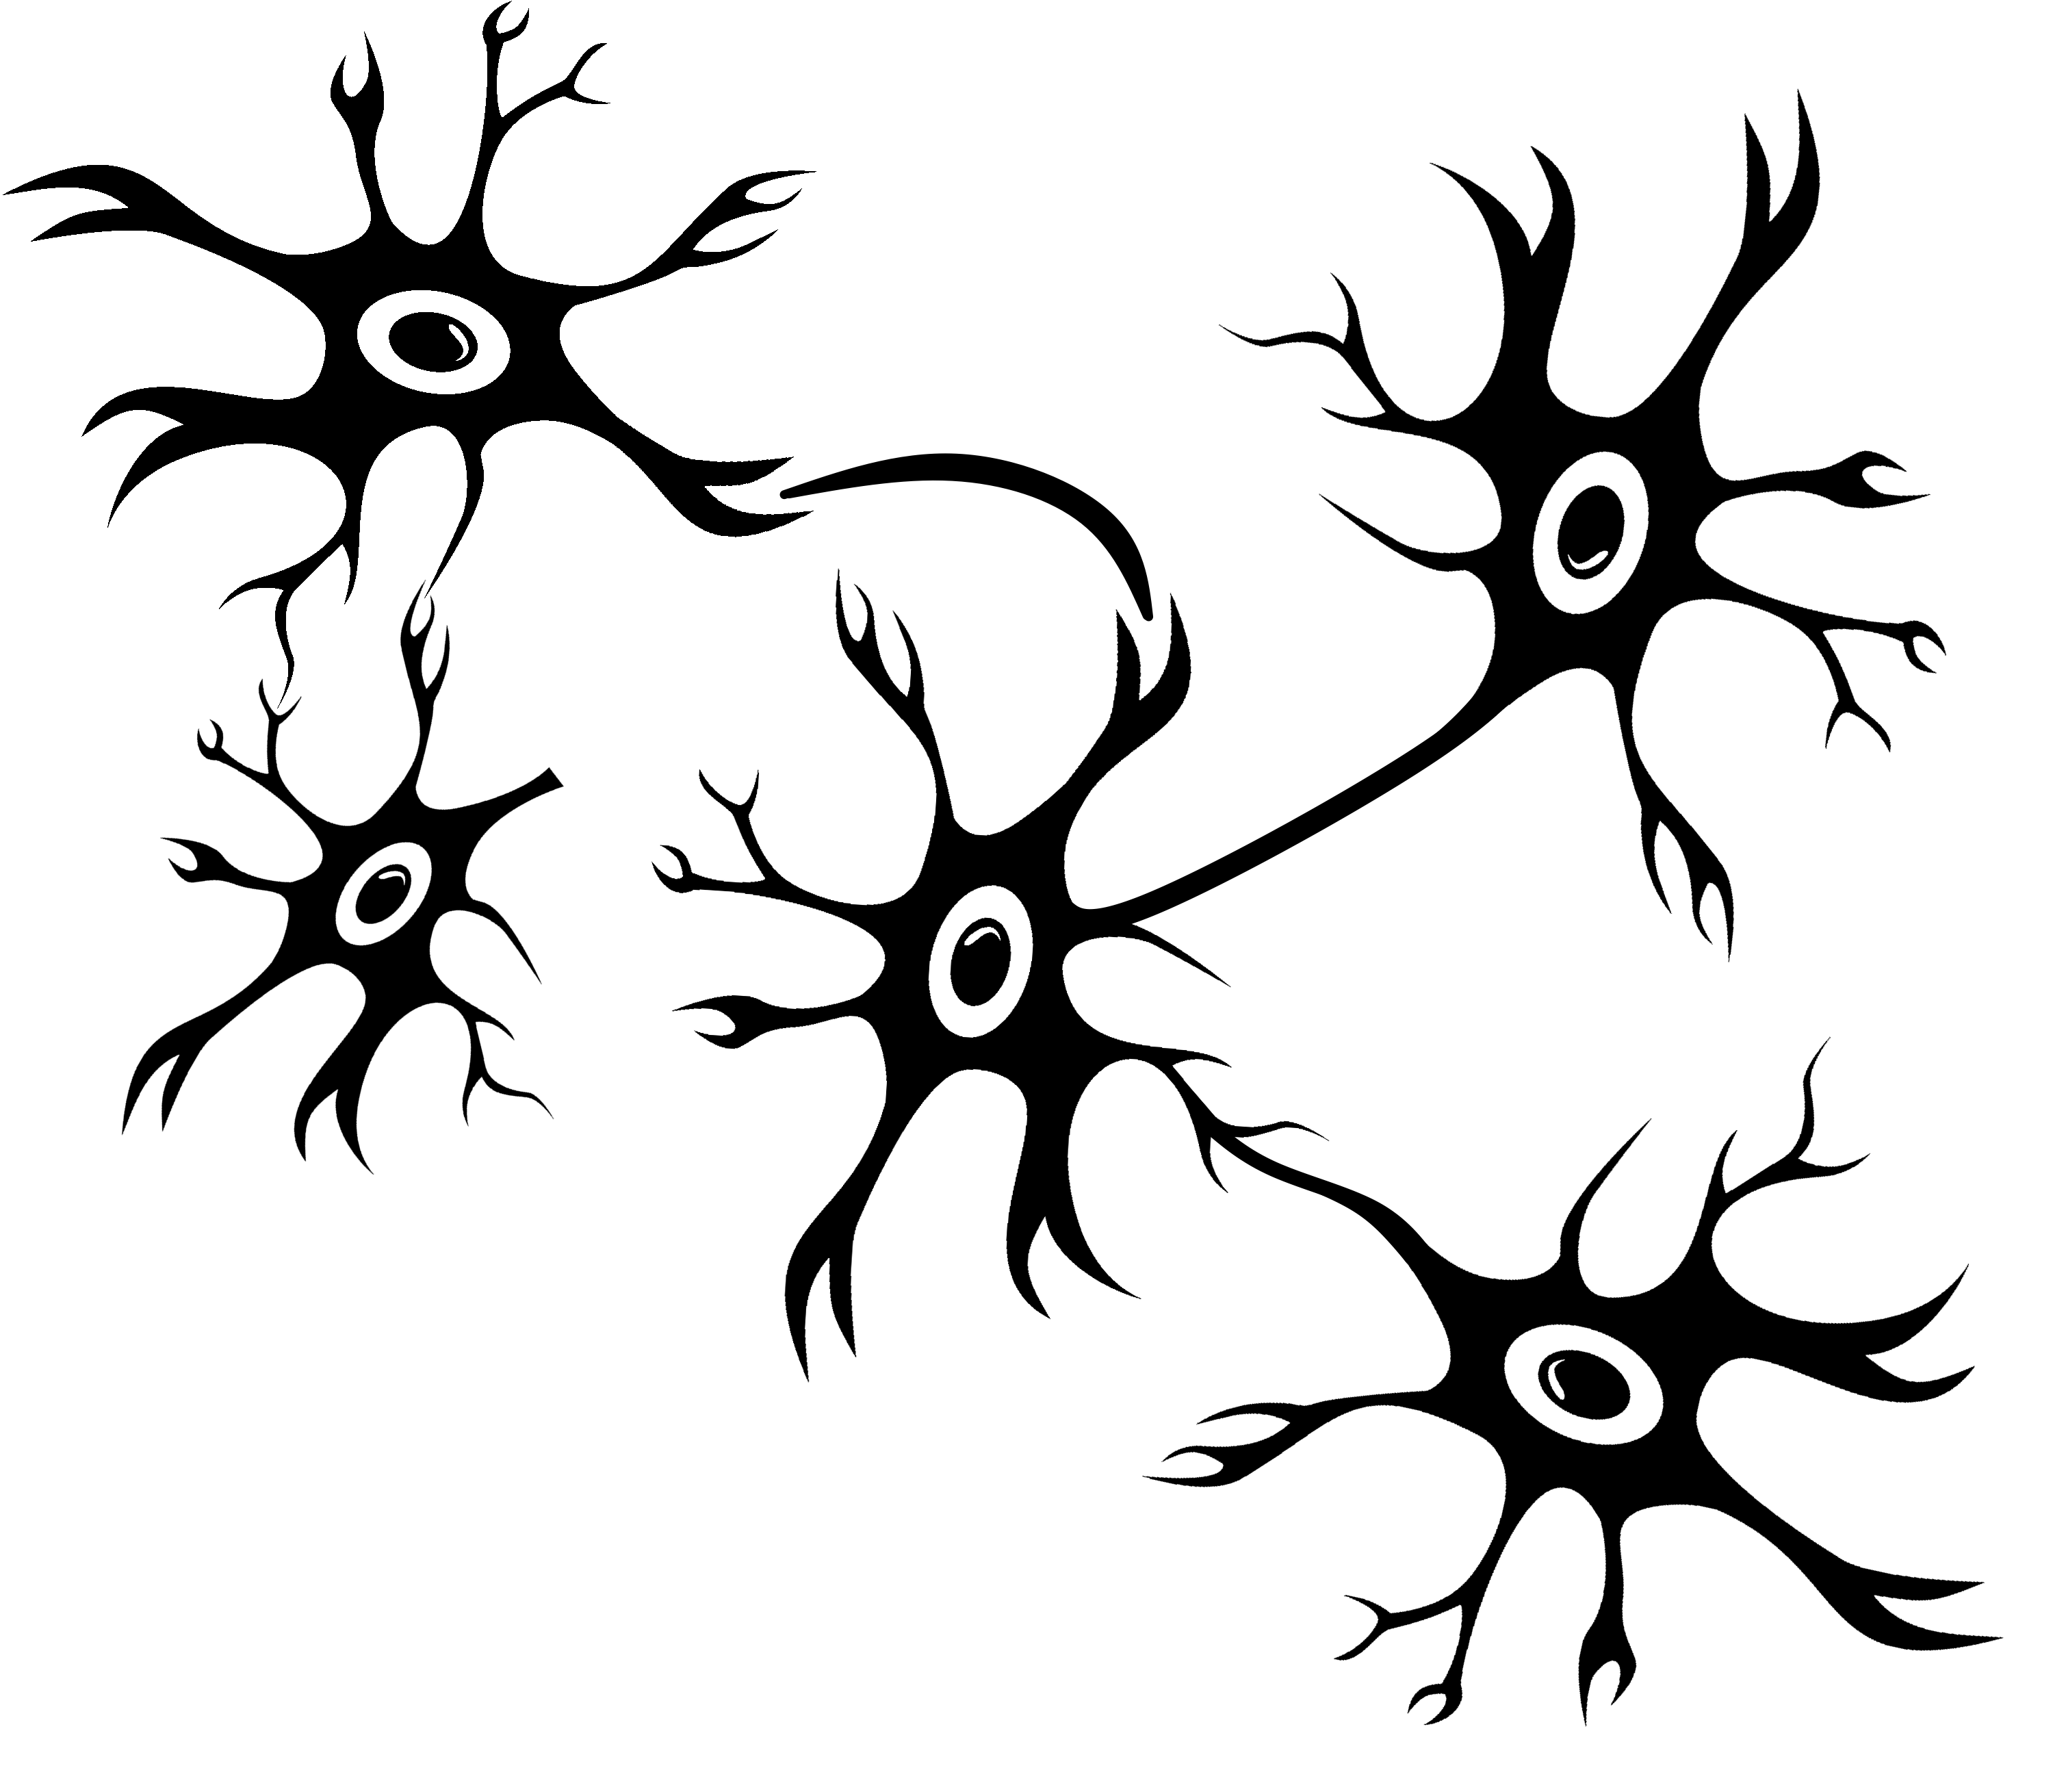
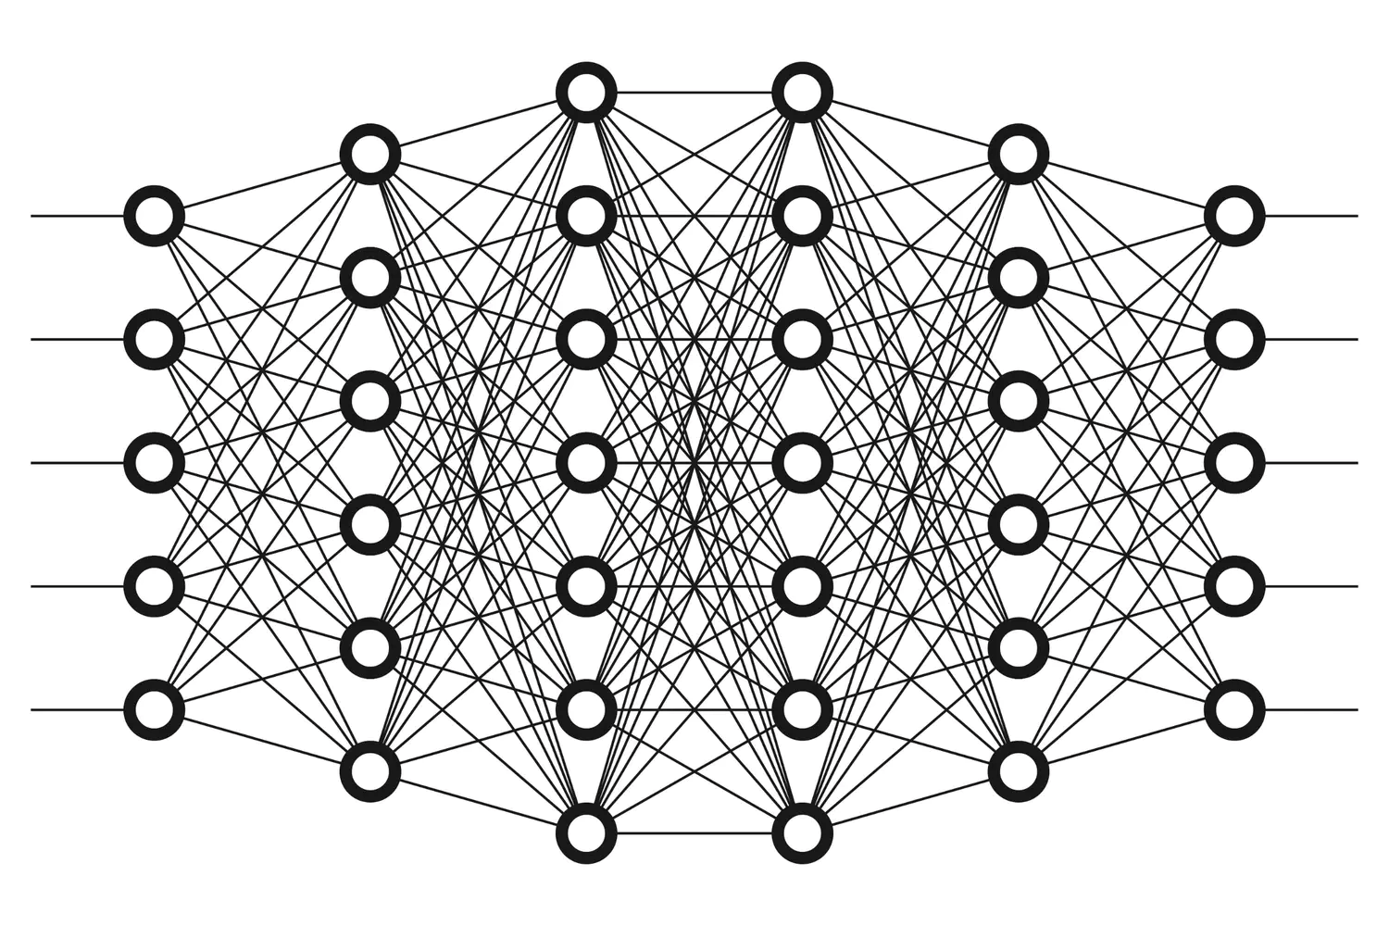
From biological neurons…
…to artificial networks!

Slide 2
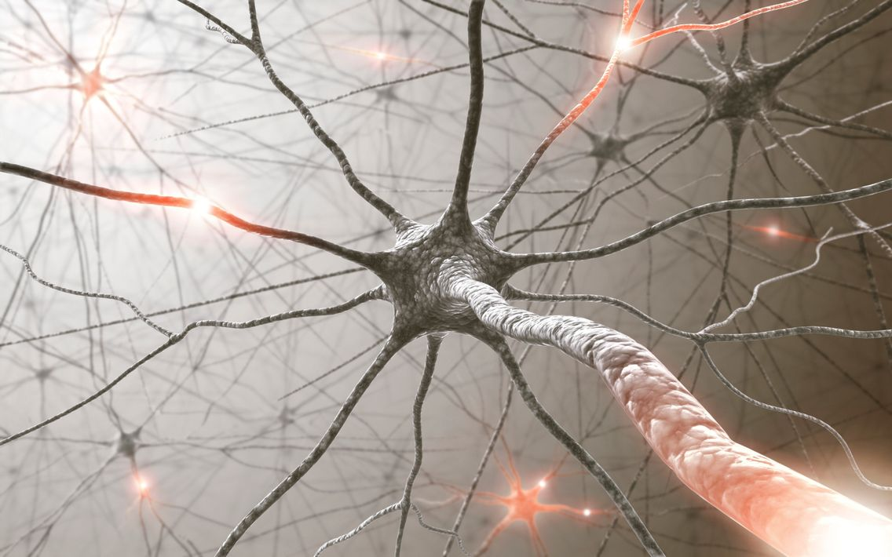
Biological Neuron

Slide 3
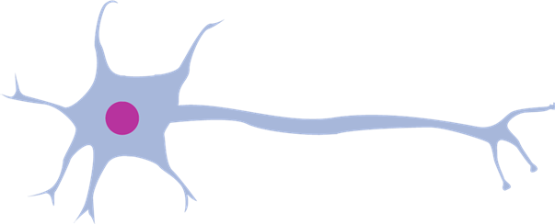
Biological Neuron
kernel
synapse
axon
cell
dendrite

Slide 4
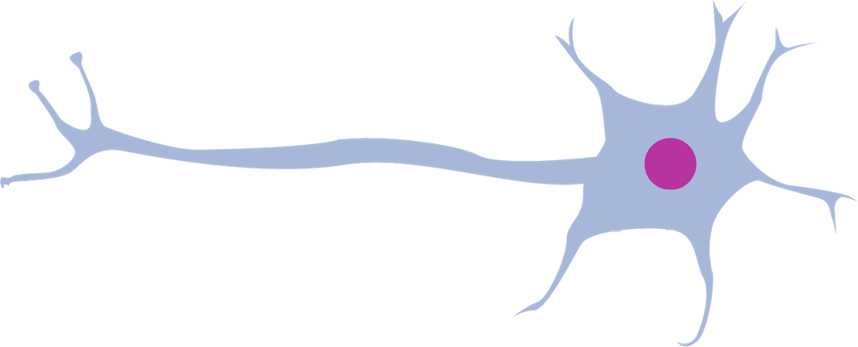




Synaptic integration
$$N_{1}$$
$$N_{2}$$
$$N_{0}$$
$$N_{3}$$

Slide 5
Synaptic integration
$$N_{1}$$
$$N_{2}$$
$$N_{0}$$
$$N_{3}$$

Slide 6
Synaptic integration
$$N_{1}$$
$$N_{2}$$
$$N_{0}$$
$$N_{3}$$

Slide 7
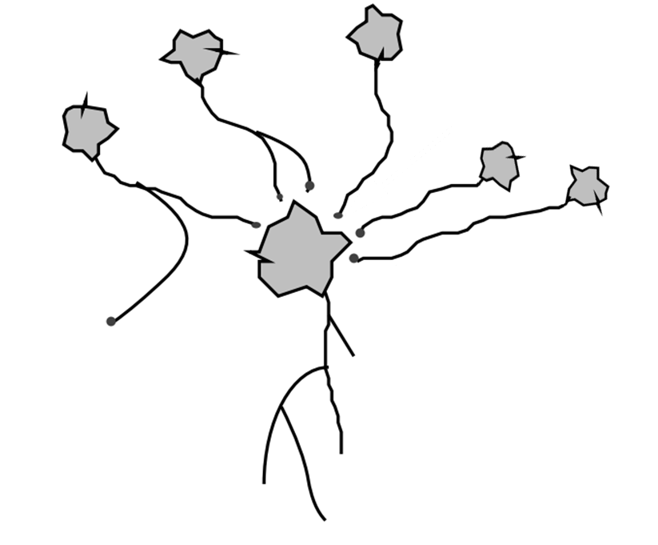
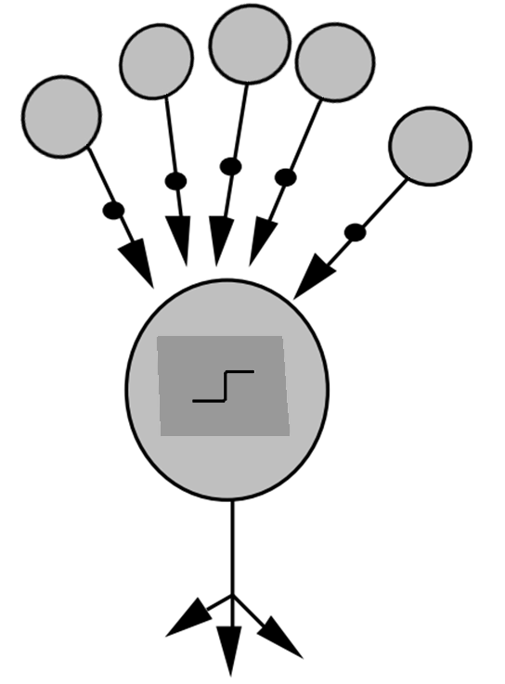
Simulation of a neuron
weights
cell
synapses
aggregation function
axon
outputs
Biological neuron
Computer neuron

Slide 8
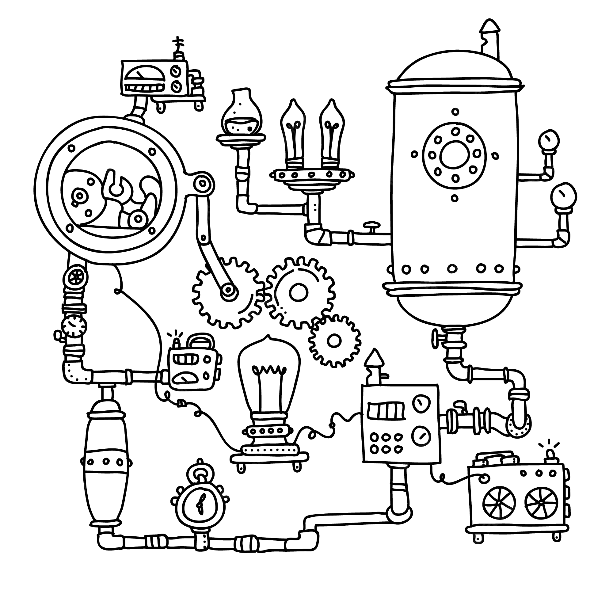
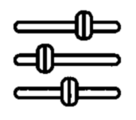
Neurons to build a function
Neurons
Inputs
Outputs

Slide 9


Using neurons
$$x$$
$$y$$

Slide 10


Adding complexity: width
$$y$$
$$x$$

Slide 11
Adding complexity: depth
$$x$$
$$y$$

Slide 12


Adding complexity: width & depth
$$x$$
$$y$$

Slide 13
Adding complexity: width & depth
$$x$$
$$y$$

Slide 14

Classification task
0
1
2
3
4
5
6
7
8
9
Inputs: pictures of numbers
Output: corresponding number

Slide 15
Last Layer: Neurons to Classes
0
1
2
3
4
5
6
7
8
9
Inputs: pictures of numbers
Output: corresponding number

Slide 16
Last Layer: Neurons to Classes
0
0
0
1
1
1
2
2
2
3
3
3
4
4
4
5
5
5
6
6
6
7
7
7
I predict « 4 »
8
8
8
9
9
9

Slide 17


1st layer: image to neurons
0
1
2
3
4
5
6
7
8
9

Slide 18
0
1
2
3
4
5
6
7
8
9

Slide 19
1st layer: image to neurons
0
1
2
3
4
5
6
7
8
9

Slide 20
Complete Architecture
0
1
2
3
4
5
6
7
8
9

Slide 21


Slide 22
Concrete example
0
0
1
1
2
2
3
3
4
4
5
5
6
6
7
7
8
8
9
9

Slide 23
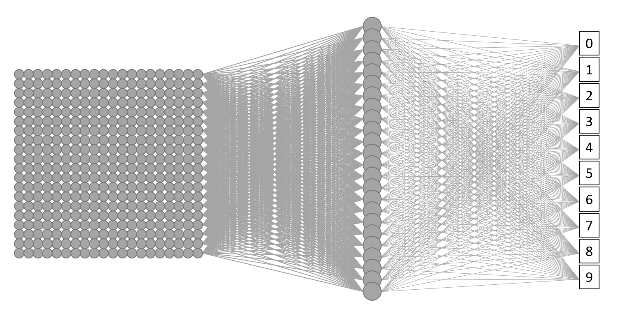

Training: technical

Slide 24

Training: technical

Slide 25

Training: technical

Slide 26
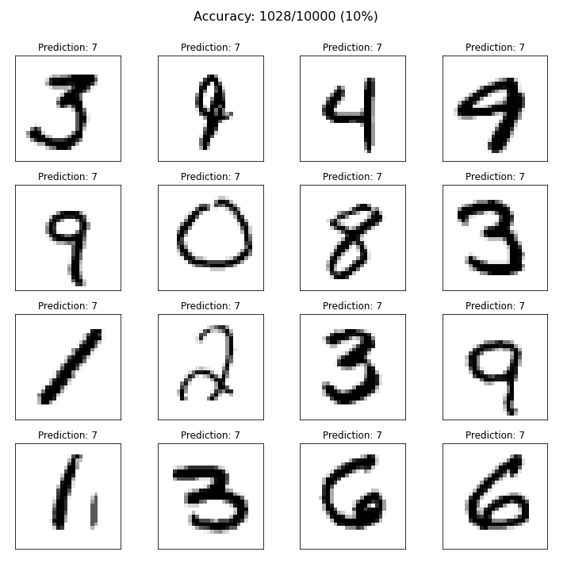
Training

Slide 27
Training

Slide 28

Training

Slide 29
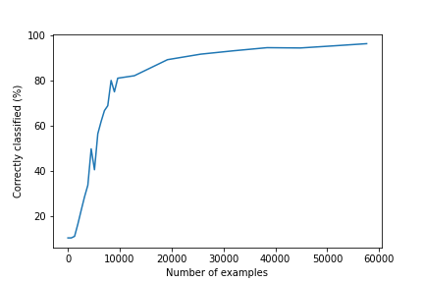
Performance Evolution

