Slide 1
Data Analysis 101
Welcome!

Slide 2
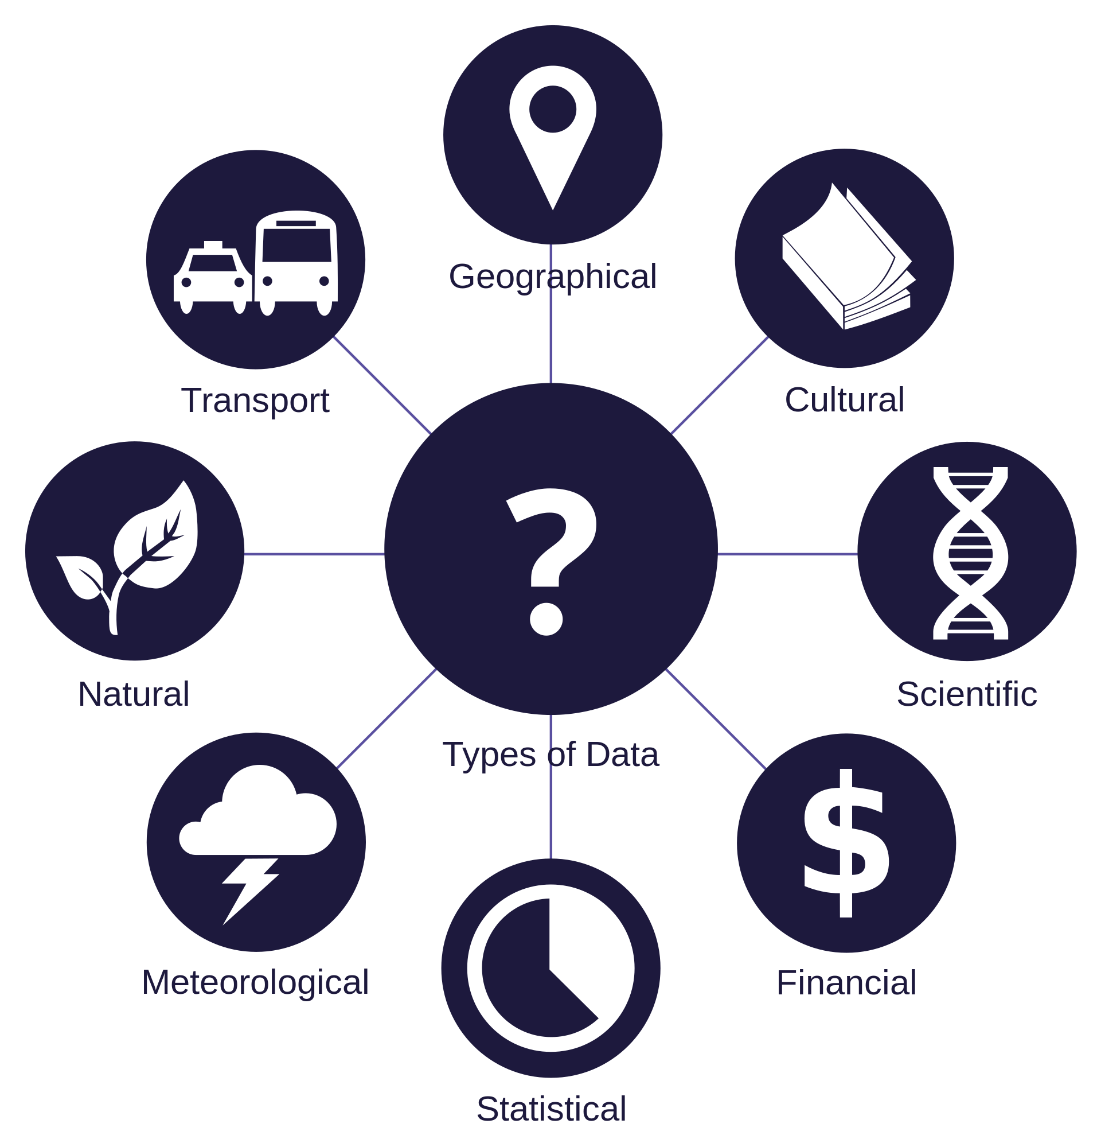
A world of data
Meta
Sensors
Personal
Connection
Logs
Text messages
Voice
Images

Slide 3
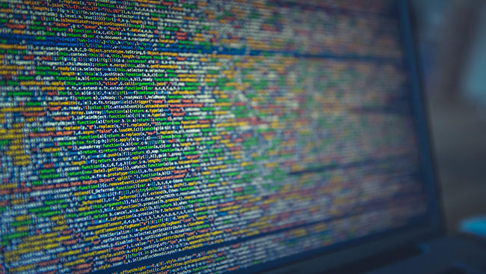

Massive data
How to make some sense out of it?

Slide 4
Goal(s) of Data Analysis
Understand the data, in order to:
Better decisions (should we choose A or B)
Predictive analysis (what will happen next?)
Pattern discoveries (find pattern, or maybe hidden information in the data)

