Slide 1
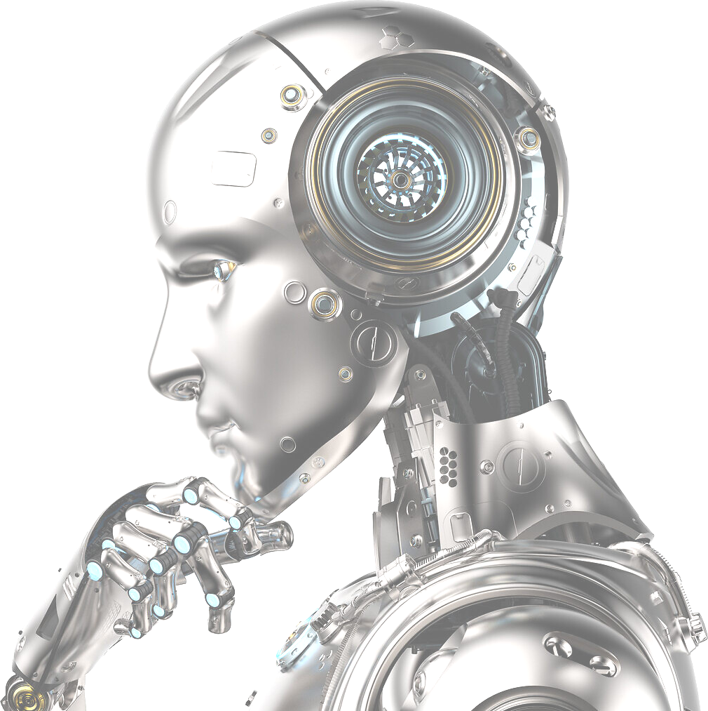
Artificial Intelligence
What is it?

