Slide 1
Data Analysis 101
Welcome!

Slide 2
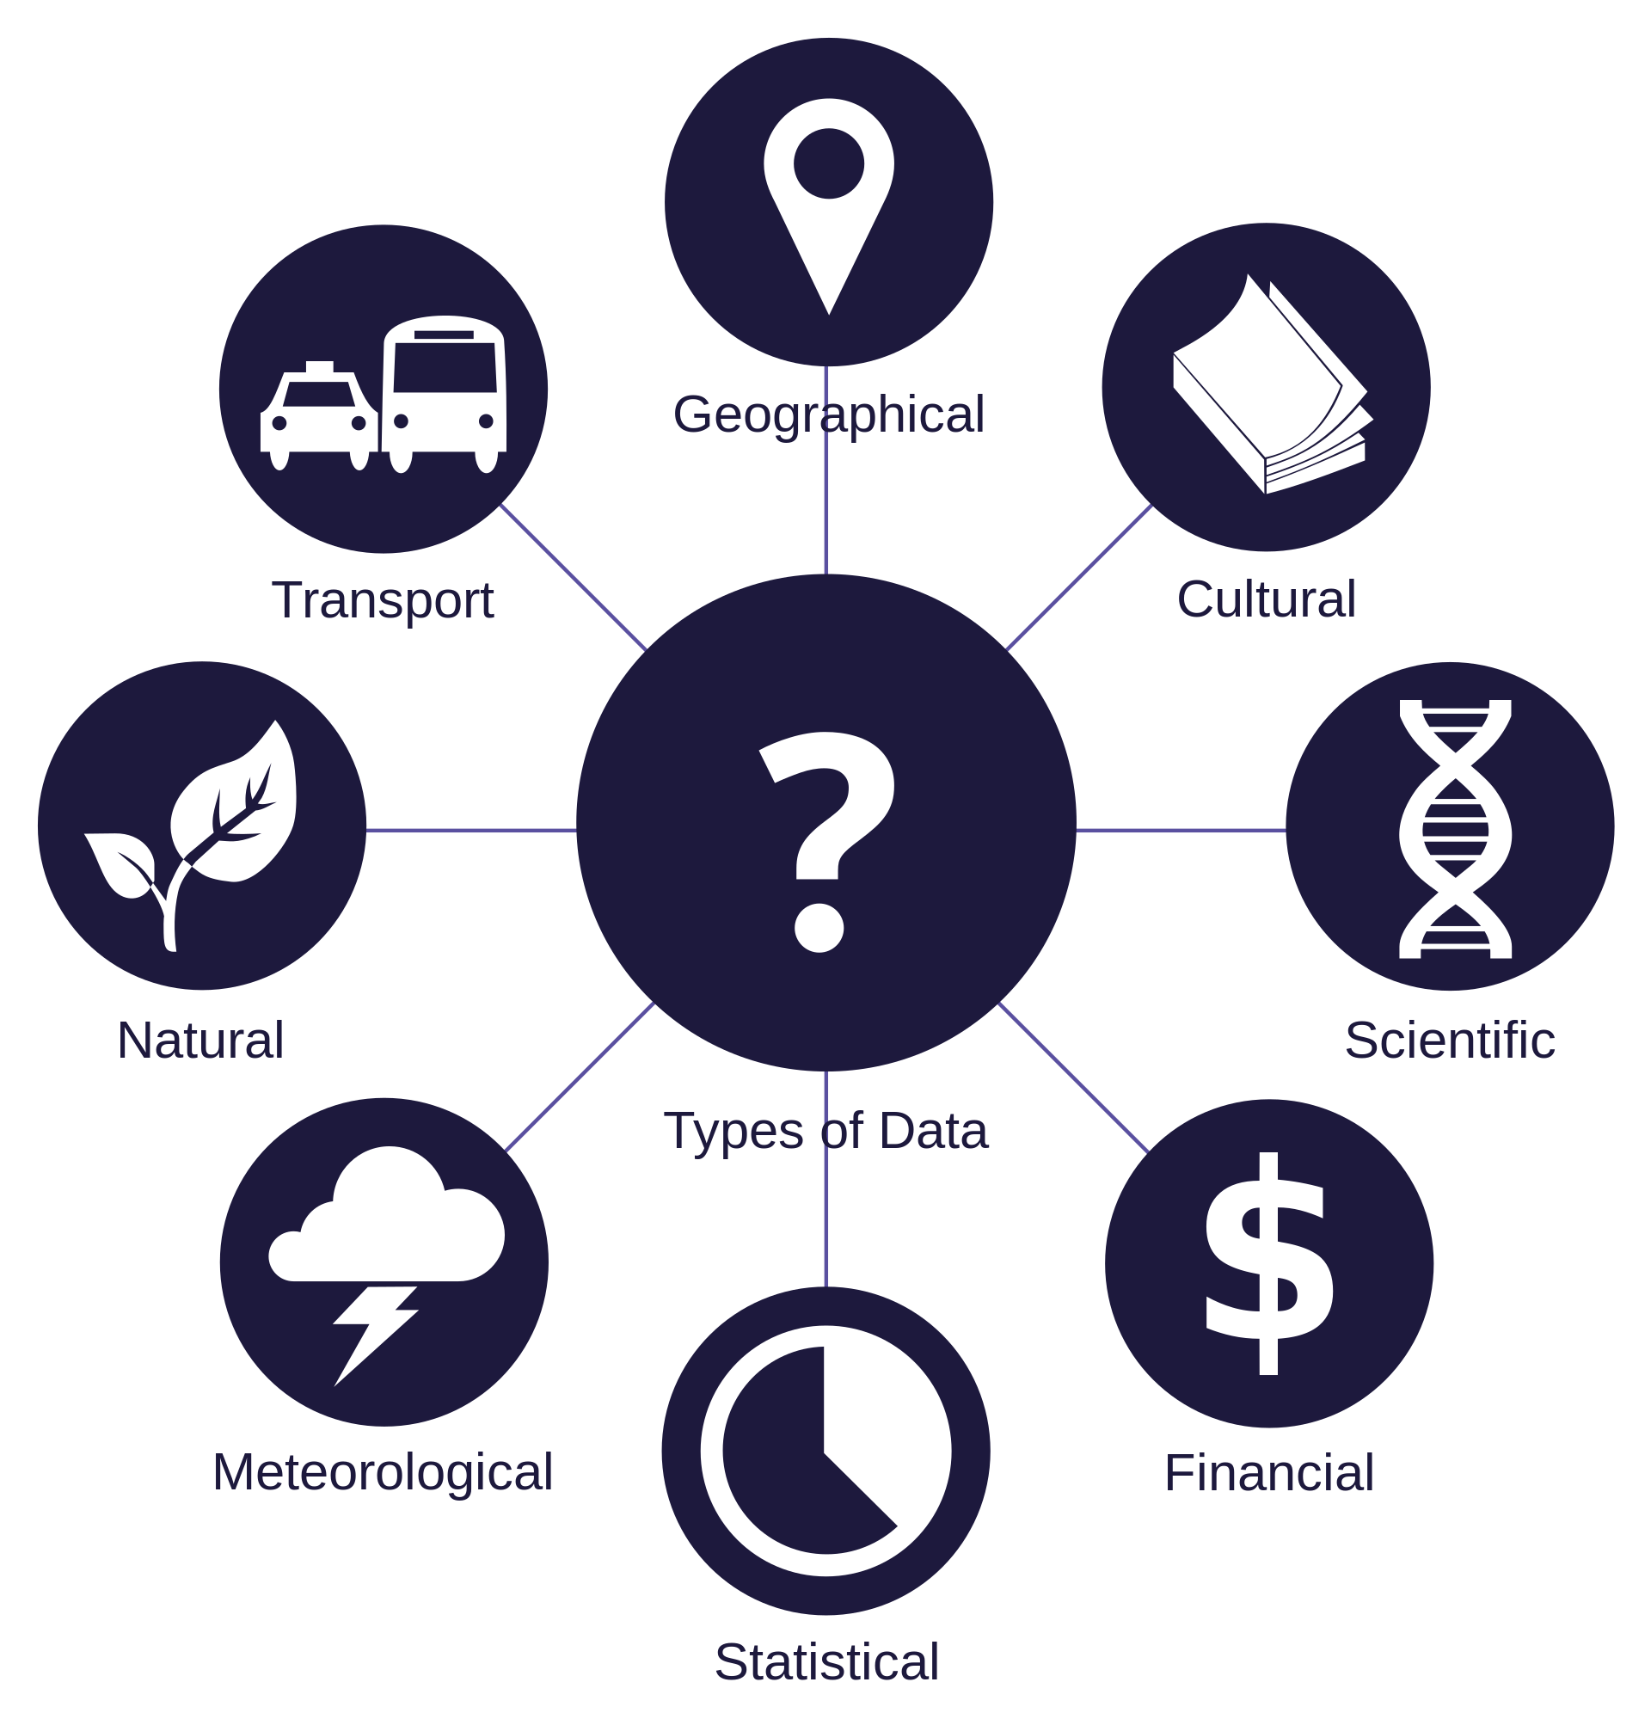
A world of data
Meta
Sensors
Personal
Connection
Logs
Text messages
Voice
Images

Slide 3


Massive data
How to make some sense out of it?

Slide 4
Goal(s) of Data Analysis
Understanding the data, in order to:
Better decisions (should we choose A or B)
Predictive analysis (what will happen next?)
Pattern discoveries (find pattern, or maybe hidden information in the data)

Slide 5
Steps of Data Analysis
In order to understand the data, we:
Gather data (SQL, web scrpping, etc…)
Analyze data (using statistics, machine learning models, etc…)
Take decisions accordingly (business analytics / common sense)

Slide 6

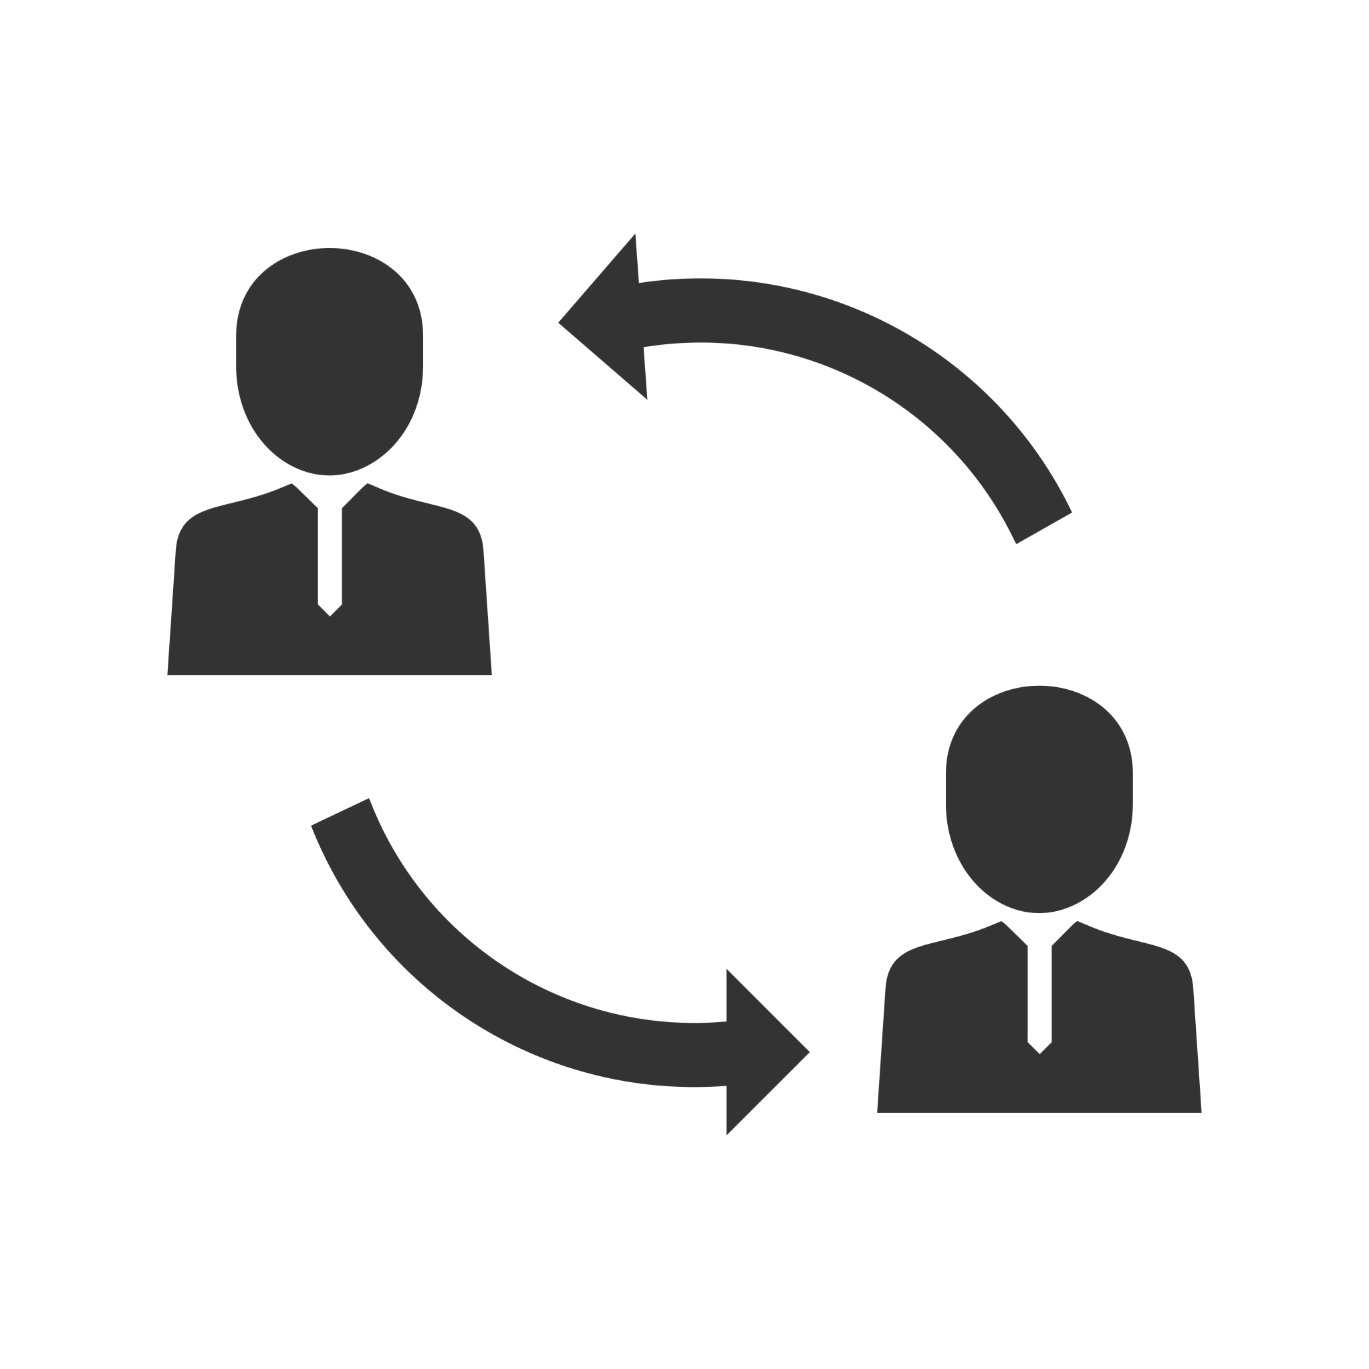


Where is Data Science Needed?
Finance
To foresee delays for flight/ship/train etc…
To predict when a mechanical equipment is about to break
To create personalized promotional offers
To find the best suited time to deliver goods / send emails
To forecast the next years revenue for a company
To analyze health benefit of treatments
To predict who will win elections
To change/update equipment just before they fail
Consultancy
Healthcare
Manufacturing

Slide 7
What is a data analyst?
“A data analyst is
better at computer science than a statistician,
and
better at statistics than a computer scientist.”
Statistics
Statisticians
Data Analyst
Computer Scientists
Computer Science

Slide 8
Expertise of data analysts
Machine Learning
Statistics
Programming (usually Python or R)
Mathematics
Databases

Slide 9

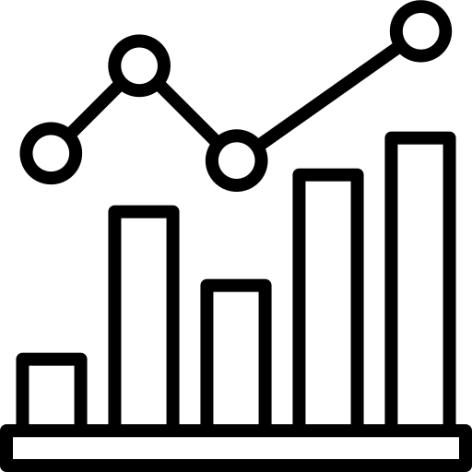
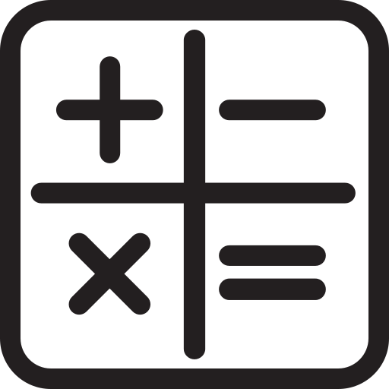


Expertise of data analysts
Machine
Learning
Statistics
Mathematics
Programming
Databases

Slide 10
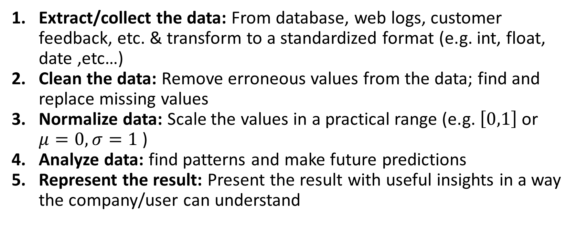
Typical data analysis
Extract/collect the data: From database, web logs, customer feedback, etc. & transform to a standardized format (e.g. int, float, date ,etc…)
Clean the data: Remove erroneous values from the data; find and replace missing values
Normalize data: Scale the values in a practical range (e.g. $\left[0,1\right]$ or $μ=0, σ=1$ )
Analyze data: find patterns and make future predictions
Represent the result: Present the result with useful insights in a way the company/user can understand

Slide 11
Data Analysis
Pros
Cons
Improved decision-making
Cost-effective
Innovation
Competitive advantage
Personalization
Data quality
Privacy concerns
Complexity
Bias
Interpretation

