Slide 1
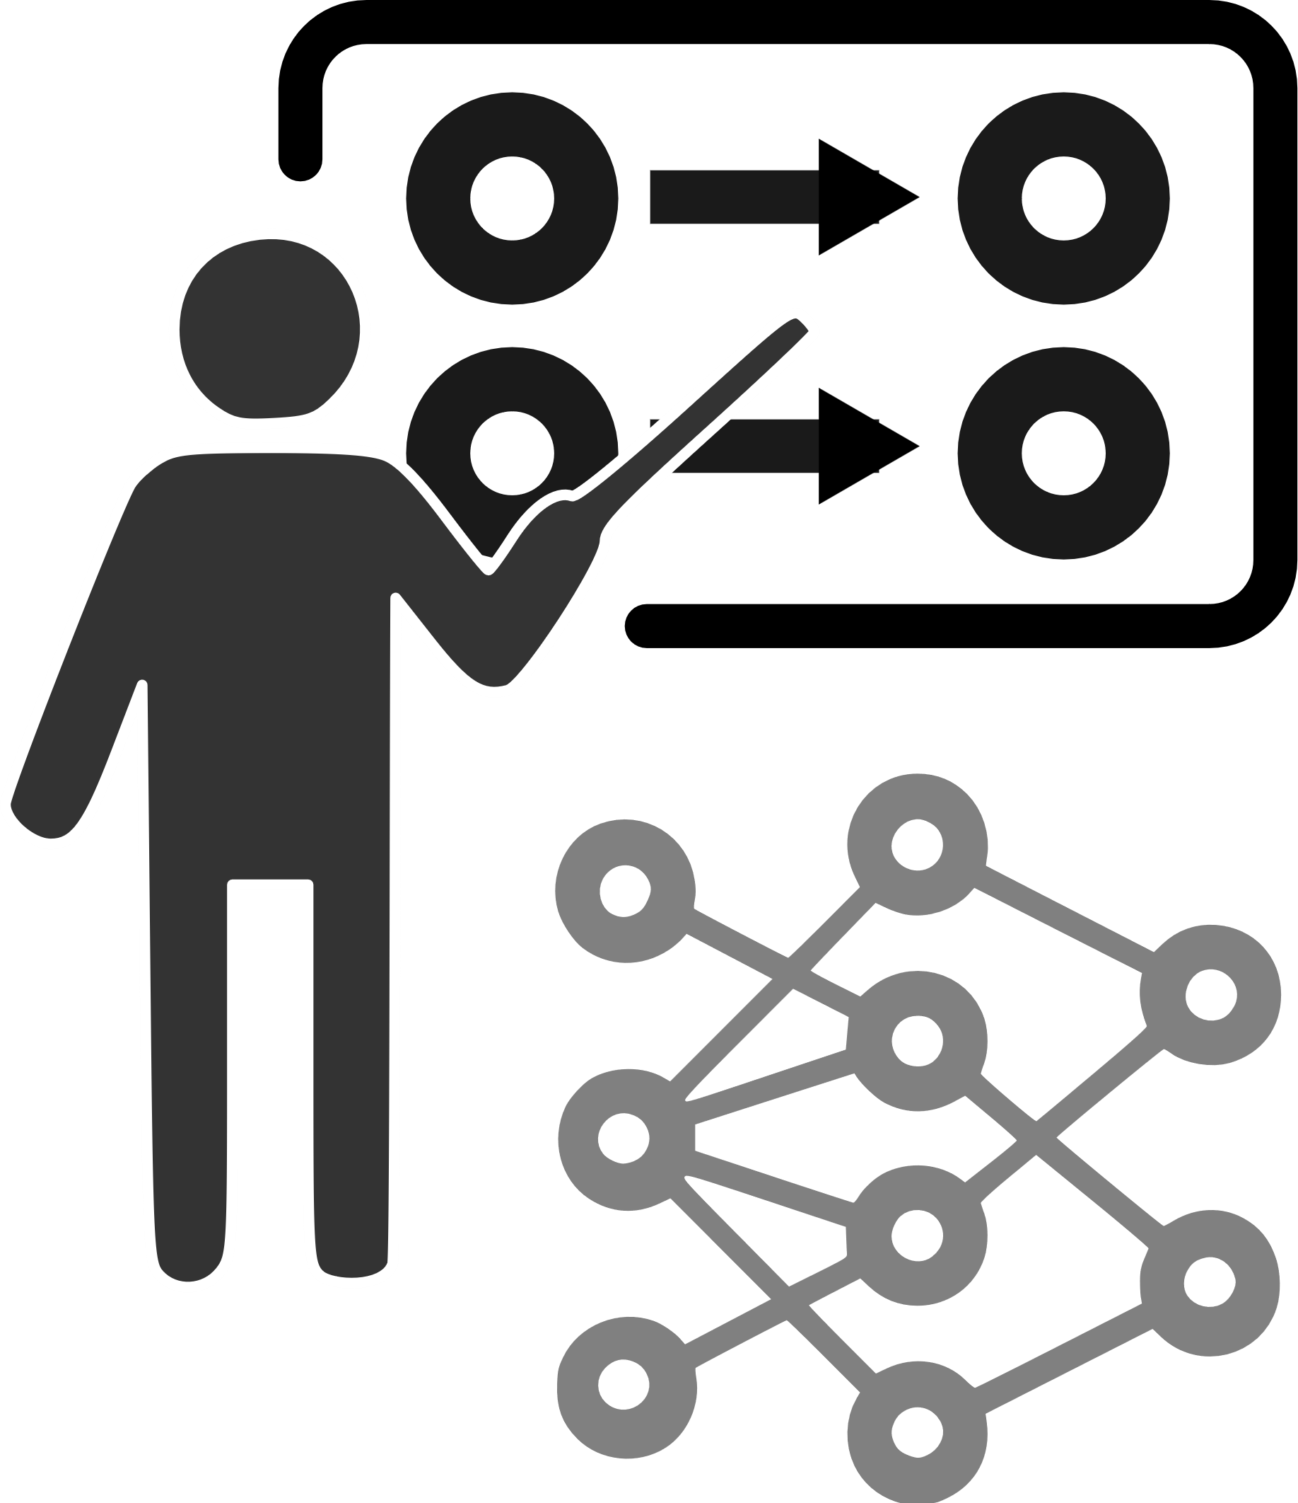
Teaching Networks
Are you a good professor?

Slide 2





Mathematically
$$x$$
$$l^{1}$$
$$l^{2}$$
$$l^{3}$$
$$y$$
Notes:
Treat each layer as a vector

Slide 3




Mathematically
$$x$$
$$∗W^{1}$$
$$l^{1}$$
$$∗W^{2}$$
$$l^{2}$$
$$∗W^{3}$$
$$l^{3}$$
$$∗W^{4}$$
$$y$$
Notes:
Treat each layer as a vector

