Slide 1
Data Analysis
Welcome!

Slide 2
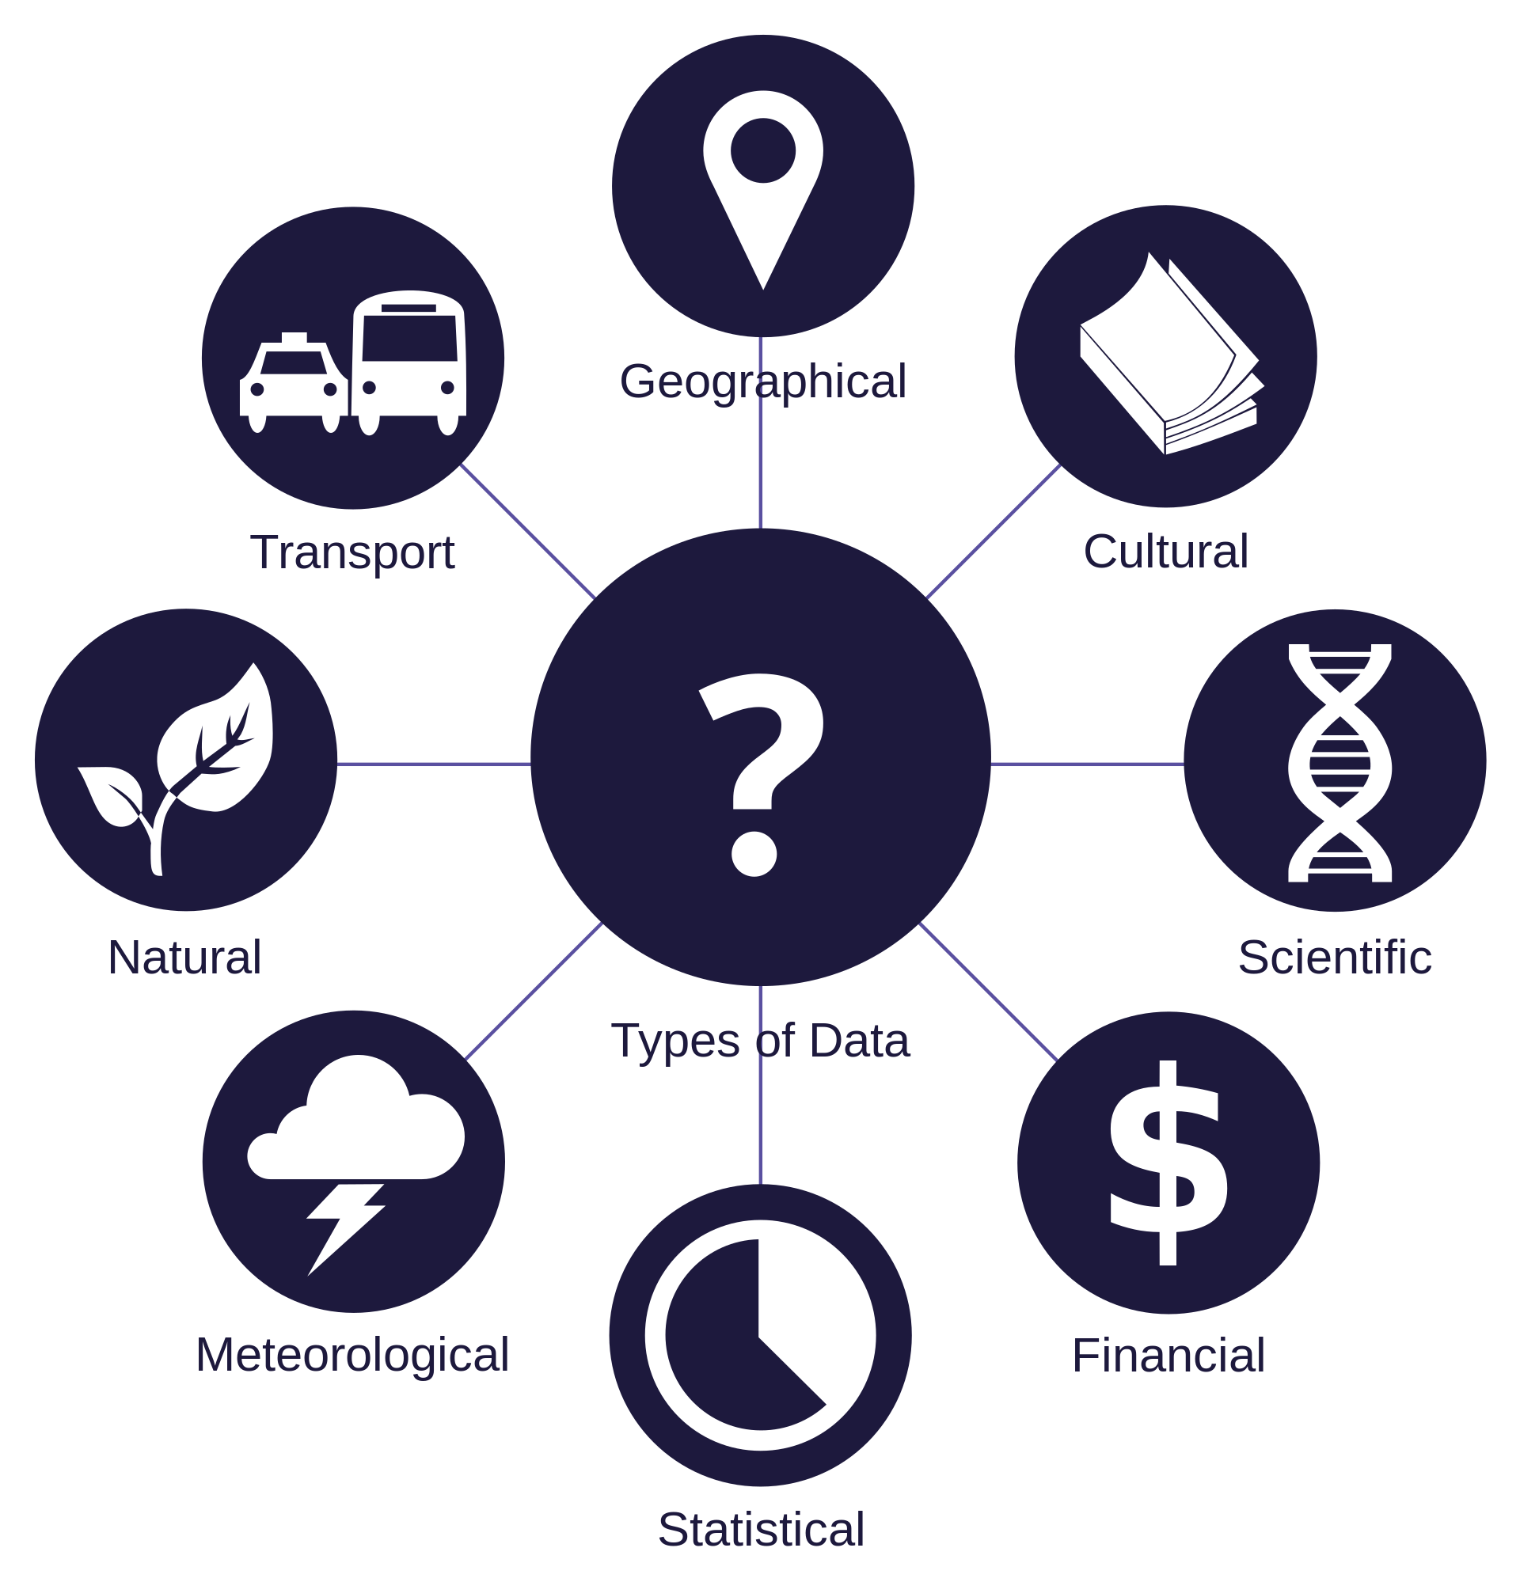
A world of data

