Slide 1
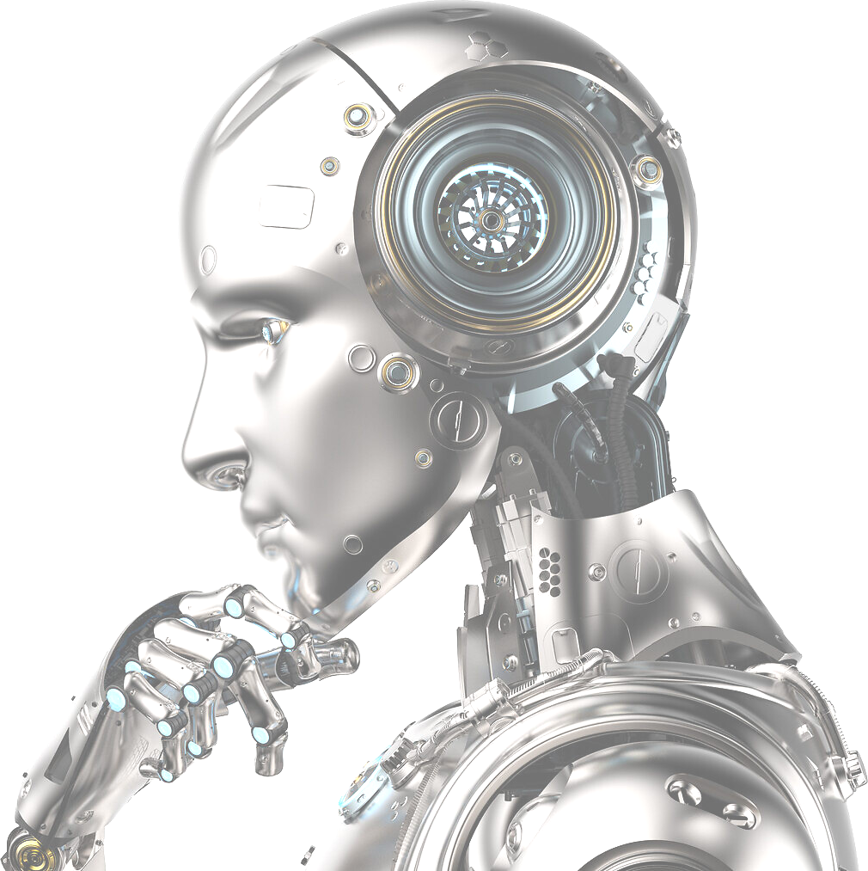
Artificial Intelligence
What is it?

Slide 2
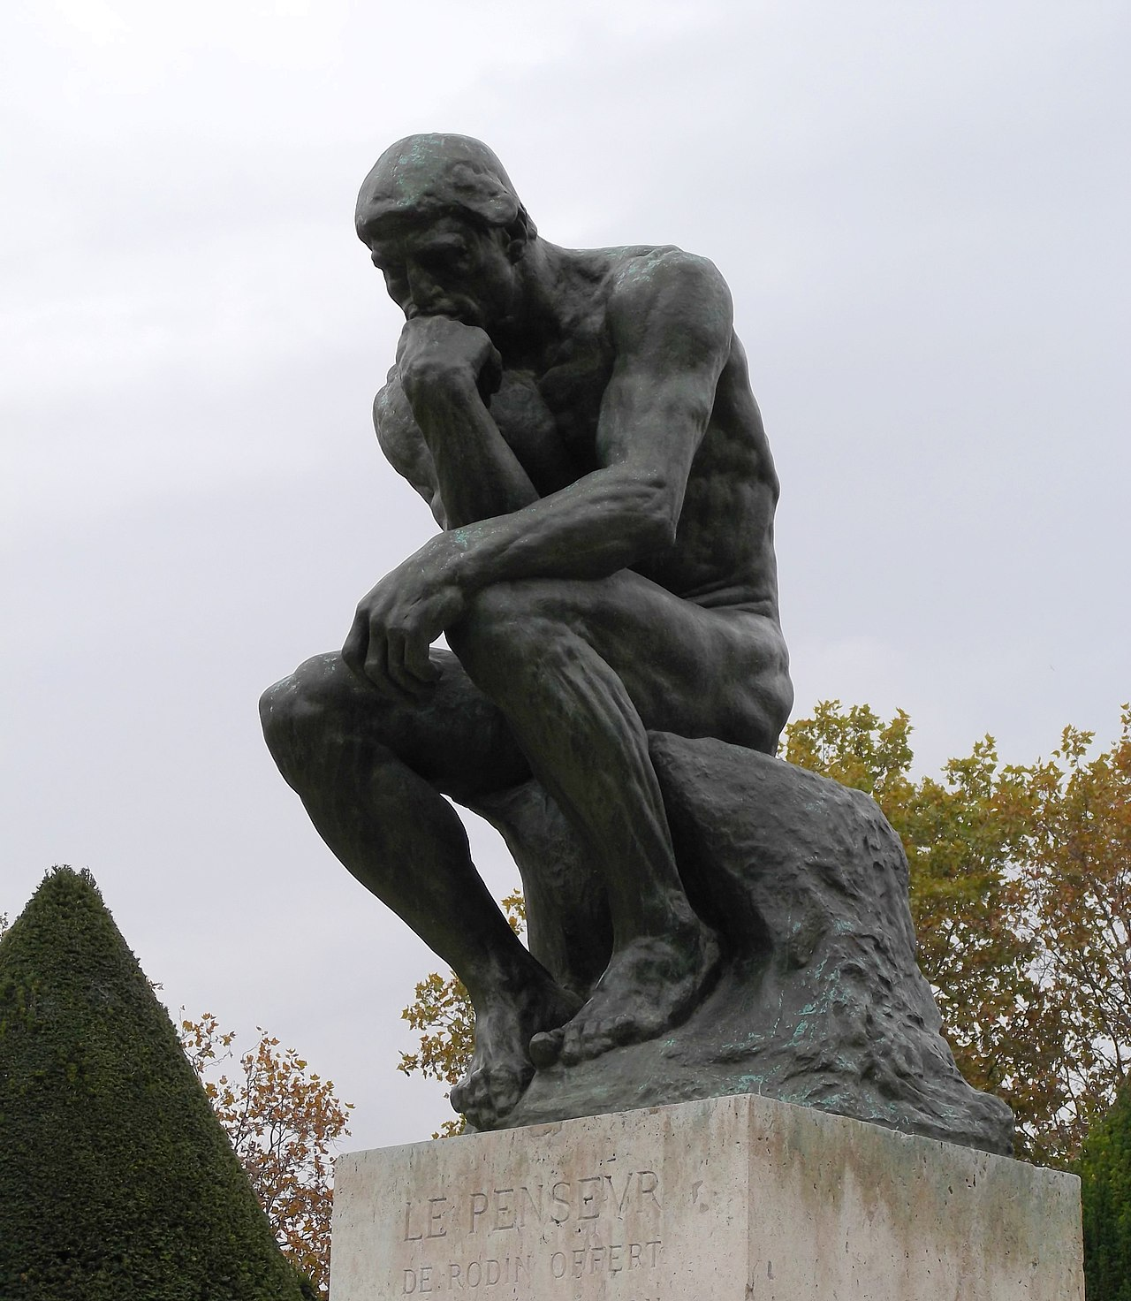
What is intelligence?
Notes:
Wiki def: Intelligence is the set of processes found in systems, more or less complex, living or not, which make it possible to learn, understand or adapt to new situations.
=> Learning, understanding, and adaptation

Slide 3
Formal definition
“the set of processes found in systems, more or less complex, living or not, which allow learning, understanding or adaptation to new situations.”

Slide 4
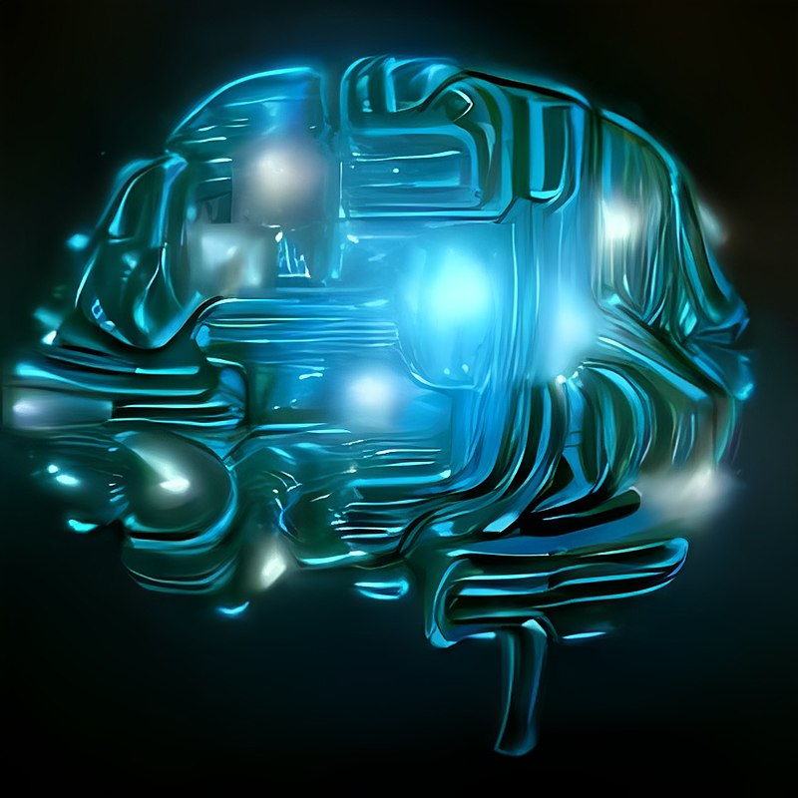
What is "artificial" intelligence?

Slide 5
Formal definition
"the set of theories and techniques implemented in order to achieve machines capable of simulating human intelligence"

Slide 6


Not all AIs are "intelligent"
AI: "the set of theories and techniques implemented in order to achieve machines capable of simulating human intelligence"
Notes:
When playing video games, if there are multiple levels, the AI is purposefully made "stupid" (to some extend)
Today, we will be more interested in the "smart" ones

Slide 7
Example of "simple" AI
X | O | O
 | X
 |  | O
X
“If two symbols line up, block the line.”

Slide 8
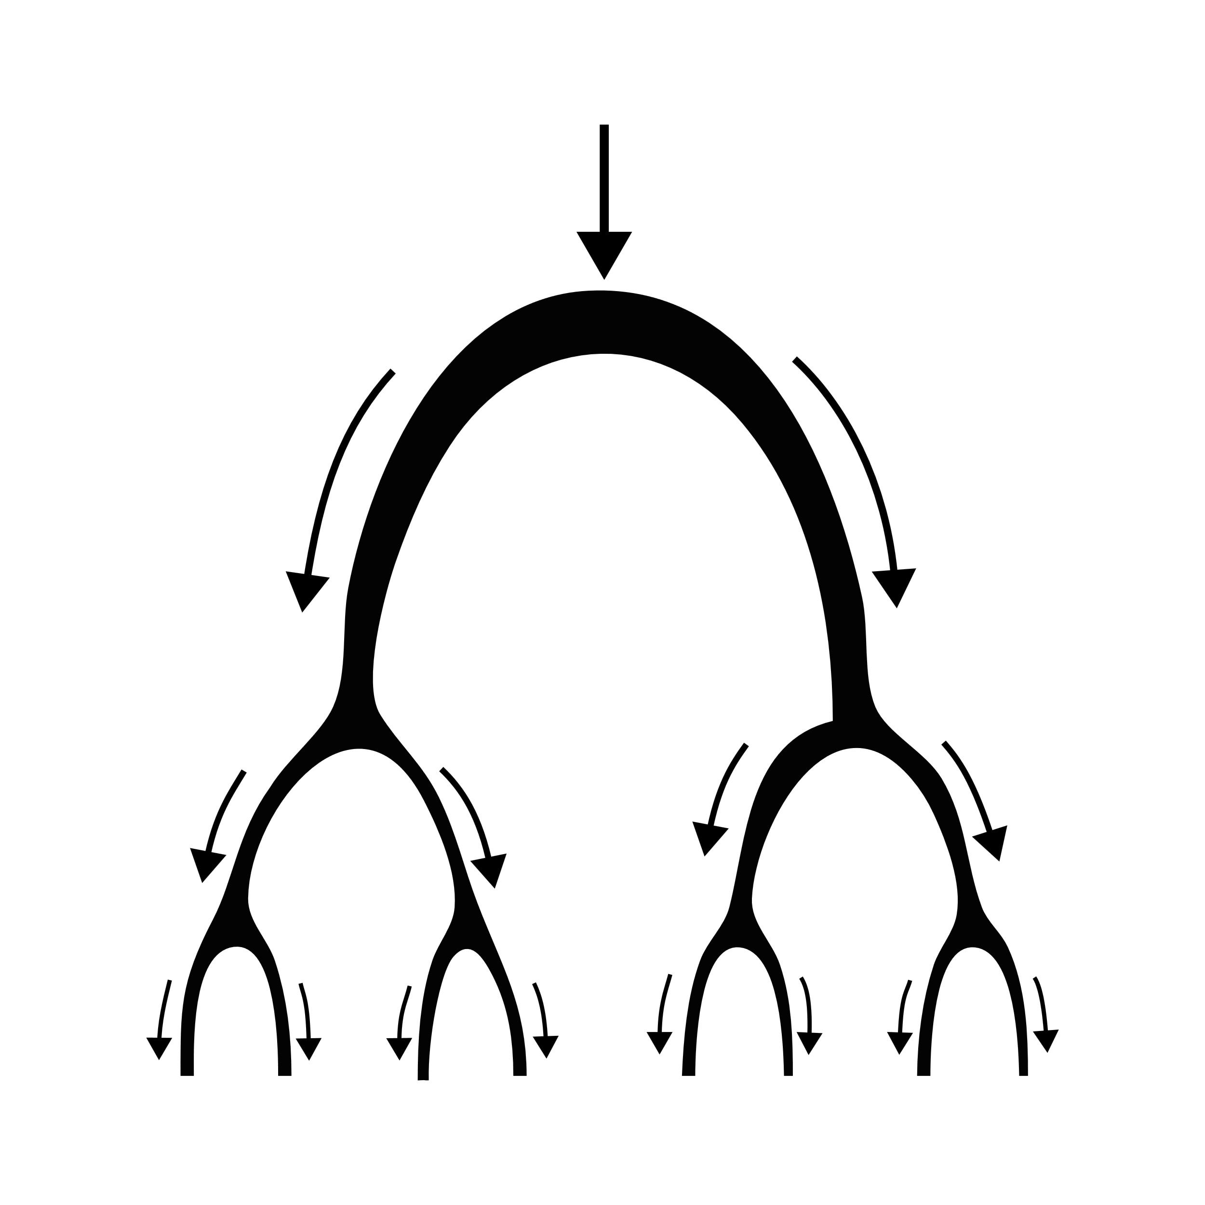
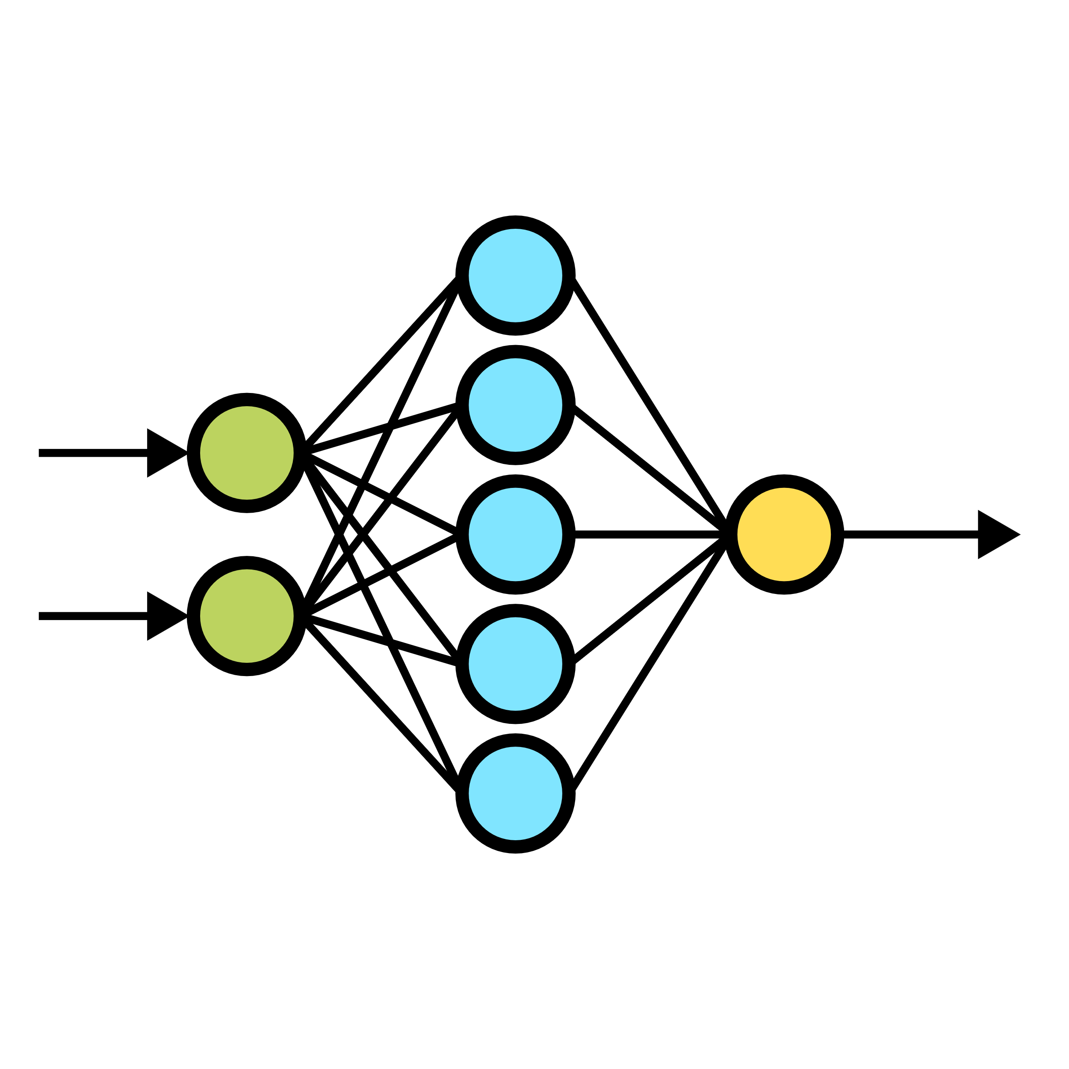
AI paradigms
"Classic" Programming
Deep Learning
If situation A, do action a
If situation B, do action b
If situation C, do action c
If situation D, do action a and b
If situation E, do action C then a
If not, do action z
Look at these examples
and find the rules to apply
Notes:
AI can be done in various ways:
- classical: tell computer what to do (if this do that, etc...)
- deep: let the computer deduce by himself what is the best behaviors
=> Today, we will try to understand how computers can "learn by themself"

Slide 9
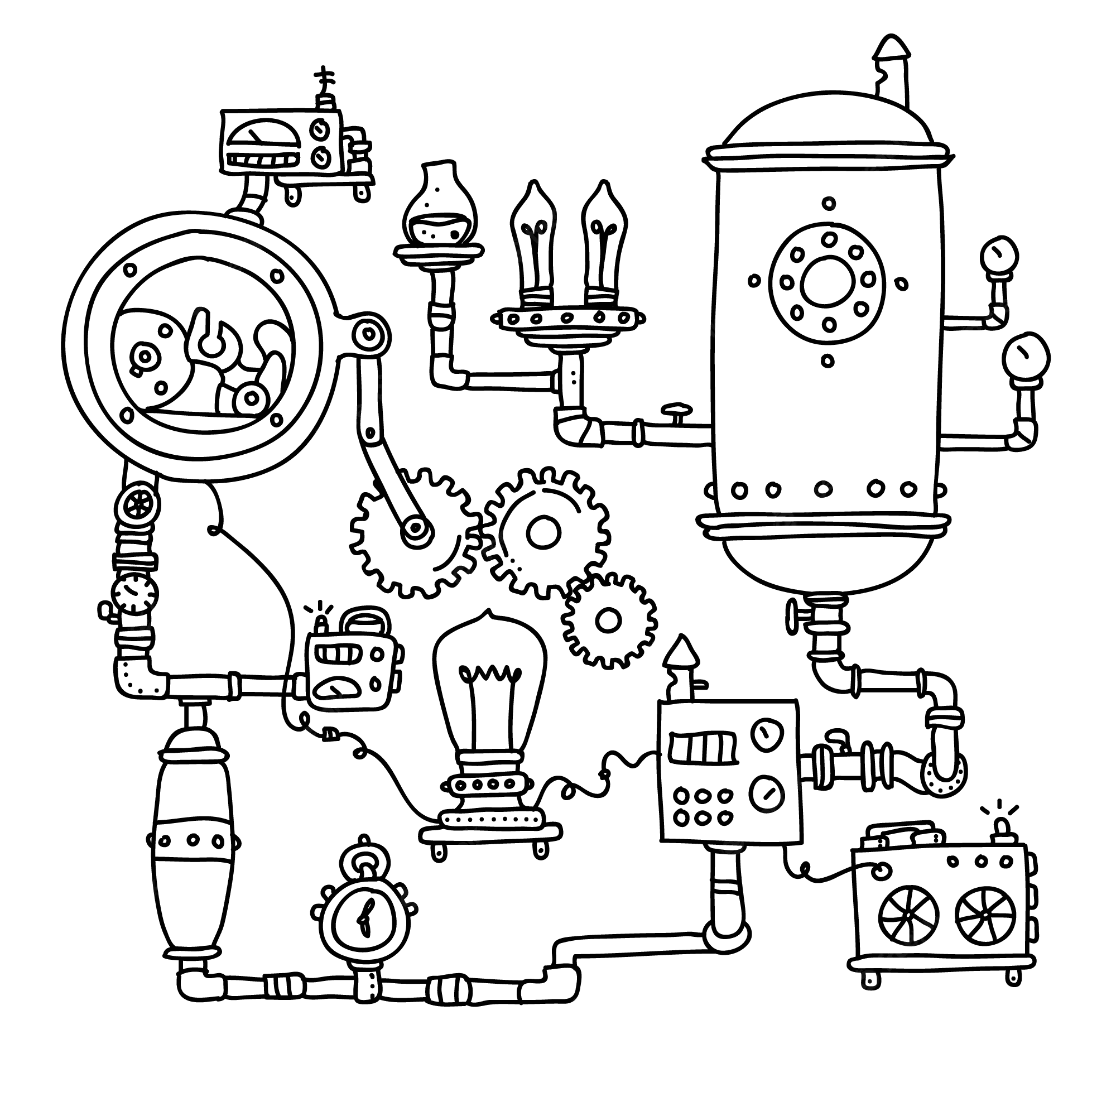
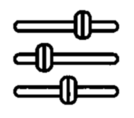
How to "find the rules to apply"?
Inputs
Outputs
Machine Parameters
Notes:
Define inputs / outputs => we are therefore looking for a function
There is an 'ideal' function, which always gives the right answer or the best move; we try to approximate this function
We can build “all-purpose machines”
With parameters, which will have to be optimized

Slide 10
Find the right settings
Notes:
Via examples, we look for the right parameters
PB: the model is black-box: we know how to make a machine to do everything, but we don't understand it

Slide 11

Try it yourself!
Online Tool
https://pauldubois98.github.io/AI-MythsReality/BlackBox

Slide 12
Evaluate Machine
?
=
Notes:
To verify that the all-purpose machine has the right parameters, we test on new examples
=> Importance of sample data!!!

Slide 13

Machine Learning
Fake!
Step 1: Learning
Step 2: Use
Notes:
Step 1,5: Evaluate

Slide 14

Try it yourself!
https://pauldubois98.github.io/AI-MythsReality/WhiteBox
Online Tool

Slide 15
How to make “all-purpose machines”?
With “parameters” to fine-tuner.

