Slide 1

Teaching Networks
Are you a good professor?

Slide 2





Mathematically
$$x$$
$$l^{1}$$
$$l^{2}$$
$$l^{3}$$
$$y$$
Notes:
Treat each layer as a vector

Slide 3


Vectors & matrices
$$l^{1}$$
$$l^{2}$$
-5.6
0.5
-2.3
-1.5
2.8
-1.5
0.5
-1.9
3.1
0.9
3.7
4.3
-0.8

Slide 4
Vectors & matrices
$$l^{1}$$
$$l^{2}$$
-5.6
-2.3
7.5
-1.5
-2.5
0.5
6.8
0.9
-3.9
3.7
6.1
4.3
-0.8

Slide 5
Vectors & matrices
$$l^{1}$$
$$l^{2}$$
-5.6
-2.3
-1.5
0.5
-2.7
3.7
0.9
6.2
3.7
-9.4
4.3
1.8
-0.8

Slide 6
Vectors & matrices
$$l^{1}$$
$$l^{2}$$
-5.6
-2.3
0.5
-1.5
7.5
-1.5
2.8
-2.5
0.5
-2.7
-1.9
6.8
3.7
0.9
3.1
-3.9
6.2
3.7
6.1
-9.4
4.3
1.8
-0.8

Slide 7
Vectors & matrices
$$l^{1}$$
$$l^{2}$$
-5.6
-2.3
0.5
-1.5
7.5
-1.5
2.8
-2.5
0.5
-2.7
-1.9
6.8
3.7
0.9
3.1
-3.9
6.2
3.7
6.1
-9.4
4.3
1.8
-0.8

Slide 8
Vectors & matrices
$$l^{1}$$
$$l^{2}$$
-5.6
-2.3
0.5
7.5
-2.7
-1.5
-1.5
-2.5
3.7
0.5
2.8
6.8
6.2
-1.9
-3.9
-9.4
0.9
3.1
6.1
1.8
3.7
4.3
-0.8

Slide 9

Vectors & matrices
$$l^{1}$$
$$l^{2}$$
$$w$$
-5.6
-2.3
0.5
0.5
7.5
-2.7
-1.5
7.5
-1.5
-1.5
-2.5
3.7
2.8
-2.5
2.8
6.8
-2.7
0.5
6.2
-1.9
6.8
-1.9
-3.9
3.7
0.9
-9.4
3.1
-3.9
3.1
6.1
6.2
1.8
3.7
6.1
-9.4
4.3
1.8
-0.8

Slide 10













Mathematically: forward
$$x$$
$$∗W^{1}$$
$$l^{1}$$
$$∗W^{2}$$
$$l^{2}$$
$$∗W^{3}$$
$$l^{3}$$
$$∗W^{4}$$
$$y$$
$$l^{1}=W^{1}x$$
$$l^{2}=W^{2}l^{1}$$
$$l^{3}=W^{3}l^{2}$$
$$y=W^{4}l^{3}$$
Notes:
Some neurons may be consistently too large/small, so we add a bias

Slide 11







Mathematically: forward
$$+b^{1}$$
$$+b^{2}$$
$$+b^{3}$$
$$x$$
$$∗W^{1}$$
$$l^{1}$$
$$∗W^{2}$$
$$l^{2}$$
$$∗W^{3}$$
$$l^{3}$$
$$∗W^{4}$$
$$y$$
$$l^{1}=W^{1}x+b^{1}$$
$$l^{2}=W^{2}l^{1}+b^{2}$$
$$l^{3}=W^{3}l^{2}+b^{3}$$
$$y=W^{4}l^{3}+b^{4}$$
Notes:
Need to add complexity: linear transform twice is itself a linear transform

Slide 12




Mathematically: forward
$$+b^{1}$$
$$+b^{2}$$
$$+b^{3}$$
$$x$$
$$∗W^{1}$$
$$l^{1}$$
$$∗W^{2}$$
$$l^{2}$$
$$∗W^{3}$$
$$l^{3}$$
$$∗W^{4}$$
$$y$$
$$l^{1}=σ(W^{1}x+b^{1})$$
$$l^{2}=σ(W^{2}l^{1}+b^{2})$$
$$l^{3}=σ(W^{3}l^{2}+b^{3})$$
$$y=σ(W^{4}l^{3}+b^{4})$$
Notes:
With non-linear activation function sigma, the complexity of the system can not be simplified to a single layer.

Slide 13
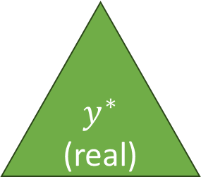
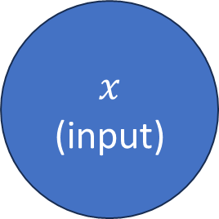
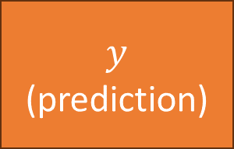
Evaluating a network
?
$$x$$
(input)
=
$$y^{∗}$$
(real)
$$y$$
(prediction)

Slide 14
Evaluating a network
(
-
)²
$$y^{∗}$$
(real)
$$y$$
(prediction)

Slide 15


Evaluating a network
(
-
)²
$$y$$
$$y^{∗}$$

Slide 16

Evaluating a network
(
-
)²
Use gradient descent!
$$y^{∗}$$
$$f(x,w)$$

Slide 17
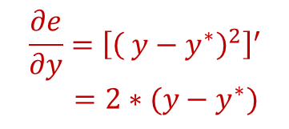
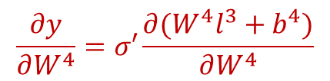
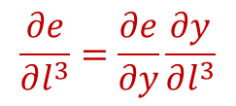
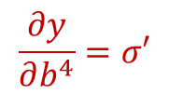

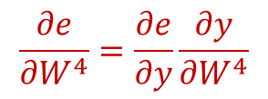
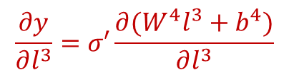
Mathematically: backward
$$\frac{∂e}{∂y}={\left[{\left( y−y^{∗}\right)}^{2}\right]}^{′}$$
$=2∗(y−y^{∗})$
$$+b^{1}$$
$$+b^{2}$$
$$+b^{3}$$
$$x$$
$$∗W^{1}$$
$$l^{1}$$
$$∗W^{2}$$
$$l^{2}$$
$$∗W^{3}$$
$$l^{3}$$
$$∗W^{4}$$
$$y$$
$$l^{1}=σ(W^{1}x+b^{1})$$
$$l^{2}=σ(W^{2}l^{1}+b^{2})$$
$$l^{3}=σ(W^{3}l^{2}+b^{3})$$
$$y=σ(W^{4}l^{3}+b^{4})$$
$$\frac{∂e}{∂l^{3}}=\frac{∂e}{∂y}\frac{∂y}{∂l^{3}}$$
$$\frac{∂e}{∂W^{4}}=\frac{∂e}{∂y}\frac{∂y}{∂W^{4}}$$
$$e={\left( y−y^{∗}\right)}^{2}$$
$$\frac{∂y}{∂l^{3}}=σ′\frac{∂(W^{4}l^{3}+b^{4})}{∂l^{3}}$$
$$\frac{∂y}{∂W^{4}}=σ′\frac{∂(W^{4}l^{3}+b^{4})}{∂W^{4}}$$
$$\frac{∂y}{∂b^{4}}=σ′$$
Notes:
Using chain rule, we step by step calculate the derivative of the error function in terms of all intermediate variables.
Then, we use gradient descent to update all parameters.

Slide 18
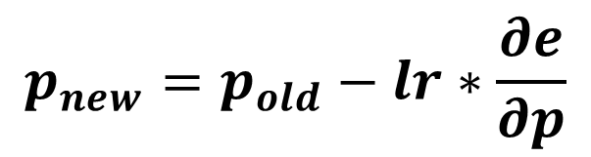
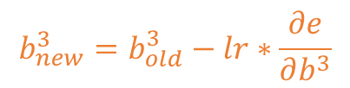


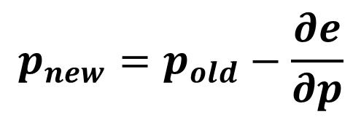
Mathematically: update
$$p_{new}=p_{old}−\frac{∂e}{∂p}$$
$$p_{new}=p_{old}−lr∗\frac{∂e}{∂p}$$
$$b_{new}^{3}=b_{old}^{3}−lr∗\frac{∂e}{∂b^{3}}$$
$$+b^{1}$$
$$+b^{2}$$
$$+b^{3}$$
$$x$$
$$∗W^{1}$$
$$l^{1}$$
$$∗W^{2}$$
$$l^{2}$$
$$∗W^{3}$$
$$l^{3}$$
$$∗W^{4}$$
$$y$$
$$l^{1}=σ(W^{1}x+b^{1})$$
$$l^{2}=σ(W^{2}l^{1}+b^{2})$$
$$l^{3}=σ(W^{3}l^{2}+b^{3})$$
$$y=σ(W^{4}l^{3}+b^{4})$$
$$W_{new}^{3}=W_{old}^{3}−lr∗\frac{∂e}{∂W^{3}}$$
$$e={\left( y−y^{∗}\right)}^{2}$$
Notes:
We update the parameters by subtracting the gradient, times the learning rate.

Slide 19
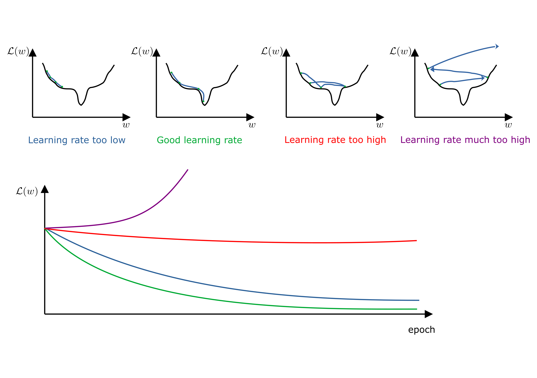
Learning Rate

Slide 20
Training steps
Create a network with random weights
Feed one piece of data (for which you know the desired output)
Calculate the error
Backpropagate the error to all intermediate variables
Update the parameters

