Slide 1
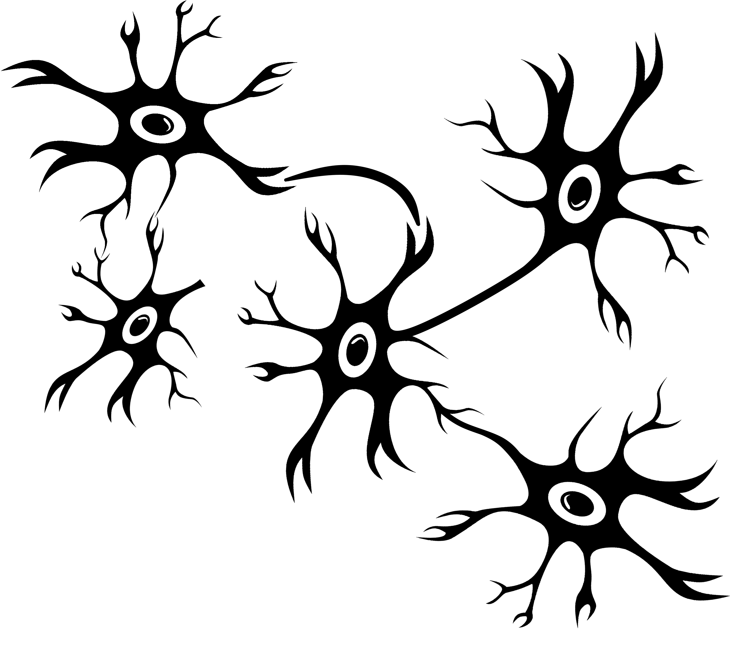
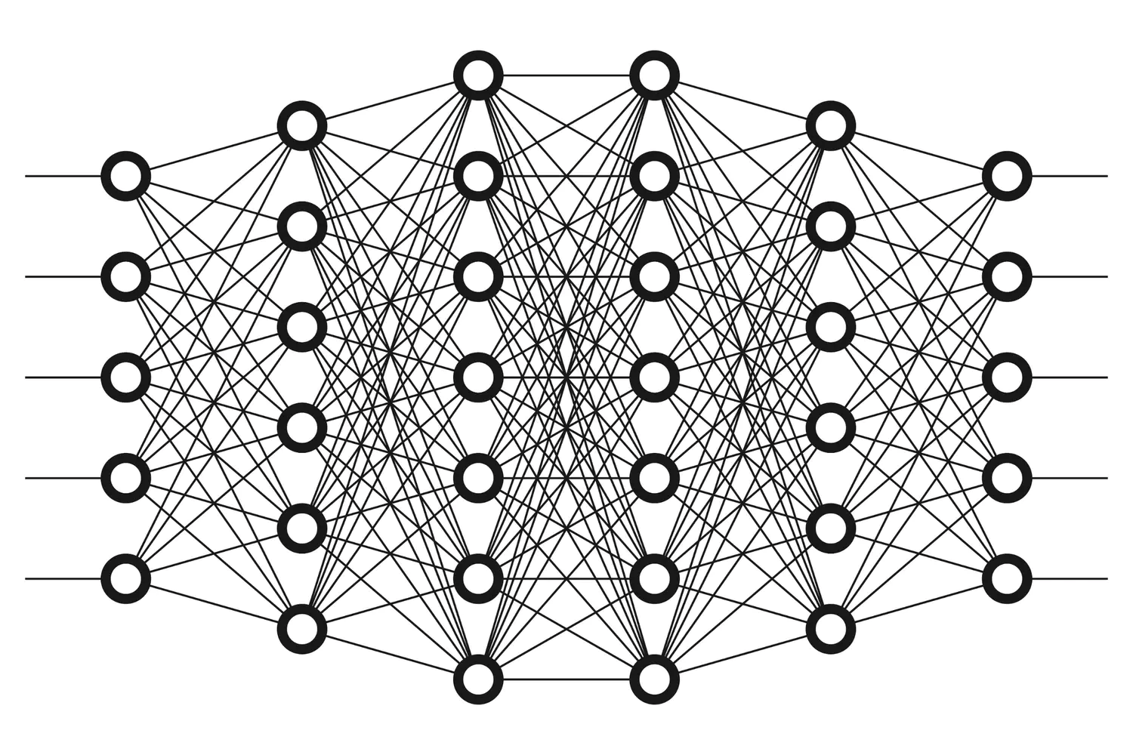
From biological neurons…
…to artificial networks!

Slide 2
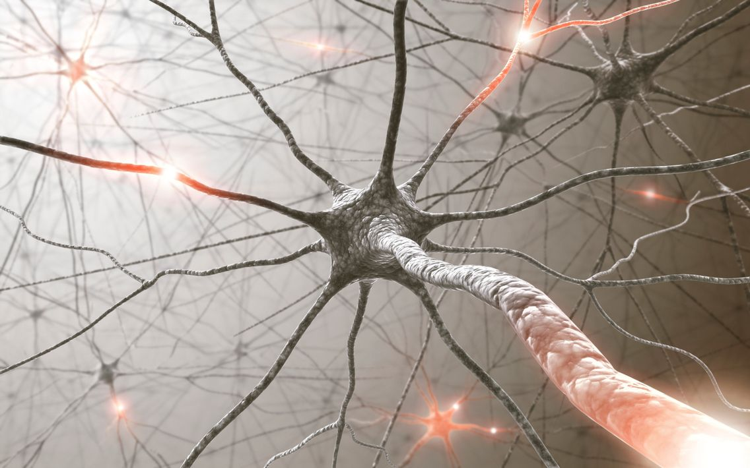
Biological Neuron

Slide 3
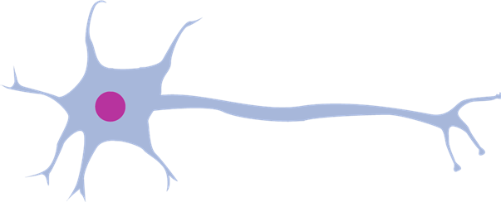
Biological Neuron
kernel
synapse
axon
cell
dendrite

