Slide 1
Data Analysis 101
Welcome!

Slide 2
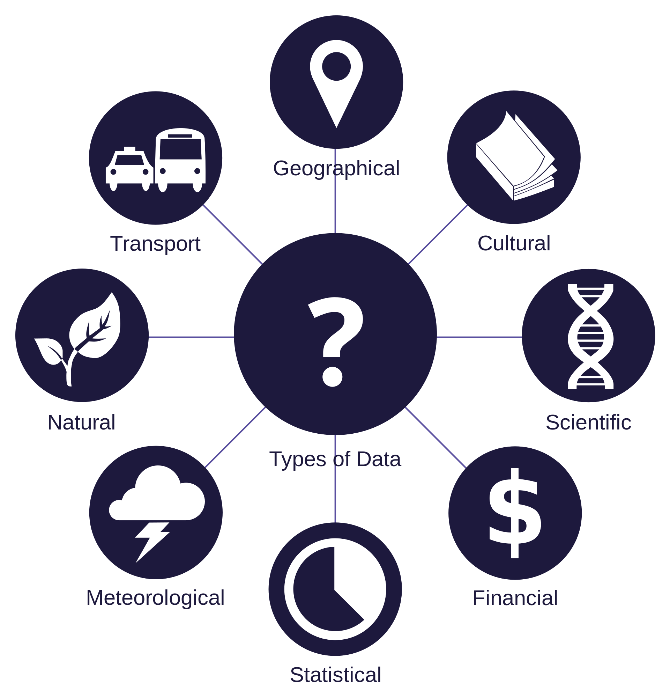
A world of data

Slide 3

Massive data

