Slide 1
Data Analysis 101
Welcome!

Slide 2
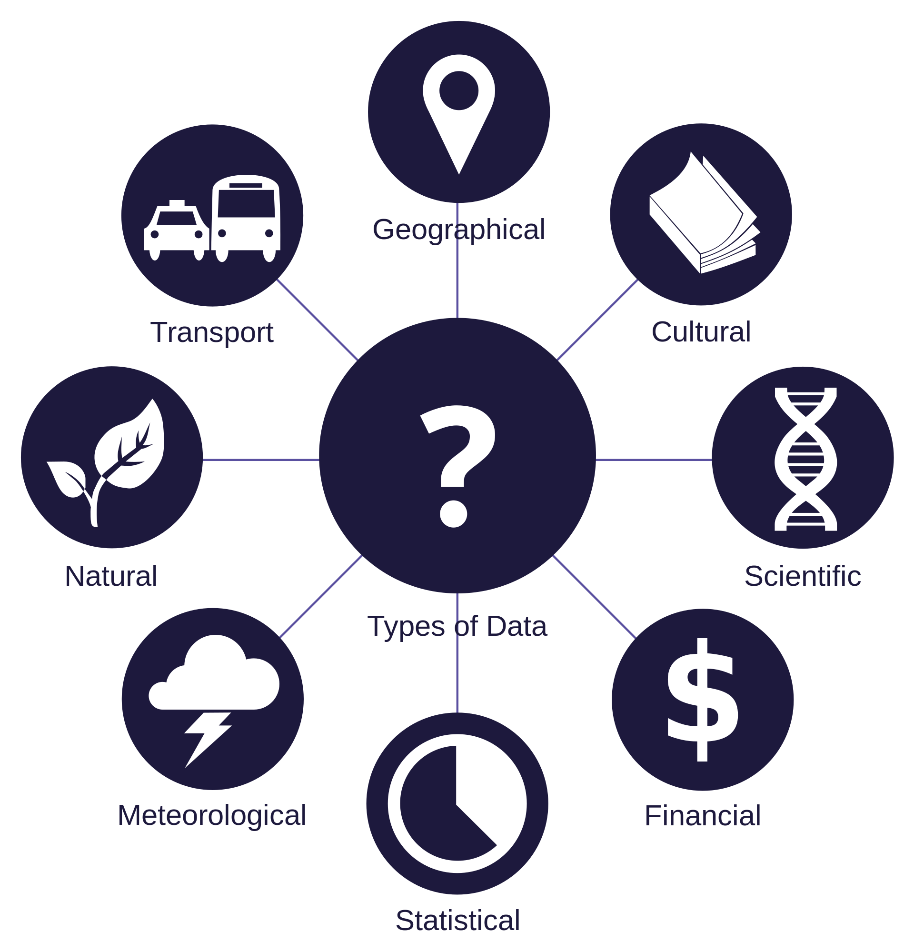
A world of data
Meta
Sensors
Personal
Connection
Logs
Voice
Text messages
Images

Slide 3
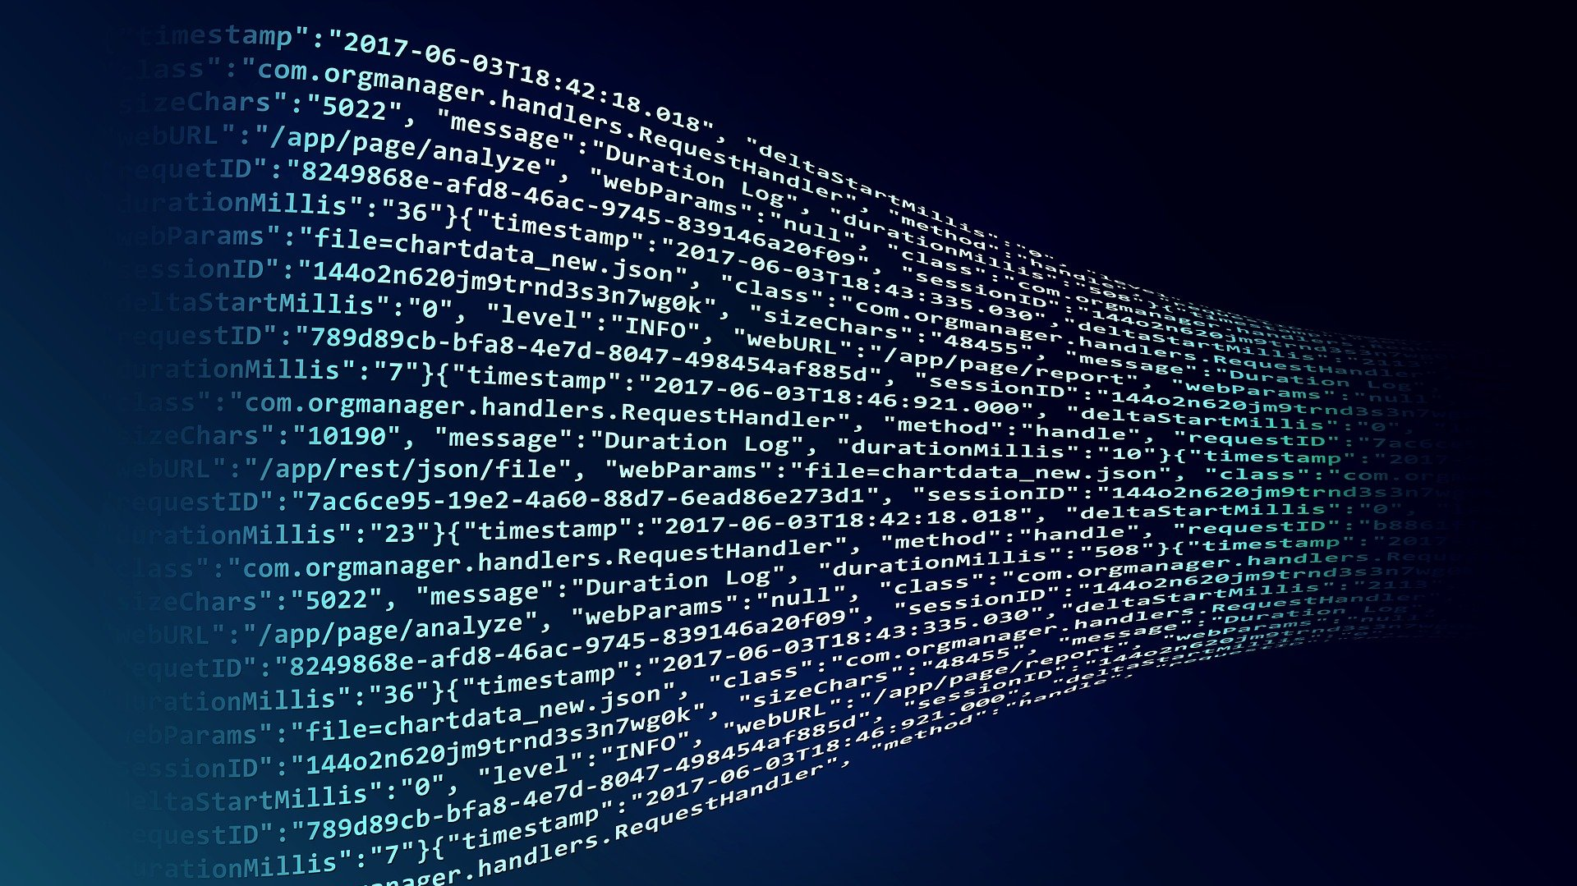
Massive data

