Slide 1
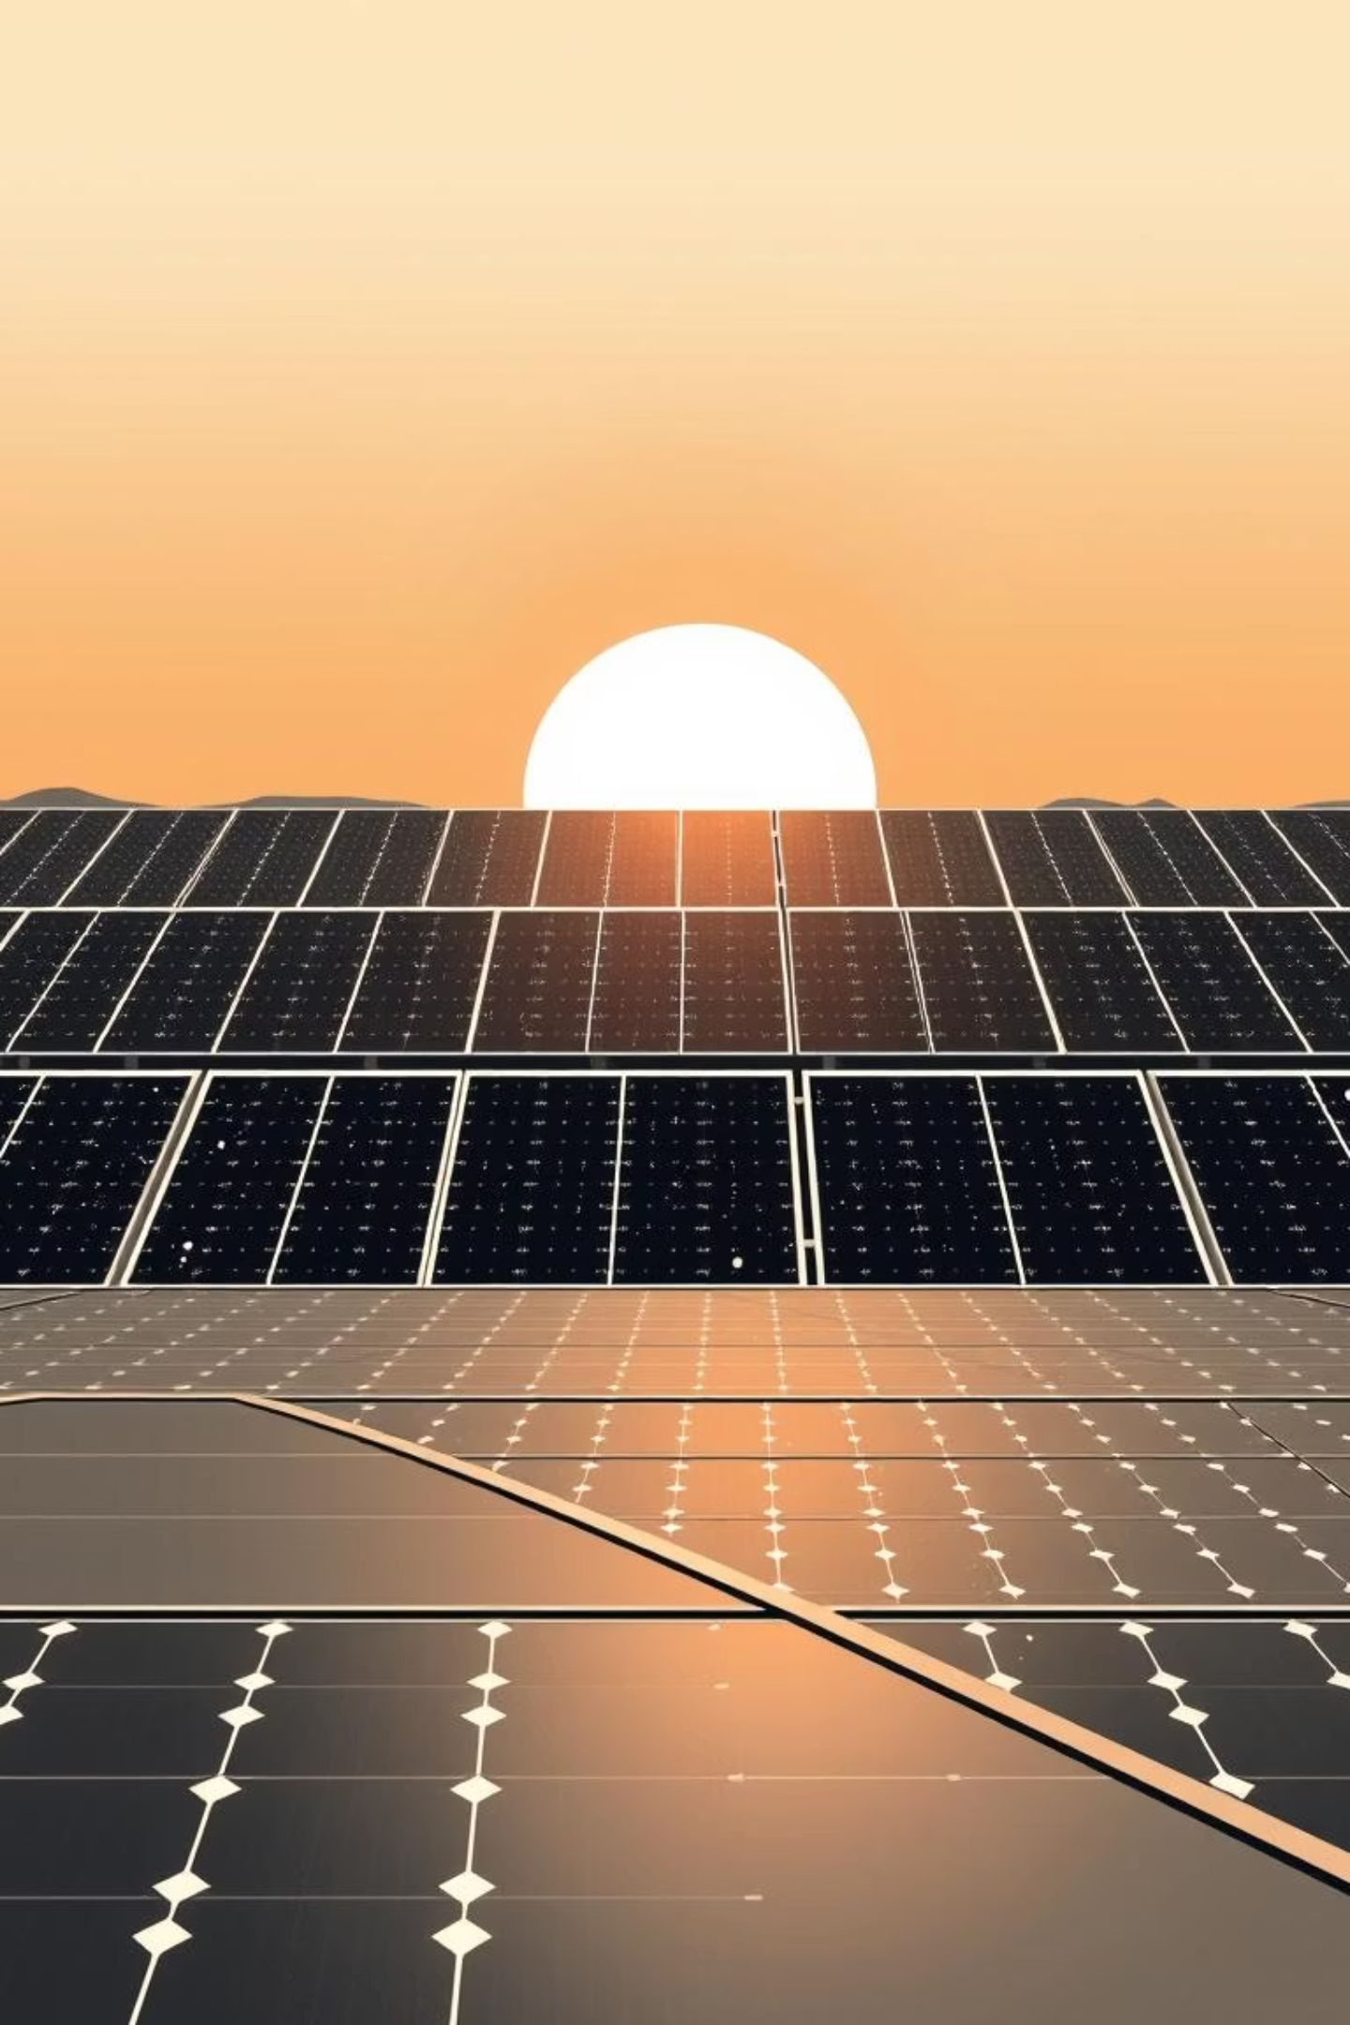
AI-Powered Solar Panel Dust Detection & Automated Cleaning System
Revolutionizing Solar Energy Efficiency Through AI and Automation
Team : AI Titans Pritik Kumar Mohanty
Mayur Rupnar
Diksha Kulkarni
Sneha Shankur

Slide 2


The Critical Problem: Dust Accumulation
Efficiency Loss
Manual Cleaning Burden
Water Scarcity
Solar panels lose 10-30% efficiency due to dust, up to 50% in desert regions.
Traditional wet cleaning methods are unsustainable in arid, solar-rich areas.
Labor-intensive, costly, and unsafe, impacting operational expenses.

Slide 3
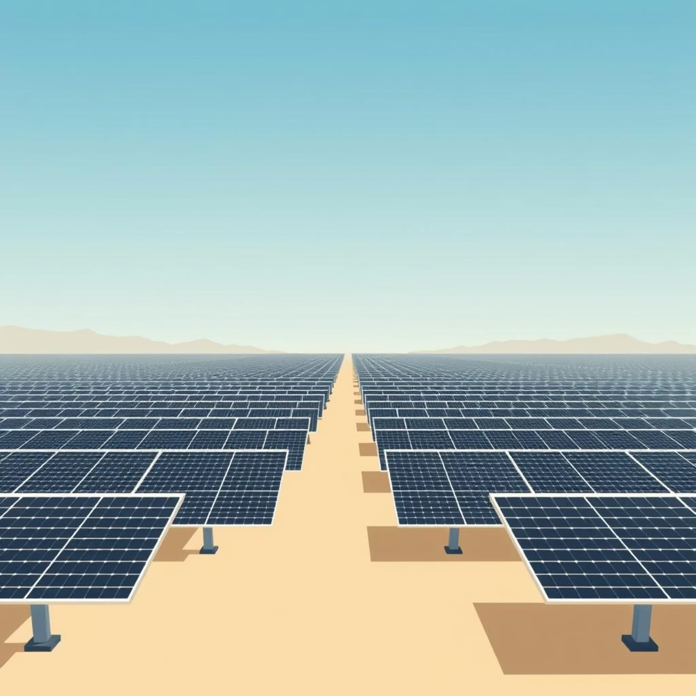
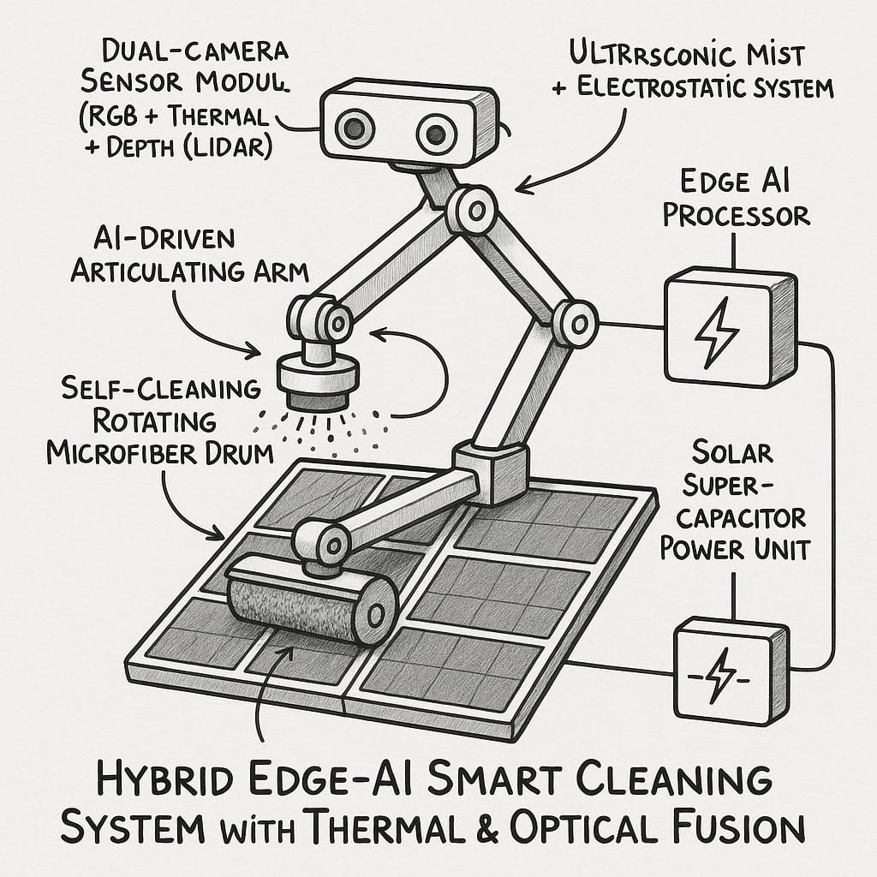
A Vast Market Opportunity
$14.51B
8.44%
O&M Market
CAGR Growth
Current value, projected to reach $32.63B by 2034.
The solar maintenance market is experiencing significant expansion.

Slide 4
Our Patented Solution
AI Dust Detection
Automated Cleaning
72% accuracy with hybrid VGG16-SVM model for precise detection.
Robotic systems triggered by AI, ensuring timely and efficient cleaning.
IoT & Edge Computing
Utility Patent
Real-time monitoring, predictive maintenance, and minimal latency (<30ms).
Our innovative technology is protected, securing our market position.

Slide 5
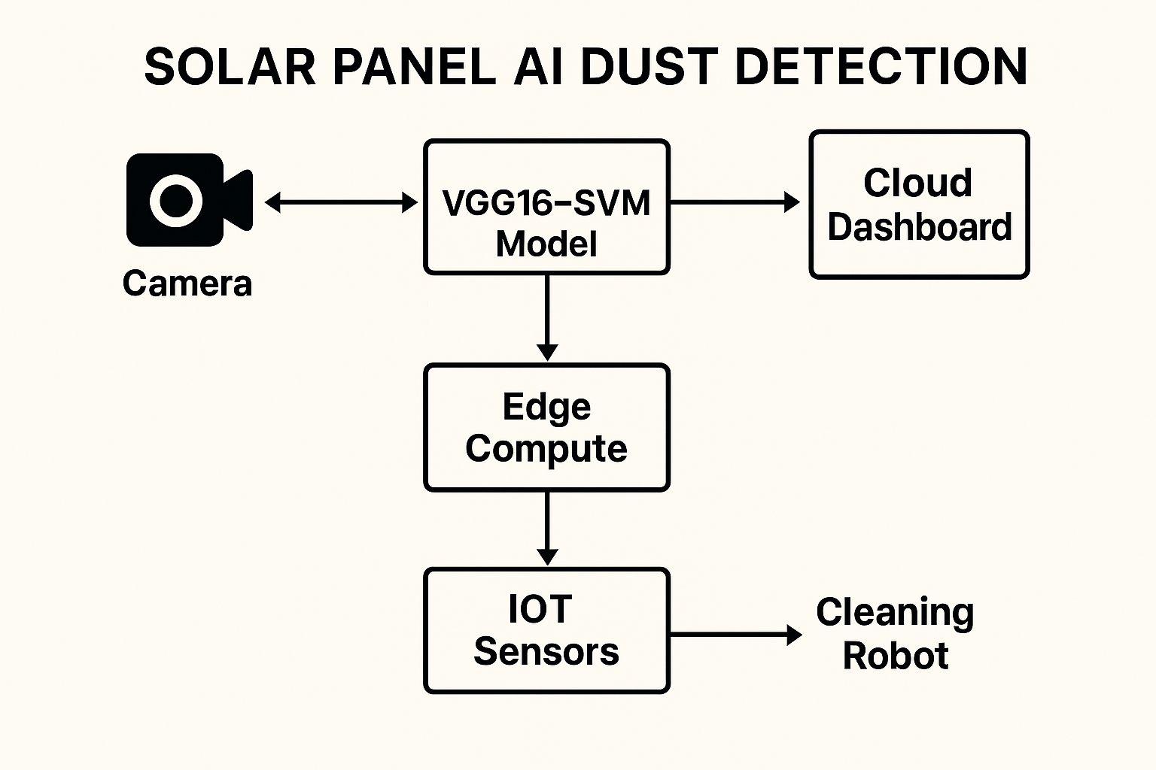
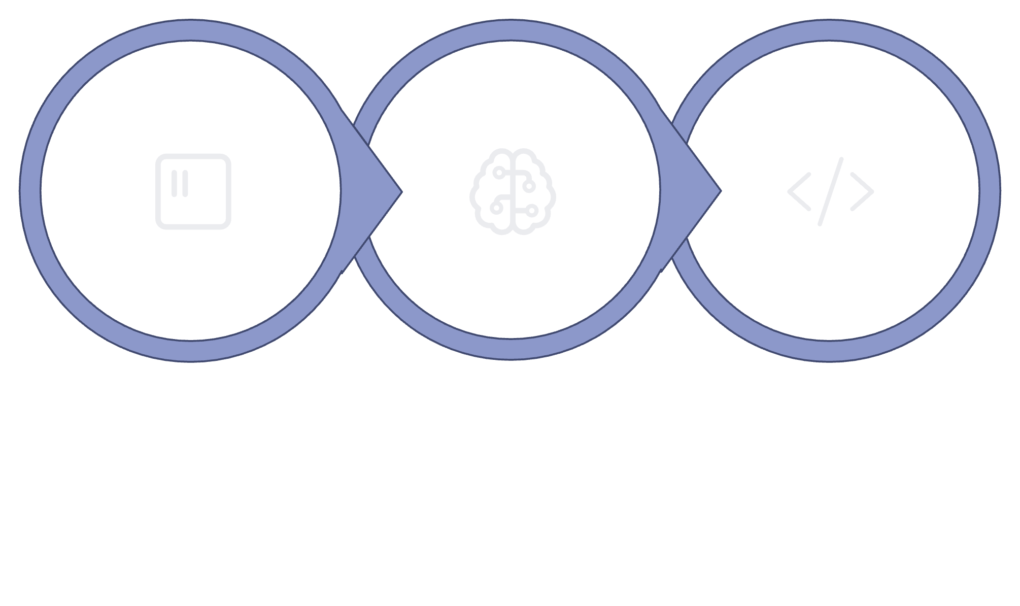


Technical Architecture
Detection Layer
Hardware Integration
Software Stack
Image Capture: Cameras installed on solar panels continuously capture images of panel surfaces.
AI Processing: The VGG16-SVM model analyzes these images on edge compute devices to detect dust presence in real time.
Data Flow & Monitoring: IoT sensors send environmental and system status data to a centralized cloud dashboard for remote monitoring and analytics.
Automated Action: When dust is detected, the system triggers the cleaning robot to clean the affected panels, optimizing performance with minimal human intervention.

Slide 6
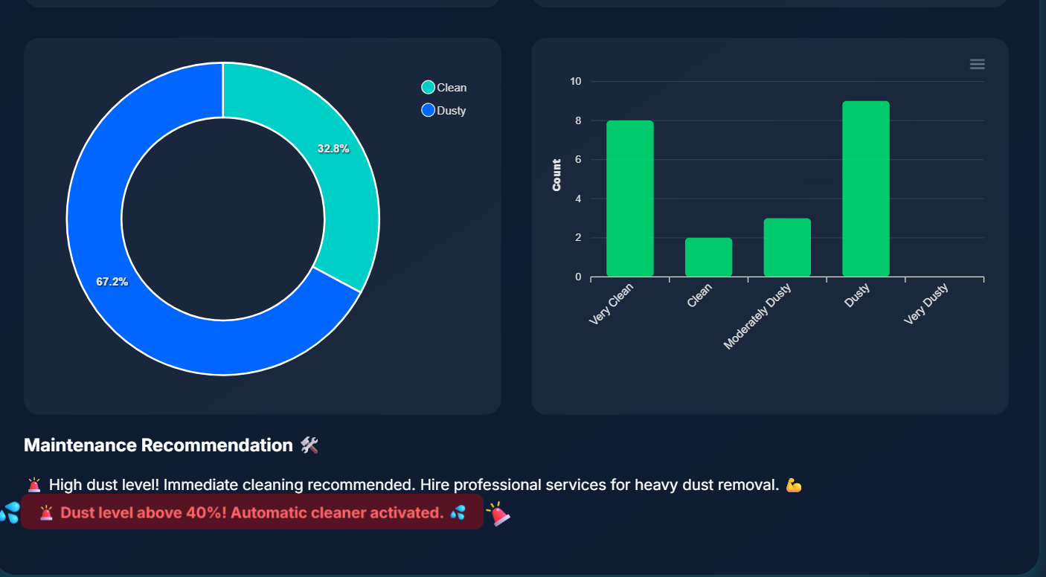
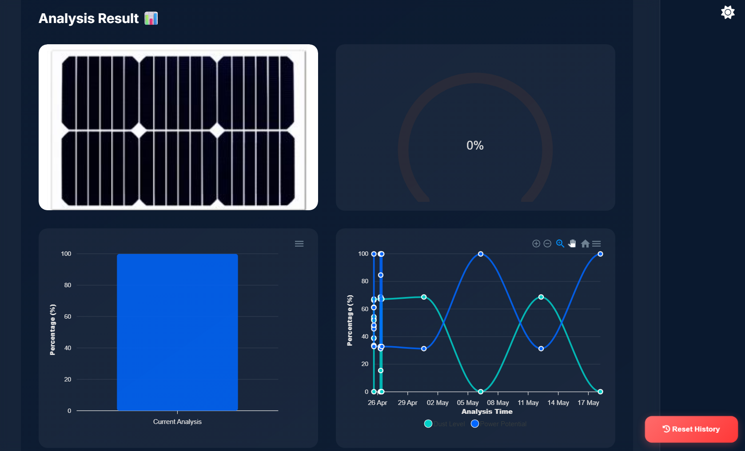
Key Innovations & Real-World Benefits
Smart Features
Predictive AI scheduling based on weather patterns.
Water-free cleaning saving millions of liters annually.
Edge computing ensures 99% system uptime.
Self-learning algorithms continuously improve accuracy.
Tangible Benefits
25-30% increase in energy output post-cleaning.
40% reduction in manual O&M costs.
15% savings on generation losses.
Payback period under 2 years for large installations.

Slide 7




Our Competitive Advantage
Patented AI
Integrated Solution
Hybrid CNN + SVM approach for superior dust detection.
First to combine dust detection with automated cleaning.
Water Efficiency
Edge Capabilities
Crucial for arid regions and sustainable operations.
Offline operation ensures reliability in remote areas.

Slide 8
Business Model & Target Markets
Revenue Streams
Target Markets
Hardware sales: Detection systems and cleaning robots.
Utility-scale solar farms (primary focus).
Commercial rooftop installations.
SaaS platform: Monthly monitoring and analytics subscriptions.
Residential solar systems.
Maintenance contracts: Predictive maintenance services.

Slide 9
Implementation Roadmap
Phase 1: Validation
1
Prototype validation and patent filing (Completed).
2
Phase 2: Pilot Deployment
Q4 2025: Pilot deployment with 2-3 major solar farms.
Phase 3: Commercial Launch
3
Q1 2026: Full commercial launch and scaling operations.
Future Technical Enhancements
Multi-spectral imaging for advanced dust classification.
Integration with solar tracking systems.
Blockchain for maintenance records and warranties.

Slide 10




Significant Financial Impact
Cost Savings
Increased Generation
Market Potential
25-30% reduction in maintenance costs for customers.
15% boost in energy output from cleaner panels.
Targeting 1% of the automated cleaning market equals $50M revenue.
Join Us: Revolutionize Solar Efficiency
Leverage our patent-protected technology to tap into a ₹2,72,460 crore market, offering sustainable and profitable solutions for solar energy.

