Slide 1
AI Smart Inventory Management System
Demand Forecasting using Machine Learning
Team Members: Name 1 | Name 2 | Name 3 | Name 4
Project Scope
Technology Stack
End-to-end ML workflow for inventory demand forecasting, deployment, and MLOps.
Python, Random Forest, XGBoost, FastAPI, Streamlit, Docker, GitHub Actions

Slide 2
Problem Statement
Key Challenges
Overstocking -> high cost Understocking -> lost sales No accurate demand prediction
Retail needs intelligent demand forecasting

Slide 3
Solution
ML-based Prediction
Feature-rich Inputs
Automated E2E Pipeline
Forecast demand with supervised learning to support better stock decisions.
Uses historical sales and engineered features to improve predictive power.
Integrated workflow from training to deployment and monitoring.

Slide 4
Dataset
Time-series retail data
Store
Product Family
Sales
Promotion
Store-level sales context
Category-level behavior
Historical target signal
Demand uplift driver
Dataset versioned using DVC

Slide 5
Preprocessing
Data Quality
Time Consistency
Encoding
Missing values handled
Sorted by time
Encoding done
Same preprocessing used in training & inference

Slide 6
Feature Engineering
Lag Features
Rolling Mean
Rolling Std
Time Features
Lag features -> past sales
Rolling mean -> trend
Rolling std -> volatility
Time features -> seasonality
Core strength of the model

Slide 7
Models Used
Random Forest
XGBoost
Ensemble baseline model
Gradient boosted decision trees
Compared using RMSE

Slide 8
Results
XGBoost -> best performance
Lower RMSE
Handles non-linear patterns better
Random Forest RMSE (higher)
XGBoost RMSE (lower)

Slide 9
Pipeline Architecture
Data
Preprocess
Features
Train
Save Model
Fully automated using pipeline.py

Slide 10
Inference Pipeline
Input
Preprocess
Features
Predict
Same logic reused -> no data leakage

Slide 11
FastAPI Deployment
API Contract
{ "store": 12, "family": "Dairy", "promotion": 1 } -> { "prediction": 1248.6 }
Endpoint: /predict JSON input Returns prediction Schema validation using Pydantic

Slide 12
MLOps
Docker
Logging
CI/CD
Containerization
Tracking predictions
Automation with GitHub Actions
This slide gives extra marks

Slide 13
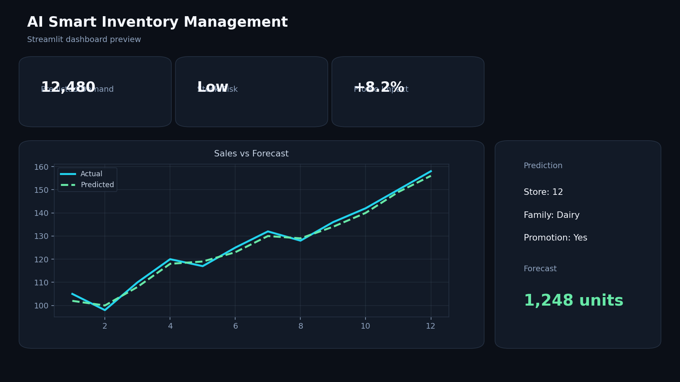
Dashboard
Streamlit SaaS UI | KPI cards | Graph + prediction

Slide 14
Live Demo
(Switch to app here)

Slide 15
Conclusion
End-to-end ML system
Production-ready
Scalable
Integrated workflow from data to prediction
Deployment and MLOps are included
Designed for extension and reuse

Slide 16
Future Work
External Signals
Advanced Models
Real-time Integration
Add weather/holiday data
Use deep learning (LSTM)
Real-time integration

