Slide 1
VISION GNN

Slide 2
EXISTING SYSTEM
COMPUTER VISION
CNN
LeNet for Image Classification , Object Detection,Semantic Segmentation
ResNet ,MobileNet & NAS for representation
DISADVANTAGES
Difficult to recognize the objects in an image when the shape is irregular

Slide 3
PROPOSED SYSTEM
VISION GNN
Split the image to a number of patches which are viewed as nodes.
Construct a graph by connecting the nearest neighbors.
Build ViG model to transform and exchange information among all the nodes
ViG consists of two basic modules
Grapher module
FFN module
Notes:
VI

Slide 4
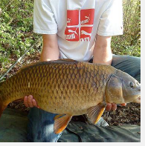
MODULES
GRAPH REPRESENTATION OF IMAGE
GRAPH PROCESSING
FEATURE
EXTRACTION
OBJECT DETECTION
VISUALIZATION

Slide 5
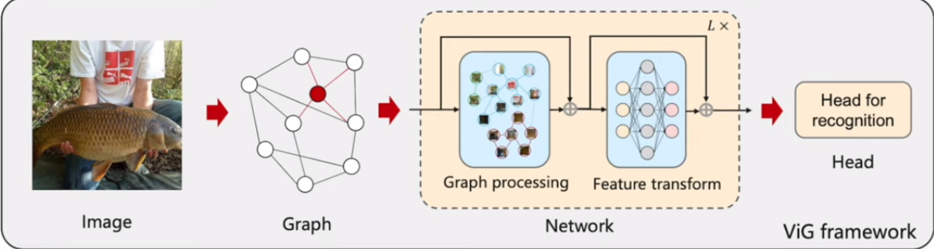
FLOW DIAGRAM

Slide 6
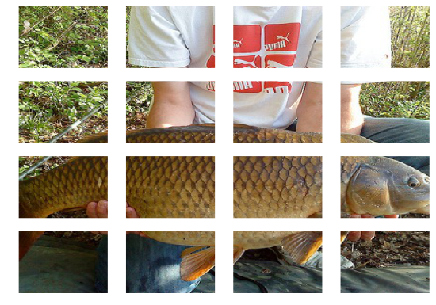
MODULE 1
GRAPH REPRESENTATION OF IMAGE
Transforming each patch into feature vector with D as feature dimension
Z=[x1,x2,….xn]
Features are set of unordered nodes
V=[v1,v2,….vn]
For each node Vi its k nearest neighbours are found N(Vi)
Adding an edge eji directed from Vj to Vi for all Vj belongs to N(Vi)
Finally graph is constructed

Slide 7

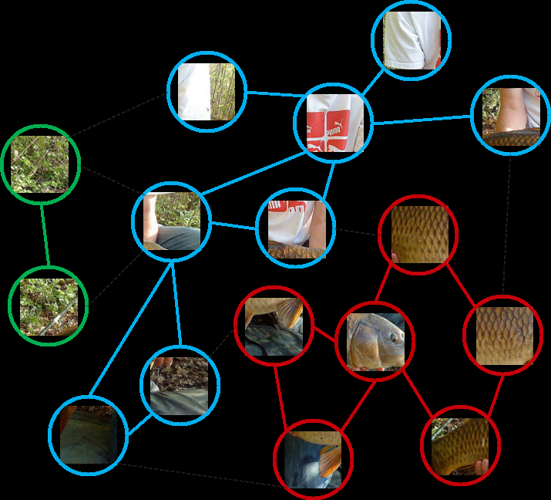
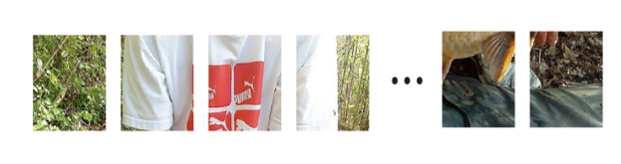
MODULE 1
(b) Sequence structure
(a) Grid structure
(c) Graph structure

Slide 8
MODULE 2
Graph Processing
Graph convolutional network
The graph convolution applies multihead update operation
because there are several nodes and there are diverse features among
different node.
By using multithread operation ,multiple representation can be
updated simultaneously.

Slide 9
MODULE 2
FEED FORWARD NETWORK
To encourage the feature transformation capacity and relief the over
smoothing phenomenon , a feed forward network is applied on each node.
The FFN module is a simple multilayer perceptron with two fully
connected layers.
Notes:
phenomenon

Slide 10
MODULE 2
GRAPH CONVOLUTION
NETWORK
FEED FORWARD
NETWORK
+
=
Vision GNN
Notes:
VI

Slide 11
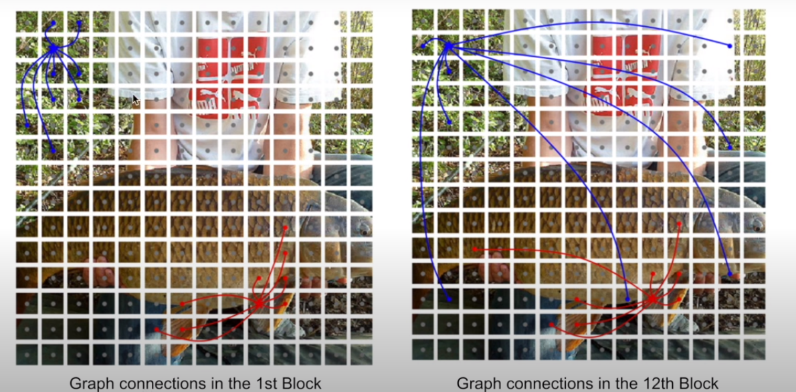
MODULE 3

Slide 12
MODULE 4
COMPUTER VISION
Isotropic architecture (ViT)
-input image is in same size in whole network, size doesn’t change.
Pyramid architecture(ResNet)
-multiscale image properties and small spatial sizes as layer goes
deep.

Slide 13
DATASET
For classificaton - ImageNet
For detection - COCO2017
For data augumentation
RandAugument
Mixup
Cutmix
Random erasing
To implement the network
Pytroch
MindSpore

