Slide 1


SMART INDIA HACKATHON 2024
Problem Statement ID – SIH1661
Problem Statement Title-Implement Software Solutions to Reduce Student Dropout Rates at Various Educational Stages
Theme-Smart Education
PS Category- Software
Team ID-
Team Name – Chakravyuh

Slide 2
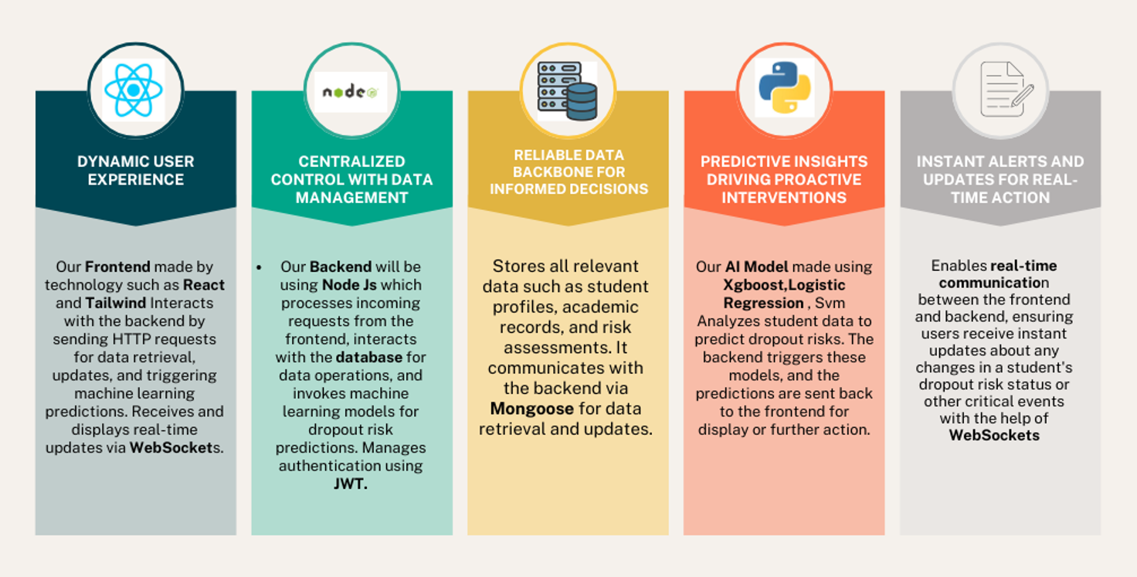

Empowering Education: Tech Solutions for Student Retention
Chakravyuh

Slide 3
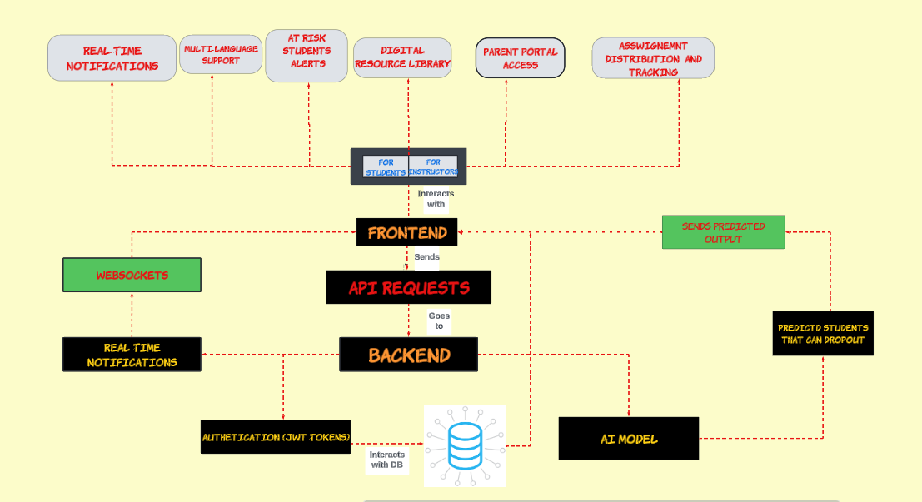


TECHNICAL APPROACH
Chakravyuh

Slide 4
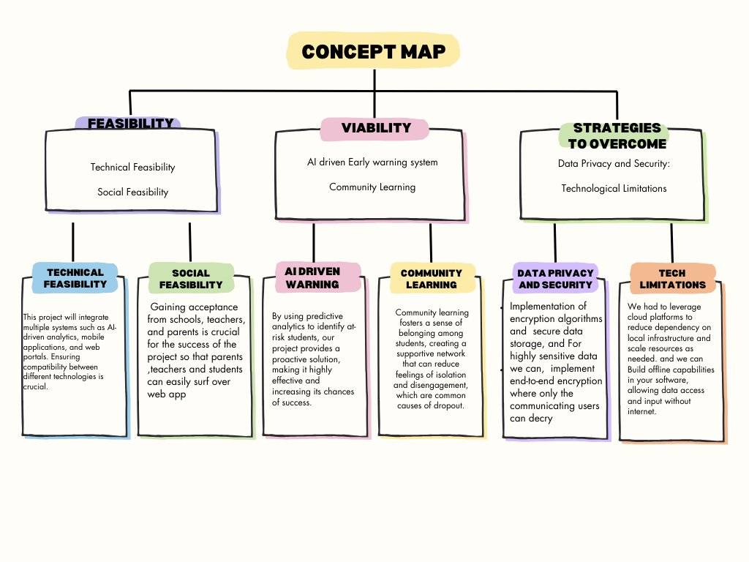
Sustainable success : Ensuring feasibilty and viability
Chakravyuh

Slide 5
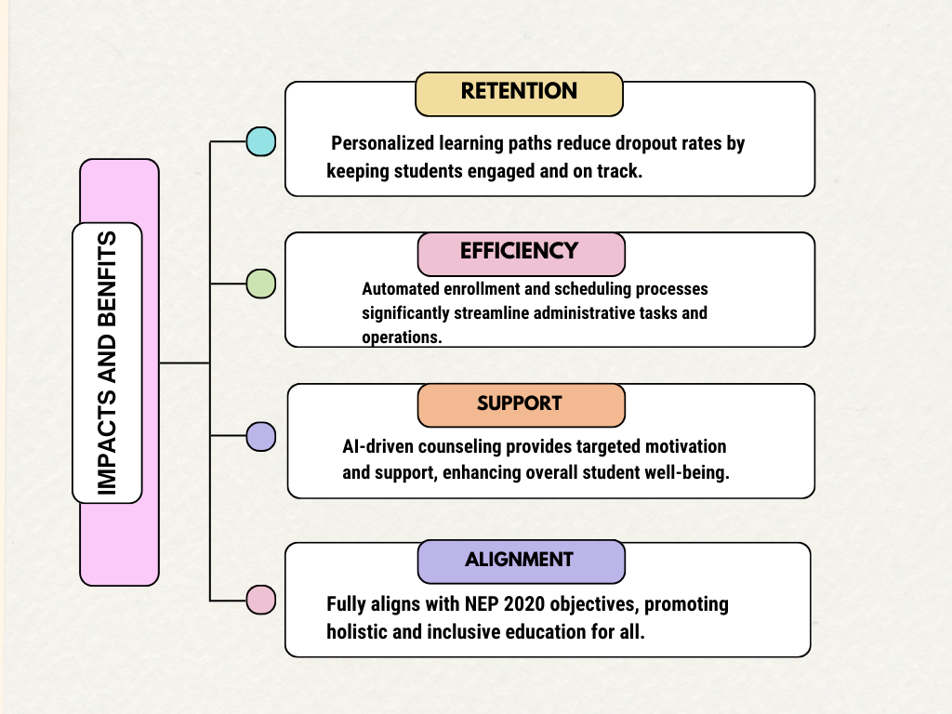
Significant Impacts and Comprehensive Benefits
Chakravyuh

Slide 6
RESEARCH AND REFERENCES
Your Team Name
https://github.com/PRIYANSH-2004/Student-DropOut.git
https://educationforallinindia.com/dropout-rates-in-schools-in-india/
https://nces.ed.gov/fastfacts/display.asp?id=16
https://www.issuelab.org/resources/11658/11658.pdf

Slide 7
