Slide 1
A
Seminar Presentation
on
Cyber Laws
Presented by
Priyansh Saxena
Under the Supervision of
Mr. Ashwani Gupta

Slide 2
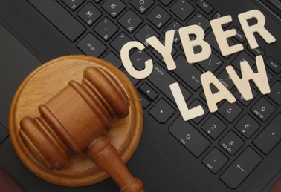

Slide 3
Cyber Laws : A Critical Pillar in Digital Age
The Internet Revolution: The internet has revolutionized communication, commerce, and governance but introduced vulnerabilities that cybercriminals exploit. While enabling connectivity and innovation, it has also introduced risks like cybercrimes.
Cyber Laws : Cyber Law is the law governing the cyber-space. It is a legal framework that governs activities in cyberspace, protecting digital data, ensuring privacy, and preventing cybercrimes.
Challenges:
Crimes transcend borders, complicating enforcements.
Ensuring these laws evolve to keep pace with emerging technologies and global digital activities.

Slide 4
The Need for Cyber Laws
Safeguarding Privacy:
Protecting personal and sensitive data in the face of increasing data breaches and privacy violations.
Preventing Cybercrime:
Laws are needed to define illegal activities like hacking, fraud, and identity theft, and to deter such actions.
Regulating Digital Transactions:
Ensuring secure online commerce, protecting intellectual property, and maintaining trust in digital systems.
Global Challenges:
Cybercrimes are often transnational, creating challenges for enforcement across borders.

Slide 5
Understanding Cybercrime and its Legal Implications
Definition: Cybercrimes are criminal activities carried out using computers or digital devices.
Characteristics:
Anonymity: Hidden identities using tools like VPNs or the dark web.
Global Reach: Cyber-attacks affect victims across borders, e.g., ransomware spreading internationally.
Technical Complexity: Involves advanced methods like malware, phishing, and botnets.
Borderless Impact: Critical infrastructure attacks (e.g., on healthcare systems) can disrupt entire nations.
Challenges in Enforcement: The global and anonymous nature of cybercrime complicates jurisdiction and prosecution. Existing laws often fail to cover the complexities of new technologies

Slide 6
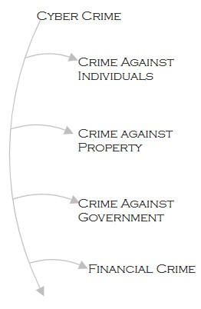
Classifying Cyber-Crime
Crimes Against Individuals:
Identity theft: Personal data is stolen for fraud (e.g., Equifax breach).
Cyberstalking: Persistent harassment online, causing psychological harms.
Phishing: scam emails that contain links to malicious websites.
Crimes Against Property:
Hacking: Unauthorized access to systems.
Intellectual Property Theft: Piracy of software, films, or music.
Crimes Against Governments:
Cyber terrorism: Attacks on national infrastructure.
Espionage: Theft of sensitive government data.
Financial Crimes:
Cryptocurrency fraud and online banking theft.

Slide 7
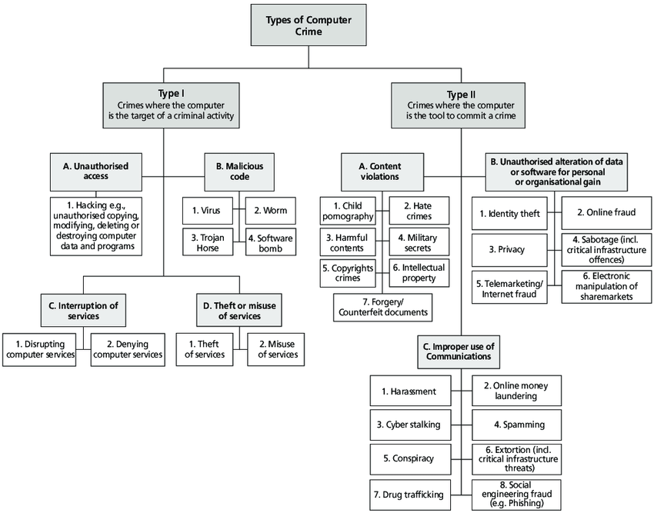

Slide 8
Cyber Laws Across Borders
Global efforts:
Budapest Convention (2001): The first international treaty addressing cybercrime, aiming to harmonize national laws and promote international cooperation.
General Data Protection Regulation (GDPR): Europe's law regulating data privacy and security. It sets strict rules for how personal data is collected and processed.
Challenges:
Jurisdiction disputes for cross-border cases.
Laws struggle to keep pace with technological advances.
Variations in national laws make global enforcement difficult.
Cybercrimes that cross borders are harder to prosecute due to differing legal standards.

Slide 9
India’s Approach to Cyber Laws
Information Technology Act (2000):
India's primary legislation for addressing cybercrimes.
It criminalizes hacking, identity theft, online fraud, and digital signatures.
IT Amendment Act (2008):
Added provisions for cyber terrorism.
Emphasized data protection and stricter penalties for cybercrimes.
Key Legal Provisions:
Section 66A: Punishment for sending offensive messages.
Section 43: Penalties for data theft and unauthorized access.
Challenges in Enforcement:
Rapid technological changes outpace legal provision.
Lack of sufficient cybersecurity infrastructure in many organizations.

Slide 10
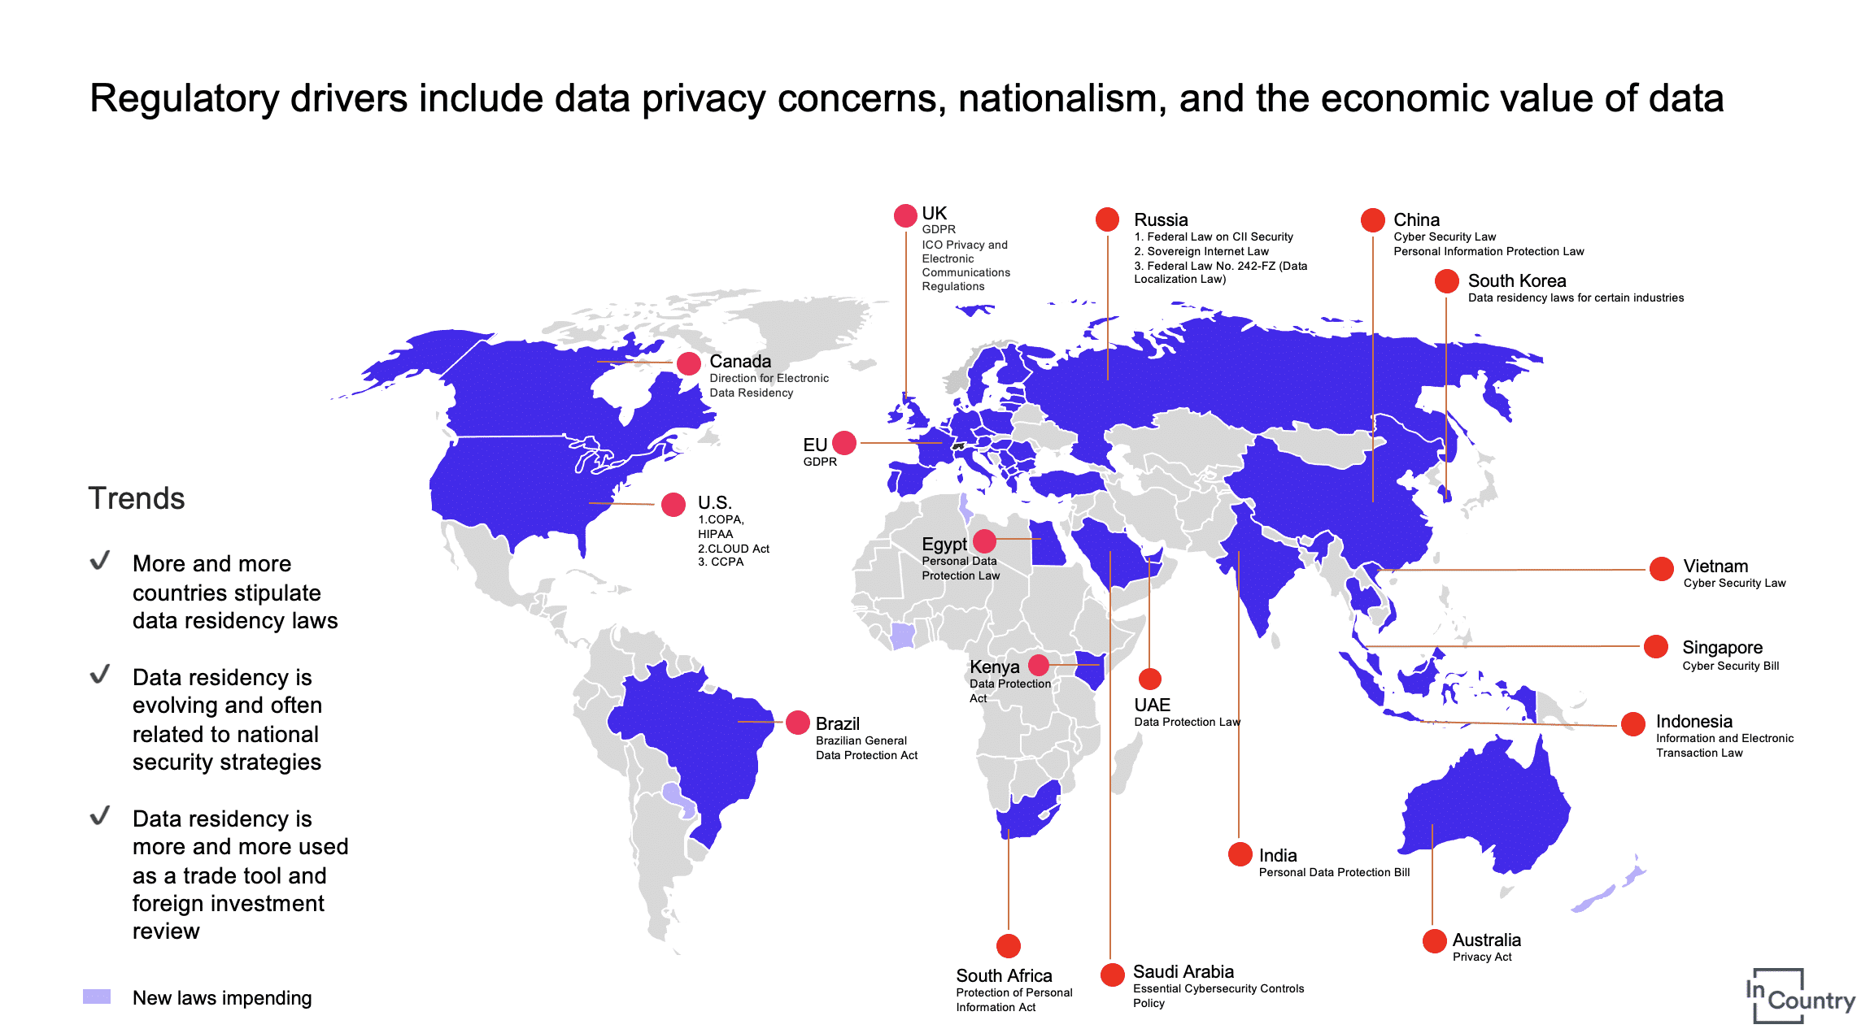

Slide 11
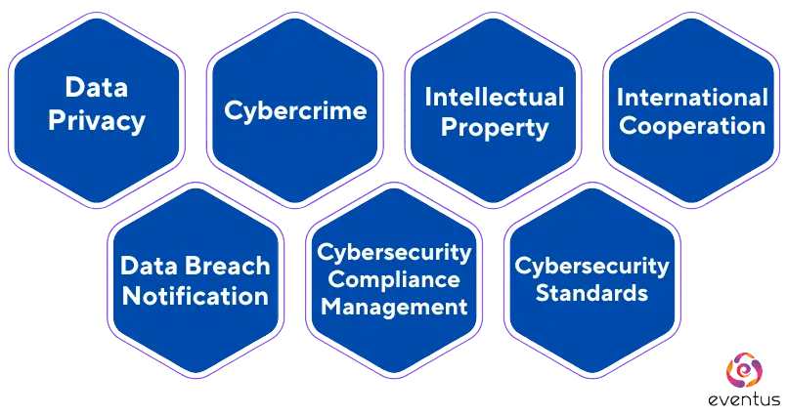
Core Elements of Cyber Laws
Data Protection Laws: Ensuring secure collection, storage, and transmission of personal data.
Example: GDPR, California Consumer Privacy Act (CCPA).
E-Commerce Regulations: Ensuring online business transactions are secure and legally valid.
Example: Legal status of e-contracts, digital signatures.
Cyber Jurisdiction: Addressing the challenges of legal authority over international cyber-crimes.
Intellectual Property Protection: Ensuring that digital content is protected against piracy and unauthorized use.

Slide 12
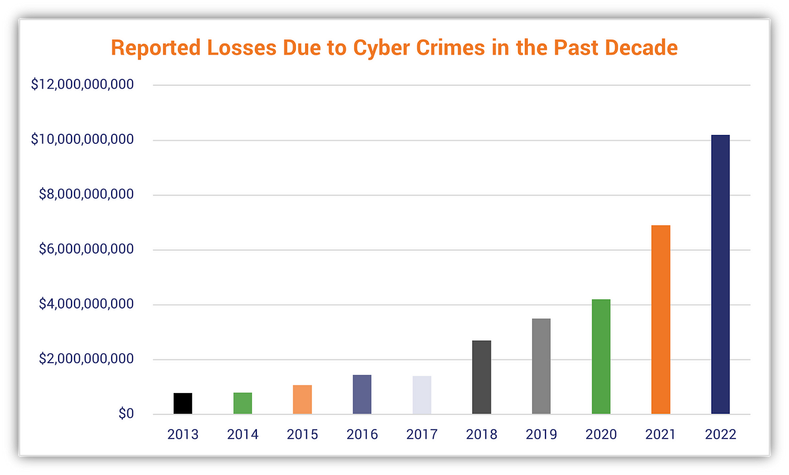
Consequences of Cyber Threat
Economic Impact:
Massive financial losses globally, e.g., WannaCry attack costing billions.
Additional costs include damaged reputations and cybersecurity upgrades.
National Security Risks:
Espionage (e.g., SolarWinds attack).
Threats to critical systems like defence and healthcare.
Social Impact:
Loss of public trust in digital platforms.
Manipulation of democratic processes via misinformation.

Slide 13

Balancing Security and Privacy
Legal and Privacy Protection:
Ensuring individual rights to privacy are not compromised by digital surveillance and data collection.
Right to access, correct, and erase personal data.
Consent requirements for collecting personal data.
Emerging Technologies:
AI: Enhances cybersecurity but can also power advanced attacks.
Blockchain: Ensures data integrity but may be misused.
Quantum Computing: A potential threat to current encryption methods
Challenges:
Balancing privacy with national security and law enforcement needs.
Increasing concerns over government surveillance and data misuse.
Regulating harmful content while protecting free speech

Slide 14

Challenges in Enforcing Cyber Laws
Jurisdictional Issues:
Cybercrimes often involve multiple countries, each with its own laws.
International cooperation is essential but difficult to achieve due to conflicting legal standards.
Tools for Enforcement:
Mutual Legal Assistance Treaties (MLATs) and agreements like the Budapest Convention to foster cross-border cooperation.
Limitations:
Difficulties in tracking anonymous online perpetrators.
Slow pace of legal reforms to address new tech (AI, Blockchain, etc.).

Slide 15
Real-World Cybercrime Incidents
WannaCry Ransomware (2017): Affected over 300,000 computers in 150 countries of organizations globally, Exploited a Windows vulnerability, encrypting their files and demanding Bitcoin as ransom.
Legal Issue: Lack of international coordination in responding to the attack.
The Equifax Data Breach (2017): Affected 147 million people, with sensitive personal information exposed.
Legal Issue: Insufficient data protection practices led to massive losses.
Estonia Cyberattack (2007): A series of coordinated DDoS attacks targeted Estonian government and banking systems. Considered one of the first examples of cyber-warfare..
Legal Issue: Lack of robust national cybersecurity laws and international support.

Slide 16
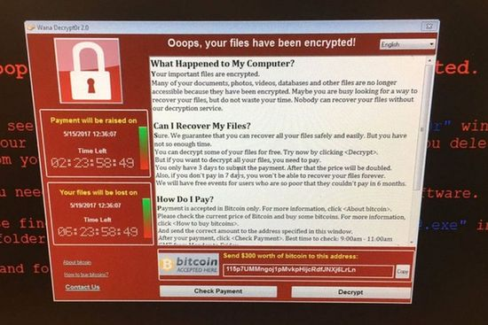
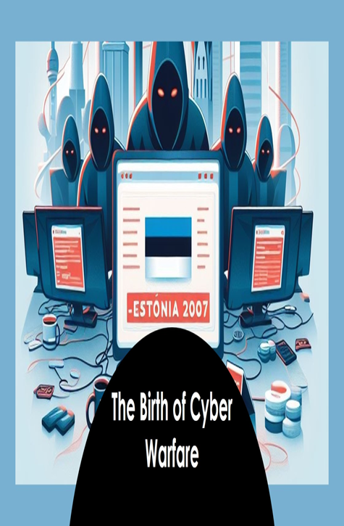

Slide 17
Barriers to Effective Cyber Law Implementation
Technological Evolution:
New technologies like cryptocurrency, AI, and blockchain create new legal challenges.
Cross-Border Nature of Cybercrime:
Jurisdictional issues arise when cybercrimes involve multiple countries.
Lack of Global Coordination:
Varying national laws and enforcement mechanisms.
Slow progress in achieving international treaties and harmonized regulations.
Emerging Threats:
Cyberterrorism and cyber warfare, which are harder to address within existing legal frameworks.

Slide 18
Improving Cyber Legal Frameworks
Global Cooperation: Strengthen international treaties and frameworks to tackle cross-border cybercrimes.
Example: Expanding the Budapest Convention and similar international agreements.
Regular Updates to Laws: Ensure laws evolve with technology to cover new threats like AI, quantum computing, and cryptocurrency.
Stronger Data Protection:
Adopt global standards like GDPR for better personal data protection.
Encourage corporate compliance with stringent data security practices.
Public Awareness and Education: Educate individuals and organizations about their rights and responsibilities under cyber laws.

Slide 19
Securing the Digital Future Through Strong Cyber Laws
Cyber Laws are crucial for regulating digital spaces, online behavior, protecting data, individuals and preventing cybercrimes.
Global Cooperation: Effective enforcement requires international collaboration and legal advancements to combat cross-border crimes.
Future-Proofing Laws: Laws must evolve in step with technological advancements to remain effective.
Collective Responsibility: Governments, tech companies, and individuals must work together to ensure a safe and secure digital environment.
By balancing innovation with ethical considerations, we can ensure a safer cyberspace for everyone.

Slide 20
Thank You

