Slide 1

Problem Statement and Team Details
Problem Statement: Duality AI - Space Station Hackathon
Team Name: 11:11 Crew
Team Leader Name: Rabbika Azmi
Institute Name:
Theme Name:
Team Leader Email ID:

Slide 2
Problem and Solution
The Problem
In high-risk environments like space stations, quick and reliable access to critical safety equipment — such as fire extinguishers, oxygen tanks, and toolkits — is essential. However, due to clutter, disorganization, and limited visibility, locating these tools manually can delay emergency responses and pose serious safety risks.
The Solution
Eleven11, developed by the 11:11 Crew, is an AI-powered object detection web app designed to automatically detect and localize essential safety gear in complex space environments using real-time computer vision. By leveraging AI and deep learning, the system acts as a virtual assistant that helps astronauts and technicians find what they need — exactly when they need it.

Slide 3
Methodology & Implementation
🛠️ Methodology and Implementation
1. Dataset Preparation
Collected custom datasets containing images of fire extinguishers, oxygen tanks, and toolkits.
Annotated each image with bounding boxes (manual labeling).
Split into training, validation, and testing sets for robust learning and evaluation.
2. Model Selection
Used YOLOv8-Large (yolov8l.pt) for its balance of speed and accuracy.
Adapted to detect the 3 custom classes by fine-tuning pretrained weights.
3. Training Process
Trained for 50 epochs using a Tesla T4 GPU on Google Colab.
Image size: 640x640 | Batch size: 8
Enabled early stopping to prevent overfitting.

Slide 4
Methodology & Implementation
4. Optimization Techniques
Optimizer: SGD with learning rate 0.001
Augmentations:
Geometric: rotations, zoom (scale = 0.8), flips (H = 50%, V = 10%)
Color: brightness, hue, saturation changes
Advanced: Mosaic, MixUp, CLAHE, grayscale
Regularization: Label smoothing for class imbalance

Slide 5
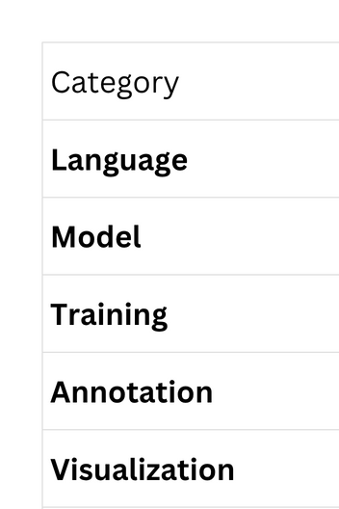
Technology Used

Slide 6
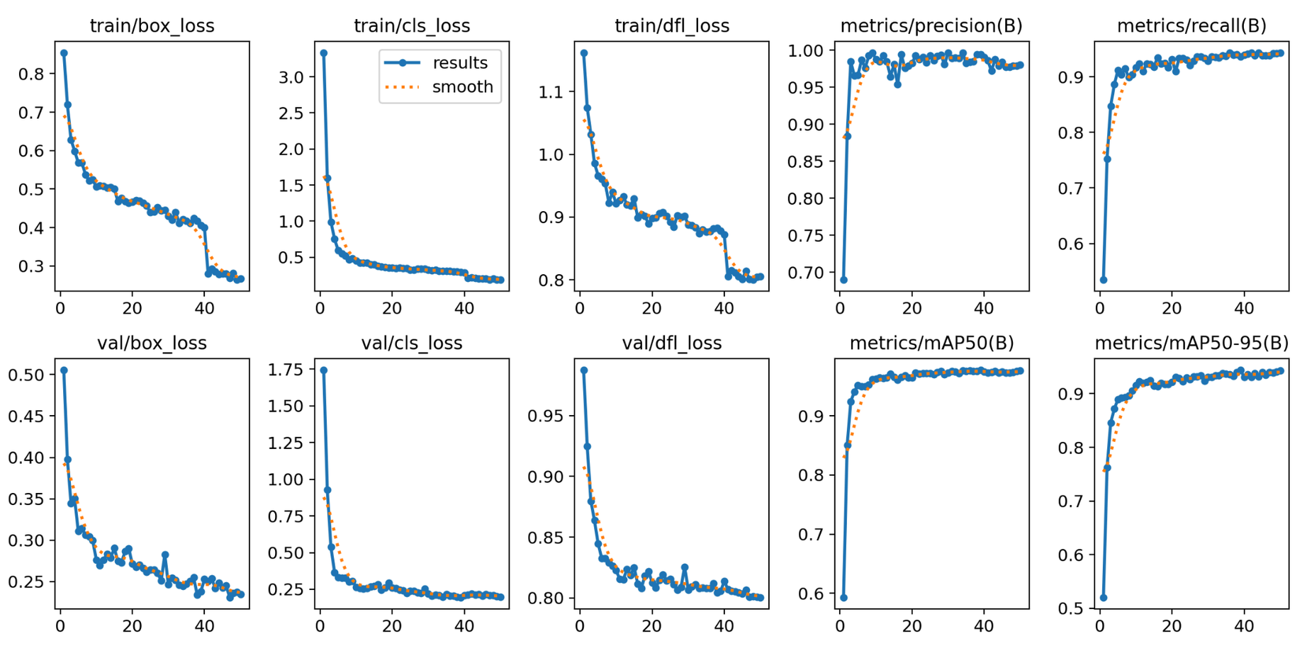
Flowchart & Supporting Images
Training Loss curves

Slide 7
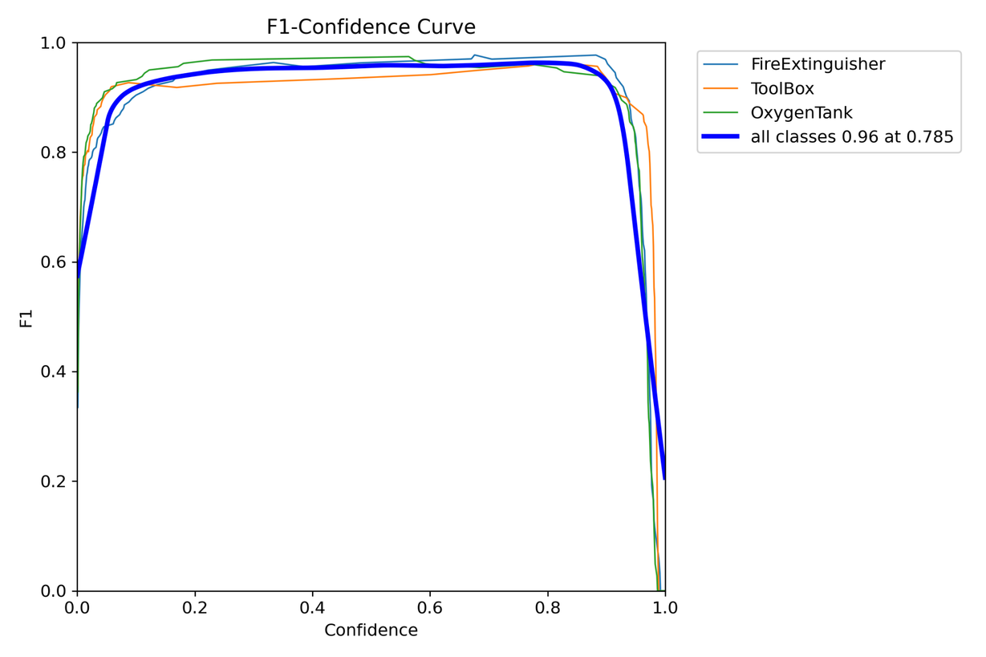
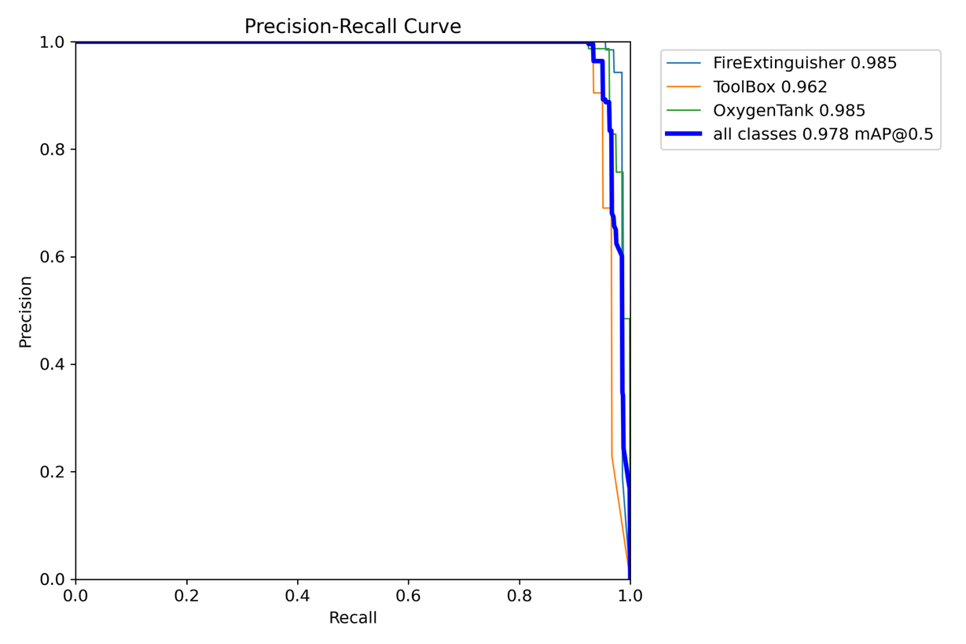
Flowchart & Supporting Images
F1 Score Curve
Precision Recall Curve

Slide 8
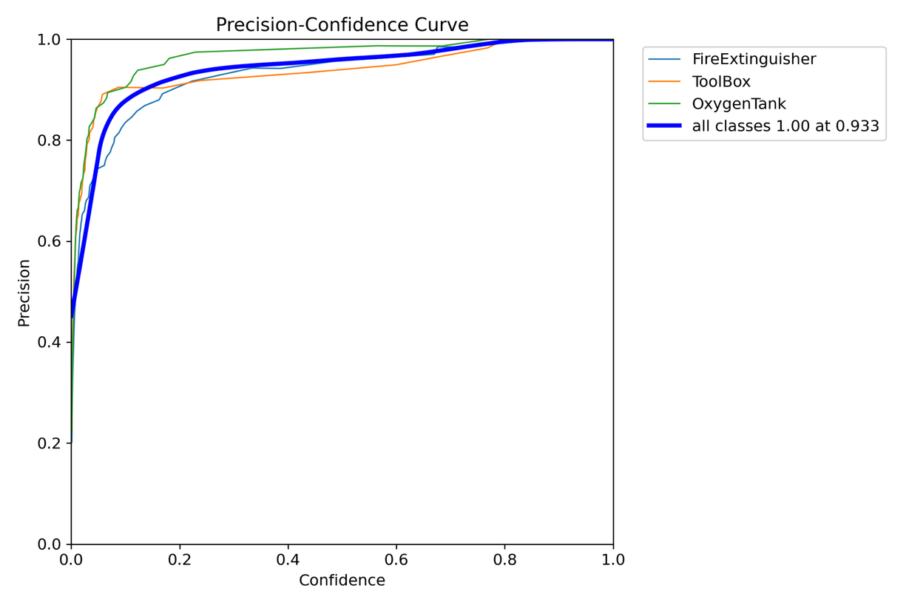
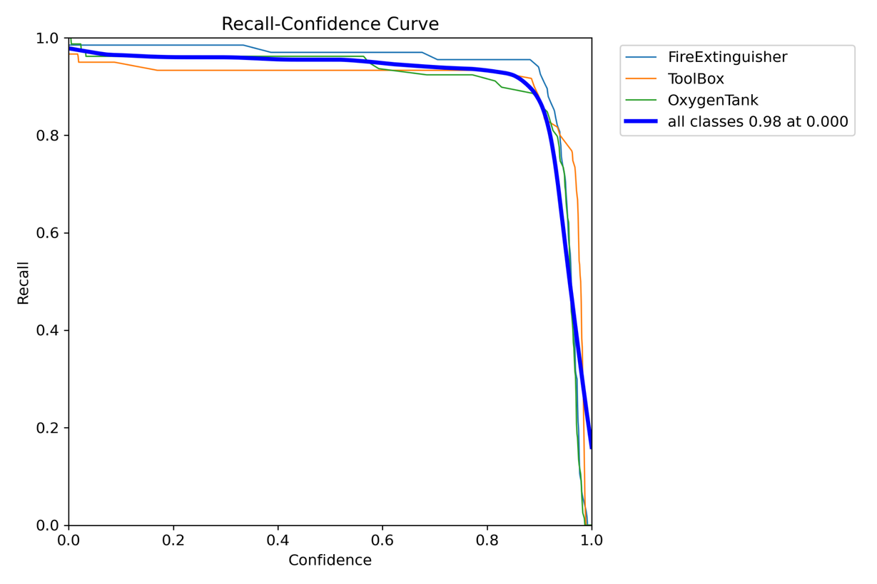
Flowchart & Supporting Images
Precision vs Confidence
Recall vs Confidence

Slide 9
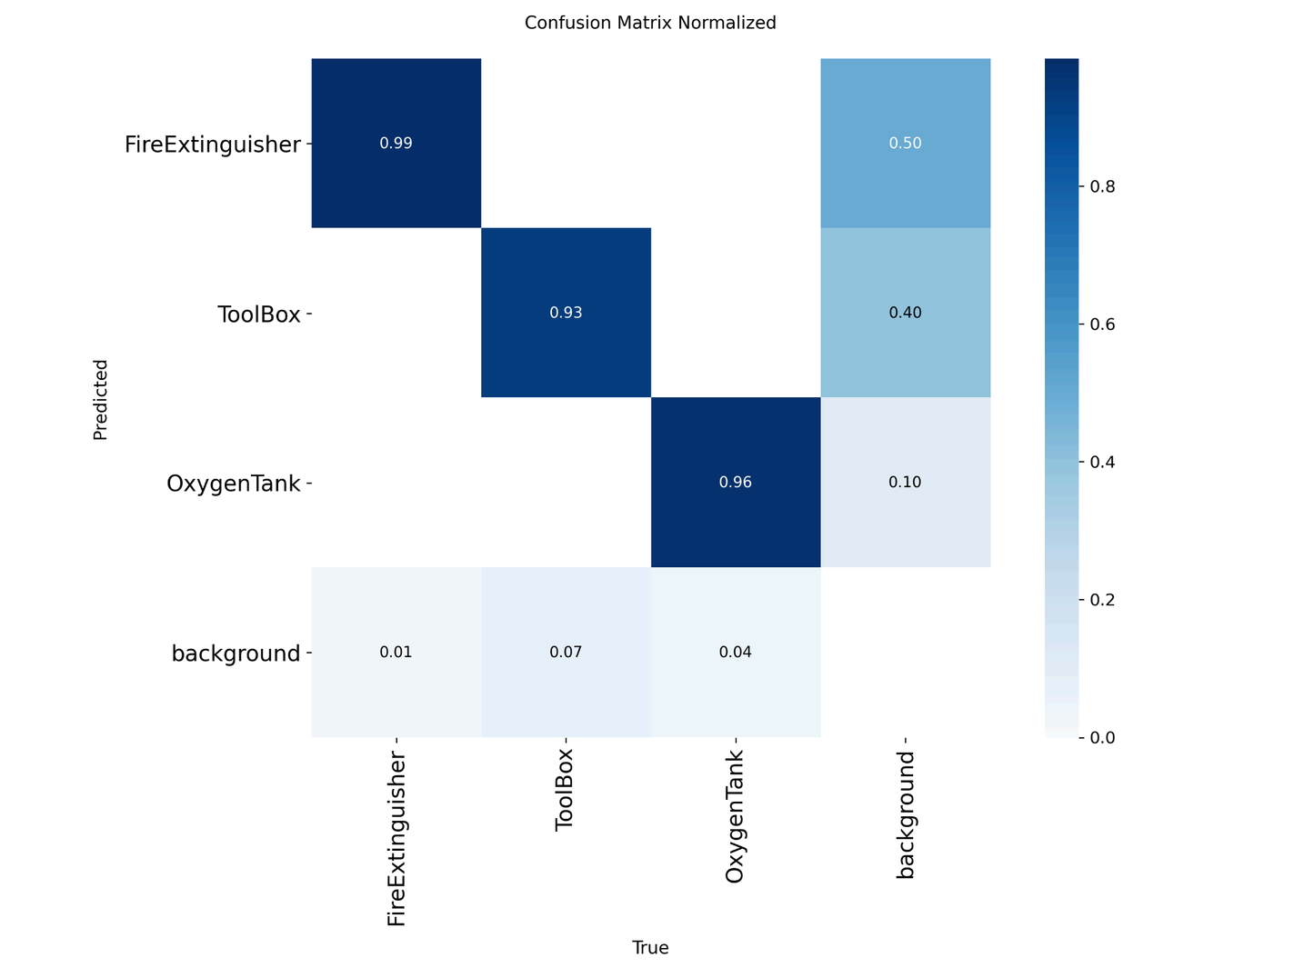
Flowchart & Supporting Images
Confusion Matrix

Slide 10
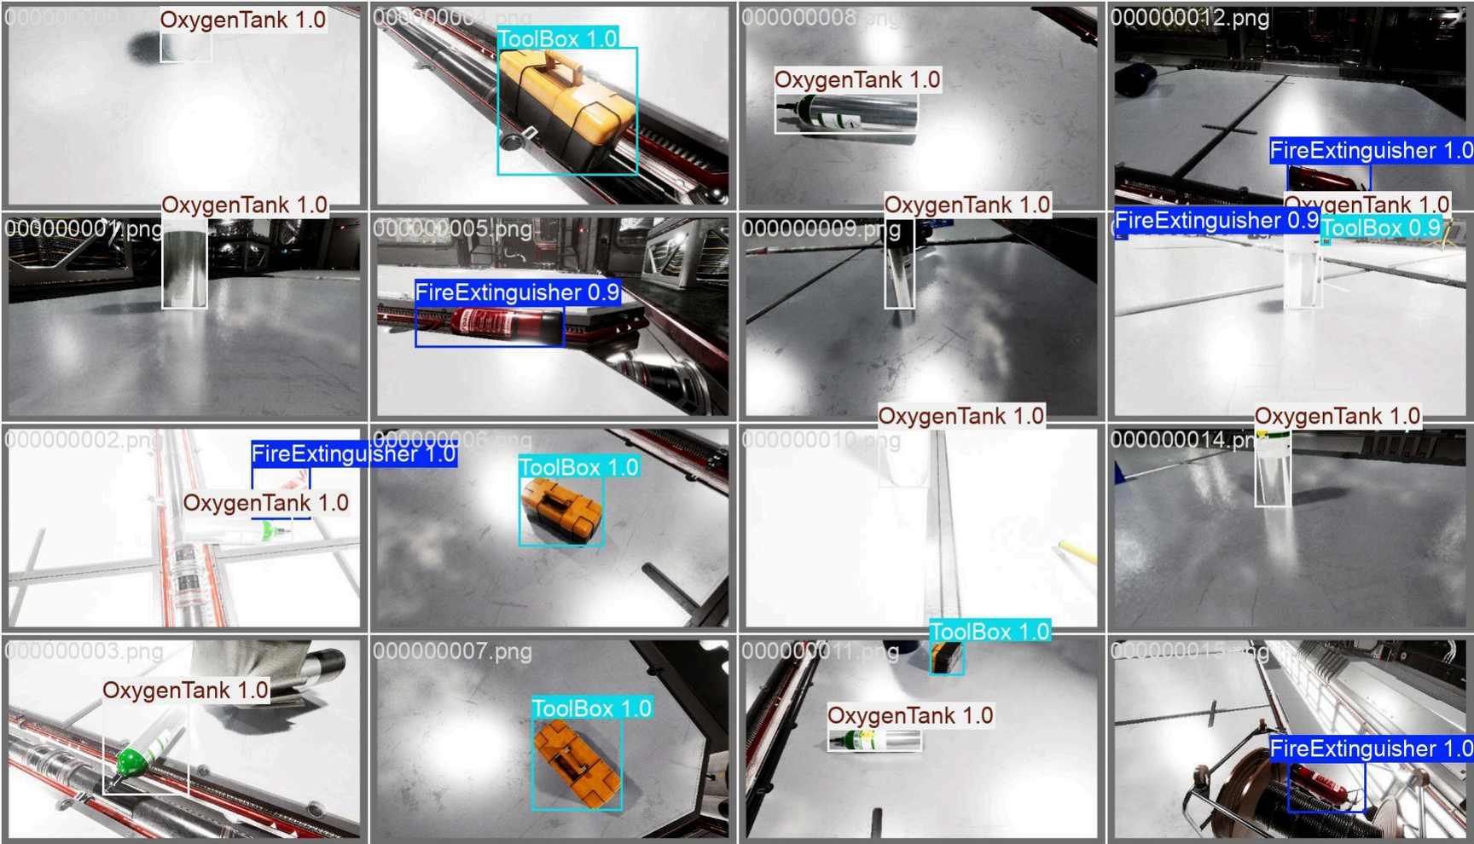
Flowchart & Supporting Images
Sample Detection Output

Slide 11
Feasibility and Market Use
✅ Feasibility
High accuracy: mAP@0.5 = 97.66%
Low latency: Suitable for real-time applications
Adaptability: Handles lighting variations and object occlusion
Scalable training infrastructure via cloud-based platforms
🌍 Market Use Cases
Space Missions & ISS Operations – Detect essential gear in orbit
Aerospace Training Simulators – Assist in emergency preparedness
Industrial Safety Monitoring – Identify critical equipment on factory floors
Defense & Disaster Zones – Locate tools during rescue operations
Smart Warehousing – Check for presence of safety kits and tools

Slide 12
Conclusion
Eleven11 is a high-performance object detection system created to enhance safety in complex and critical environments. With excellent accuracy, strong recall, and intelligent design choices, the model proves effective in detecting crucial equipment under varied conditions.
🔮 Future Directions
Deploy on Web & Mobile
Add 3D Spatial Mapping
Implement Real-time Alerts
Use Falcon for Continuous Learning
Expand to More Object Classes
Add Multi-language & Audio Support
Integrate with Incident Reporting Systems

