Slide 1
SMS Spam Message Detector
AIML Minor Project
Student: [Your Name] | Roll No: [Roll Number]
[Department] | [Institute] | Guide: [Faculty Guide]

Slide 2
Problem and motivation
• SMS spam carries scams, phishing links and unwanted promotions.
• Hand-written rules break as wording changes; manual filtering is inconsistent.
• Goal: learn from labelled examples to classify a message as spam or legitimate (ham).
• Cost asymmetry: blocking a real message is worse than letting one spam through.
SMS Spam Message Detector | AIML Minor Project
2

Slide 3
Objectives and scope
• Build an end-to-end text-classification pipeline: data → features → model → app.
• Compare several algorithms with cross-validation, not a single lucky split.
• Evaluate with precision, recall, F1, ROC-AUC and a confusion matrix.
• Ship a usable tool: web dashboard, batch scoring and command line.
• Scope: English SMS, binary spam/ham. No URL or sender checks; no automatic blocking.
SMS Spam Message Detector | AIML Minor Project
3

Slide 4
Dataset
5,574
414
5,160
12.4%
raw messages
exact duplicates removed
unique messages
spam (642 of 5,160)
• UCI SMS Spam Collection (Almeida, Gómez Hidalgo & Yamakami, 2011).
• Duplicates would land in both train and test and inflate scores, so they are dropped first.
• Stratified 80/20 split: 4,128 train, 1,032 test (seed 42).
SMS Spam Message Detector | AIML Minor Project
4

Slide 5
System architecture
SMS text
Word TF-IDF
+ Char TF-IDF
+ style cues
Logistic
Regression
Spam score
→ tuned
threshold 0.48
Spam / Ham
+ word
explanation
→
→
→
→
Served through: Streamlit dashboard (classify, batch CSV, evaluation, dataset) and predict.py CLI.
One shared module (spam_detector/core.py) keeps training, app and CLI identical. The model loads from disk, so the app starts instantly.
SMS Spam Message Detector | AIML Minor Project
5

Slide 6
Method: what was upgraded
• Leakage fix: duplicates removed; model chosen by 5-fold CV on training data only; test set used once.
• Richer features: word 1–2-grams, character 2–5-grams (catch fr33 / txt4), style cues (URL, phone number, £/$, caps, !).
• Kept stop words: now, free, call are strong spam signals.
• Four models compared: original baseline, Naive Bayes, Logistic Regression, calibrated Linear SVM.
• Threshold tuned for max F1 with spam precision ≥ 98%.
SMS Spam Message Detector | AIML Minor Project
6

Slide 7
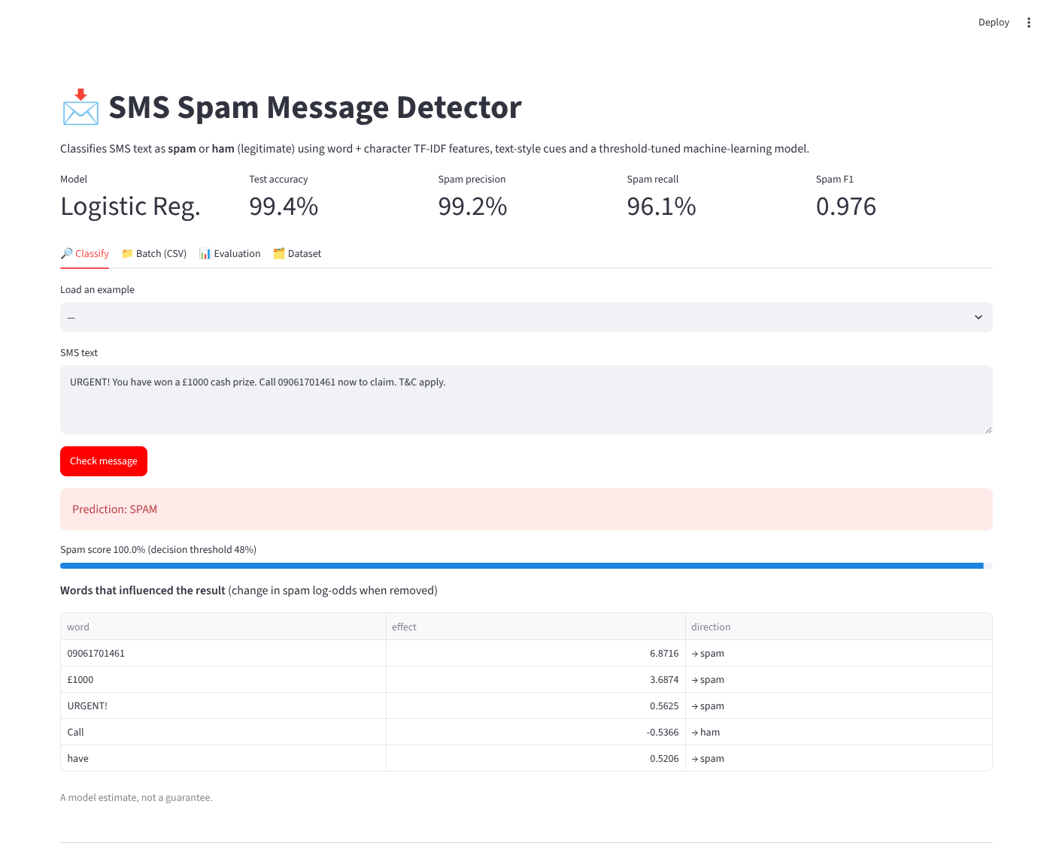
Application demo
Paste a message and get the label, spam score and the words that drove it.
Example: a prize scam scores 100% spam; the phone number and £1000 contribute most.
Batch tab scores a whole CSV and lets you download results.
SMS Spam Message Detector | AIML Minor Project
7

Slide 8
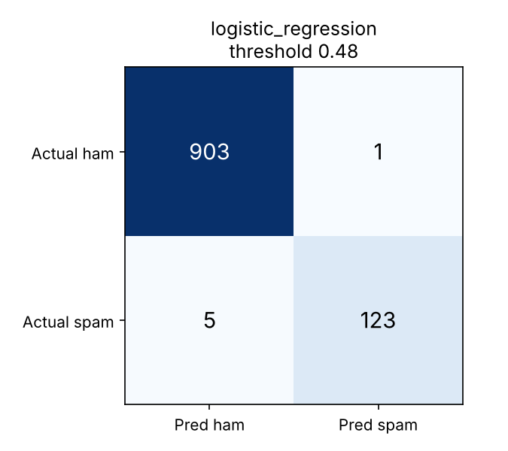
Results on held-out test set (1,032 messages)
99.4%
Model | Test recall | Test F1
Original baseline | 0.766 | 0.863
Naive Bayes | 0.914 | 0.929
Logistic Reg. | 0.961 | 0.976
Linear SVM | 0.953 | 0.972
accuracy
99.2%
spam precision
Recall rises from 76.6% to 96.1% at the same precision.
The original code's F1 0.925 was inflated by duplicate leakage; on a clean split it is 0.863.
96.1%
F1 0.976 | ROC-AUC 0.999
1 false positive, 5 missed spam
spam recall
SMS Spam Message Detector | AIML Minor Project
8

Slide 9
Limitations and future scope
• Small, mid-2000s English dataset; new scams, slang and other languages will hurt accuracy.
• Only 128 spam messages in the test set, so scores can shift by a point or two; CV F1 is 0.951.
• Misses are atypical spam (adult content, stock pumps, subscription replies).
• No URL or sender reputation checks.
• Next: fresh multilingual data, transformer embeddings, URL/sender features, drift monitoring.
SMS Spam Message Detector | AIML Minor Project
9

Slide 10
Conclusion and references
• Delivered a complete, tested pipeline with a dashboard, batch scoring and CLI.
• Found and fixed a train/test duplicate leak, then raised spam F1 from 0.863 to 0.976.
• Prototype for education; keep a human in the loop for important messages.
References
Almeida, T. A., Gómez Hidalgo, J. M., & Yamakami, T. (2011). Contributions to the Study of SMS Spam Filtering. ACM DocEng. DOI 10.1145/2034691.2034742
UCI Machine Learning Repository: SMS Spam Collection | scikit-learn | Streamlit
SMS Spam Message Detector | AIML Minor Project
10

