Slide 1

IFET COLLEGE OF ENGINEERING (An Autonomous Institution) Department of Computer Science and Engineering
Explainable Multimodal Deep Learning for Huntington’s Disease Forecasting Using EfficientNet-B3 and Graph Neural Networks
PRESENTED BY, GUIDENCE BY,
S.PADMAPRIYA (421122102104) MRS. INBAVALLI.A
ASSISSTANT PROFESSOR
CSE DEPT

Slide 2
ABSTRACT
Huntington’s disease is a genetic neurodegenerative disorder affecting movement, cognition, and behavior. Early prediction is crucial but traditional diagnosis relies mainly on symptoms. This work proposes an explainable multimodal deep learning model that combines genetic data and brain MRI images. Graph Neural Networks analyze DNA features, while EfficientNet extracts MRI patterns. A transformer-based fusion method integrates both modalities, and explainable AI tools improve transparency, accuracy, and clinical decision support for early disease risk prediction.

Slide 3
INTRODUCTION
Huntington’s Disease (HD) is an inherited brain disorder caused by the abnormal expansion of CAG repeats in the HTT gene. Symptoms usually appear between 30 and 50 years of age and affect both physical movement and mental health. Patients may face involuntary jerks, speech and swallowing difficulties, and loss of coordination. Over time, memory decline and psychiatric symptoms such as mood swings and irritability worsen the condition.

Slide 4
This project addresses the need for an efficient and interpretable AI-based malnutrition detection system. Existing models often focus on single data sources and lack transparency, reducing trust in clinical use. The proposed approach integrates deep learning and explainable techniques to improve prediction accuracy while remaining lightweight and practical. The problem addressed is the absence of reliable, scalable, and explainable tools for early malnutrition detection in real-world healthcare settings globally today.

Slide 5
PROBLEM STATEMENT
Huntington’s disease is a genetic neurodegenerative disorder often diagnosed late due to symptom-based methods. Existing approaches fail to integrate genetic and imaging data effectively and lack interpretability. There is a need for an explainable multimodal deep learning system that combines DNA and MRI data to enable early, accurate prediction and support reliable clinical decision-making.

Slide 6
OBJECTIVE
To develop an AI-based system for early detection of malnutrition using health data and image-based features with improved accuracy and reliability.
To design a explainable deep learning model suitable for real-time screening in resource-constrained healthcare settings.
The project focuses only on malnutrition prediction and risk classification in children, covering data analysis, model development, and interpretation, and excluding treatment planning or clinical diagnosis.

Slide 7
LITERATURE SURVEY
TITLE | METHODOLOGY | YEAR | OUTCOME
Explainable DL for HD via scRNA-seq | Explainable deep learning applied to single-cell RNA sequencing | 2024 | Helped uncover biological mechanisms underlying HD at a cellular level. Supported precision medicine but interpretability remains challenging.
Triad ML-based Framework for Prognosis of HD | Combined supervised ML models for prognosis | 2024 | Offered an integrative framework to predict HD progression stages. Improved interpretability and accuracy, though validation on larger datasets is still needed.
External Evaluation of DL-based Brain Volumetry | Deep learning applied to automated brain volumetry | 2024 | Achieved accurate brain volume quantification in HD patients. Supported early structural analysis, although external generalization requires improvement.

Slide 8
Domain-based Feature Extraction for EEG, ECG, and fNIRS | Shallow ML models on multimodal biosignals | 2024 | Showed competitive performance in HD diagnosis using non-invasive signals. Highlighted the importance of multimodal fusion but required higher robustness.
DL Analysis of Organoids for Drug Screening | Deep learning on micropattern-based organoids | 2022 | Enabled large-scale drug screening for HD using organoid models. Provided a cost-effective approach for therapeutic testing.
ML-derived HD Progression Model | Machine learning progression modeling | 2022 | Predicted disease progression and supported clinical trial design. Demonstrated practical utility but requires continuous validation.
DL-based Gait Analysis for HD | Deep learning on gait datasets | 2019 | Demonstrated feasibility of gait-based HD detection. Provided early direction for movement analysis using AI.

Slide 9
EXISTING SYSTEM
Traditional methods for malnutrition detection rely on manual anthropometric measurements such as height, weight, and mid-upper arm circumference, along with visual observation by healthcare workers. Some machine learning approaches use survey data, demographic information, or facial images, but these methods are often applied separately.
Many existing systems focus on a single data source and lack explainability, making them less effective for accurate early detection and large-scale screening.

Slide 10
DRAWBACKS OF EXISTING SYSTEM
Many methods rely on a single data type (genetic or imaging).
CNN/RNN models cannot capture long DNA sequence patterns well.
Traditional ML may overlook subtle early HD changes.
Brain and genetic data are not integrated effectively.
This reduces accuracy in early detection and disease monitoring.

Slide 11
PROPOSED SYSTEM
The proposed system integrates advanced deep learning models to analyze multiple data sources together. Genetic features are extracted using Graph Neural Networks, while brain MRI images are analyzed using EfficientNet. A transformer-based fusion method combines genetic and imaging information to improve prediction accuracy.
The model also includes explainable AI techniques to provide clear insights into predictions. This approach supports early disease detection, improves reliability, and overcomes the limitations of existing single-modal methods.

Slide 12
ADVANTAGES OF PROPOSED SYSTEM
Early Disease Prediction: Identifies Huntington’s disease at an early stage by analyzing MRI and genetic data together, enabling timely intervention and improved patient outcomes.
High Prediction Accuracy: Uses advanced deep learning models to learn intricate patterns, ensuring reliable and consistent predictions.
Explainable AI: Provides clear insights into genetic and brain factors, enhancing transparency and clinical trust.
Improved Clinical Support: Assists healthcare professionals with data-driven insights, enabling better decision-making and patient management.

Slide 13
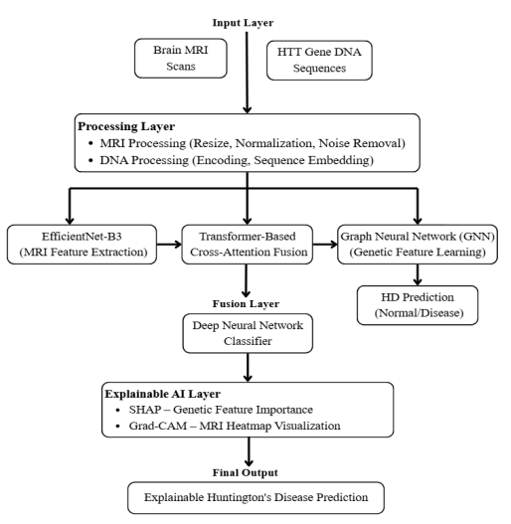
SYSTEM DESIGN

Slide 14
Step1: Input Layer - Collects Brain MRI scans and HTT gene DNA sequences.
Step2: Processing Layer: -MRI is resized, normalized, and denoised
-DNA is encoded into sequence format
Step3: Feature Extraction: -EfficientNet-B3 extracts MRI features
-GNN learns genetic relationships
Step4: Fusion Layer: -Transformer combines MRI and DNA features
-Captures complex multimodal interactions
Step5: Classification Layer: Deep Neural Network classifies Normal or Disease
Step6: Explainable AI Layer: SHAP identifies important genetic features
Step7: Final Output: Produces accurate and explainable Huntington’s disease prediction

Slide 15
Data Collection: -Gather MRI brain images and HTT gene DNA data
-Include both Huntington’s patients and healthy individuals
Data Preprocessing: -Clean and prepare MRI and DNA data
-Resize/normalize MRI and encode DNA sequences
Feature Extraction: -Extract important patterns from MRI and DNA
-EfficientNet-B3 for MRI and GNN for genetic data
Model Training: -Train the multimodal model with processed data
-Learn patterns and optimize accuracy using validation

Slide 16
SYSTEM REQUIREMENT SPECIFICATIONS
HARDWARE REQUIREMENTS:
Processor: Intel i5/i7 or AMD Ryzen 5/7
RAM: 16 GB (min)
Storage: 256 GB SSD (min)
Others: Stable internet, good cooling system
SOFTWARE REQUIREMENTS:
Operating System: Windows 10/11 or Linux
Programming Language: Python
Deep Learning Frameworks: TensorFlow
Machine Learning Libraries: scikit-learn, NumPy, Pandas
Image Processing Libraries: OpenCV
IDE/Code Editor: VS Code / Jupyter Notebook / PyCharm

Slide 17
RESULT
The proposed explainable multimodal deep learning model was evaluated using brain MRI images and HTT gene DNA sequences from 4,200 samples. The results show that integrating EfficientNet-B3, Graph Neural Network, and cross-attention fusion significantly improves prediction performance compared to single-modality and traditional machine learning models. The system achieved high accuracy, precision, recall, and AUC-ROC values, demonstrating strong generalization with minimal overfitting. Additionally, SHAP and Grad-CAM explanations enhanced interpretability, making the model reliable and suitable for clinical decision support and early Huntington’s disease detection.

Slide 18
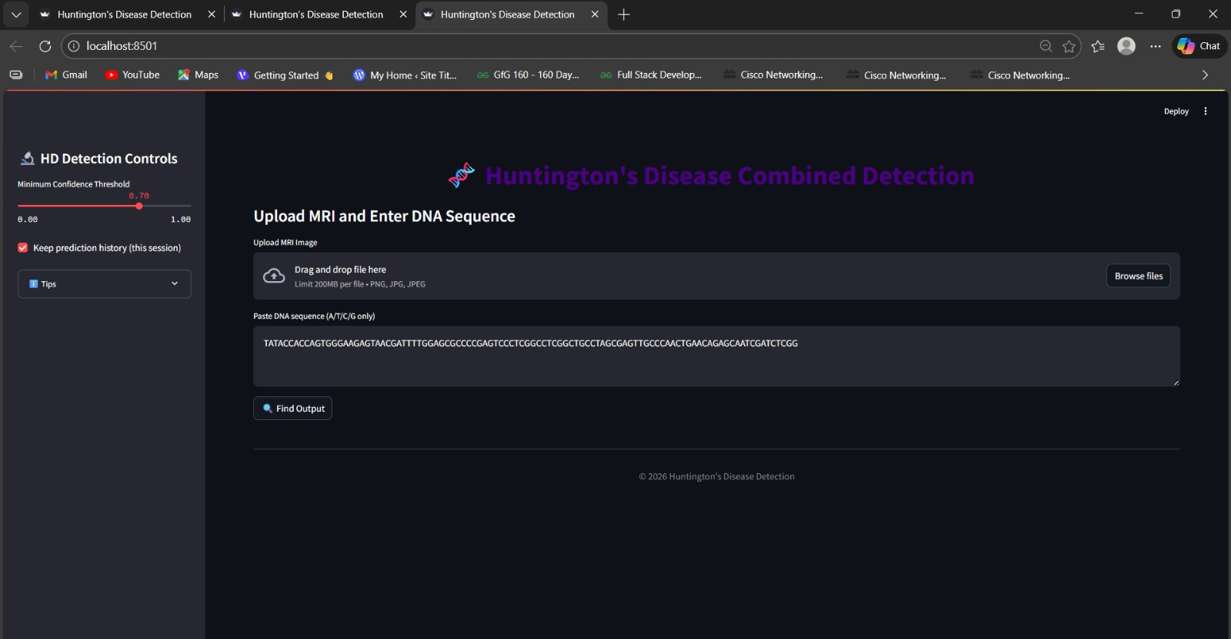
OUTPUT

Slide 19
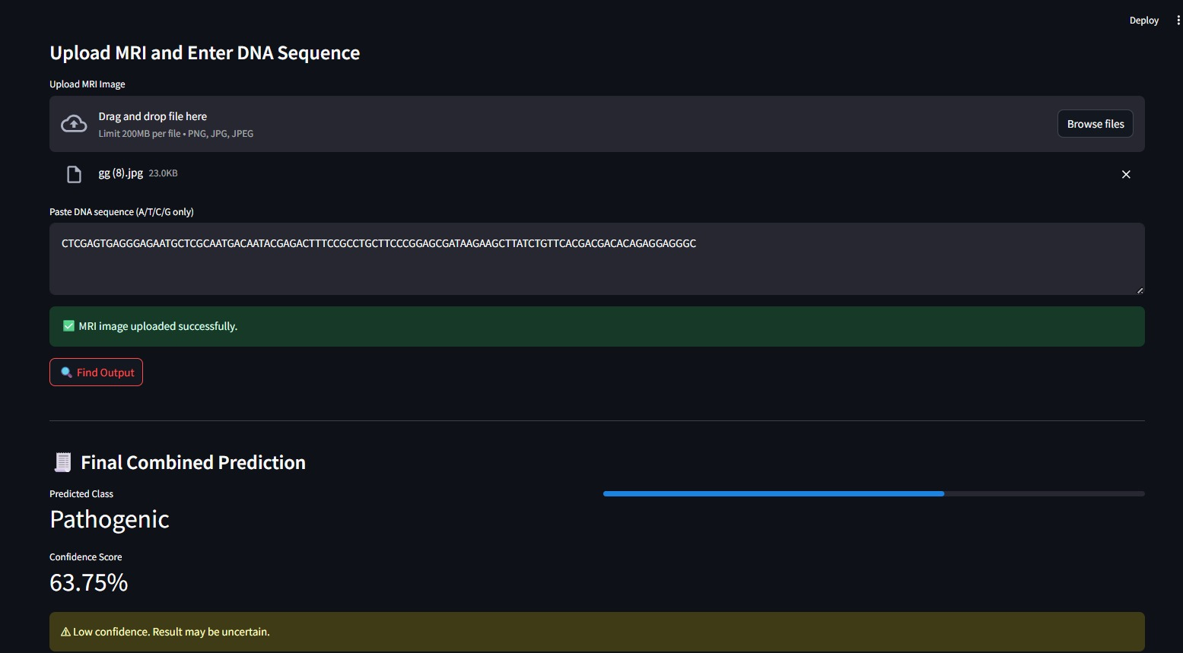

Slide 20
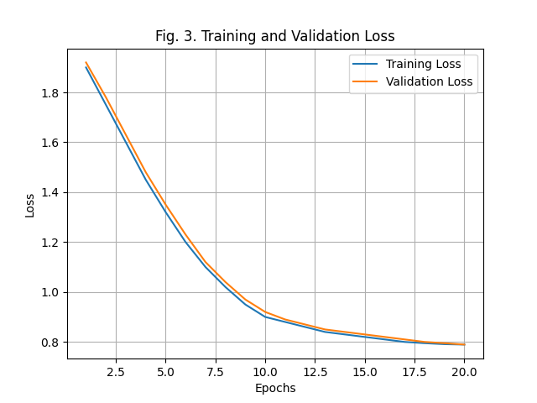
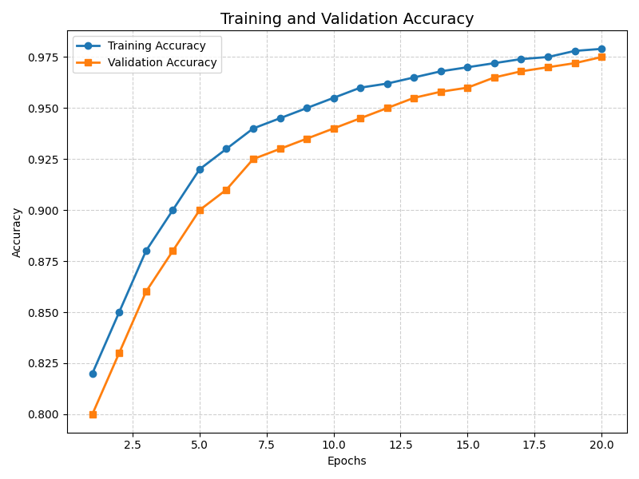
TRAINING ACCURACY AND LOSS

Slide 21
CONCLUSION
This work presents an explainable multimodal deep learning framework for early prediction of Huntington’s disease by integrating genetic and brain MRI data. EfficientNet-B3 effectively captures structural brain abnormalities, while Graph Neural Networks model complex genetic relationships. The transformer-based cross-attention fusion improves feature interaction and prediction accuracy. Explainable AI techniques such as SHAP and Grad-CAM enhance transparency and clinical trust. Overall, the proposed system demonstrates high accuracy, reliability, and interpretability, supporting early diagnosis and advancing AI-assisted precision healthcare.

Slide 22
FUTURE SCOPE
Incorporate additional biomarkers such as EEG signals, clinical scores, and wearable sensor data to improve early-stage prediction and monitoring.
Develop a real-time clinical decision support tool with user-friendly dashboards for doctors and healthcare professionals.
Optimize the model for mobile and edge devices to enable low-cost, remote screening and continuous patient monitoring in real-world healthcare settings.

Slide 23
REFERENCE
[1] AbdelAziz, Nabil M., Gehan A. Fouad, Safa Al-Saeed, and Amira M. Fawzy. "Deep Q-Network (DQN) Model for Disease Prediction Using Electronic Health Records (EHRs)." Sci 7, no. 1 (2025): 14.
[2] Amudaria, S., and S. Joseph Jawhar. "MIMI-ONET: Multi-Modal image augmentation via Butterfly Optimized neural network for Huntington Disease Detection." Brain Research 1855 (2025): 149530.
[3] Banu, Mohammed Razia Alangir, K. Purushottama Rao, and Arpita Gupta. "Accurate Human Brain Tissue Segmentation in MRI Scans Using Optimized Deep Neural Network." SN Computer Science 6, no. 6 (2025): 614.
[4] Deepak, Shashikant, Ananta Ojha, Kalyan Acharjya, Reshmi Mishra, Amit Gantra, C. Kalaiarasan, Ramakant Upadhyay, and Suchita Walke. "A novel and proposed triad machine learning-based framework for the prognosis of Huntington’s disease." International Journal of Information Technology 16, no. 4 (2024): 2603-2610.
[5] Gao, Shichen, Yadong Wang, Jiajia Wang, and Yan Dong. "Leveraging explainable deep learning methodologies to elucidate the biological underpinnings of Huntington’s disease using single-cell RNA sequencing data." BMC genomics 25, no. 1 (2024): 930.
[6] Gibson, Jessie S., Jeremy W. Eberle, Alexandra Werntz, Madaline B. Harrison, Carol A. Manning, Guofen Yan, and Bethany A. Teachman. "Development of the Movement Disorders Interpretation Bias Scale and Psychometric Evaluation in Adults with Huntington’s Disease." Parkinsonism & Related Disorders (2025): 107971.
[7] Haase, Robert, Nils Christian Lehnen, Frederic Carsten Schmeel, Katerina Deike, Theodor Rüber, Alexander Radbruch, and Daniel Paech. "External evaluation of a deep learning-based approach for automated brain volumetry in patients with huntington’s disease." Scientific Reports 14, no. 1 (2024): 9243.

Slide 24
THANK YOU!

