Slide 1

21CSP302L- Minor Project
Optimized Machine Learning Framework for Dental Caries Detection
Faculty Guide-
Dr. Aswathy K Cherian
Pratham K [RA2311003012072] - Ctech
Kaushika R [RA2311003012077] - Ctech
Notes:
1

Slide 2

Problem Statement:
A Widespread Problem with the early detection necessity.
Limitations of Manual Diagnosis: time consuming, dependent on expertise, detection difficulty in early stage.
The Need for Innovation : An automated assist
Notes:
2

Slide 3
Project Objectives:
1
Develop an automated carries detection system.
2
Implement transfer learning using Resnet-50.
3
Achieve high classification accuracy.
4
Ensure model generalization.
Notes:
3

Slide 4
Literature review:
Existing Research:
Deep learning model was proposed for radiographs. [1]
CNN-based architectures- ResNet and VGG improve diagnostic accuracy. [1], [2]
Key Findings:
Transfer learning enhances performance on limited medical datasets. [2]
Research Gap:
Need for improved accuracy & generalization.
Limited optimization of balanced dataset training.
Scope for enhancing interpretability and performance.
Deep learning
>>>
traditional ml approaches
[1]
Accuracy range:
85%-92%
[1],[2]
References:
[1] An Explainable Deep Learning Model to Predict Dental Caries Using Panoramic Radiograph Images, 2023.
[2] H. Geetha et al., “Dental Caries Detection in Digital Radiographs Using Deep Learning Models,” IEEE Access, vol. 8, 2020.
Notes:
3

Slide 5
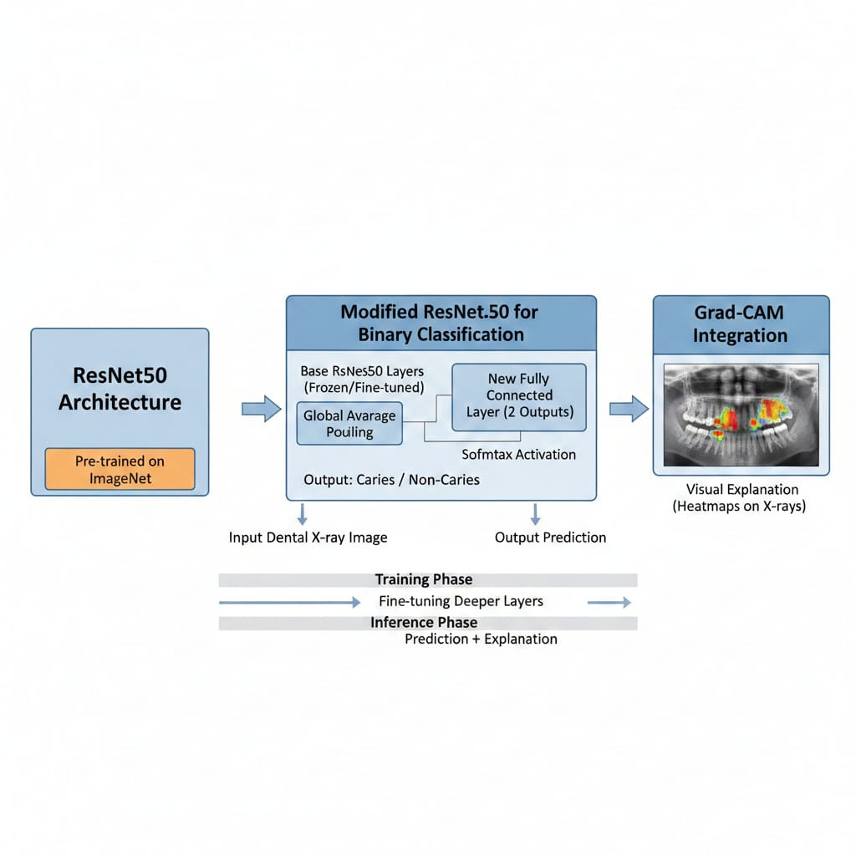
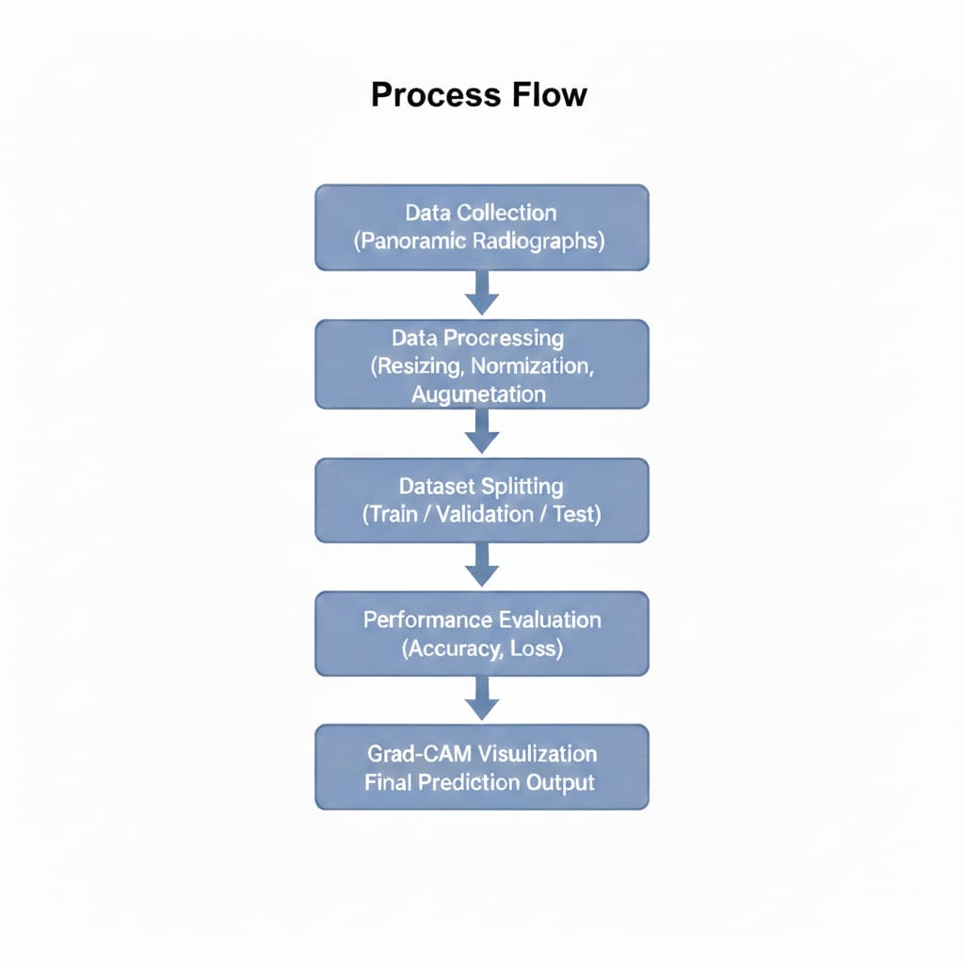
Proposed Methodology:
Tools & Technologies:
Python, TensorFlow / Keras, OpenCV, Google Colab, Matplotlib.
Notes:
3

Slide 6

Expected Outcomes:
Product / Research Output:
AI Caries Detection Model
ResNet50 + Grad-CAM
93% Accuracy
Binary Classification System
Explainable Prediction Output
Publication Plans:
IEEE Conference / Journal Submission
Book chapters
Notes:
3

Slide 7
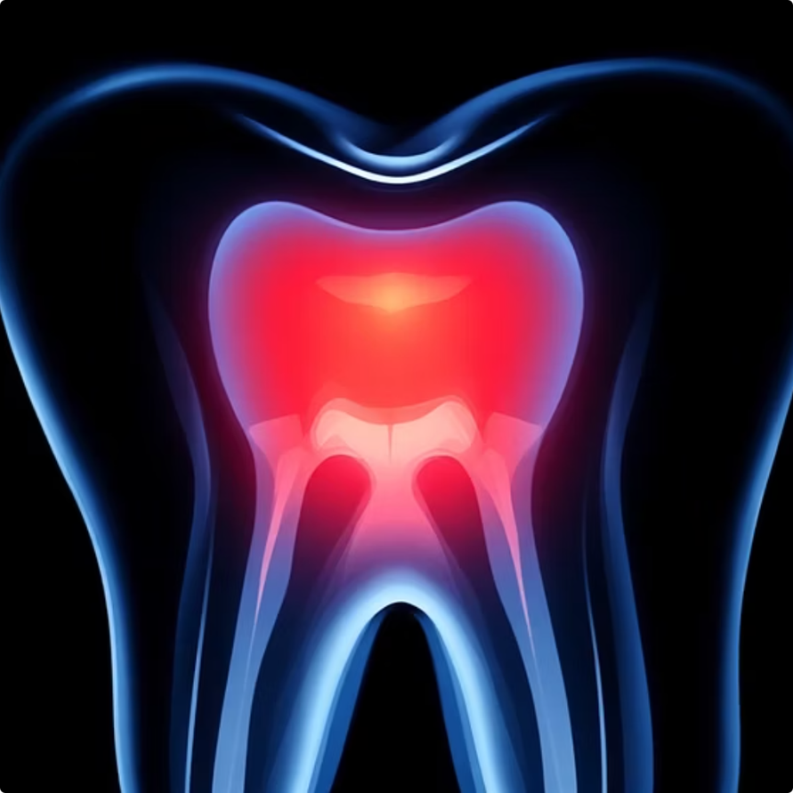
Conclusion:
Summary of Proposed Work:
ResNet50-based Caries Detection
Transfer Learning
Balanced Dataset Training
93% Accuracy Achieved
Grad-CAM Explainability
Automated Binary Classification
Future Scope:
Larger Multi-center Dataset
Real-time Clinical Integration
Mobile / Web Deployment
Multi-class Lesion Detection
Improved Generalization
Notes:
7

Slide 8
References:
[1] An Explainable Deep Learning Model to Predict Dental Caries Using Panoramic Radiograph Images, 2023.
[2] K. He, X. Zhang, S. Ren, and J. Sun, “Deep Residual Learning for Image Recognition,” in Proceedings of the IEEE Conference on Computer Vision and Pattern Recognition (CVPR), 2016.
[3] R. R. Selvaraju et al., “Grad-CAM: Visual Explanations from Deep Networks via Gradient-Based Localization,” in Proceedings of the IEEE International Conference on Computer Vision (ICCV), 2017.
[4] H. Geetha et al., “Dental Caries Detection in Digital Radiographs Using Deep Learning Models,” IEEE Access, vol. 8, 2020.
[5] M. Lee et al., “Deep Convolutional Neural Networks for Detection of Dental Caries in Panoramic Radiographs,” Scientific Reports, 2018.
Other online articles.
Notes:
7

