Slide 1


PRML
RECORDS
Bridging the Gap Between Innovation & Technology
3D-Printed Marketing Materials • NFC Technology • Digital & Physical Solutions
YOUR BRAND. ELEVATED.

Slide 2




PRML RECORDS
Bridging the Gap Between Innovation & Technology
Why 3D-Printed NFC Marketing Materials?
Stop being forgettable. Start being unforgettable.
Instant Engagement
Premium Brand Image
One tap or scan connects customers instantly to your website, reviews, menus, listings, or service pages—zero friction.
Custom 3D-printed materials signal quality before a customer even speaks to you. Perception is everything.
Customer Retention
Lead Generation
Tangible branded items keep your business top-of-mind long after the sale. Keychains, signs & gifts that last.
NFC & QR-enabled pieces turn passive brand exposure into active digital leads—24/7, automatically.
PRML Records | prmlrecords.com
02

Slide 3

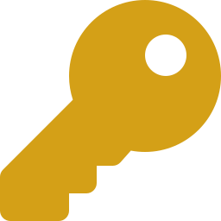


PRML RECORDS
Bridging the Gap Between Innovation & Technology
AUTOMOTIVE INDUSTRY
YOUR #1 REVENUE OPPORTUNITY
NFC Keychains
Branded Keychains
Dashboard NFC Discs
Drive-away gift that links to service booking, AAA, or emergency contacts. Your logo in their hands every day.
Custom dealership keychains with logo & colors. Closing gifts clients actually keep and show off.
Adhesive tap-points on dashboards, armrests & sun visors. One tap → service scheduler or roadside assistance.
Employee Desk Signs
Custom Clocks
Keychain Display Holders
Personalized 3D-printed desk signs with dealership branding—professionalism that impresses every walk-in.
Branded lobby & office clocks. Premium décor that reinforces your brand 24 hours a day.
Stunning custom holders that showcase your keychains beautifully at the point of sale.
💡 Every customer who drives away with your NFC keychain becomes a repeat service opportunity. Tap into it.
PRML Records | prmlrecords.com
03

Slide 4

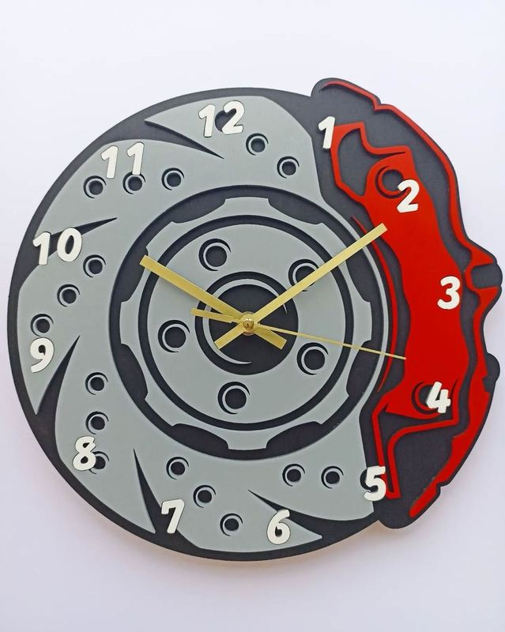
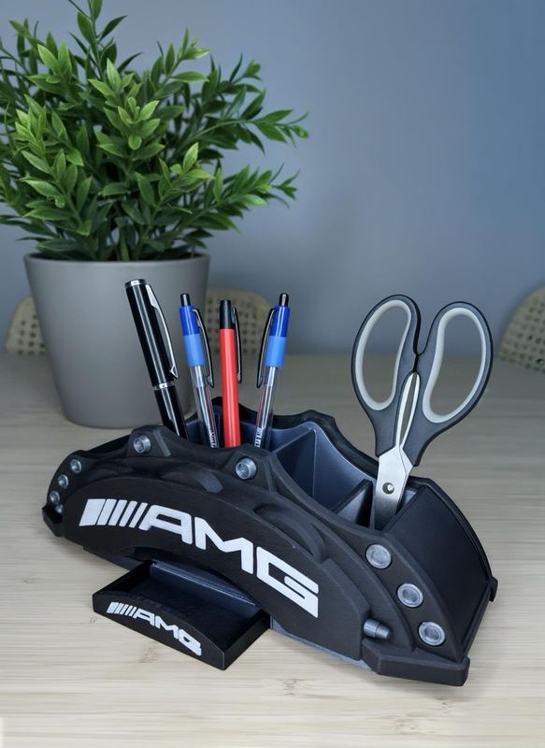
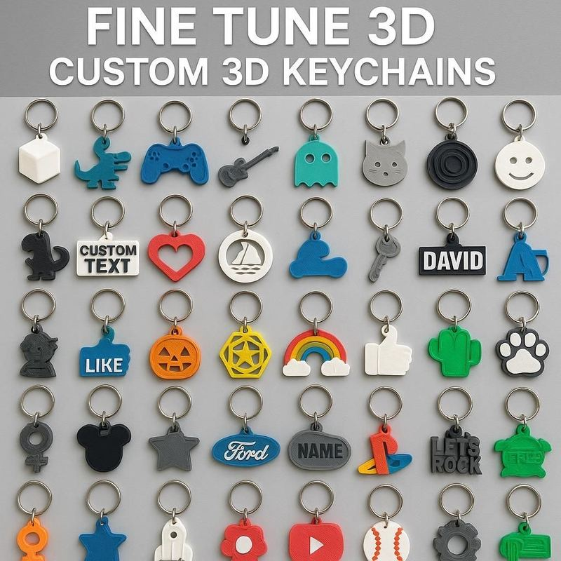
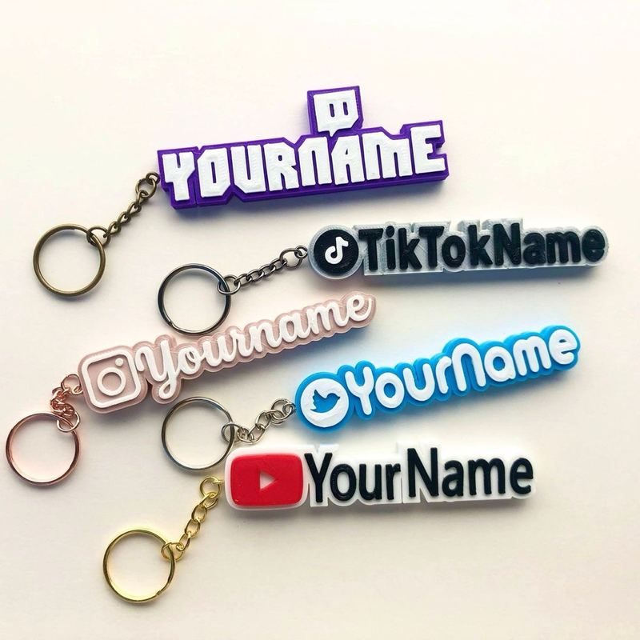
PRML RECORDS
Bridging the Gap Between Innovation & Technology
AUTOMOTIVE — PRODUCT SHOWCASE
Custom Brake Disc Clock
Branded Desk Organizer
Custom 3D Keychains
Social Media Keychains
PRML Records | prmlrecords.com
04

Slide 5

PRML RECORDS
Bridging the Gap Between Innovation & Technology
REAL ESTATE INDUSTRY
CLOSE DEALS. STAY MEMORABLE.
Custom Sold Signs
Business Card Holders
NFC Home Keychains
3D-printed SOLD signs with your name, logo & QR code. Every sale becomes a billboard for your next listing.
House-shaped card holders—a showpiece that lives on desks and gets noticed by every visitor.
Closing gift keychains with access info or your contact page. Buyers remember who sold them their dream home.
Magnetic QR Codes
Light Boxes
Closing/Opening Gifts
Adhesive/magnetic QR codes attach to any existing sign instantly—more listing info, more leads, zero hassle.
Eye-catching light boxes that make listings unmissable at night. Stand out on every street.
Premium branded keychains & souvenirs your clients treasure. Referrals start with relationships.
💡 In real estate, first impressions win listings. Our materials make yours impossible to forget.
PRML Records | prmlrecords.com
05

Slide 6
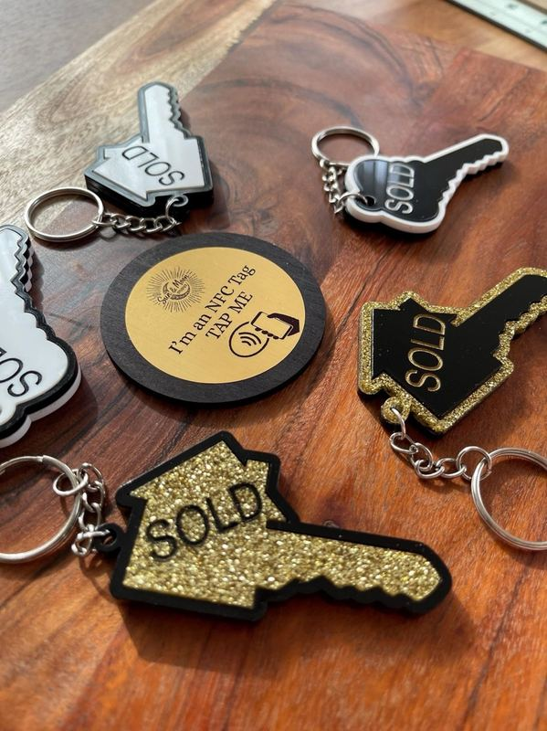
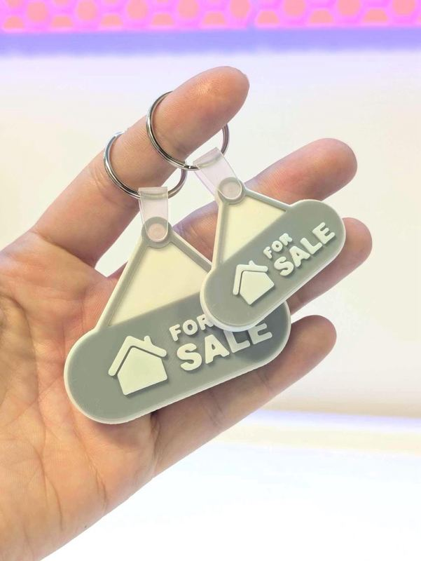
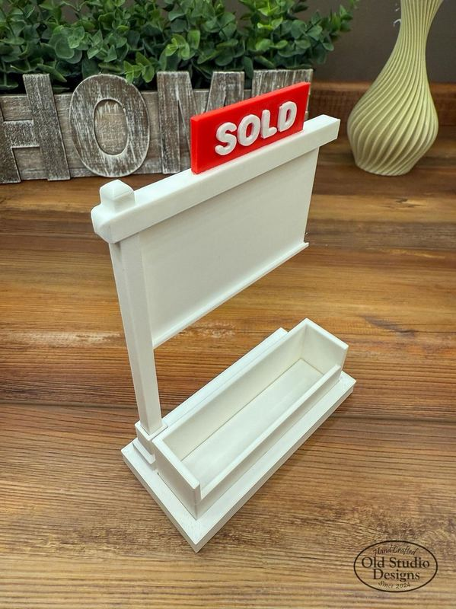
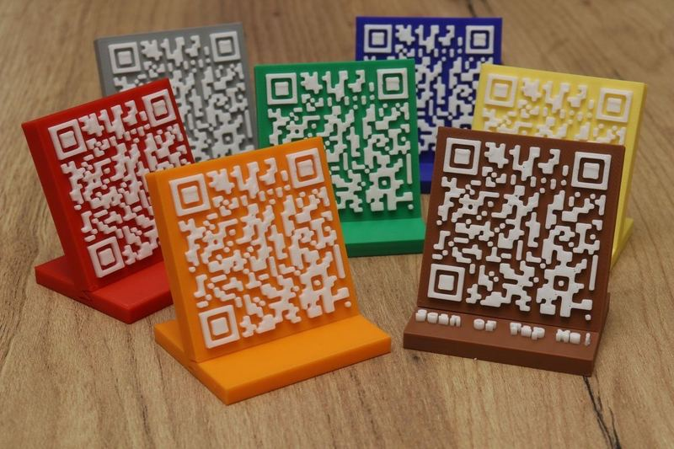
PRML RECORDS
Bridging the Gap Between Innovation & Technology
REAL ESTATE — PRODUCT SHOWCASE
SOLD Keychains + NFC Tag
For Sale Keychains
SOLD Sign + Card Holder
Custom QR Code Stands
PRML Records | prmlrecords.com
06

Slide 7


PRML RECORDS
Bridging the Gap Between Innovation & Technology
RESTAURANT INDUSTRY
SERVE UP AN EXPERIENCE THEY REMEMBER.
NFC Wi-Fi Signs
NFC Menu Coasters
Light Boxes
Tap to connect—no typing passwords. Custom branded signs guests appreciate every visit.
Tap to open your full digital menu instantly. No printing costs, always up-to-date.
Custom light boxes for your entrance: OPEN signs, specials, logos. Visibility that drives foot traffic.
Custom Table Signs
Custom Napkin Holders
Custom Bathroom Signs
Miniature branded table signs & holders reinforce your identity at every single seat.
Branded table accessories that elevate your aesthetic—details that say 'we care about quality.'
Branded, stylish directional signs throughout your space keep the guest experience polished.
💡 Restaurants that invest in their brand experience see 30%+ higher repeat visit rates. Let's build yours.
PRML Records | prmlrecords.com
07

Slide 8
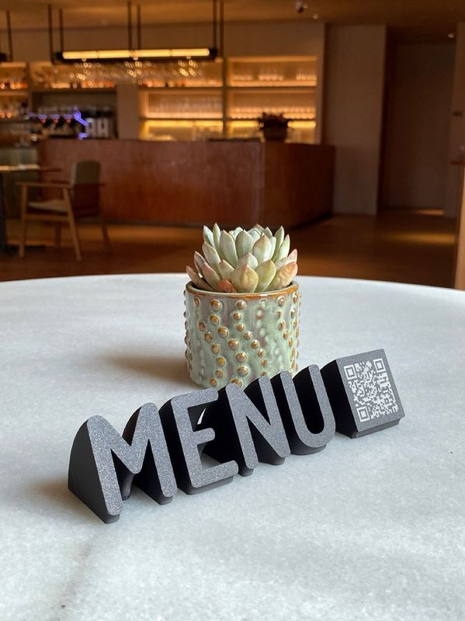
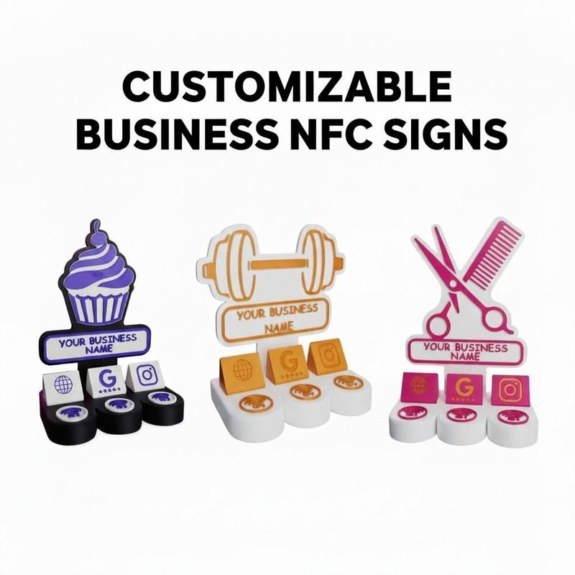
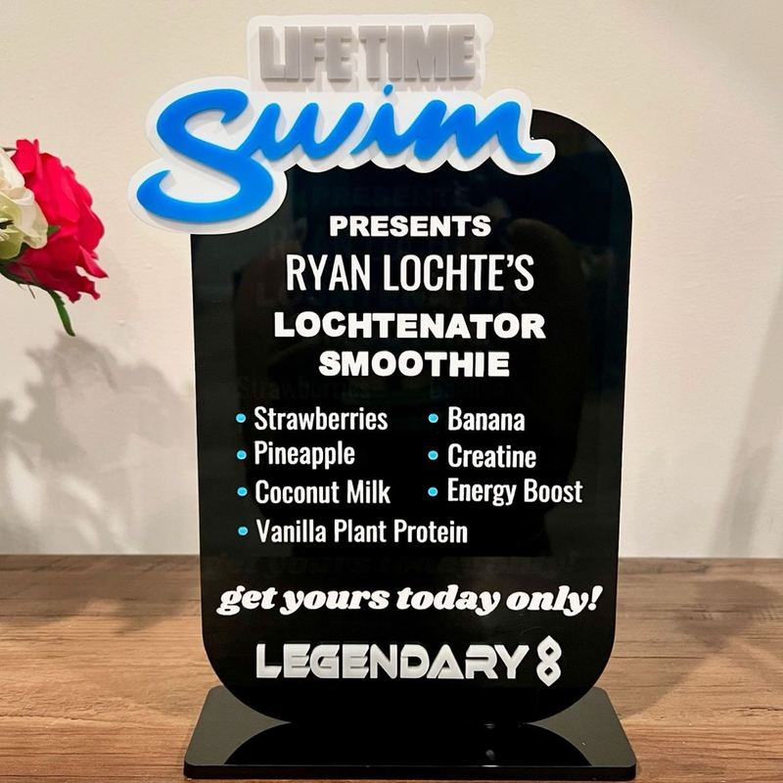
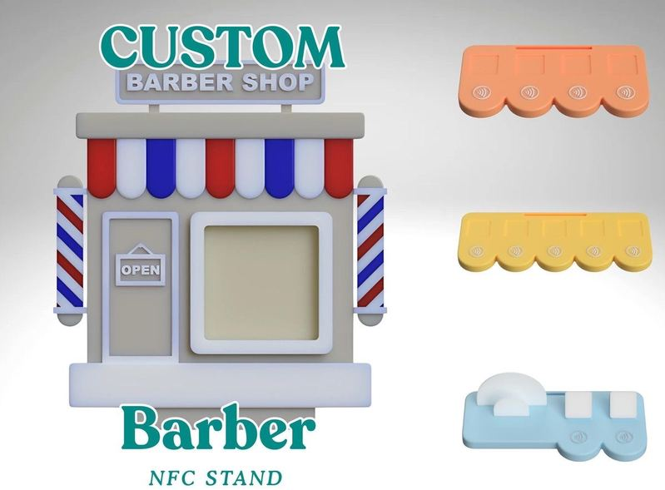
PRML RECORDS
Bridging the Gap Between Innovation & Technology
RESTAURANT — PRODUCT SHOWCASE
MENU QR Table Sign
Customizable Business NFC Signs
Custom Event Menu Display
Custom NFC Stand (Any Business)
PRML Records | prmlrecords.com
08

Slide 9

PRML RECORDS
Bridging the Gap Between Innovation & Technology
GYMS, SPORTS & PET INDUSTRY
NICHE MARKETS. MASSIVE OPPORTUNITY.
🏋️ GYM & FITNESS
🏆 SPORTS TEAMS
Custom barbell & dumbbell keychains with gym branding
NFC keychains for member check-in or class booking
Juice bar coasters with NFC menu access
3D-printed branded signage throughout the facility
Custom business NFC signs (website, Google reviews, IG)
3D jersey keychains in team colors with player stats
Display frames with mascot, number & season year
🐾 PET INDUSTRY
Custom 3D-printed pet tags with name, contact info
NFC-enabled tags linking to pet health records or owner info
Branded gifts for veterinary clinics & pet boutiques
💡 Specialty markets crave specialty branding. Be the vendor that delivers what no one else can.
PRML Records | prmlrecords.com
09

Slide 10
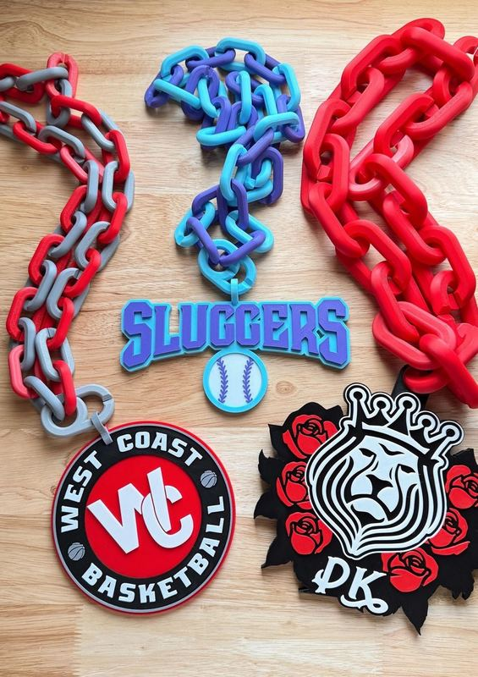
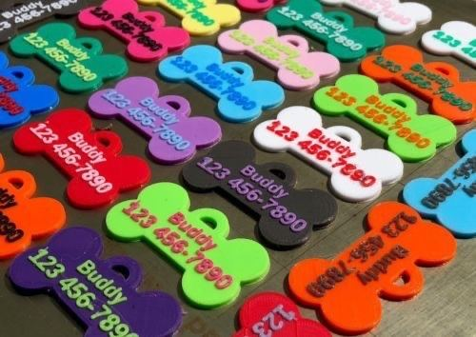
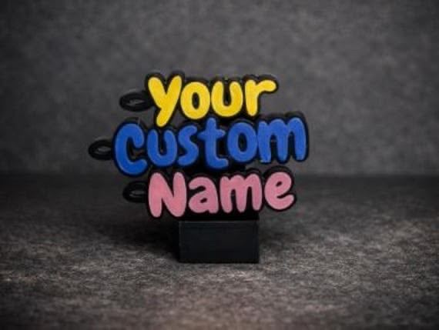
PRML RECORDS
Bridging the Gap Between Innovation & Technology
GYMS, SPORTS & PETS — PRODUCT SHOWCASE
Sports Team Chain Medallions
Custom Pet ID Tags
Custom Name Display Stand
NFC Signs — Gym Style
PRML Records | prmlrecords.com
10

Slide 11


PRML RECORDS
Bridging the Gap Between Innovation & Technology
EVENTS & FAMILY GATHERINGS
MAKE EVERY MEMORY LAST FOREVER.
QR Code Event Schedules
Centralized Memory Hub
Custom Event Keychains
Custom 3D-printed QR stands display the full event schedule. Guests scan once and stay informed all day.
One QR code links all guests to a shared upload page—photos, videos, and clips from everyone in one place.
Personalized 3D-printed keychains as party favors. Guests take home a branded memory of your special day.
NFC Guest Check-In Signs
Table Name & Number Signs
Commemorative Displays
Tap-enabled welcome signs link to RSVPs, seating charts, or event programs instantly. Zero paper.
Elegant 3D-printed table signs with event name, date & custom designs. Receptions, reunions, galas & more.
Custom photo display frames, milestone signs & event banners that double as keepsakes long after the event.
💡 Weddings, reunions, quinceañeras, graduations, corporate events — every celebration needs a PRML touch.
PRML Records | prmlrecords.com
11

Slide 12

PRML RECORDS
Bridging the Gap Between Innovation & Technology
VENDORS & TRADE SHOW SOLUTIONS
YOUR BOOTH. YOUR BRAND. UNFORGETTABLE.
Custom Display Stands
NFC-Enabled Booth Signs
Branded Price Tag Holders
3D-printed product display stands tailored to your exact item dimensions & brand aesthetic. No off-the-shelf generic.
Tap-to-order, tap-to-follow, tap-to-review. Turn every visitor into a lead before they walk away.
Sleek 3D-printed price displays with your logo. Elevates perceived value instantly at the point of sale.
Business Card Stands
QR Product Info Signs
Custom Light Boxes & Logos
Custom shaped card holders in any form—your logo, your niche. Stand out on every table and counter.
Scan to learn more, see reviews, or watch demos. Sell even when you're busy with another customer.
Illuminated 3D-printed signage for your vendor booth. Be the brightest brand in the room. Literally.
💡 If you sell at markets, expos, or trade shows — your display IS your brand. Make it impossible to walk past.
PRML Records | prmlrecords.com
12

Slide 13
PRML RECORDS
Bridging the Gap Between Innovation & Technology
If You Can Imagine It — We Can Print It.
The only limit is your imagination. Here are more industries & products we can serve:
🏥 Healthcare & Wellness
🎓 Schools & Churches
🏡 Home Services & Contractors
Custom NFC clinic check-in signs
Appointment reminder QR stands
Branded pill organizer holders
Medical office name plates & signs
Spa/salon NFC review & booking signs
NFC event bulletin boards
3D class schedule display stands
Fundraiser QR code signs & displays
Graduation & senior keychains
Custom donor wall name plaques
Branded door hangers with NFC/QR
Custom leave-behind keychain tools
NFC review signs for happy clients
Lawn & yard signage displays
Business card stands for offices
Think of any industry. Any product. Any need. We build custom. We build fast. We build unforgettable.
PRML Records | prmlrecords.com
13

Slide 14
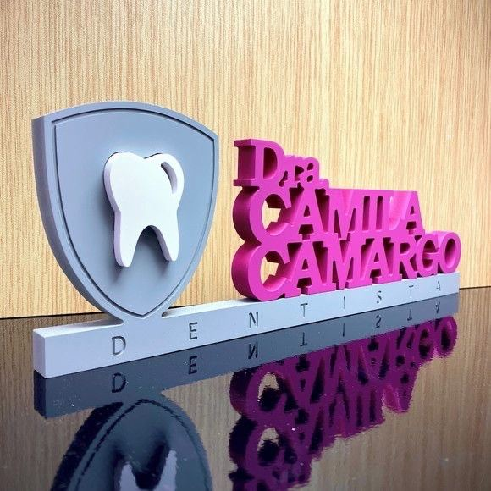
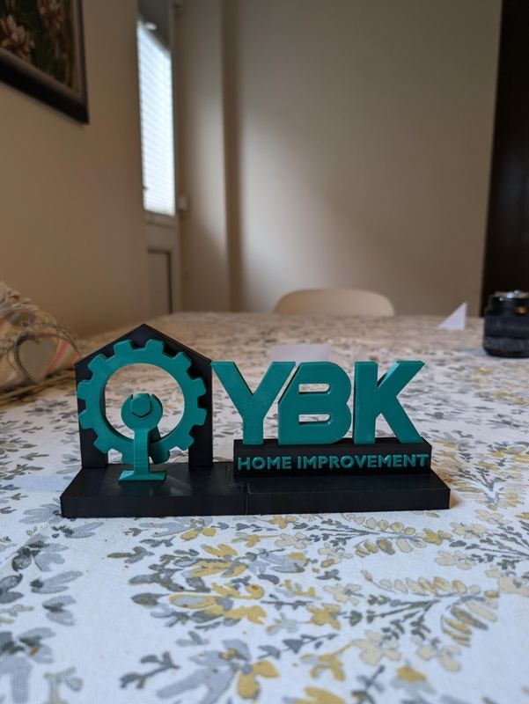
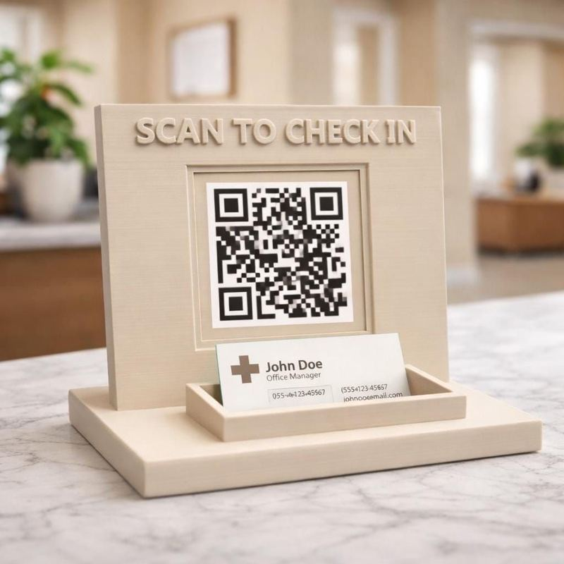
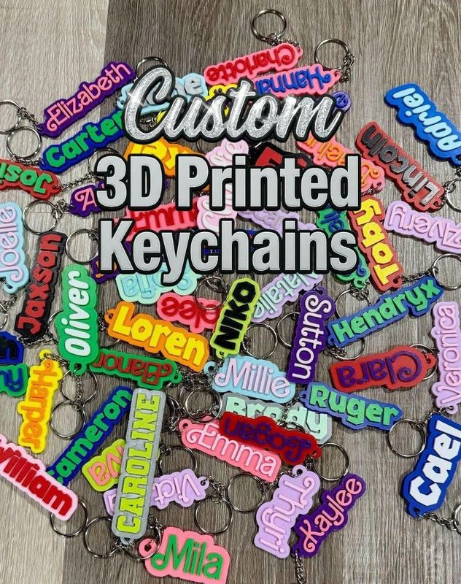
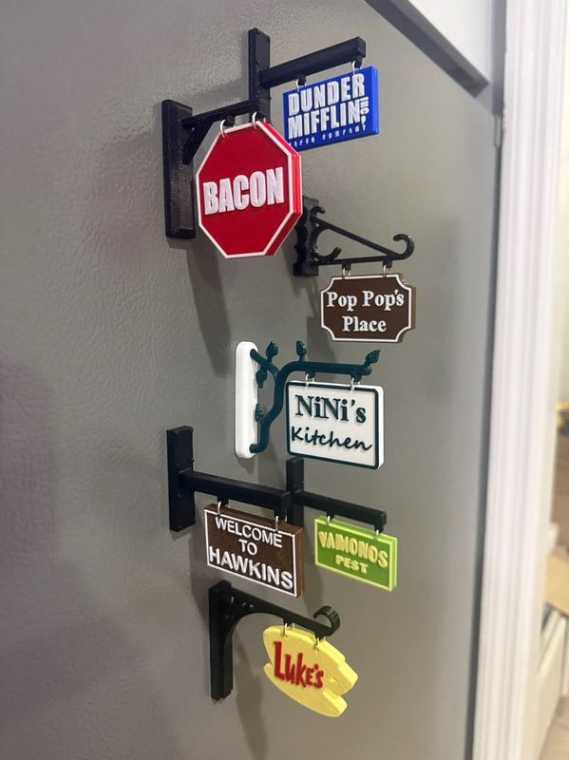
PRML RECORDS
Bridging the Gap Between Innovation & Technology
MORE FROM OUR CATALOG — THE WORK SPEAKS FOR ITSELF
Professional Name Display
Business Logo Stand
QR Check-In Display
Custom Name Keychains
Custom Hanging Mini Signs
PRML Records | prmlrecords.com
14

Slide 15
PRML RECORDS
Bridging the Gap Between Innovation & Technology
Custom NFC Business Signs
One Sign. Endless Connections. Works for EVERY Industry.
What's Included
89%
of consumers read online reviews
Your website URL — tap to visit instantly
Google Reviews link — tap to leave a review & boost your rating
Instagram profile — tap to follow & grow your audience
Optional QR code visible for scan OR tap
Fully customizable design, color & logo branding
Durable 3D-printed construction — built to last
3×
more engagement with NFC vs QR alone
24/7
passive lead generation, no effort
💡 Every customer who walks in or passes by is a potential tap. Make it effortless for them to connect with you.
PRML Records | prmlrecords.com
15

Slide 16



PRML RECORDS
Bridging the Gap Between Innovation & Technology
We're More Than 3D Printing.
PRML Records is your full-service creative & marketing powerhouse.
Videography
Sound Engineering
Product Reviews
Web Development
Graphic Design
Music Recording
Live Bands
Product Photography
Real Estate Photography
Digital Marketing
One relationship. One vendor. Everything your brand needs under one roof.
PRML Records | prmlrecords.com
16

Slide 17

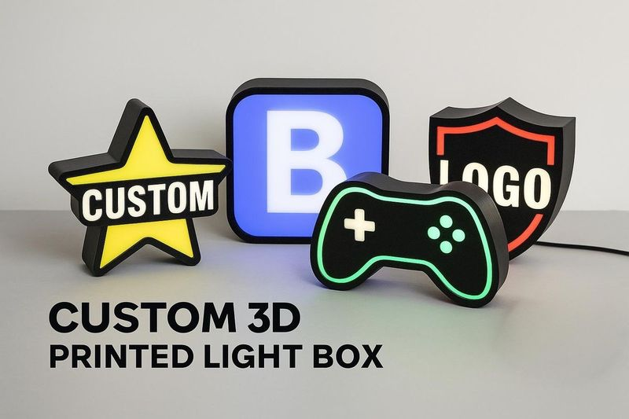
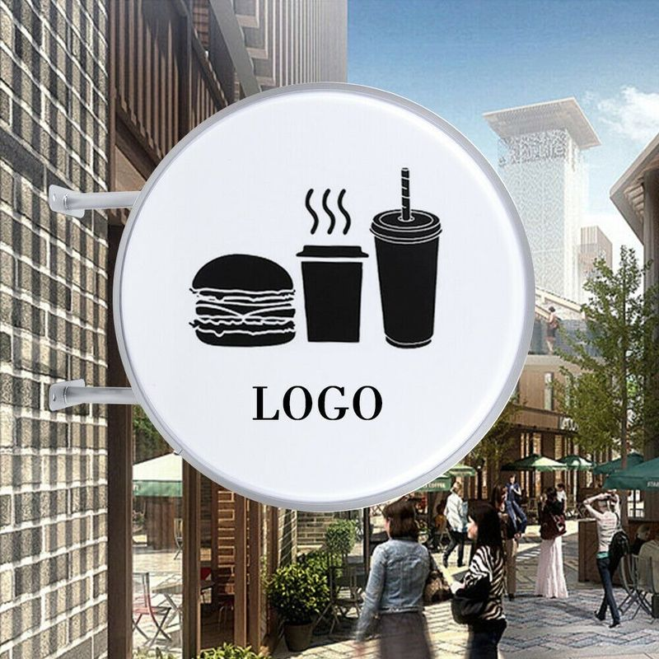
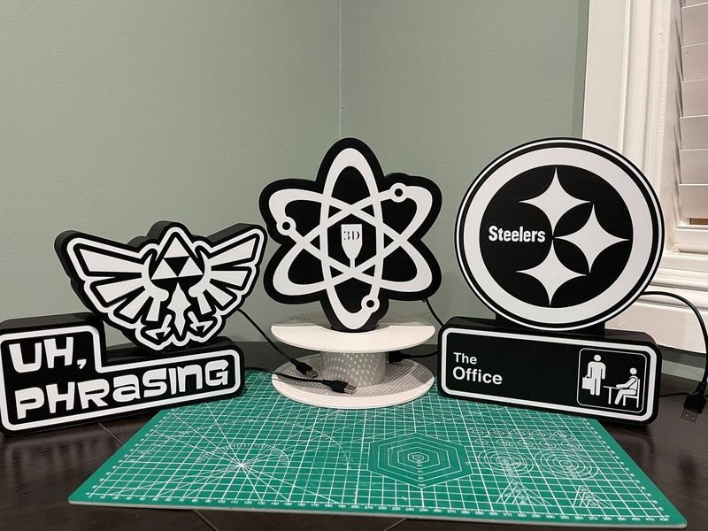
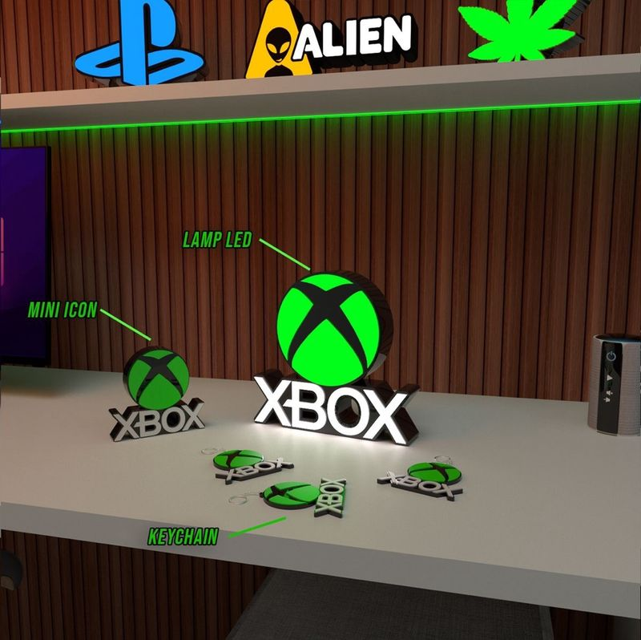
PRML RECORDS
Bridging the Gap Between Innovation & Technology
CUSTOM LIGHT BOXES & LED SIGNS
BE THE BRIGHTEST BRAND IN THE ROOM.
WHY LIGHT BOXES?
24/7 passive visibility — your brand glows day and night
Any shape, any logo — fully custom 3D-printed to your specs
Custom 3D Printed Light Boxes
Round LED Storefront Signs
Perfect for storefronts, offices, booths & event spaces
USB or plug-in power — easy to set up anywhere
Combine with NFC/QR for interactive brand experiences
Logo & Icon Light-Up Displays
LED Brand Displays & Room Décor
💡 Your sign never sleeps. Make it impossible to walk past your business without noticing.
PRML Records | prmlrecords.com
17

Slide 18

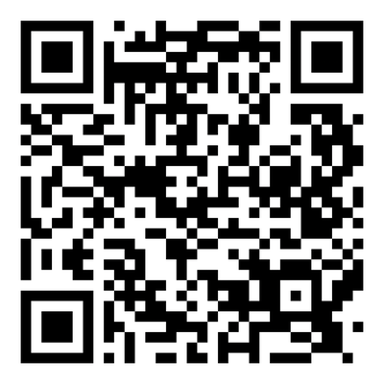
Ready to Elevate Your Brand?
SCAN TO
GET STARTED
PRML Records — Bridging the Gap Between Innovation & Technology
Turnkey Solutions
From concept to finished product, we handle everything. No juggling multiple vendors.
Custom, Not Generic
Every piece is designed specifically for your brand. No templates. No compromises.
ROI-Driven Design
Every item we make is engineered to generate leads, drive reviews, or retain customers.
Get Started Today | Scan the QR Code or Visit prmlrecords.com
Inquiry Form & Services
prmlrecords.com

