Slide 1
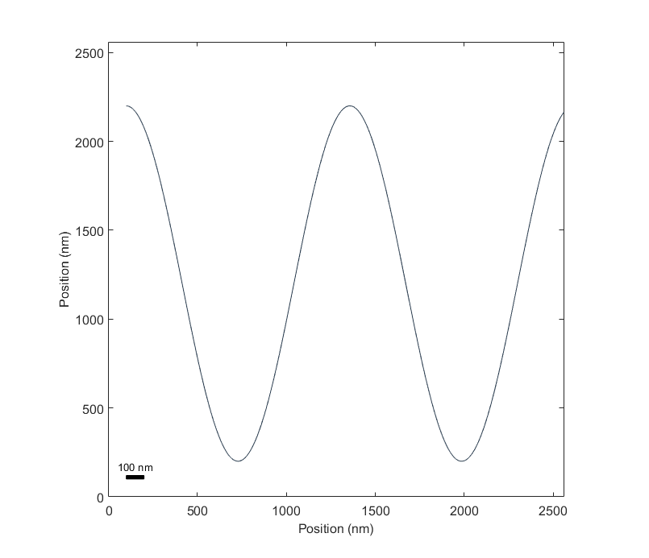
Ground truth 2d object

Slide 2
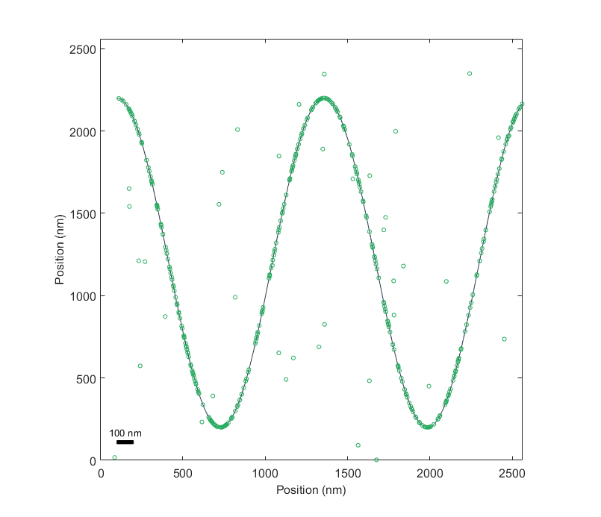
‘Molecules’ label object with additional ‘off-target binding’

Slide 3
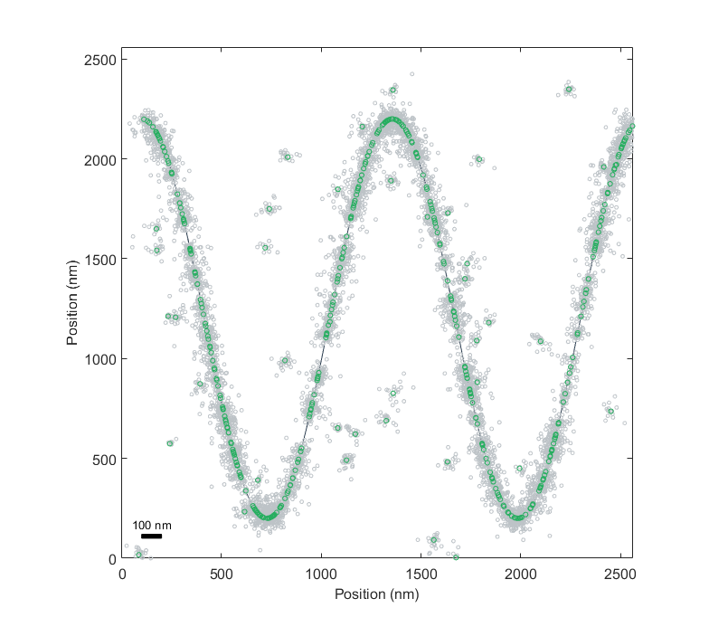
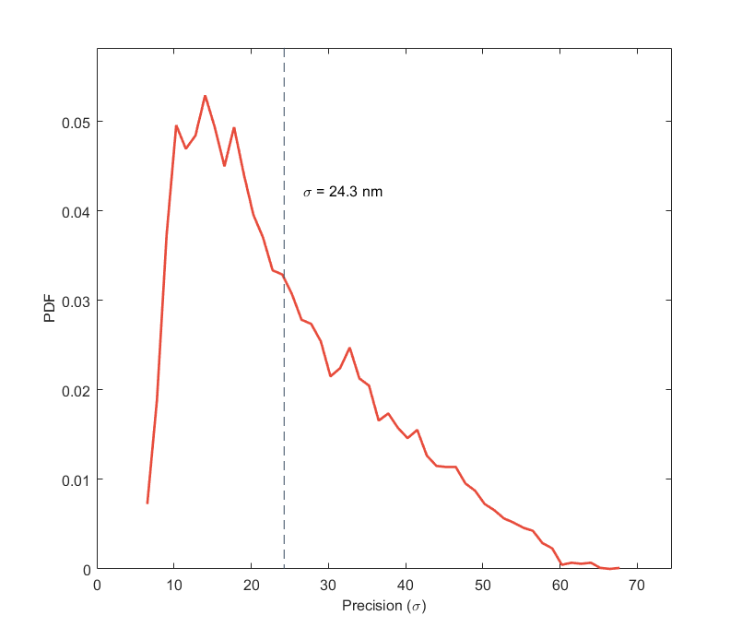
Detection events (gray) simulated around each molecule.
Detection events assumed to have Gaussian distribution around center with σ = 24.3 nm.

Slide 4
Detection events only information returned from experiment. These point clouds are:
Noisy
Sparse
Spatially inhomogeneous
Unordered
Contain significant off-target signal
Best defined by local center of mass
Not defined by a priori model for shape
Challenge then becomes how to efficiently recover ground truth structure with available info

Slide 5
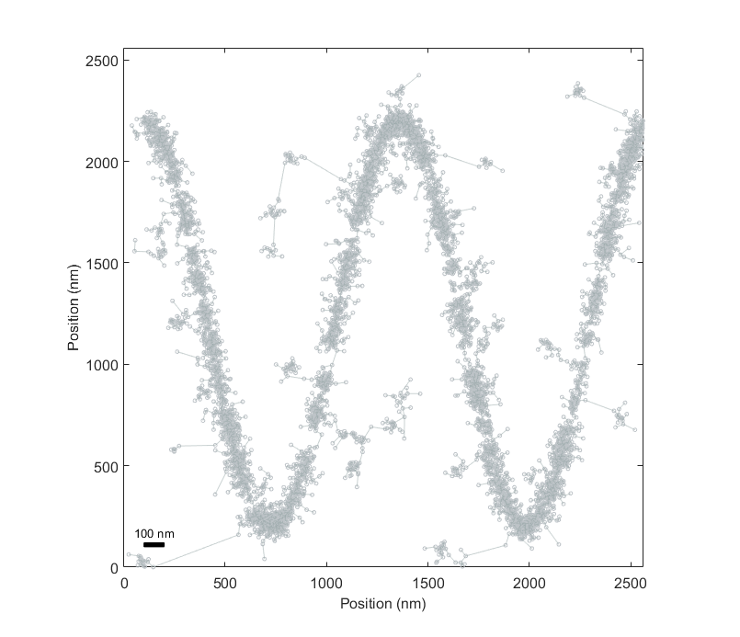
Guided by Lee, 1998, generate minimum spanning tree of all points

Slide 6
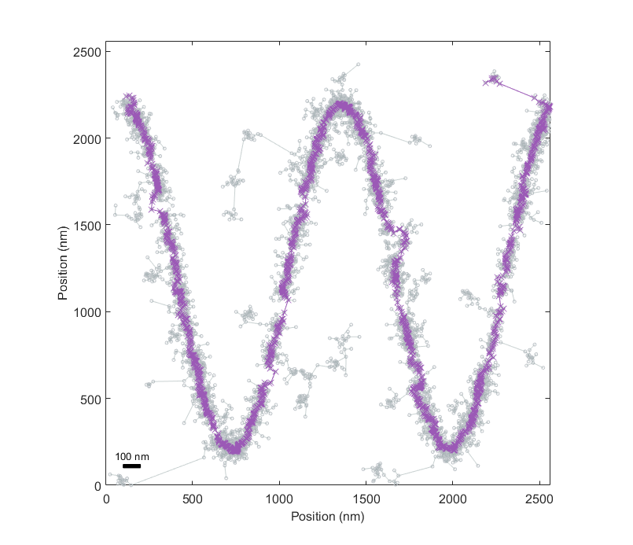
Find shortest connected path between farthest-separated points in tree.

Slide 7
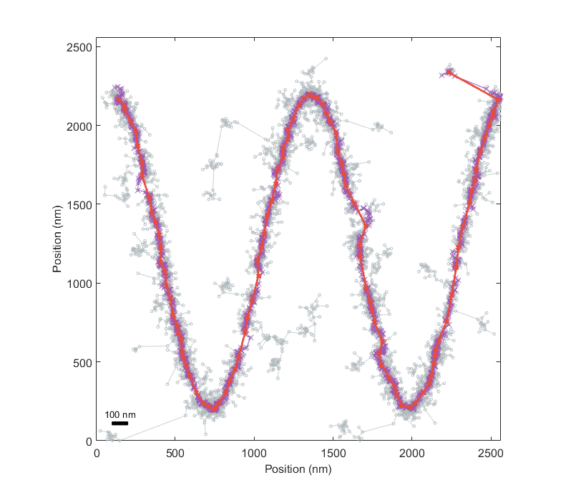
Smooth and sub-sample shortest connected path points.

Slide 8
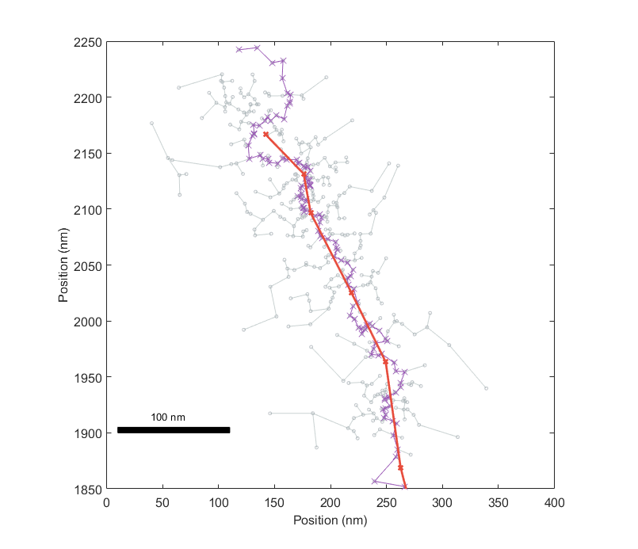
Focusing on initial segment. Can see detection points (grey circles), minimum spanning tree edges (gray lines), minimum spanning tree points (purple) and smoothed points (red).
User-defined number of points in initial minimum spanning tree are omitted at smoothing step.

Slide 9
Moving to 3D
Point clouds have many more points. Min span tree algorithm scales poorly, so want way to parcellate this challenge into smaller problems.
Can assume that point cloud is locally smooth and over-samples desired resolution*. Can then take meridians along intersecting planes through point cloud, fit local points to 2D curves (plus some error avoidance) and then re-sample these smoothed points.
This generates a smoothed, local-center-of-mass point cloud that can then feed into surface reconstruction algorithm. Reconstructed surface allows further quantification of curvature, local occupancy of secondary target molecules, etc.
* How this is quantified is future work.

Slide 10
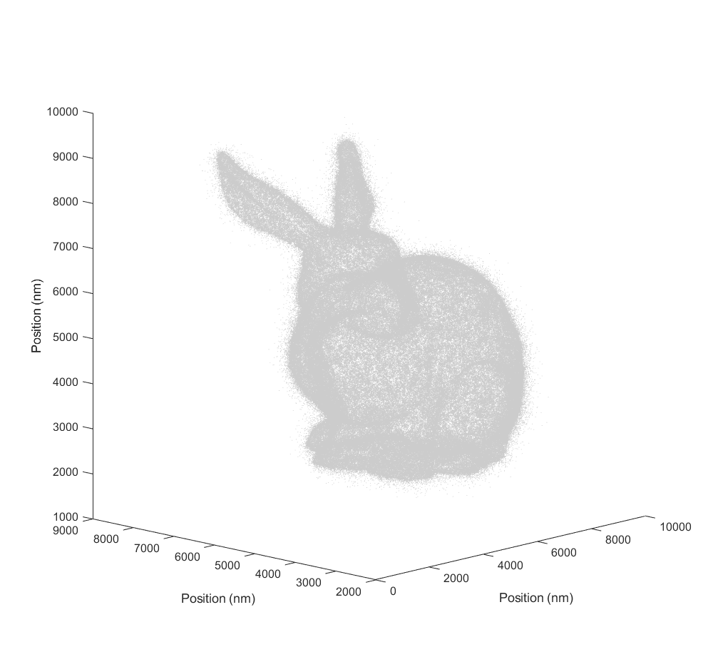
3D point cloud simulated around test object

Slide 11
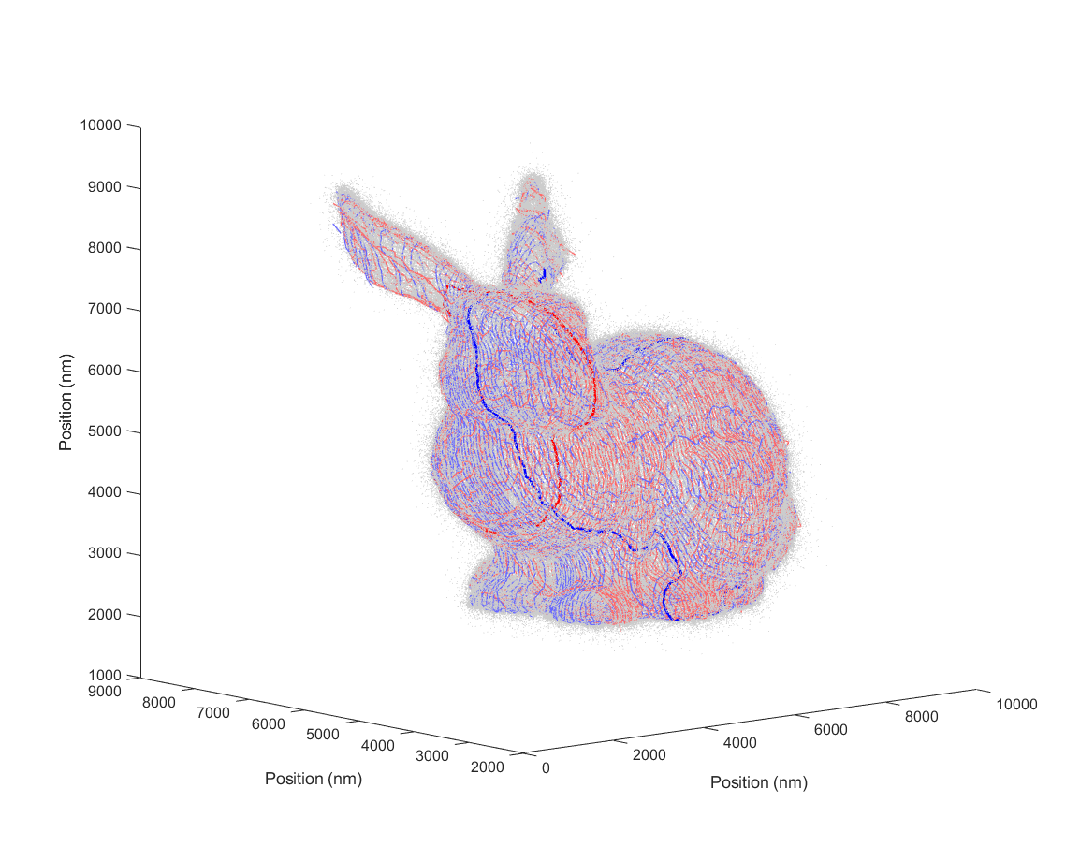
Meridians fit in point cloud along two axes.
Representative meridians highlighted.

Slide 12
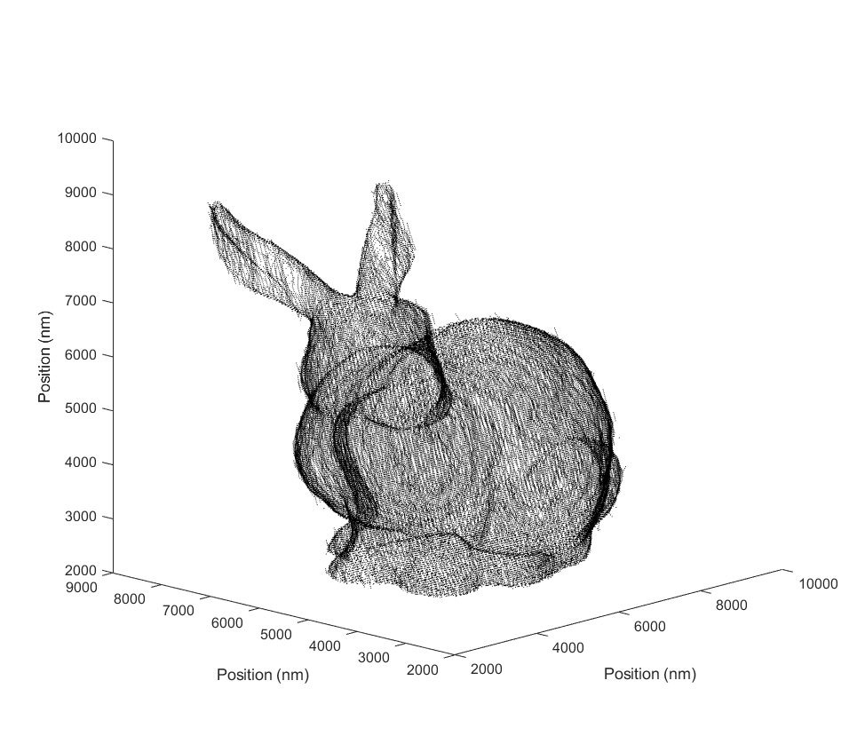
Resampled points along meridians taken along four intersecting axes.

Slide 13
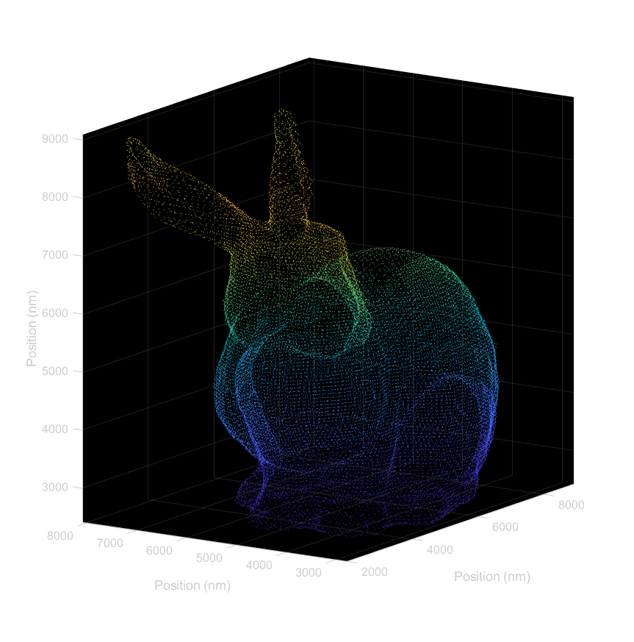
Points resampled from reconstructed surface fit to smoothed point cloud.
This representation is final desired outcome. Is reconstructed surface, not just unordered point cloud as shown here.

Slide 14
Quantifying resolution
Important to understand how input parameters of point cloud and of reconstruction algorithm influence recovered resolution of object. Possible routes to measure ‘resolution’ in final reconstructed surface:
Error or deviation from known ground truth object
‘Modulation depth’ or similar metric for periodic structures
Fourier ring correlation (Pham, et al, 2019).
Ideally metric can be applied to input w/o ground truth known to quantify appropriate resolution limits for interpretation.

