Slide 1
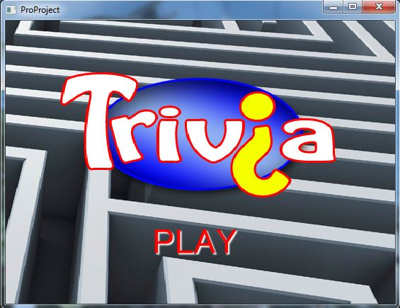
CSCD 350 Spring 2014 Trivia Maze
By The ProCrastinators
Kyle Phillips
Zac Bowman
Kevin Murray
Pavlo Bilous

Slide 2
Our Tools
Languages:
Java (for testing)
ActionScript (for flash/ Final game)
Flash Develop
Adobe Flash Prof. CS6
SQLite
Microsoft Excel
http://www.convertcsv.com/csv-to-sql.htm

Slide 3
Our Features
Major GUI elements through Flash
Choose different types of:
trivia
Characters
Difficulty
Ability to return to menu screen to play again when game is completed
Fun sprites, backgrounds and sounds!

Slide 4
Our Features
Organized database for Trivia Questions
Schema:
Question (varchar) (primary key)
Answer (varchar)
A (varchar)
B (varchar)
C (varchar)
D (varchar)
Type (int)
Category (varchar)

Slide 5
Features Not Implemented
Scores (through database)
Ability to name player and save high scores

Slide 6
Known Bugs
Signs tend to not update after answering questions
Game stops responding to answer choices when being asked a question

Slide 7
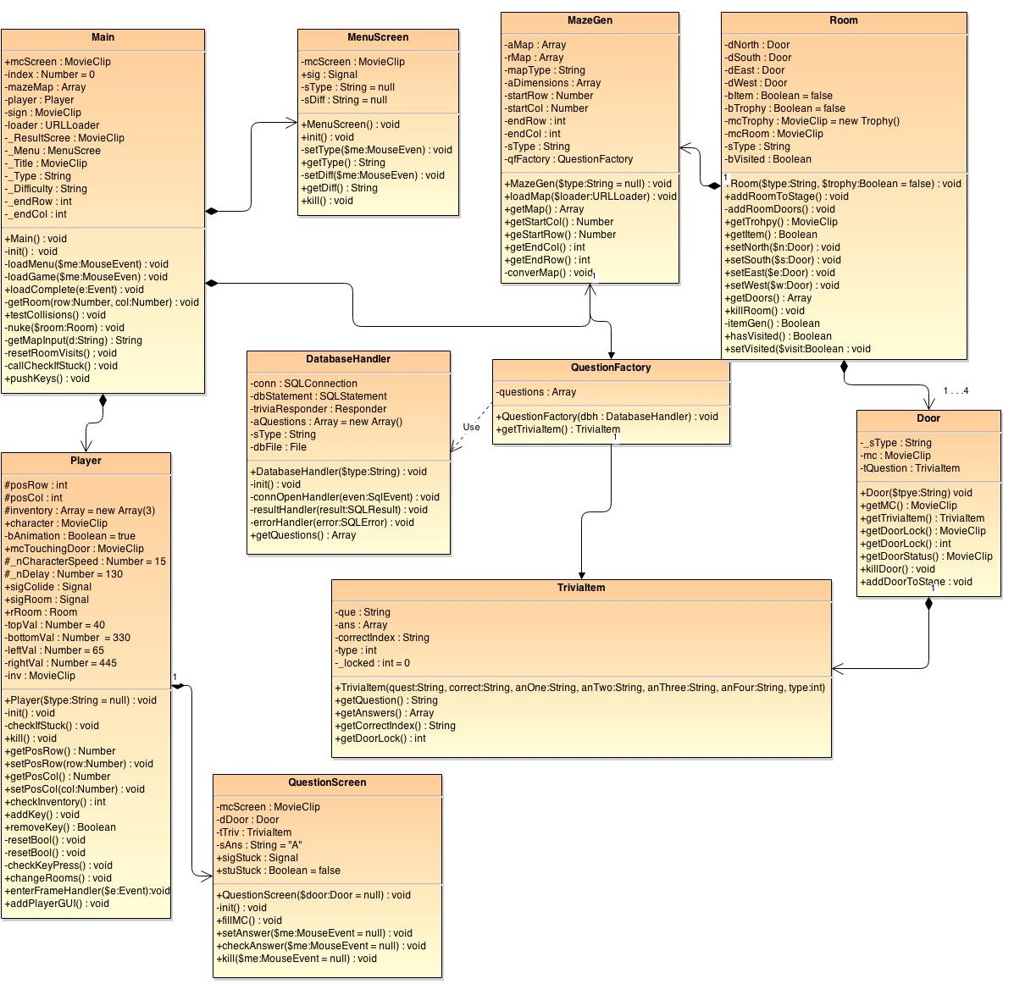
S t r u c t u r e

Slide 8
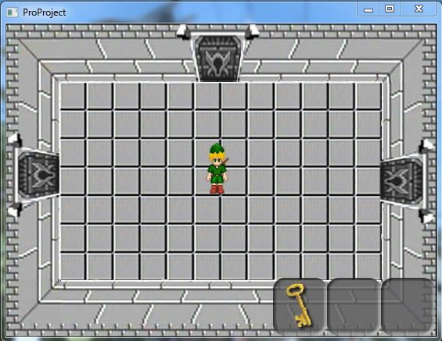
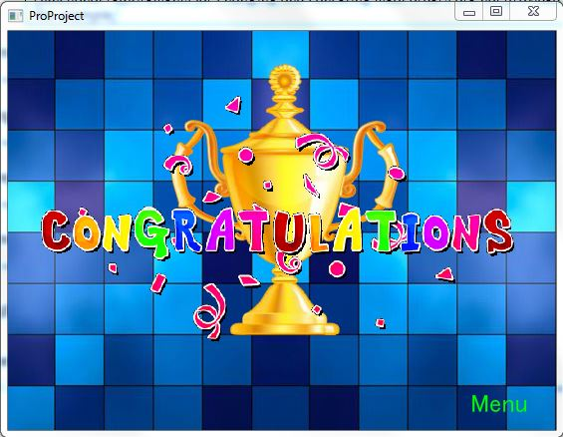
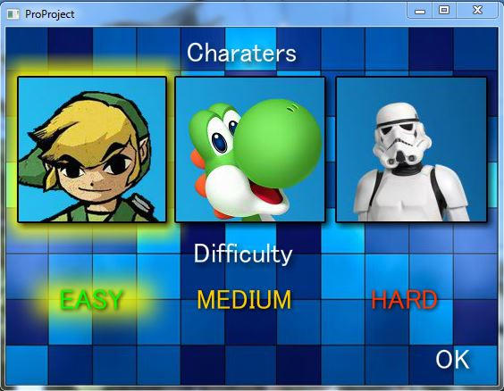
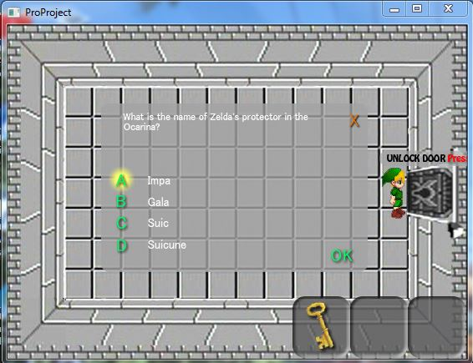
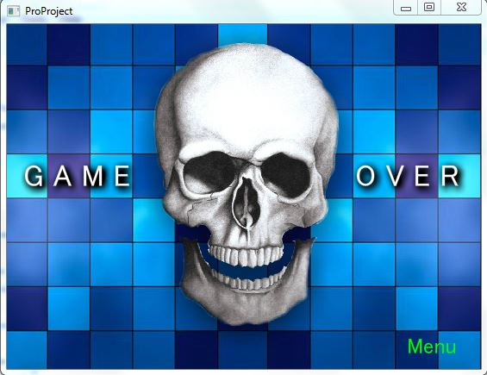
Gameplay

