Slide 1

FINAL YEAR PROJECT
ProctorAI
AI-assisted examination integrity
Development progress and working prototype
Ahmar Muzaffar
232475
Moaz Iqbal
232490
Ali Asghar
232411
Air University Islamabad
Department of Computer Science
Supervisor
Dr. Muhammad Bilal Khan
PROCTORAI
University panel presentation
01
Notes:
PRESENTER NOTES
Introduce the group and project. Explain that this presentation describes the work completed so far, with a working local demonstration and an explicit remaining-work plan. Ali Asghar's registration number comes from the submitted scope document. Suggested presentation duration: 10–12 minutes, plus a short demonstration.
SOURCE RECORD
Scope: C:/Users/ahmar/Downloads/ProctorAI_Scope_Document.docx
Status reviewed: 4 October 2026. Local prototype; no production or university-pilot claim.

Slide 2
CONTEXT
The problem we address
A suspicious moment is only the start of a case.
Observation
Evidence
Follow-through
An invigilator cannot watch every student continuously.
A review needs a clear event, seat and supporting image.
Decisions and appeals need a consistent, traceable process.
ProctorAI connects monitoring with a human review process.
PROCTORAI
University panel presentation
02
Notes:
PRESENTER NOTES
The project helps an invigilator identify events that deserve attention, keep evidence, and route the record to the right decision-maker. Do not describe a detected movement as proof of cheating. No external statistics are used on this slide.
SOURCE RECORD
Scope: C:/Users/ahmar/Downloads/ProctorAI_Scope_Document.docx; sections 3–5
Implementation and recorded checks: D:/FYP_fall_23/backend/LOCAL_PLATFORM.md
Status reviewed: 4 October 2026. Local prototype; no production or university-pilot claim.

Slide 3
MVP BOUNDARIES
Project scope
Physical examinations
Current demonstration
Support in-person university exams with camera-based monitoring.
One clearly visible student per webcam, explicitly linked to a registered seat.
Human decisions
Teachers review alerts. HODs decide penalties. Students can appeal.
Phase 2 exclusions
Multi-camera synchronization, audio monitoring, facial identity matching and SIS integration.
Single-room MVP
A web platform connects exam setup, evidence, cases and reports.
PROCTORAI
University panel presentation
03
Notes:
PRESENTER NOTES
The original MVP scope is a single physical exam room. The present capture integration monitors a selected registered seat and one clearly visible student, not every face in a hall. Multi-student room attribution remains work within the original scope; multi-camera, audio, facial registry matching and SIS integration are later extensions.
SOURCE RECORD
Scope: C:/Users/ahmar/Downloads/ProctorAI_Scope_Document.docx; section 5
Implementation and recorded checks: D:/FYP_fall_23/backend/LOCAL_PLATFORM.md; Evidence and detector limits
Status reviewed: 4 October 2026. Local prototype; no production or university-pilot claim.

Slide 4
WHAT THE SYSTEM SHOULD ACHIEVE
Project objectives
01
Identify events that need attention
Detect visible phones, books and sustained head movement.
02
Deliver useful alerts
Link the event to an exam, student seat and evidence.
03
Support a fair decision process
Connect teacher review, HOD decisions and student appeals.
04
Reduce administrative work
Automate setup, preserve records and provide reports.
PROCTORAI
University panel presentation
04
Notes:
PRESENTER NOTES
These are the practical objectives. The full scope also includes gaze, lip movement, a physical alert device, branded PDF notices and email delivery. Those items are not presented as completed. Quantitative success targets appear in the appendix and still require the controlled evaluation.
SOURCE RECORD
Scope: C:/Users/ahmar/Downloads/ProctorAI_Scope_Document.docx; objectives and evaluation criteria
Implementation and recorded checks: D:/FYP_fall_23/backend/LOCAL_PLATFORM.md
Status reviewed: 4 October 2026. Local prototype; no production or university-pilot claim.

Slide 5
IMPLEMENTATION
Major modules and system structure
Module | Current technology | Purpose
AI monitoring | Python, OpenCV, MediaPipe, Grounding DINO | Camera, head pose, phone and book recognition
Web portals | React, TypeScript, Tailwind CSS | Five portals, light and dark modes
Core services | FastAPI, Socket.IO, PostgreSQL, Redis | Permissions, live updates, cases and records
Exam setup | CSV import and seat-map tools | Rosters, rooms, schedules and assignments
Notices and devices | Template/AI notices, MQTT connector | Text notices ready; PDF, email and hardware pending
The camera, website and case workflow share the same authorized records.
PROCTORAI
University panel presentation
05
Notes:
PRESENTER NOTES
The frontend uses REST for permitted records and Socket.IO change events for refresh. The backend stores data in PostgreSQL and uses Redis for state and messaging support. The current default phone/book model is Grounding DINO Tiny; the original proposal named YOLOv8. Head pose uses MediaPipe Face Landmarker transformations rather than the earlier six-point PnP method. This architecture table describes the implemented stack, not the proposal's older version numbers.
SOURCE RECORD
Implementation and recorded checks: D:/FYP_fall_23/backend/LOCAL_PLATFORM.md
Detector implementation and validation: D:/FYP_fall_23/ai-engine/README.md
Head-pose validation: D:/FYP_fall_23/ai-engine/HEAD_POSE_VALIDATION.md
Notice service: D:/FYP_fall_23/backend/app/services/notices.py
MQTT connector: D:/FYP_fall_23/backend/app/services/mqtt.py
Status reviewed: 4 October 2026. Local prototype; no production or university-pilot claim.

Slide 6
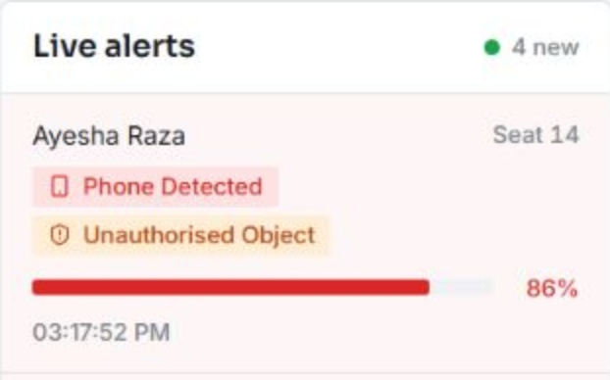
COMPLETED WORK
Phone and book detection
Visible objects produce review alerts in the teacher portal.
Recognition
Phone and book detection uses the real object model.
Responsive preview
Background inference keeps the video feed moving.
Linked evidence
Stable detections save a snapshot against the selected seat.
Recorded browser test with sample accounts
PROCTORAI
University panel presentation
06
Notes:
PRESENTER NOTES
Explain the visible phone and book boxes and the teacher alert inbox. This is a recorded browser acceptance test using real models, the same application pages and disposable accounts. Phones and books are the only enabled object policy. Preview rates around 10–16 FPS were observed across recorded and webcam checks; that is not the neural inference speed. New objects need several seconds and multiple model observations to confirm. Visibility, distance, orientation and lighting affect detection. The displayed 93% and 77% values are model confidence, not measured accuracy.
SOURCE RECORD
Implementation and recorded checks: D:/FYP_fall_23/backend/LOCAL_PLATFORM.md
Detector implementation and validation: D:/FYP_fall_23/ai-engine/README.md
Screenshot: D:\FYP_fall_23\ai-engine\validation-output\platform\real-model-monitor.png
Status reviewed: 4 October 2026. Local prototype; no production or university-pilot claim.

Slide 7
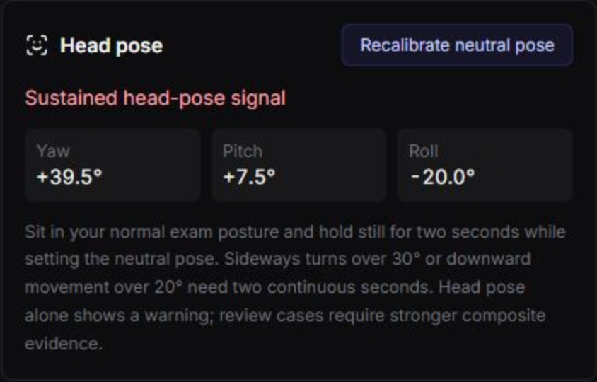
COMPLETED WORK
Calibrated head-pose monitoring
Angles relative to each student’s neutral posture
Neutral calibration
A short, stable forward pose sets the reference.
±30°
−20°
2 seconds
Sideways yaw
Downward pitch
Sustained movement
Head movement raises a warning and provides review context.
PROCTORAI
University panel presentation
07
Notes:
PRESENTER NOTES
The previous incorrect angle estimator was replaced with the MediaPipe canonical face transformation, a stable rotation calculation and neutral calibration. Yaw beyond either 30-degree side or pitch below minus 20 degrees must persist for two seconds. Smoothing and hysteresis reduce flicker; missing faces clear stale angles. Earlier guided webcam checks verified neutral posture and both sideways directions. The downward webcam check was inconclusive because the face became occluded. Geometry and timing regression tests cover pitch. The final integrated browser run verified neutral calibration but not a fresh live sideways warning, at the user's request. This screenshot comes from the earlier webcam validation, not the final role-based monitor.
SOURCE RECORD
Head-pose validation: D:/FYP_fall_23/ai-engine/HEAD_POSE_VALIDATION.md
Implementation and recorded checks: D:/FYP_fall_23/backend/LOCAL_PLATFORM.md
Screenshot: D:/FYP_fall_23/ai-engine/validation-output/head-pose-live/website-sustained-turn.png
Status reviewed: 4 October 2026. Local prototype; no production or university-pilot claim.

Slide 8
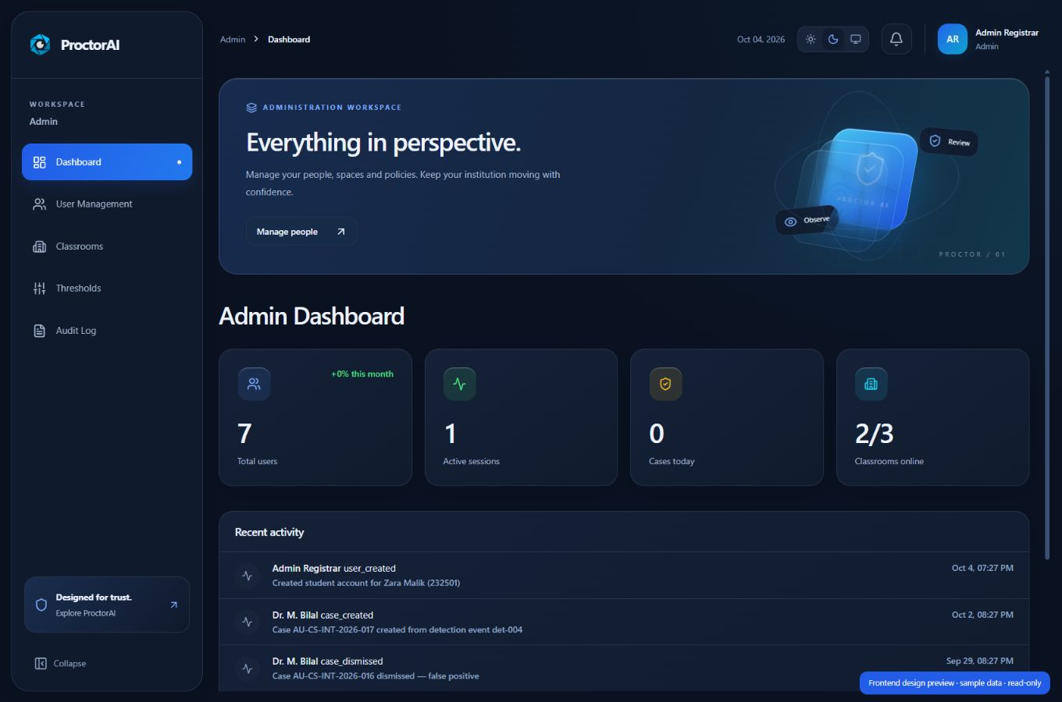
ROLE HIERARCHY
Five portals with defined responsibilities
Admin
Users, rooms, settings and all CSV imports
Exam Controller
Exam schedule and invigilator assignments
Teacher
Seat setup, camera sessions and alert review
HOD / Dean
Case decisions, penalties and appeal review
Student
Own case records, notices and appeals
Dark-mode design preview with sample data
PROCTORAI
University panel presentation
08
Notes:
PRESENTER NOTES
Permissions are enforced by the backend as well as role-based frontend routing. Teachers see assigned sessions; students see only their own cases. Admin may import all four CSV categories, while Exam Controller may import schedules and invigilator assignments. HOD and Student do not receive import access. The screenshot illustrates the refreshed dark-mode frontend and uses sample data, not institutional deployment results. The case workflow and role restrictions were tested separately using disposable browser accounts and server tests.
SOURCE RECORD
Implementation and recorded checks: D:/FYP_fall_23/backend/LOCAL_PLATFORM.md
Role and import service: D:/FYP_fall_23/backend/app/services/csv_imports.py
Screenshot: C:\Users\ahmar\.codex\visualizations\2026\10\03\01a10308-5947-7382-a685-072252f067c7\proctorai-redesign\admin-dark.png
Status reviewed: 4 October 2026. Local prototype; no production or university-pilot claim.

Slide 9
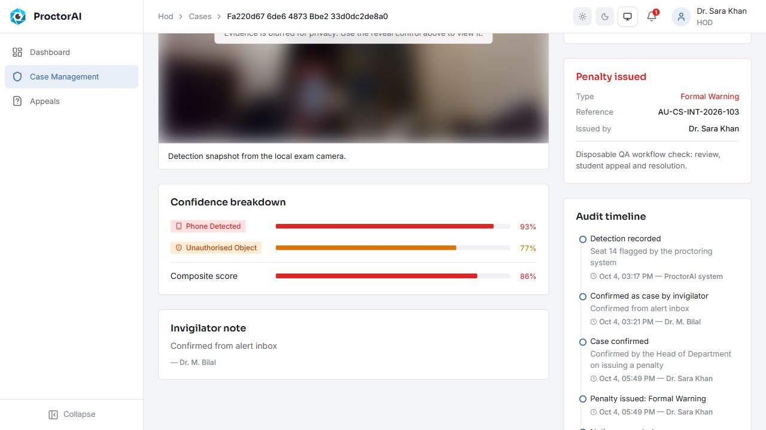
COMPLETED WORK
A complete human review workflow
1
Detection and saved evidence
2
Teacher confirms or dismisses
3
HOD reviews and decides
4
Student receives notice and may appeal
5
HOD resolves the appeal
Recorded case review with sample accounts
Accepted appeals revoke the penalty.
PROCTORAI
University panel presentation
09
Notes:
PRESENTER NOTES
The recorded browser workflow passed teacher confirmation, HOD formal warning and notice, student appeal, HOD acceptance, dismissed case and revoked penalty in the student view. The evidence access and notice download routes enforce permissions. A pending review record can be created by a stable detection; human confirmation is required for a confirmed misconduct case and a human HOD decision for any penalty. Current notice downloads are text. Branded PDF generation and email delivery remain planned. The event score helps review and is not a probability of guilt.
SOURCE RECORD
Implementation and recorded checks: D:/FYP_fall_23/backend/LOCAL_PLATFORM.md
Screenshots: D:\FYP_fall_23\ai-engine\validation-output\platform\hod-case-review.png and student-resolution.png
Status reviewed: 4 October 2026. Local prototype; no production or university-pilot claim.

Slide 10
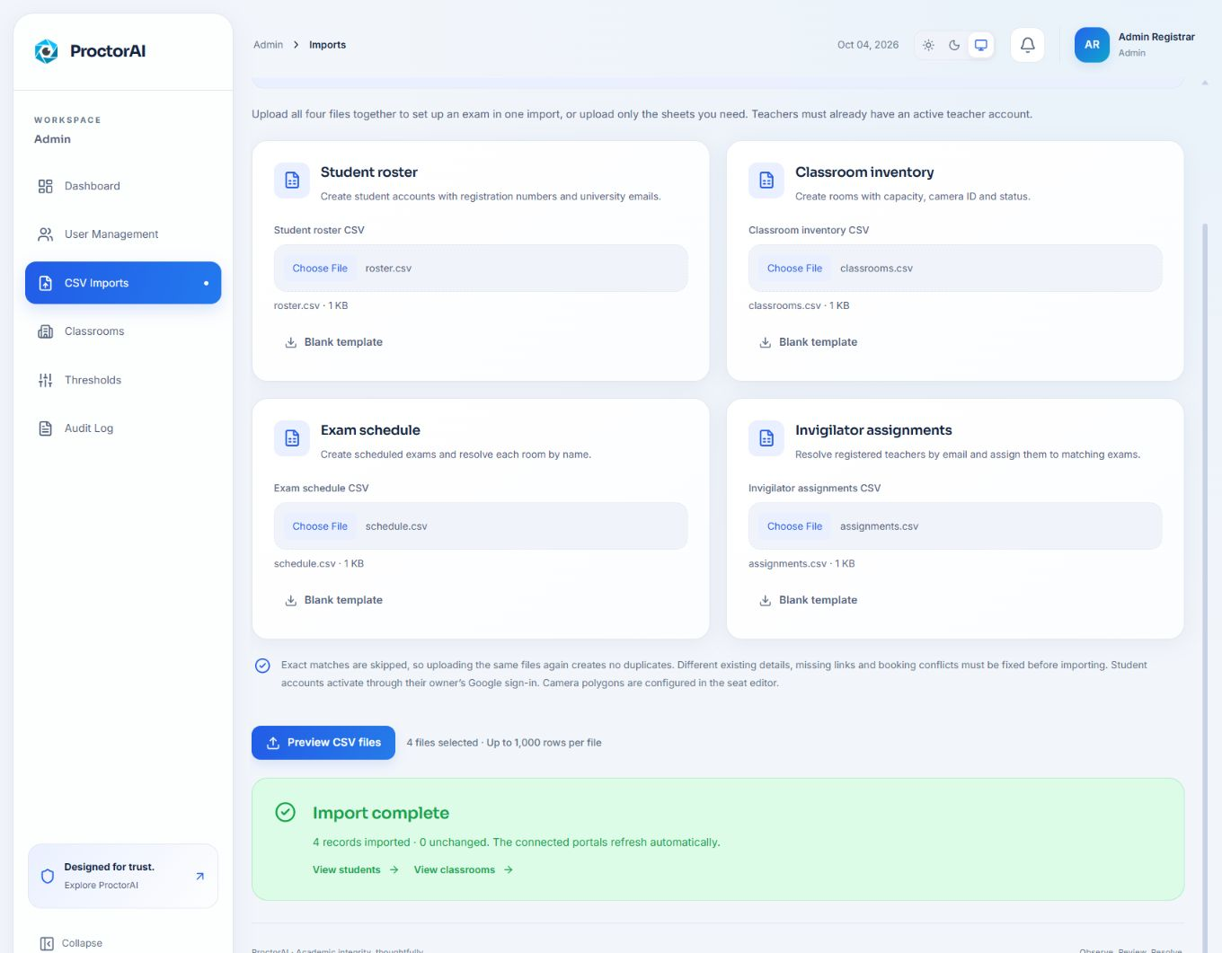
COMPLETED WORK
CSV files automate exam setup
Four reusable inputs
Student roster
Classroom inventory
Exam schedule
Invigilator assignments
Validation before saving
Linked records, conflict checks and duplicate protection.
PROCTORAI
University panel presentation
10
Notes:
PRESENTER NOTES
The operator uploads all four CSVs or the permitted subset. The system validates headers, identifiers, dates, institutional emails, cross-file links and room/teacher booking conflicts before a preview. Saving is atomic; exact existing matches are skipped and a stale preview must be revalidated. The browser test imported four related records, reflected them in the appropriate portals, and skipped all four on a repeated upload. Admin handles all inputs; Controller handles schedule and invigilator files. Teachers must already have active accounts, students activate through institutional Google sign-in, and camera polygons still require alignment.
SOURCE RECORD
Implementation and recorded checks: D:/FYP_fall_23/backend/LOCAL_PLATFORM.md; CSV import setup
Importer: D:/FYP_fall_23/backend/app/services/csv_imports.py
Screenshot: C:\Users\ahmar\.codex\visualizations\2026\10\03\01a10308-5947-7382-a685-072252f067c7\proctorai-redesign\csv-imports.png
Status reviewed: 4 October 2026. Local prototype; no production or university-pilot claim.

Slide 11
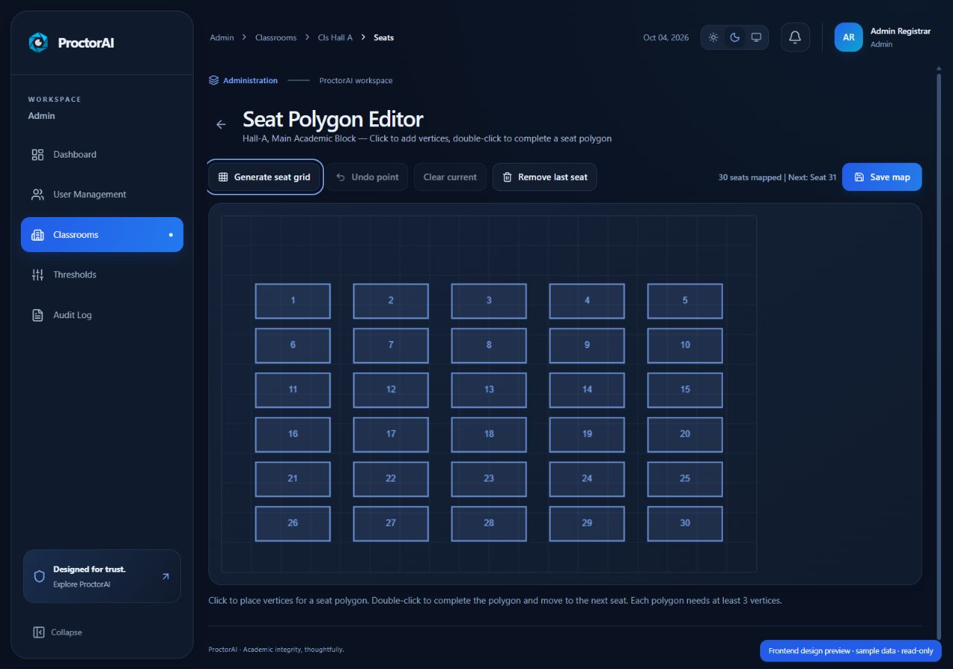
COMPLETED WORK
Reusable seat maps and setup templates
Generate a layout
Create a reusable seat grid for the exam room.
Assign students
Import registered student numbers into numbered seats.
Align the camera
Adjust seat polygons to match the real camera view.
Seat-grid design preview with sample data
PROCTORAI
University panel presentation
11
Notes:
PRESENTER NOTES
The setup toolkit provides reusable seat assignment CSVs, printable seat-map SVGs and draft polygon JSON. Presets support 30, 60 and 120 seats with configurable layouts. Teachers upload assignments, while Admin maintains the camera seat map. A generated grid is a planning aid and must be manually aligned to a classroom camera; it does not implement automatic face-to-seat attribution across a hall. This screenshot uses the frontend design preview with sample data.
SOURCE RECORD
Implementation and recorded checks: D:/FYP_fall_23/backend/LOCAL_PLATFORM.md
Frontend setup toolkit and seat polygon editor in D:/FYP_fall_23/src
Screenshot: C:\Users\ahmar\.codex\visualizations\2026\10\03\01a10308-5947-7382-a685-072252f067c7\proctorai-redesign\seat-grid.png
Status reviewed: 4 October 2026. Local prototype; no production or university-pilot claim.

Slide 12
STATUS AS OF 4 OCTOBER 2026
Current development progress
Area | Current status | Evidence or next step
Core monitoring | Working local prototype | Phone/book alerts and calibrated head pose
Web portals | Integrated | Five roles, authentication and live record refresh
Case review | Workflow verified | Teacher review, HOD decision and student appeal
Exam setup | Browser tested | Four CSV inputs, permissions and seat tools
Notices and devices | Partially implemented | Text notices and MQTT; PDF, email and ESP32 pending
Full-room AI | Remaining work | Gaze/lip signals, multiple students and pilot study
PROCTORAI
University panel presentation
12
Notes:
PRESENTER NOTES
Use this table to state the progress directly. There is no invented completion percentage. Working local prototype means the feature exists and has relevant local checks; it does not mean all classroom conditions have been validated. Notice text generation and a backend MQTT connector exist, but branded PDF/email delivery and a physical ESP32 room demonstration do not. Current camera integration monitors one clearly visible selected student. The AI notice service has a deterministic fallback if the external API is unavailable or its output fails checks.
SOURCE RECORD
Implementation and recorded checks: D:/FYP_fall_23/backend/LOCAL_PLATFORM.md
Head-pose validation: D:/FYP_fall_23/ai-engine/HEAD_POSE_VALIDATION.md
Detector implementation and validation: D:/FYP_fall_23/ai-engine/README.md
Notice service: D:/FYP_fall_23/backend/app/services/notices.py
MQTT service: D:/FYP_fall_23/backend/app/services/mqtt.py
Status reviewed: 4 October 2026. Local prototype; no production or university-pilot claim.

Slide 13
RECORDED EVIDENCE
Verification completed so far
102
272
80
AI and bridge regression checks
Backend checks in the prior full run
Checks in the latest focused CSV and role run
Browser acceptance
Real-model phone/book alerts, saved evidence, case review, appeal resolution and repeat CSV import.
These test groups overlap. A controlled accuracy benchmark is still pending.
PROCTORAI
University panel presentation
13
Notes:
PRESENTER NOTES
These are recorded successful test runs, not newly executed presentation-time tests. The latest focused CSV/role/scheduling run passed 80 tests with 203 deselected. The prior full backend run passed 272 tests. The AI and bridge regression suite passed 102 tests. Do not add these counts into a total because backend and focused groups overlap. The production frontend build passes, and lint exits successfully with existing warnings. Neutral and both sideways head movements passed earlier webcam checks; integrated sideways and downward validation remain limited. No precision, recall, F1 or false-positive percentage is claimed from these checks.
SOURCE RECORD
Implementation and recorded checks: D:/FYP_fall_23/backend/LOCAL_PLATFORM.md
Head-pose validation: D:/FYP_fall_23/ai-engine/HEAD_POSE_VALIDATION.md
Recorded CSV/import verification from the current project development record
Status reviewed: 4 October 2026. Local prototype; no production or university-pilot claim.

Slide 14
NEXT MILESTONES
Remaining work before the university pilot
Complete the detection scope
Finish delivery integrations
Add and validate gaze and lip movement; support multiple mapped students.
Verify the ESP32 alert node; add branded PDFs and email delivery.
Run controlled evaluation
Prepare institutional deployment
Measure precision, recall, false alarms, latency and classroom robustness.
Validate privacy and retention, consent, real roles and pilot operation.
Next milestone: validate the complete MVP in a real classroom.
PROCTORAI
University panel presentation
14
Notes:
PRESENTER NOTES
The remaining work closes the gap between the current single-student local prototype and the single-room MVP. Prioritize safe face-to-seat attribution and individual calibration for multiple students, camera-angle and lighting trials, long-duration stability and object confirmation latency. Gaze and silent-mode lip detection require careful false-positive testing. Build and test the physical ESP32 node and its latency, branded PDF notice rendering and email delivery confirmation. The scope proposes ten consenting volunteers and ground-truth scripted behaviors. Review consent, evidence access, face blur and retention against the final institutional policy before the pilot. Phase 2 exclusions remain outside this completion plan.
SOURCE RECORD
Scope: C:/Users/ahmar/Downloads/ProctorAI_Scope_Document.docx; sections 5, 8, 15 and 16
Implementation and recorded checks: D:/FYP_fall_23/backend/LOCAL_PLATFORM.md
Head-pose validation: D:/FYP_fall_23/ai-engine/HEAD_POSE_VALIDATION.md
Status reviewed: 4 October 2026. Local prototype; no production or university-pilot claim.

Slide 15
WORKING LOCAL WEBSITE
Panel demonstration plan
01
Prepare the exam
Import setup CSVs and show the linked schedule and seat roster.
02
Start monitoring
Use an assigned teacher session and select the registered seat.
03
Show the review process
Detect a visible phone/book and open the saved evidence.
04
Resolve a case
Show HOD review, the student appeal and the final outcome.
PROCTORAI
University panel presentation
15
Notes:
PRESENTER NOTES
Use only an approved demonstration environment with sample records. Start services, warm the object model and confirm camera access before the panel arrives. Avoid running the model benchmark or a production build during the demo. Show http://127.0.0.1:5173 on this PC. Keep objects fully visible at the tested moderate distance and allow several seconds for confirmation. A short head-pose check is optional after stable neutral calibration; face visibility matters. Use the recorded screenshots if the camera or account switching fails. No automatic punishment is demonstrated. Never create demonstration penalties against actual student accounts.
SOURCE RECORD
Implementation and recorded checks: D:/FYP_fall_23/backend/LOCAL_PLATFORM.md
Detector implementation and validation: D:/FYP_fall_23/ai-engine/README.md
Local website: http://127.0.0.1:5173
Status reviewed: 4 October 2026. Local prototype; no production or university-pilot claim.

Slide 16
DISCUSSION
A working local prototype
Monitoring, evidence and human review
connected in one platform.
Next milestone: a validated single-room university pilot.
Questions and demonstration
PROCTORAI
University panel presentation
16
Notes:
PRESENTER NOTES
Close with the completed result: the local platform connects phone/book detection, calibrated head pose, authorized evidence, five roles, review and appeal records, and CSV exam setup. Acknowledge that classroom-wide AI, other behavior signals, physical hardware, PDF/email delivery and controlled pilot evaluation remain. Invite questions, then run the prepared demonstration if time allows. Team responsibilities in the scope: Ahmar is AI and IoT lead, Moaz is backend lead, Ali is frontend lead; do not infer that every proposed assignment is finished.
SOURCE RECORD
Scope: C:/Users/ahmar/Downloads/ProctorAI_Scope_Document.docx
Implementation and recorded checks: D:/FYP_fall_23/backend/LOCAL_PLATFORM.md
Head-pose validation: D:/FYP_fall_23/ai-engine/HEAD_POSE_VALIDATION.md
Status reviewed: 4 October 2026. Local prototype; no production or university-pilot claim.

Slide 17
APPENDIX
Evaluation targets in the project scope
Targets for the controlled study. Performance benchmarking remains pending.
Measure | Scope target | Verification plan
Phone detection | Precision ≥85% Recall ≥80% | 50 phone-visible and 50 absent events
Head/gaze false alarms | ≤10% | Scripted innocent behavior checks
AI throughput | ≥6 processed FPS | Inference across visible students
Physical alert latency | ≤500 ms | Detection-to-ESP32 activation time
Document and email | PDF ≤10 seconds Email delivery ≥95% | Timed PDF generation and 20 email trials
Portal role isolation | 0 unauthorized accesses | Forbidden-route checks for each role
PROCTORAI
University panel presentation
17
Notes:
PRESENTER NOTES
Use this only if asked how success will be measured. These are targets in the original scope, not established results. In particular, preview frame rate is not the six-FPS all-face AI processing target. The recorded phone/book confidence values are not precision and recall. The proposal suggests ten consenting participants with scripted suspicious and innocent behaviors and an observer recording ground truth. Security role-gate tests exist, while institutional configuration and a final comprehensive matrix should be included in the acceptance exercise.
SOURCE RECORD
Scope: C:/Users/ahmar/Downloads/ProctorAI_Scope_Document.docx; objectives and Table 9
Implementation and recorded checks: D:/FYP_fall_23/backend/LOCAL_PLATFORM.md
Head-pose validation: D:/FYP_fall_23/ai-engine/HEAD_POSE_VALIDATION.md
Status reviewed: 4 October 2026. Local prototype; no production or university-pilot claim.

