Slide 1

CYBERX CHATBOT PRESENTATION
BY MUHLURI AVRIL NKUNA

Slide 2
Introduction to CyberX Chatbot
CyberX is an interactive, console-based chatbot developed in C# with the purpose of educating users about essential cybersecurity principles in a conversational and engaging manner. Designed with both beginners and everyday internet users in mind, CyberX offers a personalized experience that blends educational content with an approachable, user-friendly interface.
Upon launch, CyberX welcomes users with a custom ASCII logo and optional voice greeting, simulating a polished and professional virtual assistant. The chatbot employs real-time typing effects to enhance immersion and realism, making users feel as if they are chatting with a real cybersecurity coach.
CyberX focuses on six key areas of digital safety:
🔐 Password Safety – Best practices for creating and maintaining secure passwords.
🐟 Phishing Awareness – Recognizing and avoiding malicious emails and scams.
🌐 Safe Browsing Habits – Tips for navigating the internet securely.
📱 Social Media Security – How to protect your identity and privacy on platforms.
📶 Public Wi-Fi Risks – Understanding threats in unsecured networks.
🎭 Identifying Online Scams – Spotting and avoiding deceptive tactics.
By using color-coded text, simulated typing, and optional audio enhancements, CyberX goes beyond static content to deliver a dynamic learning experience. The structure is modular, allowing future integration with AI APIs, GUI frameworks (e.g., WinForms, WPF), or web interfaces.

Slide 3
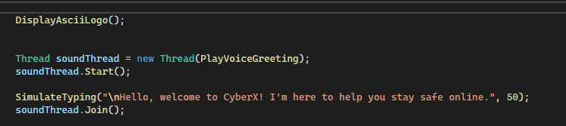
About CyberX
CyberX is an interactive console-based chatbot designed to educate users about cybersecurity in a friendly and engaging way. It opens with a stylized logo and audio greeting, followed by a menu-driven conversation where users can explore various cyber safety topics. The chatbot simulates typing and uses colored text to improve interaction and learning experience.

Slide 4
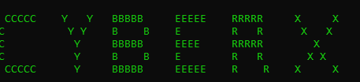
ASCII Branding CyberX ASCII Logo
To create a strong visual identity, the program features a branded ASCII logo displayed in green. This is the first element users see and helps build a recognizable and consistent interface.

Slide 5
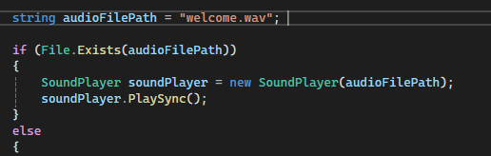
Voice Greeting Integration
Voice Interaction – Welcome Sound
To enhance accessibility and interactivity, the chatbot plays a voice greeting from a .wav file when the application starts. This makes the user feel welcomed and improves the overall experience.

Slide 6
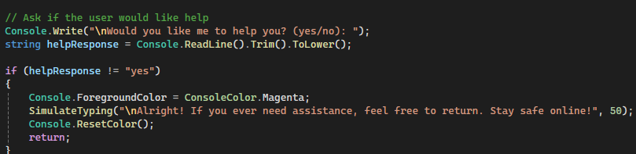
Personalized Chat Flow Engaging the User
CyberX uses a simple question to check if the user wants assistance. If the answer is yes, it requests their name to personalize the responses, making the interaction feel human and relatable.

Slide 7
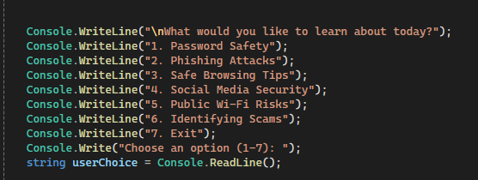
Main Menu Navigation Cyber Topics Menu
The main chatbot loop presents a clear menu of six key cybersecurity topics. Users can explore each section at their own pace, and the chatbot guides them with clear instructions and tips.

Slide 8
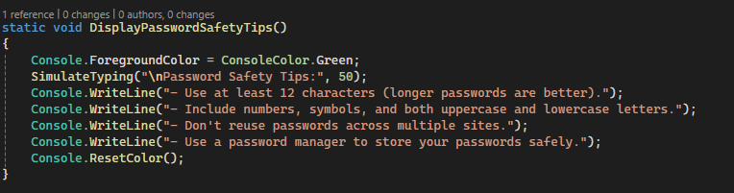
Educational Tips – Example Password Safety Guidance
Each menu option reveals a set of easy-to-understand, practical safety tips. For example, under "Password Safety", users learn about length, complexity, and the value of using password managers.

Slide 9

Voice + Typing Effect Typing Simulation
To simulate a human conversation, the chatbot displays text character-by-character with a typing delay. This keeps the user focused and creates a calm reading pace.
foreach (char c in message)
{
Console.Write(c);
Thread.Sleep(delay);
}

Slide 10
Color Coding for Readability Color Integration
Console colors are used to highlight different types of messages:
Green for topic headings
Magenta for farewells
Red for errors or invalid inputs

Slide 11
Exiting the Chat User-Friendly Exit
When users choose to exit, CyberX closes the chat with a personalized thank-you message. This polite and respectful ending reinforces the importance of cybersecurity.

Slide 12
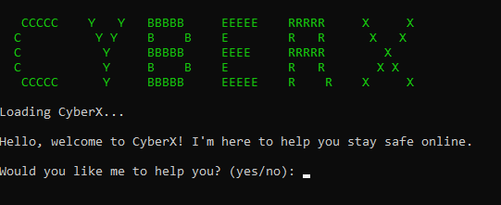
Conclusion
CyberX is more than a chatbot , it's an interactive learning assistant. By combining text, color, typing simulation, and voice interaction, the program delivers a friendly and effective experience that raises awareness about staying safe online. Future improvements could include GUI implementation and real-time chat features.

