Slide 1

CYBER DYNAMICS
CYBER SECURITY AWARENESS CHATBOT
BY TIYASE NTESENG

Slide 2

INTRODUCTION
1. Introduction • What the program does: • The Cybersecurity Awareness Bot is a console interactive application that will ask users to engage in a chat to generate awareness on cybersecurity issues. The bot can provide information on password security, phishing, and secure browsing. • The bot also supports a voice greeting feature and displays a customized ASCII Art logo when it is launched.

Slide 3

Code breakdown
2. Name: The application takes input from the user asking for their name and uses it to personalize the greeting.
Key Techniques:
• User input is taken by the application using Console.ReadLine() and checked for null or empty.
* Personalized greeting is achieved with string interpolation and Console.ForegroundColor for the formatting.
b. PlayVoiceGreeting() Method
• Function: Plays a voice greeting at startup, using the SoundPlayer class to play and load an audio file (greeting.wav).
Important Techniques:
* The SoundPlayer class is used to play and load the .wav file.
* Error handling is achieved with a try-catch block to catch any exceptions (e.g., if the file is unavailable or cannot be played).
* If the greeting cannot be played, an error message is printed to the user using Console.ForegroundColor to emphasize the error.
c. DisplayAsciiArtLogo() Method
* Purpose: Prints an ASCII Art logo in the console using the Console.WriteLine() statement.
* Techniques Used:
• The string containing the ASCII art is written to the console.
* The Console.ForegroundColor is used to change the color of the output so that the logo stands out.

Slide 4

CODE BREAKDOWN (CONT`)
d. ChatLoop() Method
* Purpose: This method provides an infinite loop to keep on communicating with the user.
* It takes input and provides responses based on specific keywords (e.g., "password safety", "phishing").
• In case the user input is not matching any of the pre-defined keywords, it asks the user to repeat his question.
Techniques:
• It makes use of Console.ReadLine() to retrieve user input and the string.Contains() method to check for keywords in the input.
* Color coding (Console.ForegroundColor) is used for distinguishing the bot's reply from other output.
* It asks if the user wishes to continue chatting by looking for a "yes/no" answer.
* The loop continues until the user chooses to quit by typing "no."

Slide 5
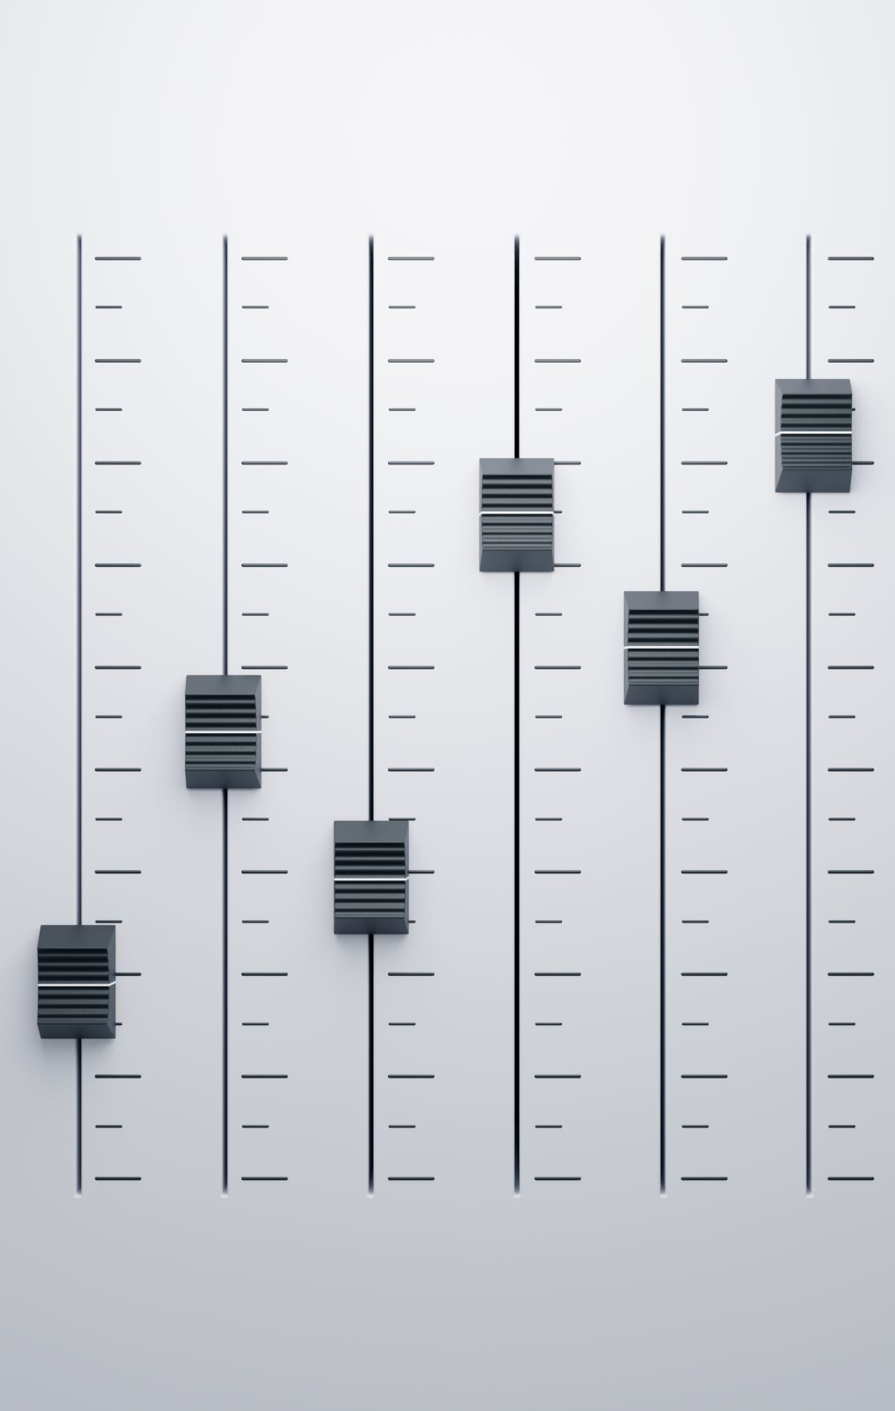
Main features & Techniques
3. Main Features & Techniques • Voice Integration: • The SoundPlayer class is used to play and load a .wav file. You may explain how voice integration adds an interactive element to the program and enhances the usability. • Illustrate how this feature works through explaining the PlayVoiceGreeting() method and how it enhances the user experience. • User Interaction: • The program uses an interactive approach where it keeps asking for user input and responds to keywords. Explain how this provides a dynamic user experience. • Formatting with Colors: • Explain how you use Console.ForegroundColor to color different parts of the output (e.g., green for the ASCII art logo, cyan for the greeting, and red for error messages). • You may also mention how the use of color helps organize the information and makes the bot look more professional

Slide 6

Challenges and solutions
4. Challenges & Solutions • Voice Greeting Issues: One problem that may arise is making the greeting sound play correctly. Describe how the try-catch block handles the errors that occur when the sound file gets lost or corrupted. • Processing a User Input: The bot can only act on pre-determined questions, so one constraint is that it will not be able to handle more complex or varied questions. But you can say how adding more conditional checks (e.g., for synonyms) would improve it.

Slide 7

Conclusion
The application combines interactive chat, voice greeting , ASCII art quite well to provide personalized and interactive Cyber Security Awareness experience.
The bot educates users educates users on basic Cybersecurity concepts in addition to demonstrating functional skills in C# including voice integration, string manipulation, and console formatting.
This is merely a starting point, and there is room for features such as adding more subjects, improving input recognition, or using a more advanced voice interface

