Slide 1

MIS PORTAL
Tally-Integrated Financial Intelligence — Live.
FINNPULSE TECH SERVICE
Presented by Rohan Mehta

Slide 2
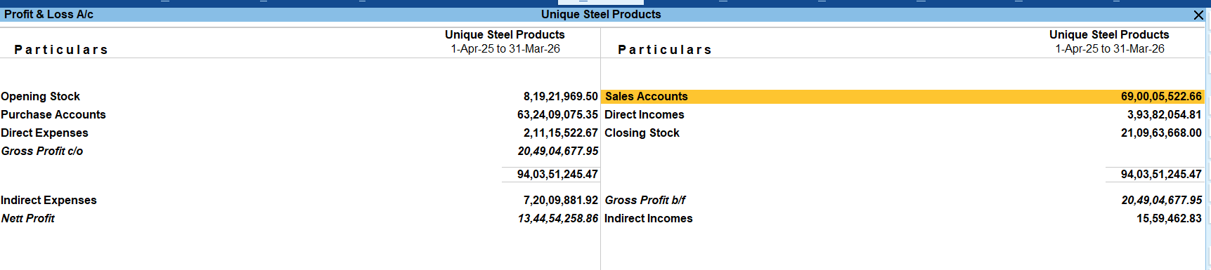



THE PROBLEM
Every Month-End, The Same Story
Manual exports from Tally into Excel, every single time
A report is outdated the moment a new voucher is posted
Your everyday Tally screen — accurate, but static and manual.
Clients keep seeing numbers that are days — or weeks — old
A backdated adjustment entry? No one notices until audit time
02

Slide 3
What if your Tally data became
a live dashboard — on its own?
No manual exports. No stale numbers.
03

Slide 4






THE SOLUTION
MIS Portal — One Place, Your Whole Business
Live Dashboard
MIS Reports
Ageing Reports
Revenue, profit, cash — one glance
Detailed monthly P&L, exportable
Receivables & payables, bucketed
Multi-Company
Auto-Sync
One-Click Export
One login, every client book
Straight from Tally, always current
Excel & CSV, client-ready
04

Slide 5
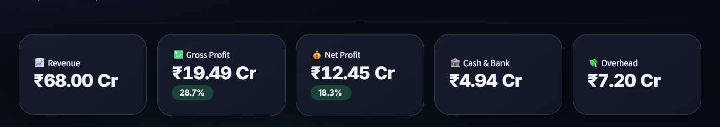

LIVE DEMO
A Live Management Dashboard
Every core number — Revenue, GP, NP, Cash & Bank, Overhead — at a glance
Trend charts: Revenue vs Profit, Overhead breakdown, month over month
Switch company & date range instantly, from the sidebar
05

Slide 6
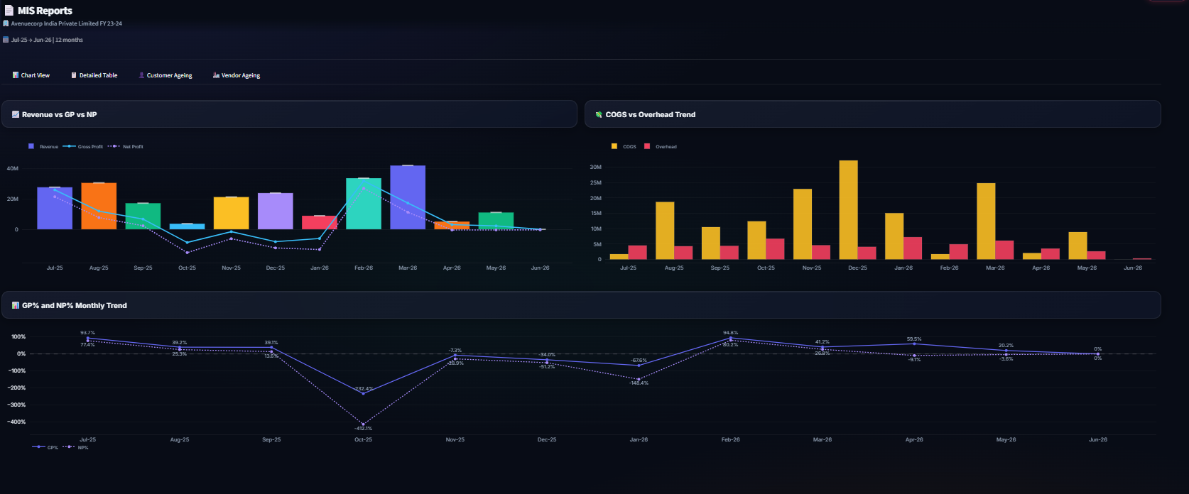
LIVE DEMO
MIS Reports — As Detailed As You Need
Revenue vs GP vs NP, COGS vs Overhead, and GP%/NP% trend — every month, one screen.
06

Slide 7
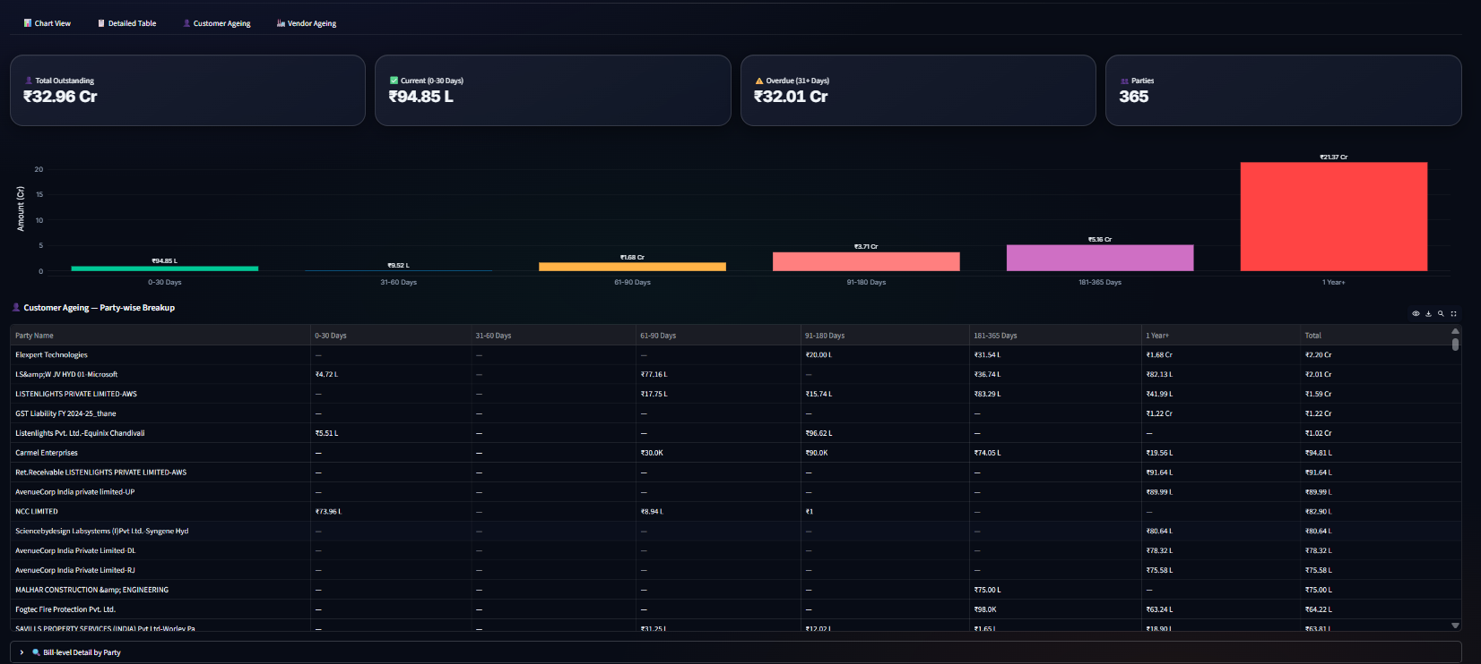
LIVE DEMO
Customer Ageing — Who Owes You, For How Long
Bucketed 0–30 to 1 Year+, with party-wise drill-down to the bill level.
07

Slide 8
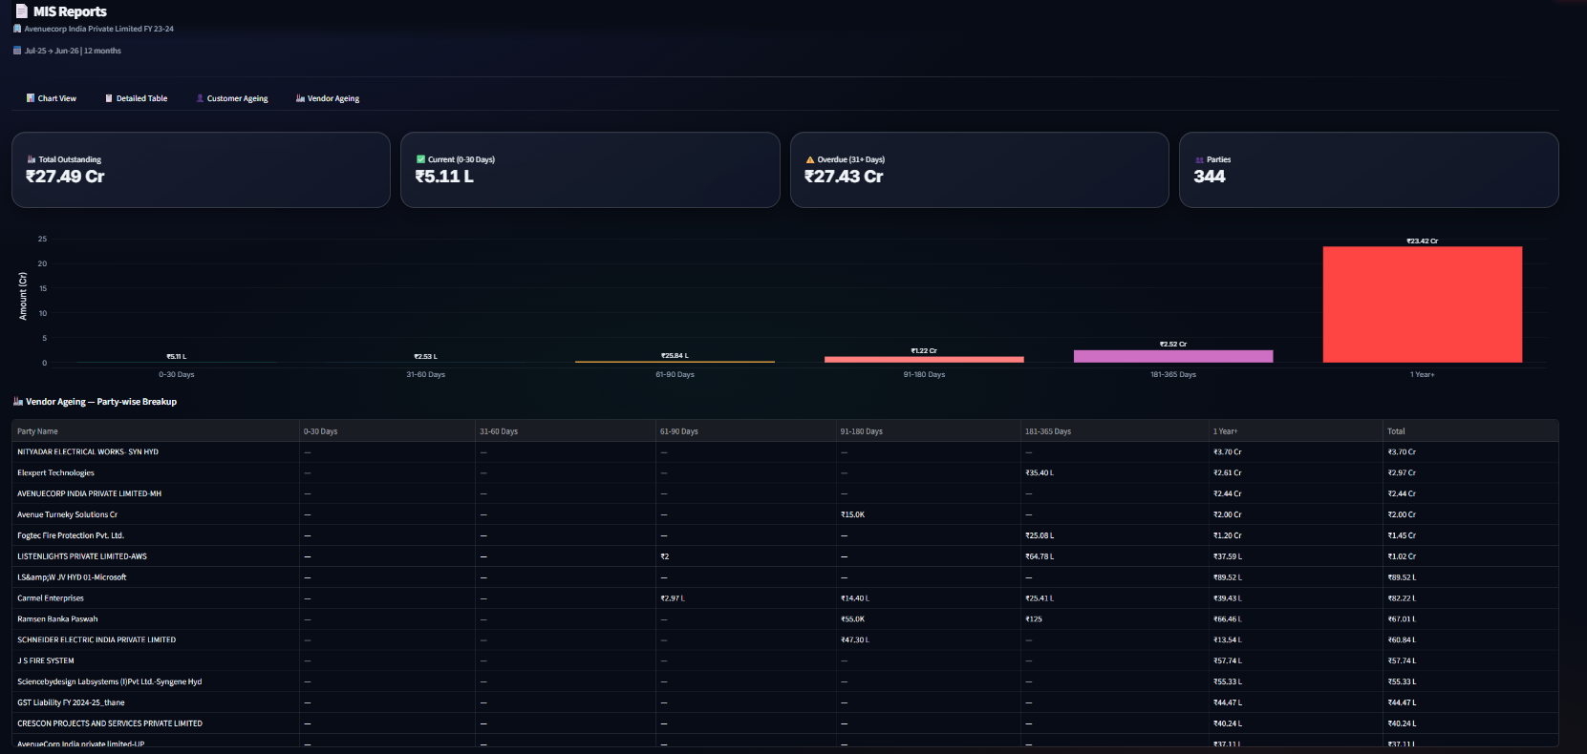
LIVE DEMO
Vendor Ageing — What You Owe, Just As Clearly
The same clarity for payables — nothing slips past due unnoticed.
08

Slide 9
WHY TRUST THE NUMBERS
The Numbers Are Always Live
We caught it ourselves — a subtle bug where Revenue was stuck on an old, frozen Tally figure instead of the live ledger total.
BEFORE — FROZEN
AFTER — LIVE
₹68.00 Cr
→
₹70.00 Cr
That is the kind of depth that makes numbers trustworthy.
09

Slide 10

WHY TRUST THE NUMBERS
Catches Backdated Entries Too
Post an adjusting entry into a month that’s already "closed"?
MIS Portal’s fiscal-year-aware sync automatically re-checks the whole financial year — not just from today onward — so a correction made in March still shows up correctly in July.
No missed adjustments. No year-end surprises.
10

Slide 11
HOW IT WORKS
From Tally To Dashboard — Automatically
→
→
Tally Prime
Auto-Sync Engine
MIS Portal
Your books, as always — no change to how you work
Reads live data, fiscal-year aware, handles corrections
Dashboard, reports & exports — always current
One click to sync — or let it auto-refresh quietly in the background.
11

Slide 12

BUILT FOR SCALE
Built For CA Firms & Multi-Business Owners
One login — every client’s books, in one place
Switch between companies instantly, no re-login
Each client sees only their own data
One consistent report format across every client
12

Slide 13



BUILT FOR SCALE
Your Clients See Only What They Should
Role-Based Access
Per-Client Controls
"View as Client"
Admin and Client roles, separate permissions
Turn Excel/PPT download on or off per client
Admins can support clients without ever sharing a password
13

Slide 14
RECAP
From This... To This.
BEFORE
AFTER
Manual Tally exports, every month
Live dashboard, always current
Reports outdated within a day
Real-time sync from Tally
Backdated entries go unnoticed
Fiscal-year-aware auto re-check
One report format, copy-pasted by hand
One-click Excel/CSV, client-named
14

Slide 15

WHAT’S NEXT
The Roadmap
Cash Flow Statement
Budget vs Actual
Mobile-Friendly View
Full Indirect Method, reconciled to the rupee
Plan against targets, month by month
Check your numbers from anywhere
15

Slide 16
Let’s Talk
Bring your Tally data to life.
FINNPULSE TECH SERVICE
Rohan Mehta
+91 96199 34745
Rohanmehta_rma@yahoo.in
Thank You
16

