Slide 1
Dependency Injection in Bevy
By: PROMETHIA
https://promethia-27.github.io/dependency_injection_like_bevy_from_scratch/

Slide 2
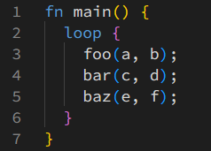
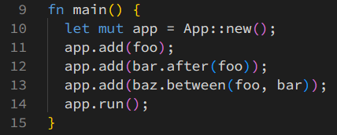
What is it?
Without:
With:

Slide 3
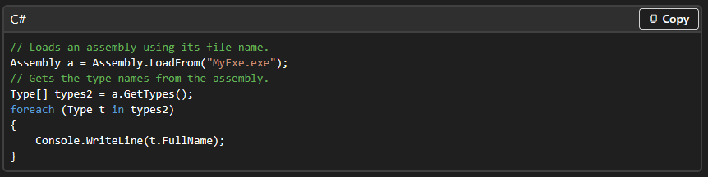
How?
Reflection

Slide 4
Why?
Change system signatures without changing call sites
Allow app to manage control flow automatically

Slide 5
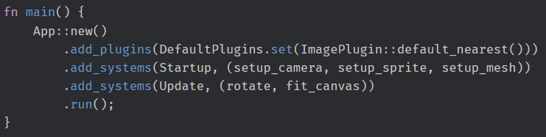
Dependency Injection In Bevy

Slide 6
How?
Rust has no reflection (yet)
Not bevy_reflect either
Function Traits

Slide 7
Key Insights
Every function has a unique type
Select a `Fn` impl by wrapping in a struct
Implement `System` for that struct

Slide 8
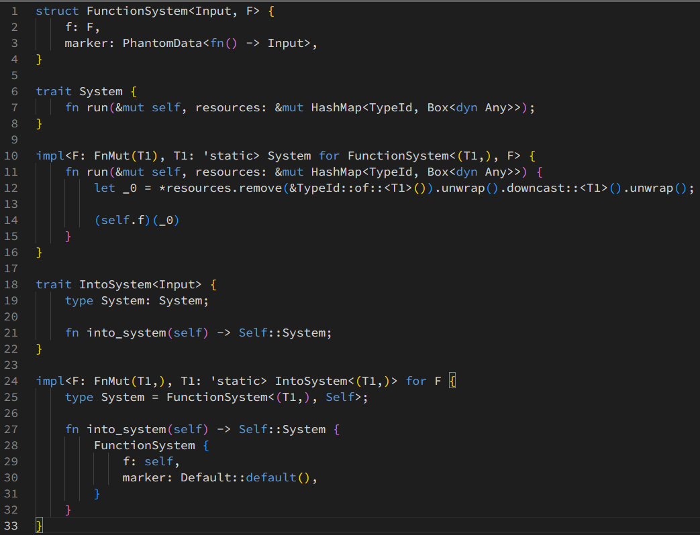

Slide 9
Notes:
Define system trait to run the system and allow the system to extract the parameters it wants from global storage

Slide 10
Notes:
Define a struct wrapper that selects a `Fn` implementation (limitation due to complexity of rust's type system, technically a function *could* have multiple impls)

Slide 11
Notes:
Implement `System` for that struct wrapper, extracting parameters and calling

Slide 12
Notes:
Define/implement helper trait to wrap the system, lets the `.add_system` function take the system directly instead of a FunctionSystem

Slide 13
Benefits
Declarative app definition
Change system parameters freely
Hook into system sets defined elsewhere
...

Slide 14
Drawbacks
Potential compile time hit
Complex for new users
Complex to develop/maintain
…?

Slide 15
Questions?

Slide 16
Thank you!

