Slide 1
Half Monthly Report
王福森
Notes:
8 分钟
进展，计划，问题

Slide 2
Intro
2024.03.08

Slide 3
Preliminaries
Bidirectional Transformation (BX)
Bidirectional Programming Language (Lenses)
Bidirectional Evaluation
A Core Calculus for Documents
documents & document languages
eight levels formal semantics of document languages (document calculus)
extend it with complex document features, e.g., Reactivity

Slide 4
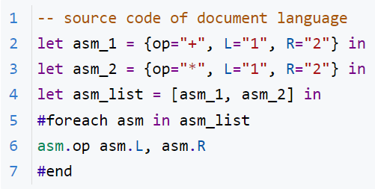
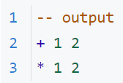
Bidirectional Document Calculus
Question: Design the Bidirectional Evaluation for the Core Calculus of Documents - more specifically - Article Template Program. Futhermore, explore the way to extend it with reactivity.
Motivation Example --value modification
forward evaluation

Slide 5

Bidirectional Document Calculus
Question: Design the Bidirectional Evaluation for the Core Calculus of Documents - more specifically - Article Template Program. Futhermore, explore the way to extend it with reactivity.
Motivation Example --value modification
forward evaluation
modify

Slide 6
Bidirectional Document Calculus
Question: Design the Bidirectional Evaluation for the Core Calculus of Documents - more specifically - Article Template Program. Futhermore, explore the way to extend it with reactivity.
Motivation Example --value modification
backward evaluation
forward evaluation
modify

Slide 7
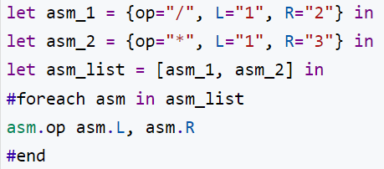
Bidirectional Document Calculus
Question: Design the Bidirectional Evaluation for the Core Calculus of Documents - more specifically - Article Template Program. Futhermore, explore the way to extend it with reactivity.
Motivation Example --value modification
backward evaluation
forward evaluation
modify

Slide 8

Bidirectional Document Calculus
Question: Design the Bidirectional Evaluation for the Core Calculus of Documents - more specifically - Article Template Program. Futhermore, explore the way to extend it with reactivity.
Motivation Example --structural modification
forward evaluation
modify

Slide 9
Bidirectional Document Calculus
Question: Design the Bidirectional Evaluation for the Core Calculus of Documents - more specifically - Article Template Program. Futhermore, explore the way to extend it with reactivity.
Motivation Example --structural modification
backward evaluation
forward evaluation
modify

Slide 10
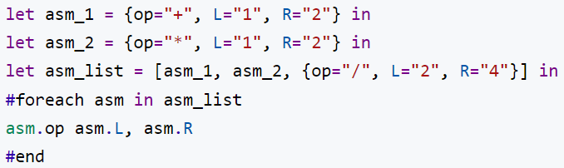
Bidirectional Document Calculus
Question: Design the Bidirectional Evaluation for the Core Calculus of Documents - more specifically - Article Template Program. Futhermore, explore the way to extend it with reactivity.
Motivation Example --structural modification
backward evaluation
forward evaluation
modify

Slide 11
Methodology
Forward evaluation of Document Calculus is a two-stage computing
desugar template into program
seems straightforward
need to define the bidirectional semantics for some primitive functions, e.g., map, flatten
forward evaluation of the desugared program
borrow the mature solution from bidirectional evaluation in the paper “Bidirectional Evaluation with Direct Manipulation, OOPSLA’18”
Extend it with Reactivity
exploring

Slide 12
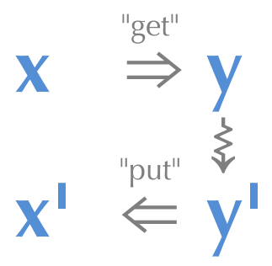
Bidirectional Programming Language
Lenses
get & put
round tripping property
[Ref] J. Nathan Foster, Michael B. Greenwald, Jonathan T. Moore, Benjamin C. Pierce, and Alan Schmitt. 2007. Combinators for bidirectional tree transformations: A linguistic approach to the view-update problem. ACM Trans. Program. Lang. Syst. 29, 3 (May 2007), 17–es. https://doi.org/10.1145/1232420.1232424

Slide 13
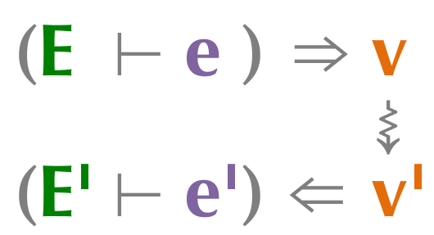
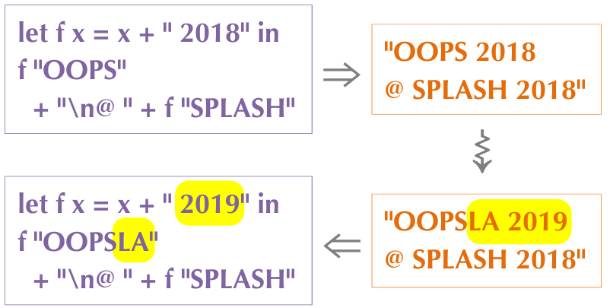
Bidirectional Evaluation
x : Programs
y : Results after the program being evaluated
[Ref] Mikaël Mayer, Viktor Kuncak, and Ravi Chugh. 2018. Bidirectional Evaluation with Direct Manipulation. Proc. ACM Program.Lang. 2, OOPSLA, Article 127 (oct 2018), 28 pages. https://doi.org/10.1145/3276497

Slide 14
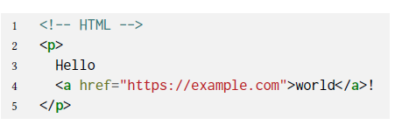
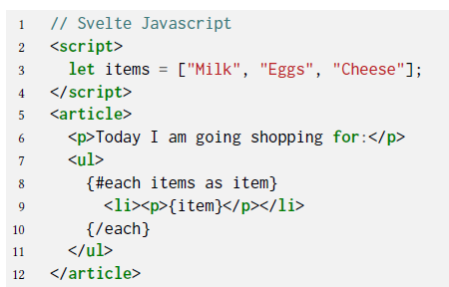
Document & Document Languages
Document
Document Languages

Slide 15
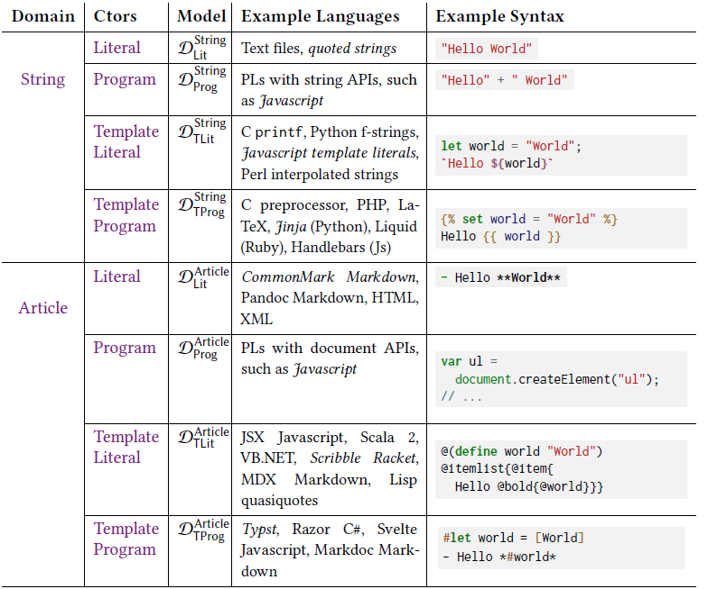
Formal Semantics of Document Languages
8 levels constructed from Domain × Constructor

Slide 16
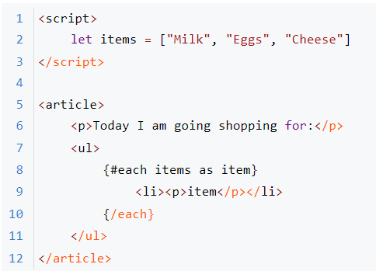
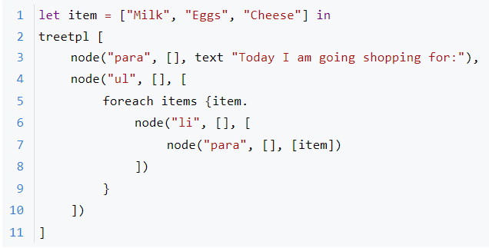
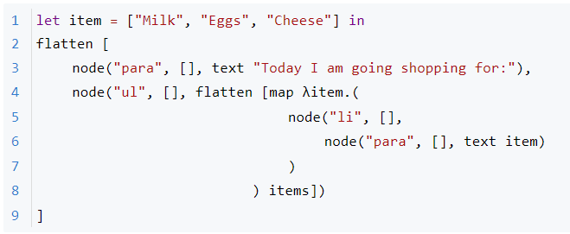
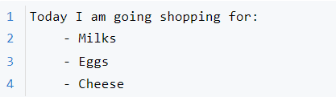
Forward Evaluation of Document Languages
Article Template Program
What we are familiar with
<Svelte Javascript>
Calculus Representation
<desugar>
Output
<evaluate>
After Desugaring

Slide 17
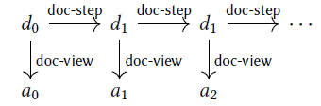
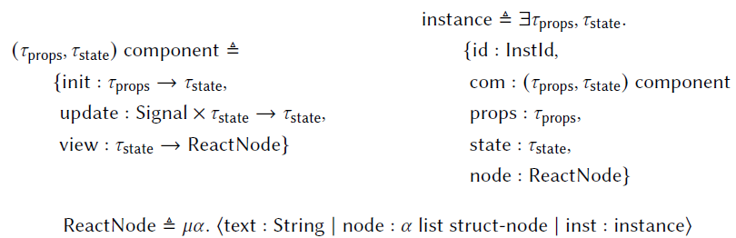
Extend it with Reactivity
Enable interaction with Document through Document Language
[Ref] Will Crichton and Shriram Krishnamurthi. 2024. A Core Calculus for Documents: Or, Lambda: The Ultimate Document. Proc. ACM Program. Lang. 8, POPL, Article 23 (January 2024), 28 pages. https://doi.org/10.1145/3632865

Slide 18
1
2024.03.08

Slide 19
Progress
Read the paper “A Core Calculus for Documents, POPL’24” and scan the code it implements.
Read the paper “Bidirectional Evaluation with Direct Manipulation, OOPSLA’18”
Find that there are gaps between the backward evaluation in stage two mentioned before and the backward evaluation semantics in OOPSLA’18 when multiple functions operating on list compose which the structural information gets lost, and find an ad-hoc solution

Slide 20
Next Plan
Make a summary of the core syntax and semantics of the document calculi - Article Template Program.
Find more examples that cover every primitive operations and perform backward evaluation using the backward evaluation semantics in OOPSLA’18 to find more gaps.
Fill the gaps using general solution (e.g., restrict the flexibility when modifying list and only modify value currently).
Implement it by coding.

Slide 21
Question
Does innovation matter in bachelor thesis?
Deadline of bachelor thesis and artifact?

