Slide 1
Half Monthly Report
王福森
Notes:
8 分钟
进展，计划，问题

Slide 2
Intro
2024.03.08

Slide 3
Preliminaries
Bidirectional Transformation (BX)
Bidirectional Programming Language (Lenses)
Bidirectional Evaluation
A Core Calculus for Documents
documents & document languages
eight levels formal semantics of document languages (document calculus)
extend it with complex document features, e.g., Reactivity

Slide 4
Bidirectional Document Calculus
Question: Design the Bidirectional Evaluation for the Core Calculus of Documents - more specifically - Article Template Program. Futhermore, explore the way to extend it with reactivity.
Motivation
The traditional way of authoring documents is intuitive, but it is inefficient when it comes to duplication and redundancy.
Authoring documents using program is efficient, but not intuitive and difficult to learn.
Design a novel document language, which not only supports the program to generate the documents, but also supports the direct manipulation of the document and synchronization of the program with the document, which combines both efficiency and intuition, as well as lowers the threshold.
Notes:
传统的文档编写方式直观，但是遇到重复和冗余时编写效率低
用程序生成文档的效率高，但是不直观、有门槛
提出一种文档语言，既支持程序生成文档，又支持对文档的直接修改同步更新程序。好处是既提高文档编写效率，又直观，且降低了编写门槛

Slide 5
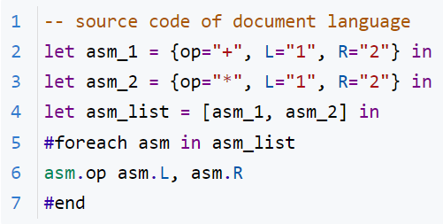
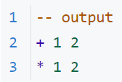
Bidirectional Document Calculus
Question: Design the Bidirectional Evaluation for the Core Calculus of Documents - more specifically - Article Template Program. Futhermore, explore the way to extend it with reactivity.
Motivation Example --value modification
forward evaluation

Slide 6

Bidirectional Document Calculus
Question: Design the Bidirectional Evaluation for the Core Calculus of Documents - more specifically - Article Template Program. Futhermore, explore the way to extend it with reactivity.
Motivation Example --value modification
forward evaluation
modify

Slide 7
Bidirectional Document Calculus
Question: Design the Bidirectional Evaluation for the Core Calculus of Documents - more specifically - Article Template Program. Futhermore, explore the way to extend it with reactivity.
Motivation Example --value modification
backward evaluation
forward evaluation
modify

Slide 8
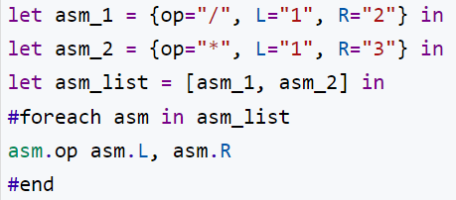
Bidirectional Document Calculus
Question: Design the Bidirectional Evaluation for the Core Calculus of Documents - more specifically - Article Template Program. Futhermore, explore the way to extend it with reactivity.
Motivation Example --value modification
backward evaluation
forward evaluation
modify

Slide 9

Bidirectional Document Calculus
Question: Design the Bidirectional Evaluation for the Core Calculus of Documents - more specifically - Article Template Program. Futhermore, explore the way to extend it with reactivity.
Motivation Example --structural modification
forward evaluation
modify

Slide 10
Bidirectional Document Calculus
Question: Design the Bidirectional Evaluation for the Core Calculus of Documents - more specifically - Article Template Program. Futhermore, explore the way to extend it with reactivity.
Motivation Example --structural modification
backward evaluation
forward evaluation
modify

Slide 11
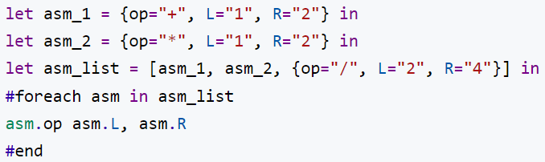
Bidirectional Document Calculus
Question: Design the Bidirectional Evaluation for the Core Calculus of Documents - more specifically - Article Template Program. Futhermore, explore the way to extend it with reactivity.
Motivation Example --structural modification
backward evaluation
forward evaluation
modify

Slide 12
Methodology
Forward evaluation of Document Calculus is a two-stage computing
desugar template into program
seems straightforward
need to define the bidirectional semantics for some primitive functions, e.g., map, flatten
forward evaluation of the desugared program
borrow the mature solution from bidirectional evaluation in the paper “Bidirectional Evaluation with Direct Manipulation, OOPSLA’18”
Extend it with Reactivity
exploring

Slide 13
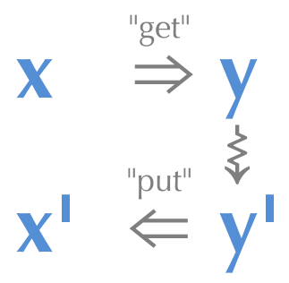
Bidirectional Programming Language
Lenses
get & put
round tripping property
[Ref] J. Nathan Foster, Michael B. Greenwald, Jonathan T. Moore, Benjamin C. Pierce, and Alan Schmitt. 2007. Combinators for bidirectional tree transformations: A linguistic approach to the view-update problem. ACM Trans. Program. Lang. Syst. 29, 3 (May 2007), 17–es. https://doi.org/10.1145/1232420.1232424

Slide 14
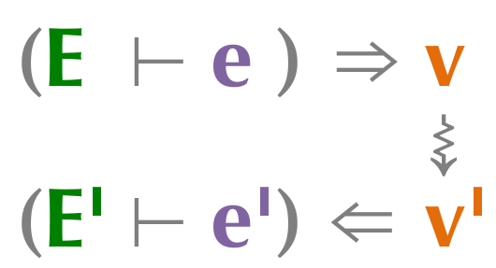
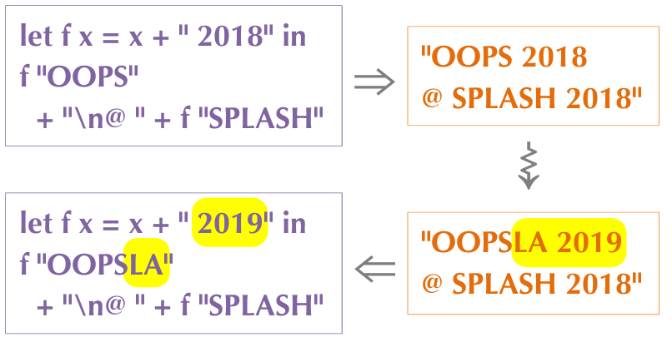
Bidirectional Evaluation
x : Programs
y : Results after the program being evaluated
[Ref] Mikaël Mayer, Viktor Kuncak, and Ravi Chugh. 2018. Bidirectional Evaluation with Direct Manipulation. Proc. ACM Program.Lang. 2, OOPSLA, Article 127 (oct 2018), 28 pages. https://doi.org/10.1145/3276497

Slide 15
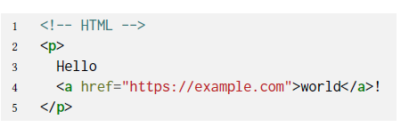
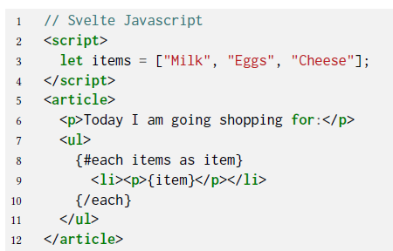
Document & Document Languages
Document
Document Languages

Slide 16
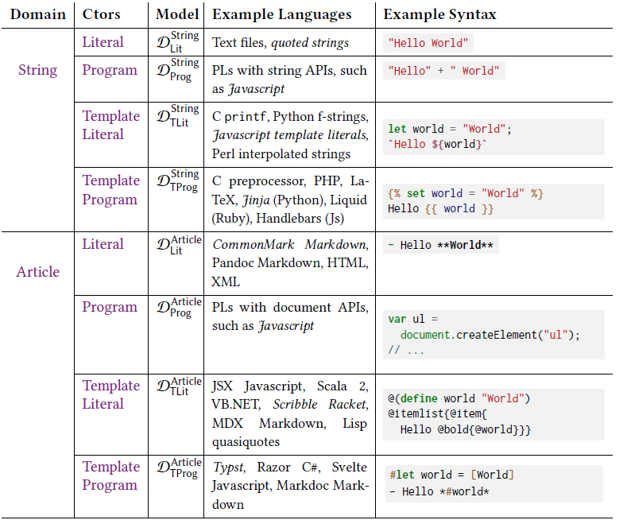
Formal Semantics of Document Languages
8 levels constructed from Domain × Constructor

Slide 17
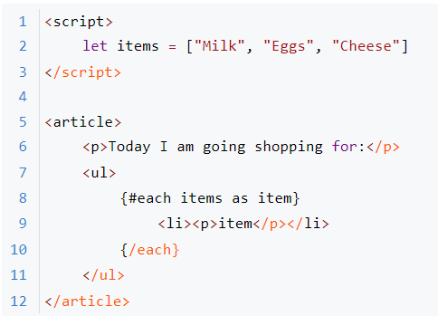
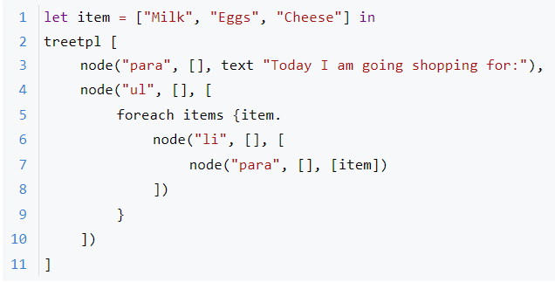
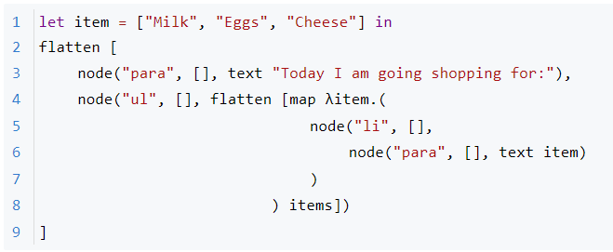
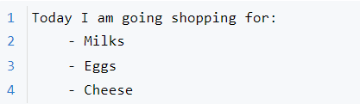
Forward Evaluation of Document Languages
Article Template Program
What we are familiar with
<Svelte Javascript>
Calculus Representation
<desugar>
Output
<evaluate>
After Desugaring

Slide 18
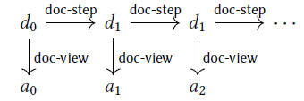
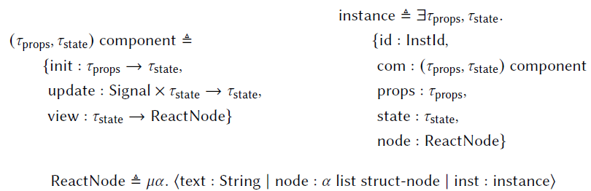
Extend it with Reactivity
Enable interaction with Document through Document Language
[Ref] Will Crichton and Shriram Krishnamurthi. 2024. A Core Calculus for Documents: Or, Lambda: The Ultimate Document. Proc. ACM Program. Lang. 8, POPL, Article 23 (January 2024), 28 pages. https://doi.org/10.1145/3632865

Slide 19
1
2024.03.08

Slide 20
Progress
Read the paper “A Core Calculus for Documents, POPL’24” and scan the code it implements.
Read the paper “Bidirectional Evaluation with Direct Manipulation, OOPSLA’18”
Find that there are gaps between the backward evaluation in stage two mentioned before and the backward evaluation semantics in OOPSLA’18 when multiple functions operating on list compose which the structural information gets lost, and find an ad-hoc solution

Slide 21
Next Plan
Make a summary of the core syntax and semantics of the document calculi - Article Template Program.
Find more examples that cover every primitive operations and perform backward evaluation using the backward evaluation semantics in OOPSLA’18 to find more gaps.
Fill the gaps using general solution (e.g., restrict the flexibility when modifying list and only modify value currently).
Implement it by coding.

Slide 22
Question
Does innovation matter in bachelor thesis?
Deadline of bachelor thesis and artifact?

Slide 23
2
2024.03.22

Slide 24
Changes to Overall Plan
Make a summary of the core syntax and semantics of the document calculi - Article Template Program.
Extend the existing BLP system (Bidirectional Preview) to support templates, which enables content modification of list
Extend the current system with the ability of structural modification of list
Find more examples that cover every primitive operations and perform backward evaluation using the backward evaluation semantics in OOPSLA’18 to find more gaps.
Fill the gaps using general solution (e.g., restrict the flexibility when modifying list and only modify value currently).
Implement it by coding.

Slide 25
Progress
Make a summary of the core syntax and semantics of the document calculi - Article Template Program.
Extend the existing BLP system (Bidirectional Preview) to support templates, which enables content modification of list
Read the source code of Bidirectional Preview. Done.
Remove all the hole out of it. Done.
Add concatenation of string. Done.
Add Forward - String Template. Doing.
Syntax & Parser
Desugar
Add Backward - String Template. Not Start
Add Forward & Backward - Article Template. Not Start
Exploring Structural Modification of List. Not Start

Slide 26
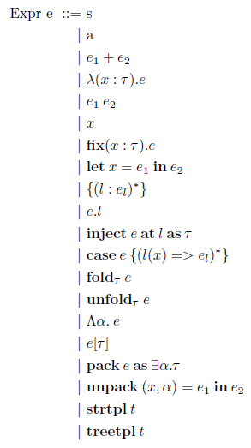
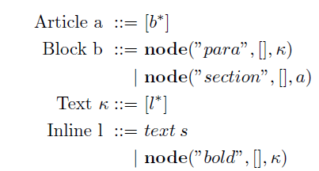
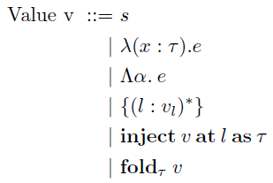
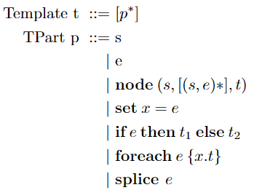
Summary of the syntax - Article Template Program

Slide 27
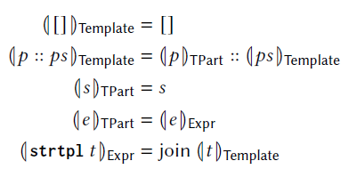
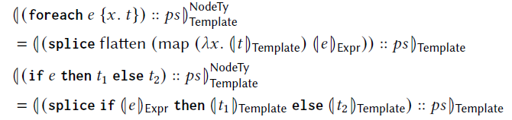
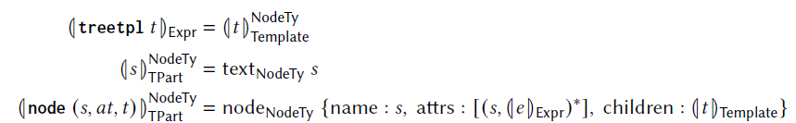


Summary of the semantics - Article Template Program
: semantics of desguaring
: semantics of forward evaluation

Slide 28
Next Plan
Read the source code of Bidirectional Preview. Done.
Remove all the hole out of it. Done.
Add concatenation of string. Done.
Add Forward - String Template. Doing. This Week
Syntax & Parser
Desugar
Add Backward - String Template. Not Start This Week
Add Forward & Backward - Article Template. Not Start Before Next Thursday
Exploring Structural Modification of List. Not Start ...

Slide 29
Question
...

