Slide 1
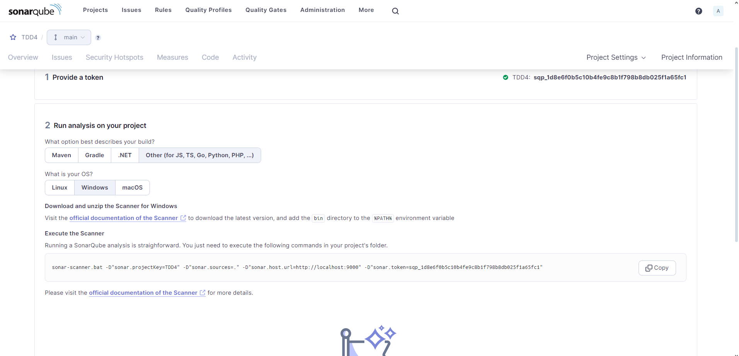
Static Code Analysis Tool Setup: SonarQube

Slide 2
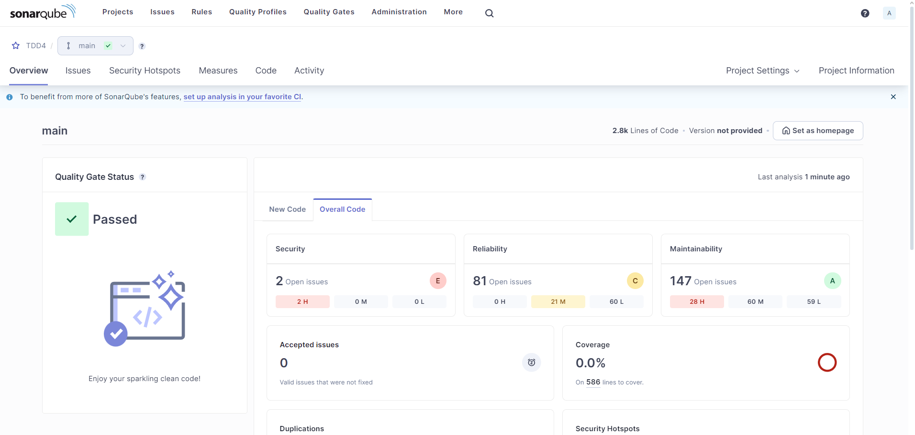
Static Code Analysis Tool Setup: SonarQube

Slide 3
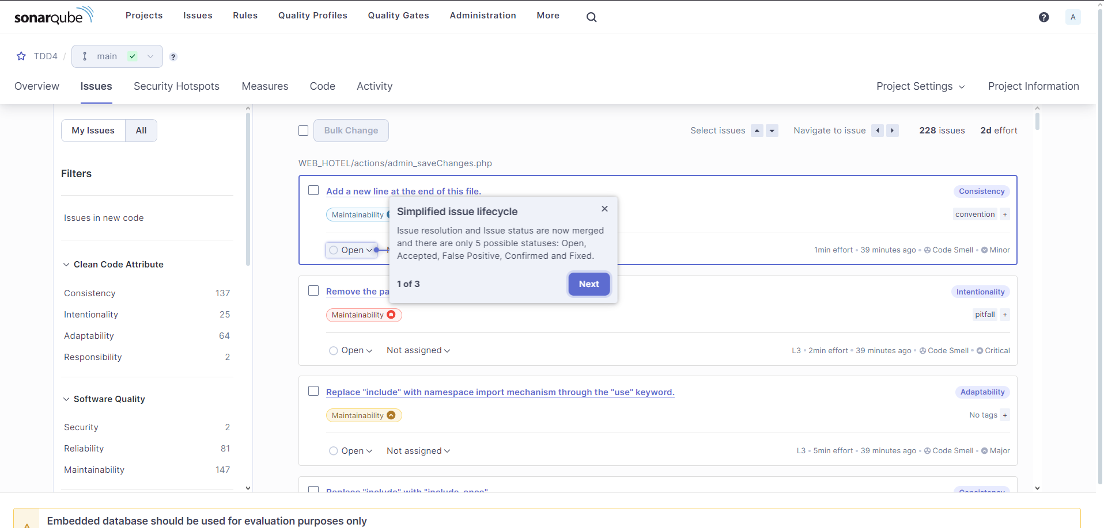
Static Code Analysis Tool Setup: SonarQube

Slide 4
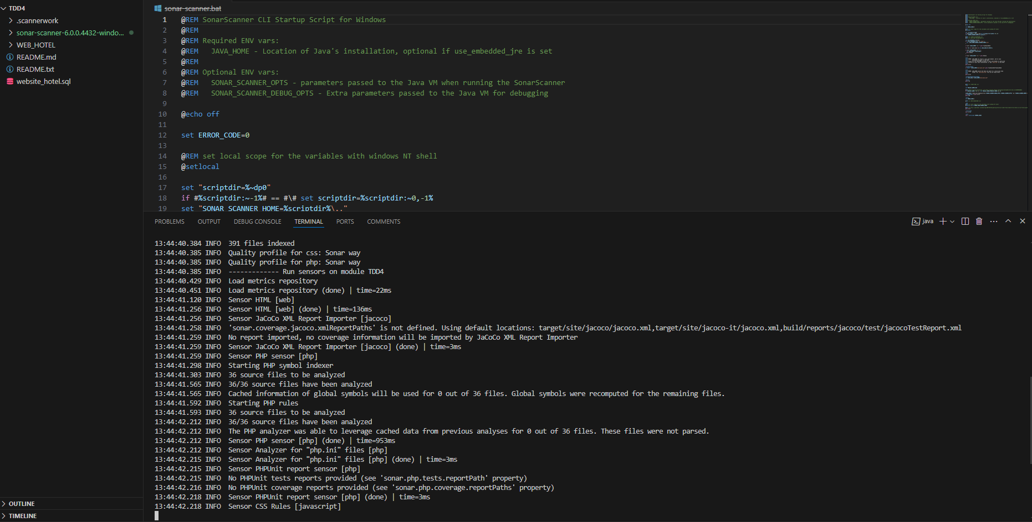
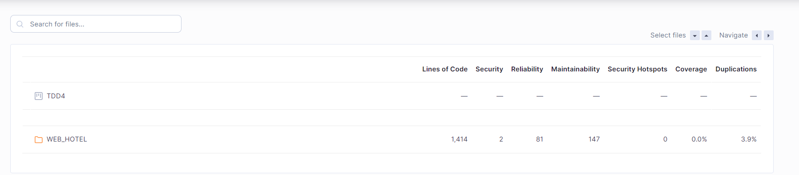
Static Code Analysis Tool Setup: SonarQube

Slide 5
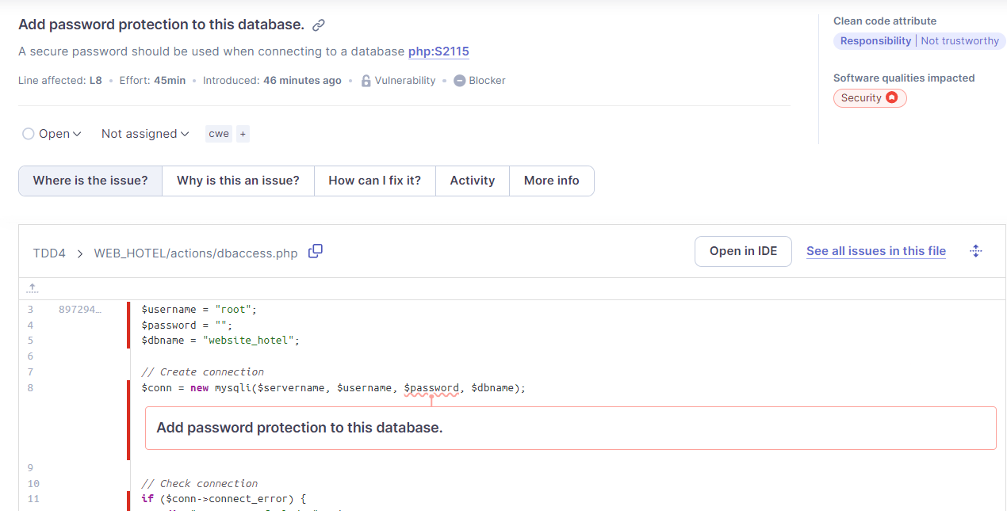
10 Most Import Findings:

Slide 6
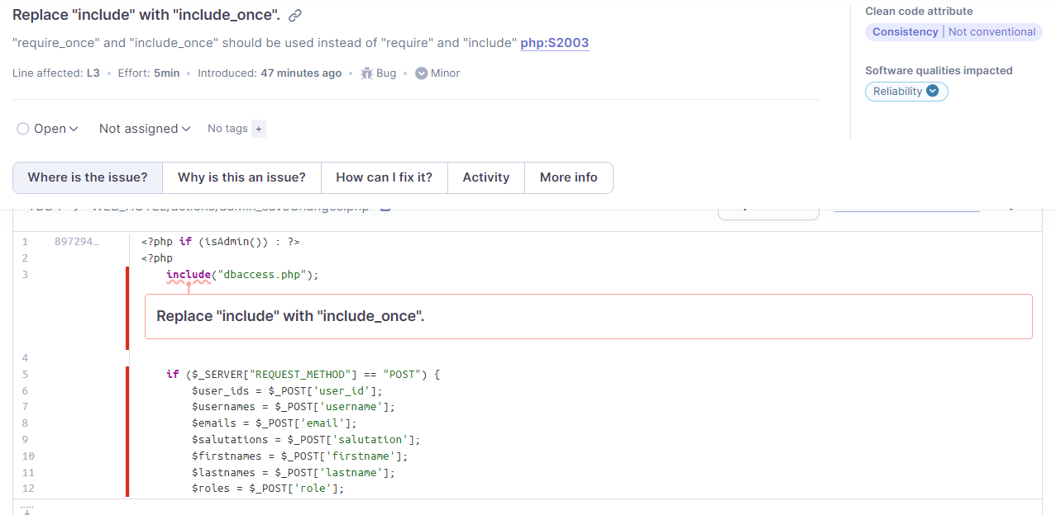
include -> include_once in all files

Slide 7
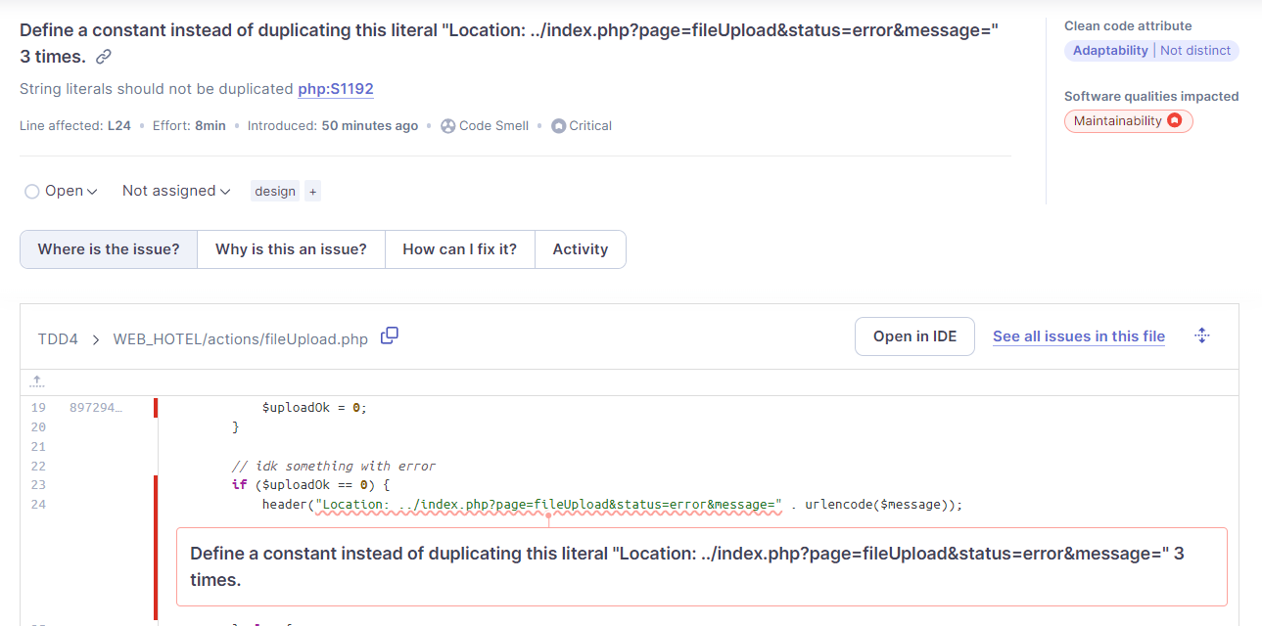
Define a constant

Slide 8
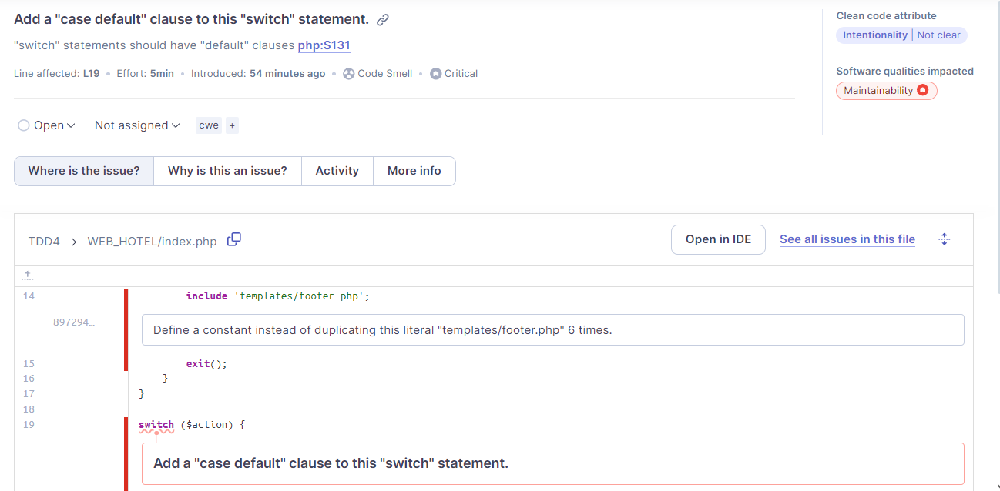
Case Default

Slide 9
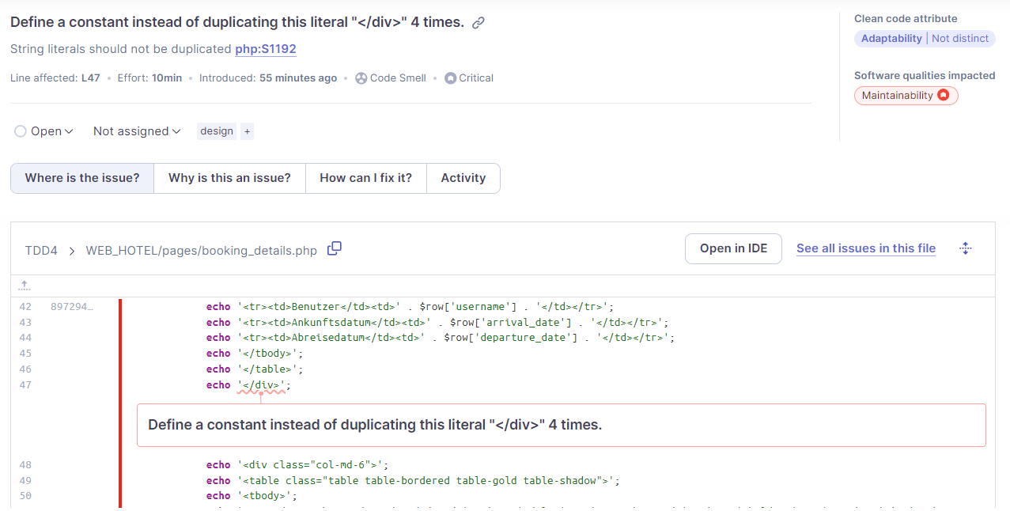
Define a constant div

Slide 10
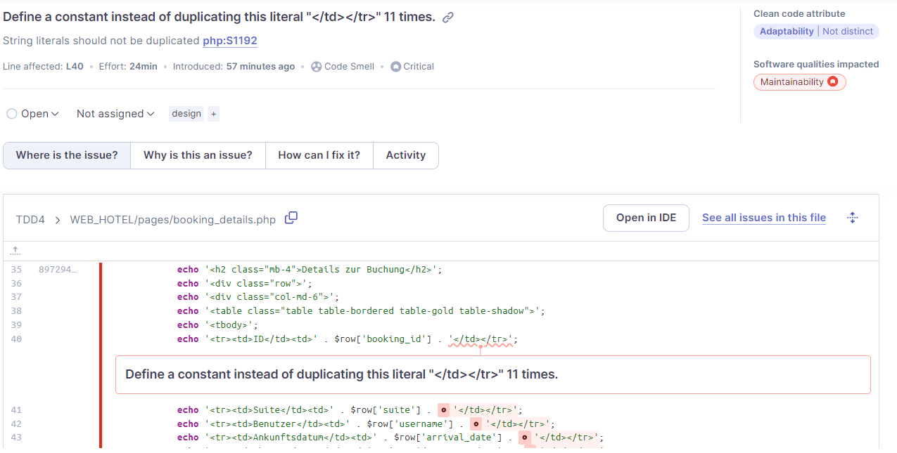
Define a constant td

Slide 11
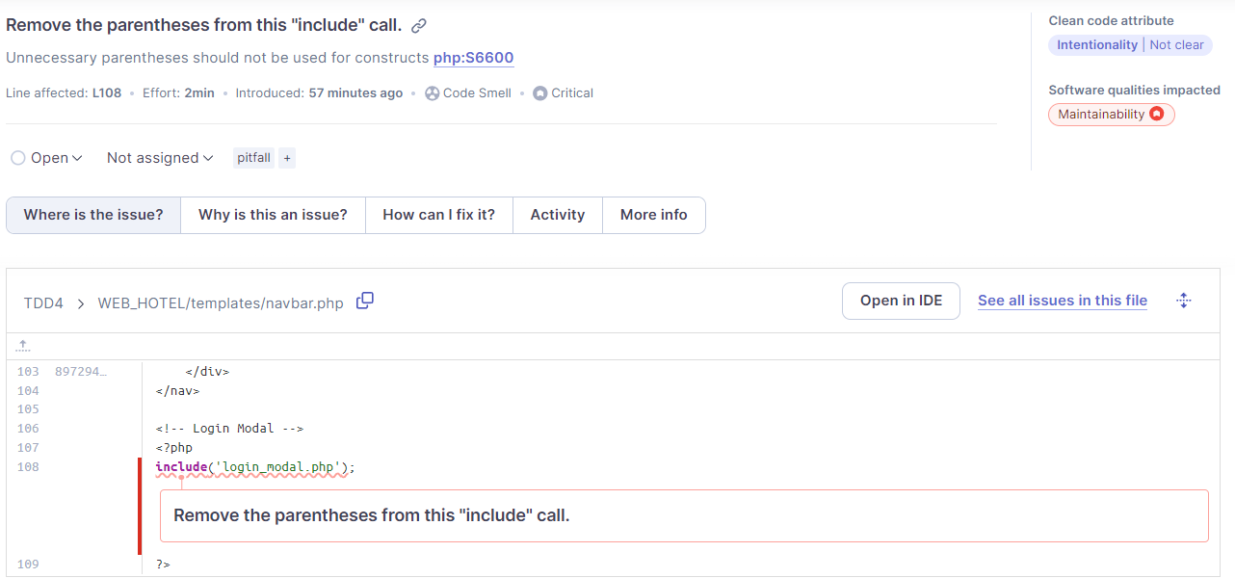
Remove parantheses

Slide 12
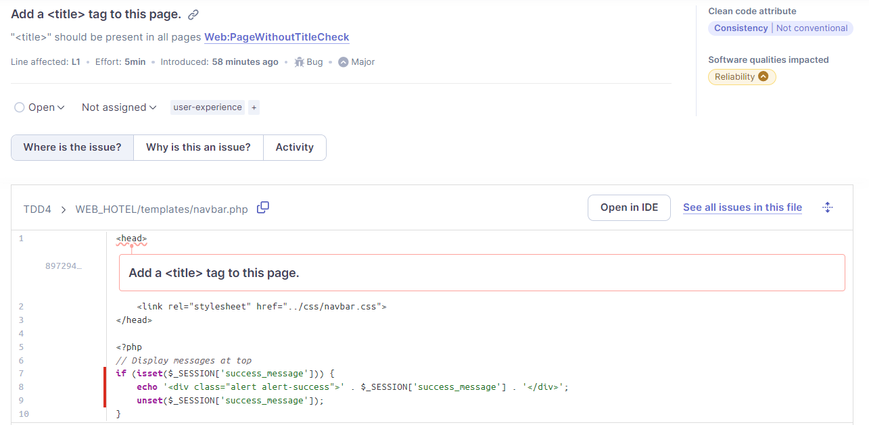
Title tag

Slide 13
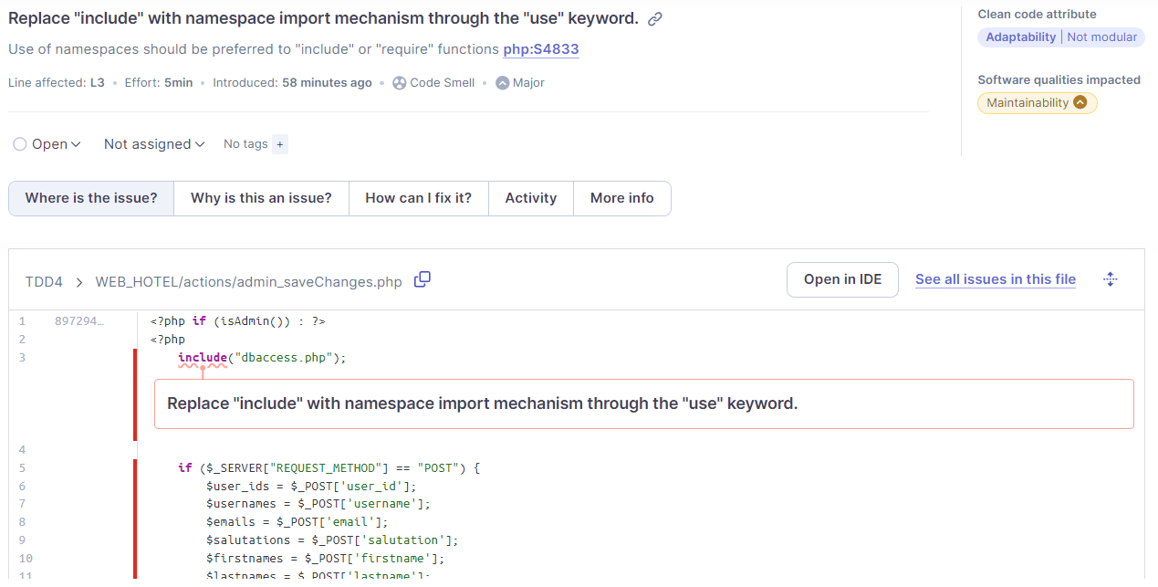
Replace include

