Slide 1
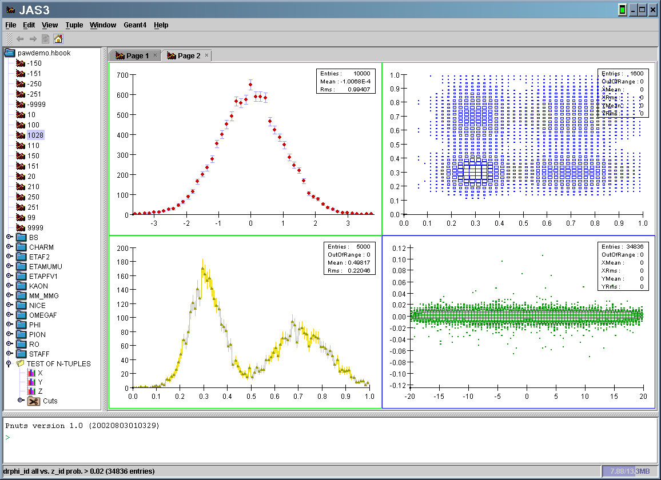
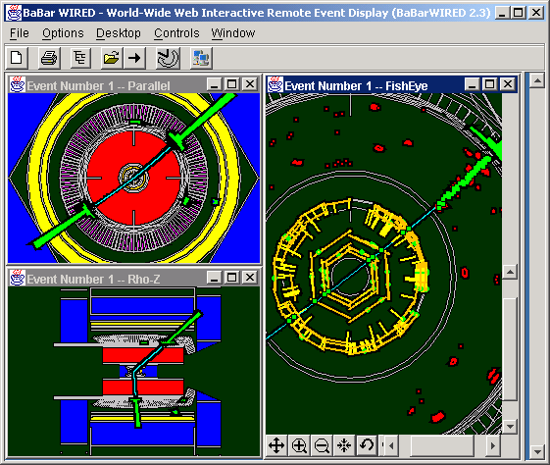
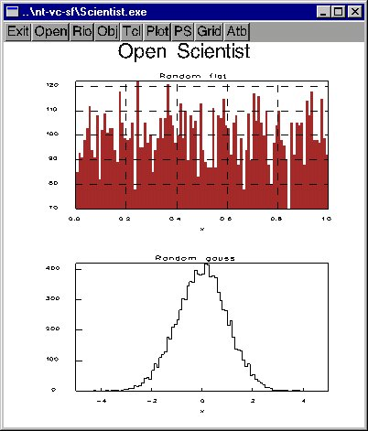
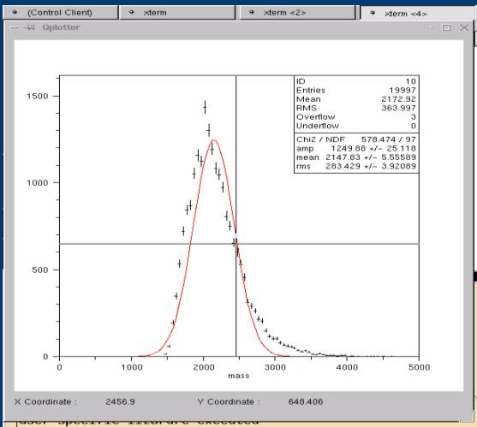
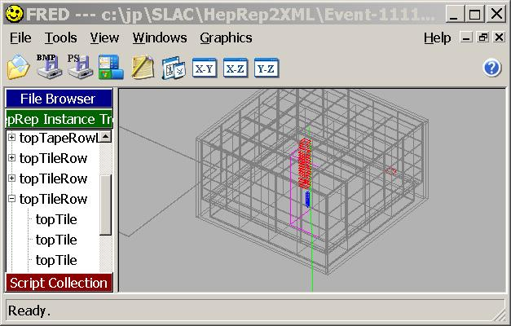
Analysis Tools for HEP http://www.freehep.org
Experiment Independent
Abstract Interfaces
Component Architecture
  Experiment or collaboration choose the interfaces; end users choose the desktop tool
  Based on well-defined, flexible, language neutral interfaces
BaBar, GLAST,
LCD, Geant4
Data Analysis
& Visualization
Event Display
Abstract Interfaces
AIDA
HepRep
IceCube, CLEO
JAS
WIRED
  Mark Dönszelmann
  Tony Johnson
  Joseph Perl
  Victor Serbo
  Max Turri
Open
Scientist
FRED
Lizard

