Slide 1
The FreeHEP Java Library http://java.freehep.org
ACAT 2000
Fermilab – October 2000
Mark Donszelmann, Julius Hrivnac – CERN
Gary Bower, Tony Johnson, Joseph Perl - SLAC
Charles Loomis – UC Santa Cruz

Slide 2
What is Freehep library
Started as a convergence of
    WIRED
    Java Analysis Studio (JAS)
  A common base library
    minimize unnecessary duplication of work
    maximize code reuse
  Soon realized many others working on Java
    Now have contributions from
      Atlas, Babar and US Linear Collider Detector (LCD)
    Others welcome to contribute
Today - a library of HEP-wide Java software
  Some very HEP specific (c.f. CLHEP)
  Some general purpose utilities

Slide 3
Goals
Open source
  All code and documentation in CVS, web browsable
  All code licensed under LGPL to make it freely reusable
  Preview area for partly-baked ideas
Minimal interdependence between packages
  Take what you like, leave what you don’t.
Pure Java where possible
  We include some C++ code
    In particular tools for helping Java and C++ to co-exist

Slide 4
Why Java?
We enjoy writing Java code
  OO, highly portable
  Maximizes programmer effectiveness
    No need to deal with memory leaks, core dumps, corrupted pointers
    Frees developer to concentrate on clean OO design
Java makes code reuse easy
  Use interfaces to separate interfaces and implementation
    Can support >1 implementation of same functionality
  No problem with incompatible base libraries

Slide 5
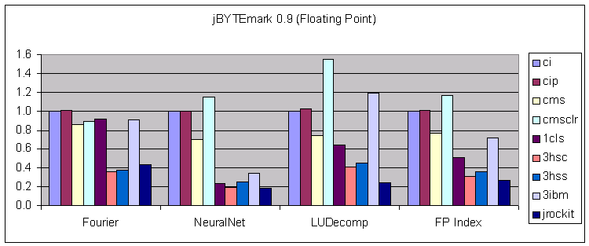
Isn’t Java too slow?
No!
  Huge advances have been made in last 4 years
    Dynamic code optimization
      Optimizes code while it is running
    Java now gives average of 60% of C++ performance
      Java performance continues to improve
      Static optimization (C++) is mature – no improvement expected

Slide 6
What does it contain?
Non-HEP specific
  2D Vector Graphics – generates .eps, .svg, …
  Studio – Hep Studio
  JACO – Java access to C++ Objects
  Jneeds – java package dependency
HEP specific
  hep.physics package
    3-vector, 4-vector’s and utilities
    Jet Finding, Event Shape routines
    Diagnostic Event Generator
  Yappi – XML Particle Property Database
  hep.io – STDHEP, Root
  AIDA interface
  HepRep
  HEP3D

Slide 7
2D Graphics Package
Java contains machine independent graphics
  Advanced 2D graphics
  Built-in support for printing
Freehep 2D graphics adds support for
  Saving graphics in vector graphics format
    Encapsulated Postscript (eps)
      Clean output – can be hand edited if necessary
    Scalable vector graphics (svg)
    Easily extensible for other vector graphics formats
  General graphics export
    Supports vector and pixel graphics (GIF, JPG, PNG)
    Easily extensible for other formats (e.g. XML)

Slide 8
(HEP) Studio
Studio
  Common Base GUI for JAS + Wired + …
    XML Menus
    Command Dispatch mechanism
    Plugin Architecture
    Flexible MDI type GUI
    Save/Restore state via XML
HEP Studio
  Adds event access
    Random or Sequential
    Remote or Local

Slide 9

JACO (Java Access to C++ Objects)
Interoperability of Java and C++ is certainly possible
  But tedious
    Code must be written for each method
    Need to deal with starting JavaVM
    Need to deal with object lifetimes
JACO – Aims to solve this
  Automatic generation of glue code
  Small library to deal with details
Aimed at Event Display and Event Analysis
.hh files
Parser
RTTI
Code Generator
.java
.hh
.cc
Runtime Library

Slide 10
hep.physics
3-vectors, 4-vectors, utilities
  Interface and basic implementation
Event Shape utilities
Jet finder framework
  Supports many different algorithms
  User extensible
Diagnostic Event Generator
  Framework for event generation
    Can support Java or Fortran/C++ generators

Slide 11
YaPPi
Java API for accessing particle properties
  Full API for access to all data
  Particle Property Provider
    Simpler interface suitable for analysis and MC programs
XML format for storing
  Particle Properties, Decay Modes and Branching Ratios
  Supports all data from PDG book
    Numeric and non-numeric data
  Allows one of more XML files to be merged
    Supports user-supplied XML files
Utilities
  Perl(!) script for parsing PDG postscript files
    Generates XML files for entire book (in progress)
  Servlet to publish data via Web

Slide 12
HEP IO
Uses:
  Event Display, Analysis tools, Event Generators
StdHep
  Complete implementation of basic StdHEP IO
    Interoperable with Fortran/C implementation
  Supports reading and writing
Root IO
  Initial implementation read-only
    Supports (de)compression, random access, StreamerInfo
    Support for reading TTree’s not yet complete
  Goal is complete read/write access to Root IO
    Including Trees, Automatic splits, pointer following etc.

Slide 13
AIDA
AIDA = Abstract Interface for Data Analysis
  Isolates analysis/reconstruction program from histogram package
  Can change from one package to another without changing code.
FreeHEP contains
  Java AIDA interface specification
  Java reference implementation
  C++ → Java mapping
C++
Program
A
I
D
A
C++ AIDA
Implementation
Java
Program
A
I
D
A
Java AIDA
Implementation
C++
Program
A
I
D
A
A
I
D
A
Java AIDA
Implementation
C++ -> Java

Slide 14
HepRep
Experiment independent graphics representables
  Can be moved from server to client
    File access, Direct or Client-Server mode:
      XML, JHepRep, RMI, or CORBA.
  Easy to add new representations for Event Display
  Allows experiment independent Event Display client
  Can be mapped to different displays
    EG Wired, Java 3D
JHepRep/C++ interface allows HepRep’s to be created from C++
  Geant 4 interface

Slide 15
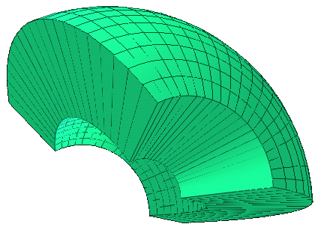
HEP3D
Java 3D Primitives for Geant4 volumes
  G4Box
  G4Cons
  G4Para
  G4Polycone
  G4Polyhedra
  G4Sphere
  G4Trap
  G4Trd
  G4Tubs
Support for switching between wireframe and solid shapes

Slide 16
Future Possibilities?
ZVTOP – Topological vertex finding
  Being worked on by Wolfgang Walkowiak
TRF++ - general purpose tracking package
  Being worked on by Norm Graf
Other reusable reconstruction algorithms
  Clustering
  Kalman Filter
General purpose fitting framework
General purpose plotter

Slide 17
More Info?
How do I get it?
  http://java.freehep.org
    All source code is in CVS
      Browse it on the web, or download with your favorite CVS client
      All software distributed under Lesser GNU Public License (LGPL)
    Manuals
    Automatically generated documentation (javadoc)
      Updated every 15 minutes
    Pre-built libraries (jar files)
How can I contribute
  Contact any of the authors or e-mail
    developers@freehep.org

Slide 18
Conclusion
Warning!
  Different sections of library are in different stages of completion
    Some packages have been in use for some time
    Some are still under development
Try it, give us feedback
Don’t waste time with
    Core dumps
    Memory leaks
    Subtle debugging problems
Join the HENP Java revolution!

