Slide 1
FreeHEP Java Library
Mark Dönszelmann, SLAC
CHEP, La Jolla, 24-28 March 2003

Slide 2
Content
The FreeHEP Java Library
  Components and Tools for Java
"Will talk about a small sample of components“
  General Components
    Application Framework
    VectorGraphics
    AID - Abstract Interface Definition compiler
  HEP Component
    HEPIO – Java RootIO

Slide 3
Tools and Components for Java
Started as a convergence of
  WIRED
  Java Analysis Studio (JAS)
A common base library
  minimize unnecessary duplication of work
  maximize code reuse
Contents is a library of HEP-wide Java software
  Some very HEP specific (c.f. CLHEP)
  Some general purpose components and tools
Open source
  All code and documentation in CVS, web browsable
  All code licensed under LGPL to make it freely reusable
Minimal interdependence between packages
  Take what you like, leave what you don’t.
Pure Java where possible
  We include some C++ code for wrappers to make components available to C++
Now have contributions from
  Atlas, Babar, IceCube, US Linear Collider Detector (LCD)
  Others welcome to contribute

Slide 4
HEP Specific Components
Physics package
  3-vector, 4-vector’s and utilities
  Jet Finding, Event Shape routines
  Diagnostic Event Generator
HEP IO
  Access to a number of common HEP formats:
    StdHEP
    MCFIO
    HBook
    Root
HEP3D
  Extensions to Java3D specific for Geant4
YaPPI – Yet another Particle Property Interface
  XML Particle Property Database
AIDA - Abstract Interfaces for Data Analysis
  Interfaces and JAIDA - Java reference implementation
  AIDAJNI – C++ wrapper around AIDA
  More on this in Max Turri’s talk on Tuesday
HepRep - HEP Representables for Event Display
  Interfaces and JHepRep - Java reference implementation
  HepRepJNI – C++ wrapper around HepRep
  see several other talks and posters
Future
  Plot Widget (JAS)

Slide 5
General Components
Application Framework
  General framework for Java applications using plugin and service technology.
AID – Abstract Interface Definition
  Compiler to make C++ headers and Java Interfaces from aid files.
Graphics3D
  Non-Java3D implementation of 3D graphics, for WIRED.
FreeHEP IO
  Extensions to the JavaIO system to handle specific encodings, ASCII85, …
PSViewer
  PostScript Viewer to embed viewing of EPS in applications, or for previews.
Swing Extensions
FreeHEP Tools
  JNeeds – java package dependency
  Ant – extensions to the build system
VectorGraphics
  Low level Input and Output of binary vector graphics formats (CGM, EMF, PDF, SVG)
  Vector output files, extension to Java2D
XML
  XMLIO – classes to store/restore state of an application
Future
  RecordLoop/EventLoop (IceCube)
and more…

Slide 6
Infrastructure
CVS
  for the repository
ant (from apache.org)
  for building the java parts and the distributions
gmake
  for building the C and C++ parts
JUnit
  for Unit testing
Java WebStart
  for application distribution

Slide 7
FreeHEP Application Framework
General Application Framework for Java

Slide 8
Application Framework
Framework to build Java Applications, which contains:
  a Plugin facility
    to add extra Modules
  a Services facility
    to publish and look up information of other modules
  a MenuBuilder
    XML for Menu and Popup Menu definitions
    Callbacks to user methods
  a Command Dispatcher
    to route GUI commands, disable and enable them
  a Save/Restore facility
    to handle saving and restoring of the application’s state via XMLIO
Can be run from WebStart
Users:
  JAS, WIRED
  and Demo Applications (available via Webstart)

Slide 9
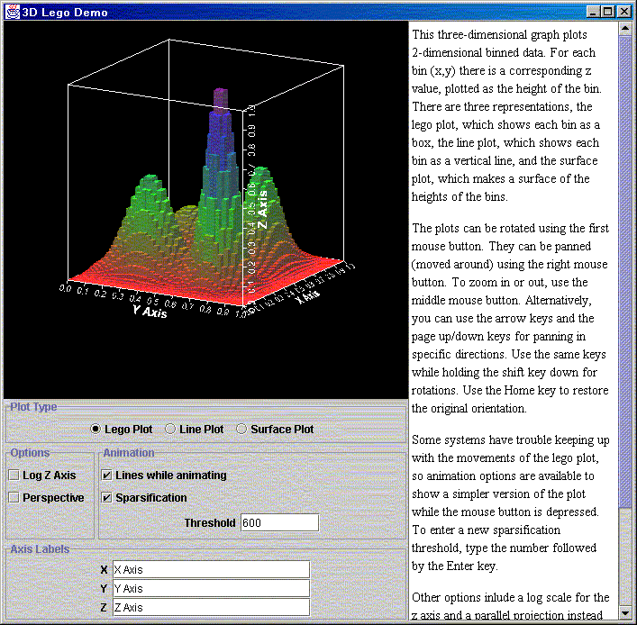
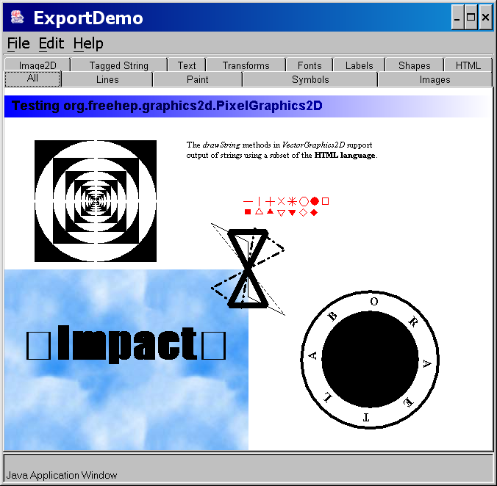
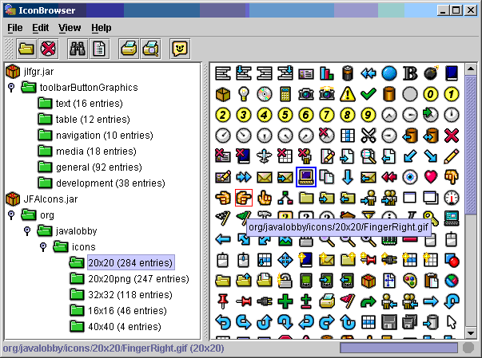
Application Framework Demos
Java3D Lego Plot Demo
Vector Graphics
Export Demo
Icon Browser

Slide 10
FreeHEP Vector Graphics
Export System for Vector Graphics in Java

Slide 11
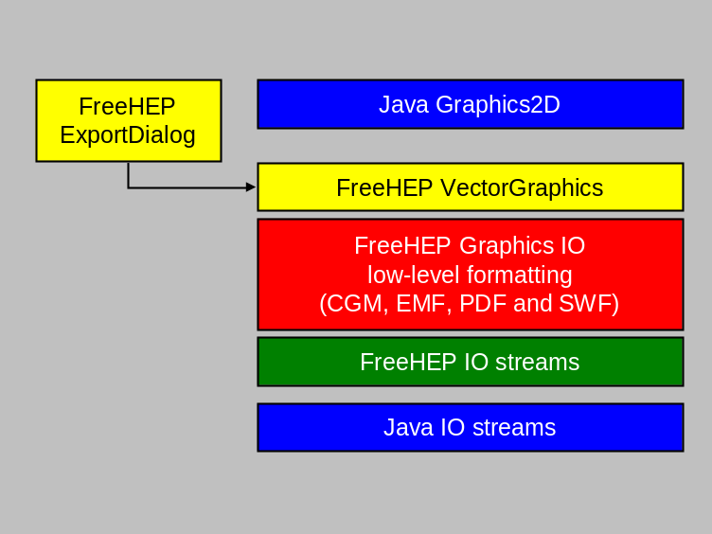
VectorGraphics
Adds Graphics Export functionality in the following Formats:
  Bitmap: GIF, JPEG, PNG and PPM
  Vector: CGM, EMF, PDF, PostScript/EPS, SVG, and SWF
  Easily extendible for new formats
  Different from Printing in Java which is machine dependent
Unique API, extended from java.awt.Graphics2D which adds:
  Double precision drawing of primitives
  Fast drawing of markers
  Handling of Colors for Screen and Printing in color, grayscale and black and white
Copy & Paste:
  EMF (Win32) and PDF (MacOS X)
Standard Export Dialog
Utility classes for:
  Fonts inclusion or embedding (PS and PDF)
  “path” (line and curve) handling
Users:
  JAS, WIRED
  and many outside users

Slide 12
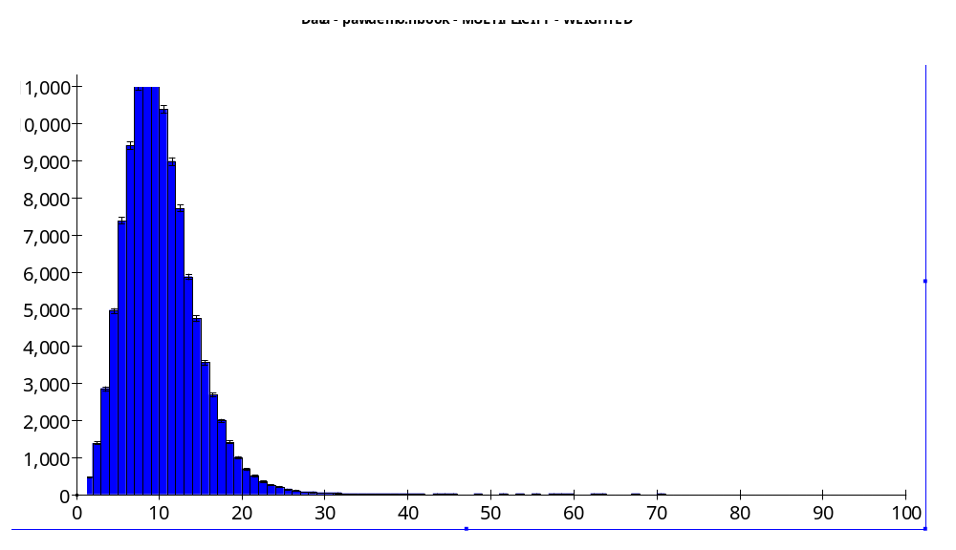
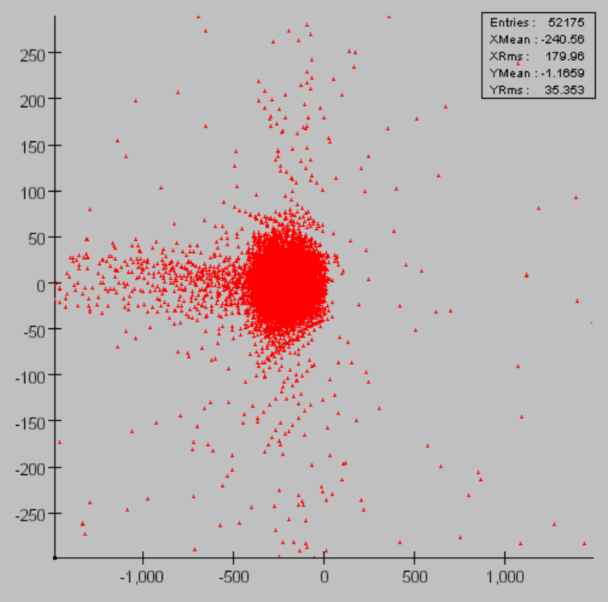
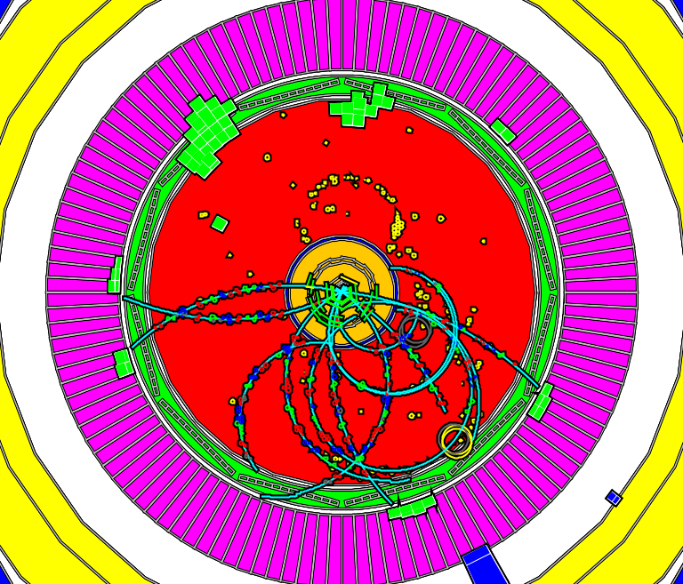
VectorGraphics Examples

Slide 13
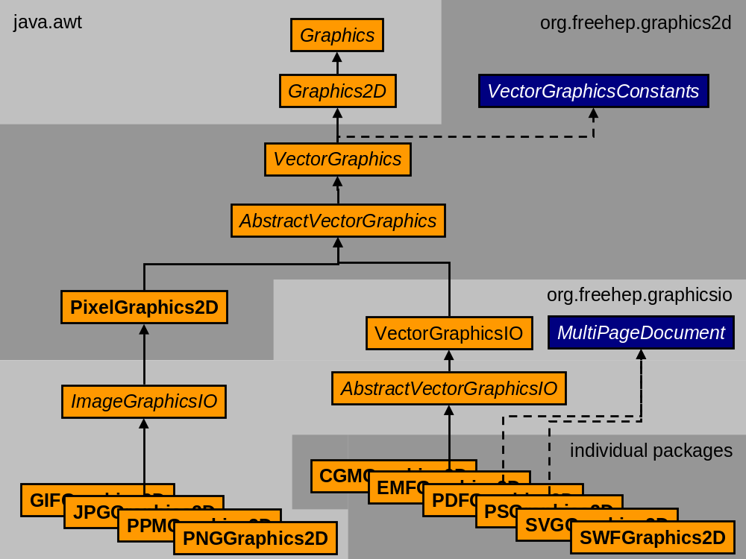
VectorGraphics Classes

Slide 14
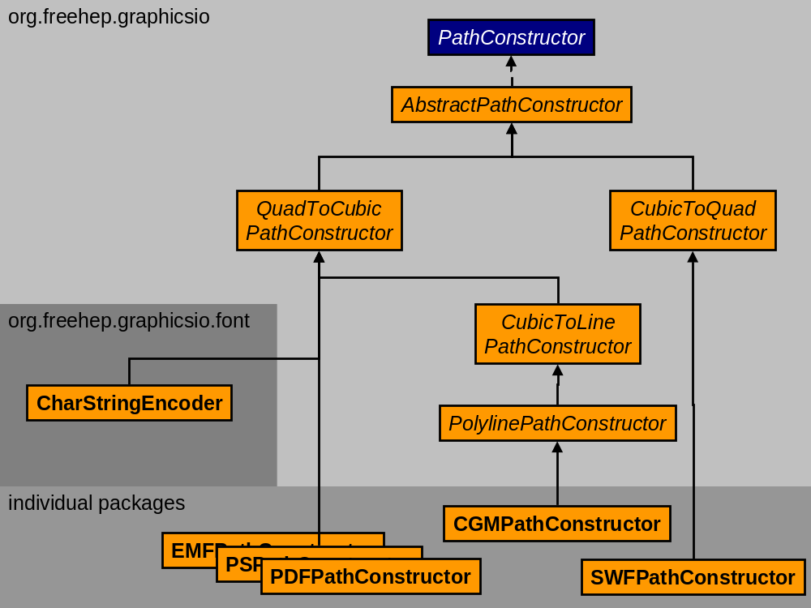
VectorGraphics Path Classes

Slide 15
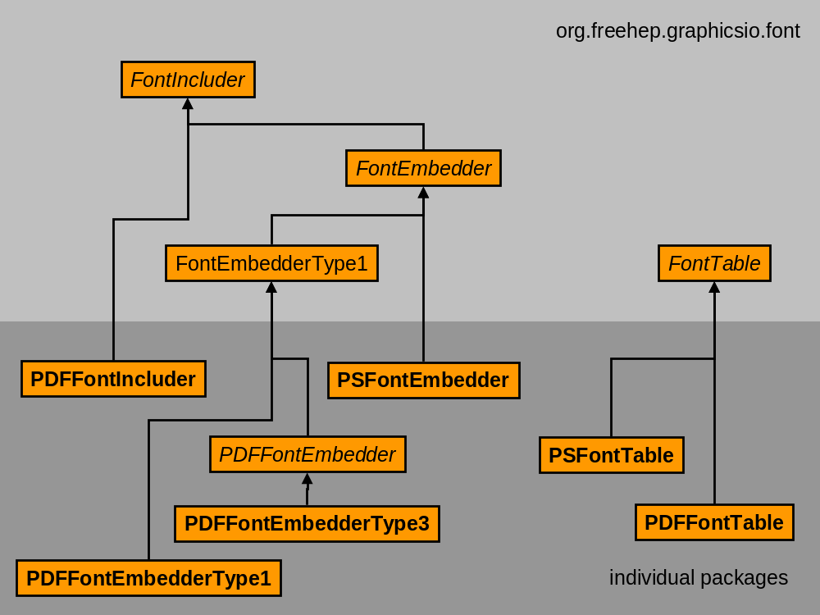
VectorGraphics Font Classes

Slide 16
FreeHEP AID
Abstract Interface Definition
One source for the Interface for C++ and Java

Slide 17
AID-Abstract Interface Definition
Tool to translate language independent Interface definitions into Interfaces of a number target languages (C++, Java)
  Unique source for Abstract Interface Definition
  Support for usage of Parameterized Types (templates)
  Preservation of Comments
User/Developer sees definition file in his own (C++, Java) language
AID language
  looks like Java with C++ markup (&, *, <>)
  Property Configuration files define:
    AID type mapping to target type
    AID value mapping to target value
    Target type to include / import statement
AID Generator (in Java) extendible for other target languages (Python?)
Could write Generator to attach to Java/C++ glue systems such as JACE
Users:
  AIDA, HepRep and LCIO (linear collider)

Slide 18
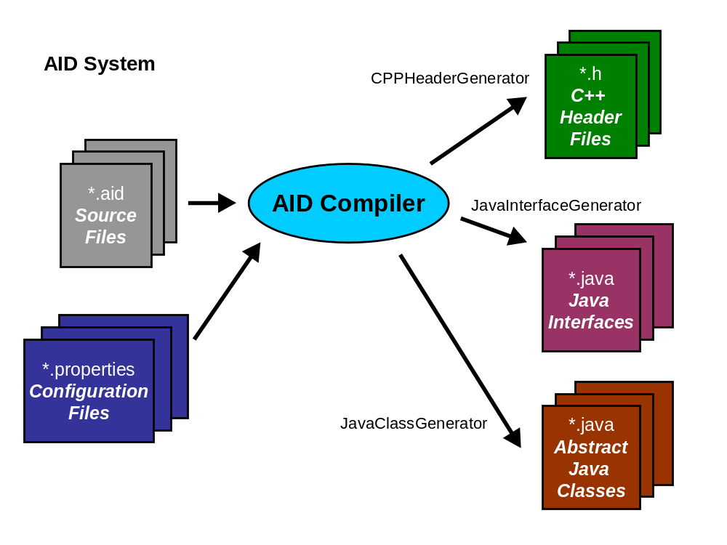
AID System

Slide 19
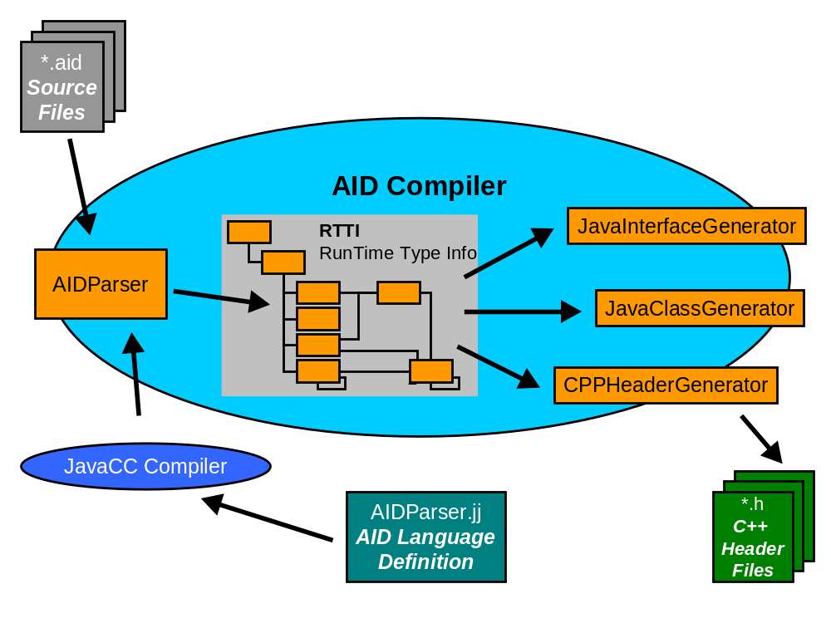
AID Compiler

Slide 20
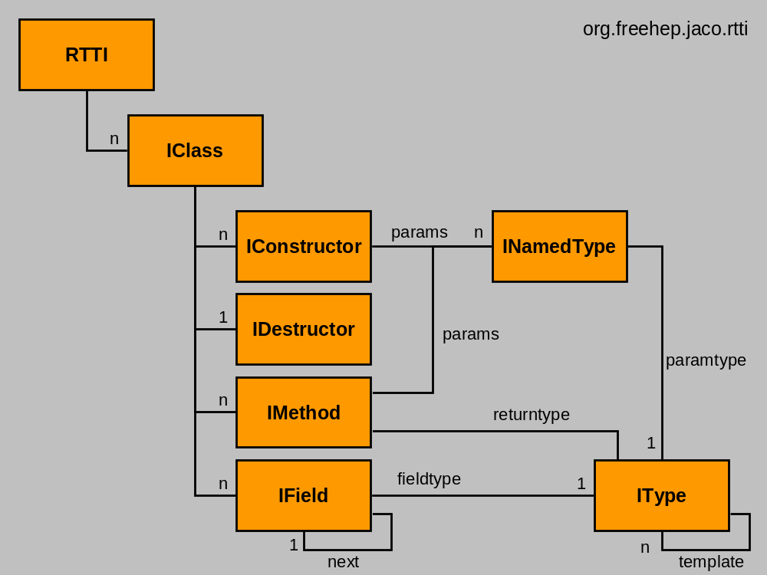
AID RTTI – RunTime Type Info

Slide 21
FreeHEP Java Root IO
Reader for RootIO in Java

Slide 22
Java RootIO: Goals and Usage
Features
  Pure Java package for reading Root Files
    Could be extended to writing later
  Should work with any Root file
  Should not need to know about objects ahead of reading
  (no need for dll’s, .so files etc.)
  Provide access to data, not C++ methods
    Much of root functionality duplicates functionality already available in Java, so data is more useful than methods
  Easy to use
Possible Usage
  Accessing Root data from Java Event Displays and Analysis Tools
    WIRED, JAIDA, JAS3
  Accessing Root data from Java Servlets, Server Pages (JSP) and Applets.
  Using Root for scripting languages such as Jython, Pnuts, Beanshell etc.
    More on these in Tony Johnson’s JAS talk on Tuesday.

Slide 23
Java RootIO: Implementation
Implementation
  Uses “streamer info” objects inside Root files (since Root 3.0) to decode contents of file
  Dynamically generates Java proxies for each Root object read
  Each proxy has custom “streamer”
    Build as Java bytecode using BCEL (http://jakarta.apache.org/bcel)
    Converted at runtime to machine code by Just-in-Time compiler & HotSpot
  Includes tool to generate Java interfaces from Root file
    Allows Java code to be compiled against custom user objects in file
Performance
  Now uses java.nio package (new since Java 1.4)
    Designed to support efficient binary IO
  Dynamic proxies much better performance than earlier Java Root IO release
  Faster than equivalent Root-CInt program, comparable to compiled C++

Slide 24
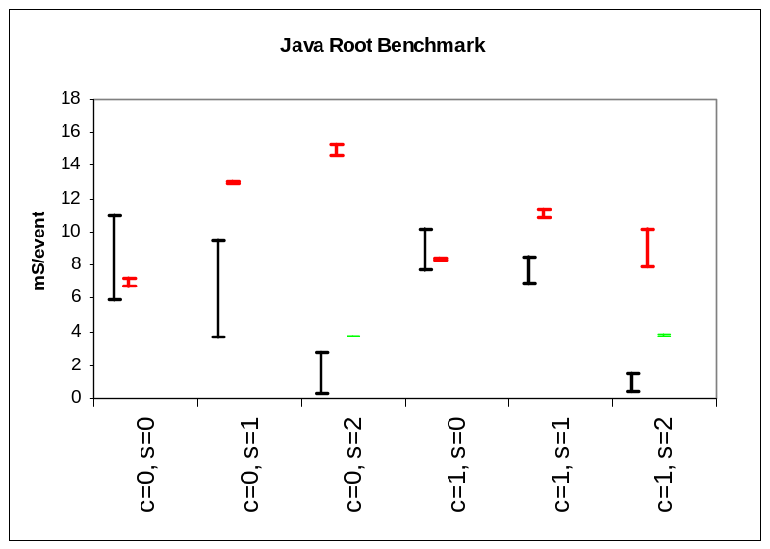
Java Root IO - Benchmark
Task: Loop over all events, loop over all tracks, sum px for all tracks. 5000 event files created with “event” test program distributed with Root.
1.4GHz AMD Athlon, Windows XP, 512MByte DDR, ATA100 disk..
S= Split level = 0,1,2
C= Compression = 0,1
Each test run 5 times in succession, lines show range in results
  in later runs file is typically cached in memory == faster if task IO limited
Red = CINT
Green = CINT (coded for split)
Black = Java

Slide 25
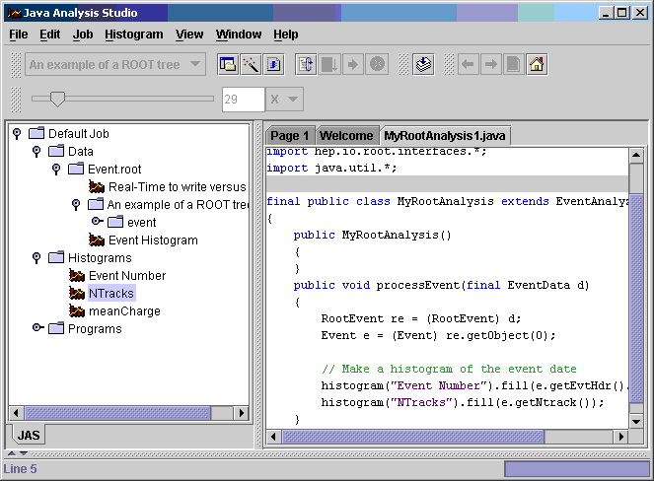
JAS and Java RootIO

Slide 26
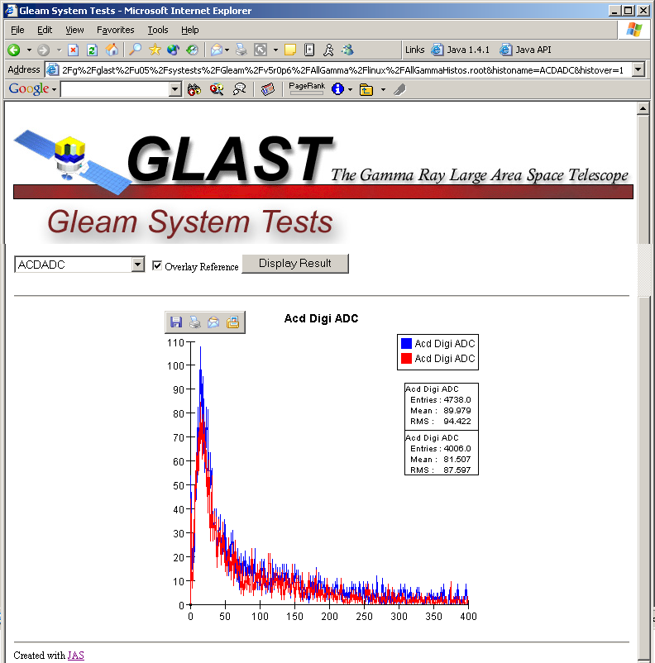
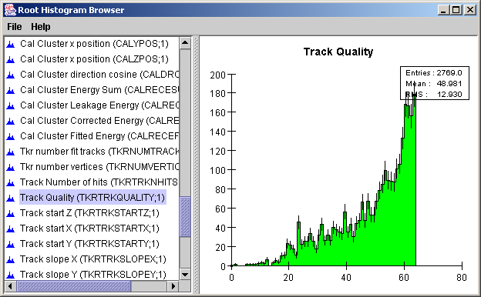
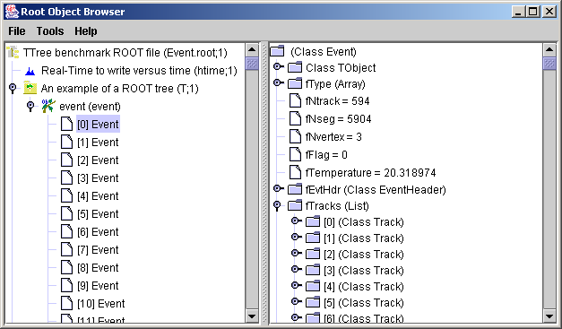
Java RootIO Examples
GLAST
Histogram Servlet
RootIO
Histogram Browser
RootIO
Object Browser

Slide 27
Summary and Acknowledgements
FreeHEP Java Library
  Library with HEP and non-HEP components
  Actively in use by several projects
New (revamped) web site
  see next slide
Authors
  Gary Bower (SLAC)
  Julius Hrivnac (LAL)
  Tony Johnson (SLAC)
  Charles Loomis (LAL)
  Joseph Perl (SLAC)
  Victor V. Serbo (SLAC)
  Massimiliano Turri (SLAC)
and others…

Slide 28
References
FreeHEP Java Libraries - http://java.freehep.org
  AID
  JAIDA
  AIDAJNI
  RootIO
  VectorGraphics
  …
JAS – Java Analysis Studio - http://jas.freehep.org
WIRED – http://wired.freehep.org
AIDA – http://aida.freehep.org
HepRep – http://heprep.freehep.org
FreeHEP - http://www.freehep.org
Come and see the other FreeHEP related talks.

