Slide 1

INDIA + BRICS · SUSTAINABILITY
VayuSetu
Find the pollution hotspot on your street, prove it, and get it fixed.
Citizen photos, ground stations and satellites, verified by Gemini and routed to the agency that can clear it.
12
137
13
4
cities live, India + BRICS
ground stations live
languages
Gemini jobs, all grounded
Live: cleanair-backend--cleanair-clear-streets.asia-southeast1.hosted.app
Notes:
HOOK (20 s): VayuSetu finds the pollution hotspot on your street, proves it with independent evidence, and makes sure it gets fixed. Live today in 12 cities: six major Indian cities and the six other BRICS capitals. 137 live ground stations, 13 languages, Gemini doing four grounded jobs.

Slide 2




THE PROBLEM
A city-wide AQI hides the air people breathe
99%
4.2 M
89%
of people live where WHO air-quality guidelines are not met
premature deaths from outdoor air pollution in 2019
of those deaths are in low- and middle-income countries
Street-level sources go unseen
A garbage fire or a construction site kilometres from the nearest monitor vanishes into the city average.
Pollution crosses borders
Crop burning and haze drift across state and national lines faster than one agency can track.
Data rarely reaches a crew
Dashboards publish numbers, but nobody is told which street to inspect or which department owns the fix.
One monitor, many invisible sources, and smoke that does not stop at the border.
Source: WHO fact sheet, Ambient (outdoor) air quality and health, updated 24 Oct 2024.
02 / 12
Notes:
PROBLEM (40 s): WHO says 99% of people live where its air-quality guidelines are not met; 4.2 million premature deaths from outdoor air in 2019; 89% of them in low- and middle-income countries. Three gaps: street sources vanish into the city average, smoke crosses borders, and data never reaches a crew.

Slide 3




OUR SOLUTION
From a citizen's photo to a verified, dispatched fix
01 SENSE
02 VERIFY
03 FUSE
04 ACT
Photo, voice note and pin from citizens; stations and satellites watch continuously.
Gemini confirms smoke, dust, fire or haze and flags fakes, screenshots and duplicates.
Scored against the nearest station, Sentinel-5P, NASA FIRMS fires and live wind.
Ranked, dispatched with a Gemini work order, then confirmed by residents.
Not another AQI dashboard
TYPICAL AQI DASHBOARD
VAYUSETU
Scale
One city-wide average
Street-level H3 cells of ~0.7 km²
Evidence
A single sensor feed
Citizens + stations + Sentinel-5P + FIRMS + wind
Trust
Reports taken at face value
Gemini, EXIF and duplicate checks; independent agreement
Outcome
Displays a number
Ranked queue, routed work order, residents confirm the fix
03 / 12
Notes:
SOLUTION (45 s): Sense, verify, fuse, act. Then the contrast: street-level cells instead of one city number; five evidence sources instead of one feed; every report checked; and the story ends with a routed work order and residents confirming the fix.

Slide 4










ARCHITECTURE
One hexagon grid ties every source together
INPUTS
Google Cloud
OUTPUTS
Citizens
Residents
Web app and WhatsApp, 13 languages
Gemini
Earth Engine
Area page, status, fix-check
vision · copilot · writing
Sentinel-5P · FIRMS · WorldPop
Ground stations
Operators
OpenAQ, WAQI and CPCB, merged per city
Ranked queue and evidence
BigQuery + ML
Firebase
Satellites
station history · ARIMA_PLUS
Firestore · Auth · App Hosting
Agencies
Sentinel-5P NO₂ and aerosol, NASA FIRMS
Work orders, EN + local
Maps Platform
Cloud Scheduler
Weather & air models
Places · Air Quality · Maps
scan + ingest every 30 min
Everyone
Open-Meteo wind, Google Air Quality
24-hour forecasts, 12 cities
Key decision: every report, station reading and satellite pixel is indexed to the same H3 hexagon (~0.7 km²), so different evidence can be compared in the same place.
04 / 12
Notes:
ARCHITECTURE (45 s): Three boxes: inputs, Google Cloud, outputs. Key decision: everything is indexed to the same H3 hexagon (~0.7 km2), so a citizen photo, a station reading and a satellite pixel are compared in the same place. Cloud Scheduler runs the scan and BigQuery ingest every 30 minutes.

Slide 5

GENERATIVE AI
Gemini does four jobs and shows its evidence
Photo check
Operations copilot
Work orders
Resident summaries
Labels smoke, dust, fire or haze with severity, and flags screenshots, edits and stock images.
Answers operators by calling live tools: incidents, stations, wind, fires, forecasts, upwind sources.
Drafts the order for the right agency, citing the evidence, in English and the city's language. For a repeat hotspot, asks for action at the source.
Explains what's happening on each street in the reader's language, with read-aloud.
Vision + JSON output
Function calling · 7 tools
Structured output
13 languages · cached
Guardrails
Facts in, facts cited
Never blank, never faked
Cached per cell
Health advice
Prompts carry only recorded evidence; outputs list what they used.
Flash-Lite fallback; if both fail, the page says so.
Summaries regenerate only when the evidence changes.
Comes from Google's Air Quality API, not from Gemini.
05 / 12
Notes:
GEMINI (50 s): Four jobs. Photo check (vision + JSON, authenticity). Operations copilot (function calling over 7 live tools). Work orders (structured output, English + local language, repeat-hotspot aware). Resident summaries (13 languages, cached, read-aloud). Guardrails: facts in, facts cited; Flash-Lite fallback; the page says so if both fail; health advice comes from Google, not Gemini.

Slide 6

HOW A HOTSPOT IS VERIFIED
No alert without independent evidence
Report
Classify
Integrity
Fuse
Dispatch
Photo, hazard, voice note and pin, from web or WhatsApp.
Gemini labels the hazard and judges authenticity.
EXIF time and GPS, duplicate hashes, screenshots.
Station vs national limit, Sentinel-5P, FIRMS, wind.
Promoted hotspots join the ranked queue with a work order.
Promotion tiers, strongest first
Sensor + satellite
Crowd verified (3+)
Citizen + sensor
Citizen + satellite
Sensor detected
Satellite detected
53 of 55 incidents on record were raised automatically: a scan checks every station and Sentinel-5P every 30 minutes, with no photo needed. Flagged reports stay visible but never count toward promotion.
06 / 12
Notes:
VERIFICATION (45 s): Report, classify, integrity (EXIF time/GPS, duplicate hashes, screenshots), fuse, dispatch. Six promotion tiers, strongest first. 53 of our 55 incidents were raised automatically by the 30-minute station + satellite scan. Flagged reports never count toward promotion.

Slide 7
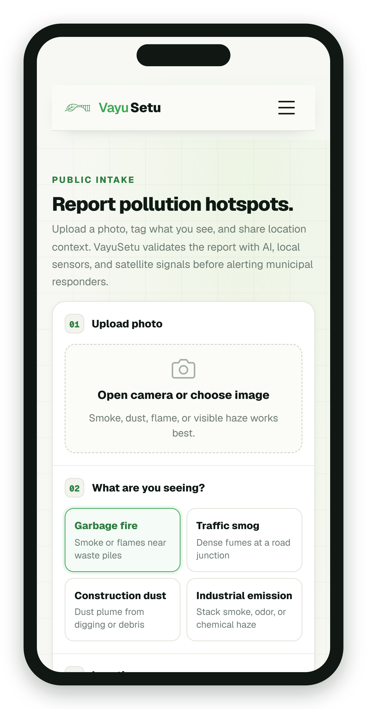
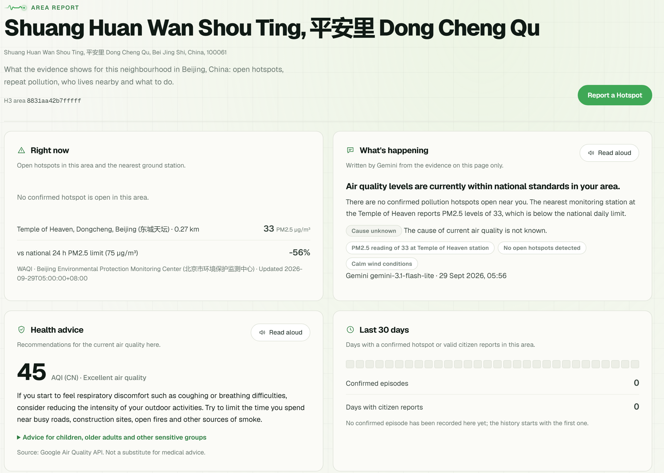



PRODUCT · FOR RESIDENTS
Report in seconds, see what's on your street
Photo, voice, pin
13 languages; Gemini checks the photo first.
A page for every street
AQI gauge, station, Gemini summary, history.
Who's affected
WorldPop residents, schools and hospitals within 1 km.
"Is it fixed?"
Reporters confirm or dispute a fix for 72 h.
Live: Temple of Heaven area, Beijing. Nearest station 0.27 km away; ≈71,838 residents within 1 km (WorldPop 2020).
07 / 12
Notes:
RESIDENTS (50 s) - DEMO /report then /zone/8831aa42b7fffff: photo, voice note (Speak), pin, Submit Report, Track this report. Area page: an AQI gauge for the nearest station (India's National AQI in Indian cities, the US EPA AQI in the BRICS capitals), station 0.27 km away, Gemini summary with Read aloud, Google health advice, 30-day history, about 71,838 residents within 1 km. After a fix, reporters answer 'Is it fixed?'.

Slide 8
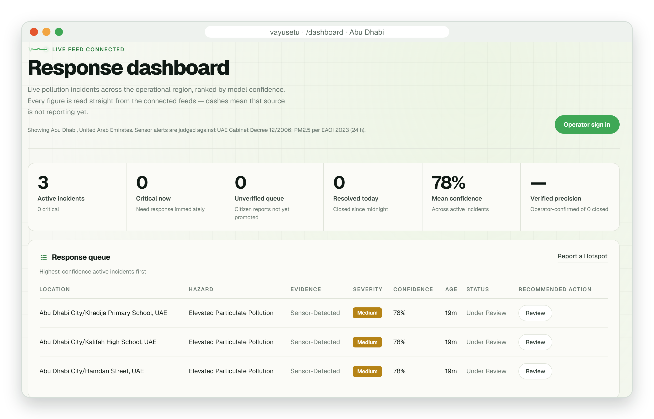
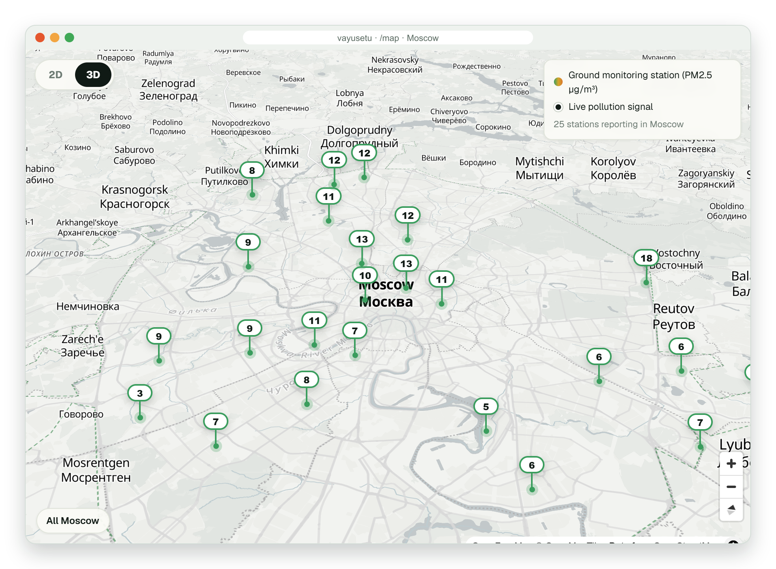
PRODUCT · FOR OPERATORS
Operators see what to fix first, and why
Moscow, 3D view: official stations reporting live.
Ranked queue
Evidence tier first; repeat, overdue and disputed chips.
Traceable evidence
Station vs national limit, satellite window, reports.
One-click action
Abu Dhabi, live: particulate hotspots raised automatically from official EAD stations, judged against the UAE limit.
Draft a work order, dispatch, resolve; reporters are told.
08 / 12
Notes:
OPERATORS (50 s) - DEMO /dashboard (signed in): Response queue ranked by evidence, with Repeat hotspot / Overdue / Disputed chips. Review opens the evidence trail, Last 30 days, Field context (Load) and Draft with Gemini. Live map: stations, hotspots and satellite fires, 2D or 3D. Do not resolve a real incident on stage.

Slide 9

CLOSING THE LOOP
A fix counts only when residents confirm it
Report
Verified
Dispatched
Resolved
Is it fixed?
Photo and pin, or the automatic station scan.
Promoted only on independent evidence.
Work order routed, with a response clock.
The operator marks the hotspot fixed.
Reporters are asked for 72 h, web or WhatsApp.
Every step is logged, so repeats show up
Yes, fixed
Still there
promoted
reopened
dispatched
resolved
fix confirmed
disputed
Counted as a resident-confirmed fix on the model quality card.
Reopens as Disputed and goes back to the operator queue.
Repeat hotspot: 3+ episodes in 30 days, reports on 3+ days, or a fix that did not hold. The next work order asks for action at the source.
09 / 12
Notes:
CLOSING THE LOOP (50 s): Most systems stop at 'resolved'. Reporters get 72 h to answer 'Is it fixed?' on the web or FIXED/STILL on WhatsApp. 'Still there' reopens it as Disputed. Every step is logged, so repeat spots are flagged and the next work order targets the source. Tested end to end against the live database.

Slide 10

FORECASTS IN EVERY CITY
From raw feeds to an honest 24-hour outlook
Ground stations
Yes
OpenAQ, WAQI and CPCB, merged
BigQuery
Station forecast, shown as Live
Google Air Quality
Station readings
Hourly history, health advice
162 stations · ARIMA_PLUS trains here
12+ station hours?
Cloud Scheduler
Earth Engine
every 30 minutes
google_aq_history
No
Sentinel-5P, FIRMS, WorldPop
Modelled PM, kept in its own table
Modelled forecast, labelled Modelled
Delhi archive
Open-Meteo
Optional 2015–2020 CPCB history
Live wind for attribution
12 / 12
137
50
17,118
cities with a 24-hour forecast
ground stations live, feeding BigQuery
forecast zones with a week of modelled history
modelled hourly rows stored
Real station readings always win; modelled history is Google's 500 m estimate and never appears as live. Counts as of 29 Sep 2026.
10 / 12
Notes:
FORECASTS (45 s) - DEMO /forecast: Every 30 min Cloud Scheduler pulls every station into BigQuery; Indian cities merge OpenAQ, WAQI and CPCB, the BRICS capitals use WAQI. A forecast needs 12 hours of a station's own readings; until then it uses Google's modelled history from a separate table, labelled 'Modelled data'. Real readings always win; ARIMA_PLUS trains only on them. 12 of 12 cities have a forecast, including Hyderabad, where CPCB has been offline since 24 Sep.

Slide 11
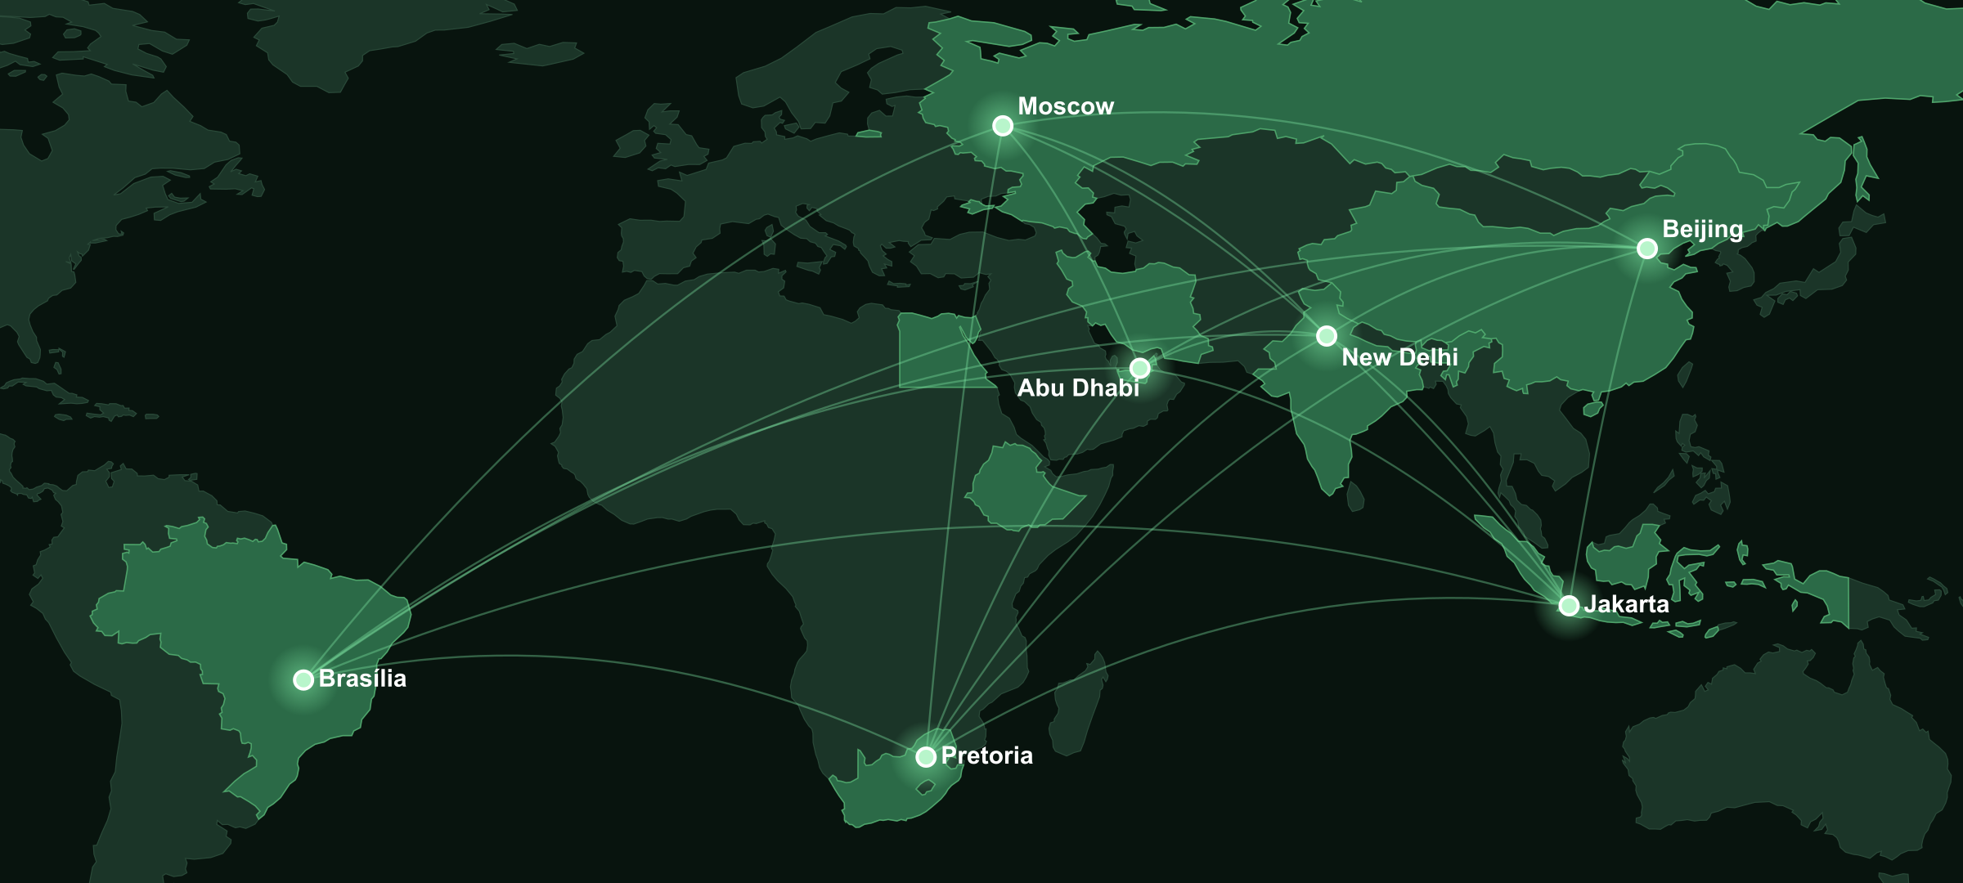
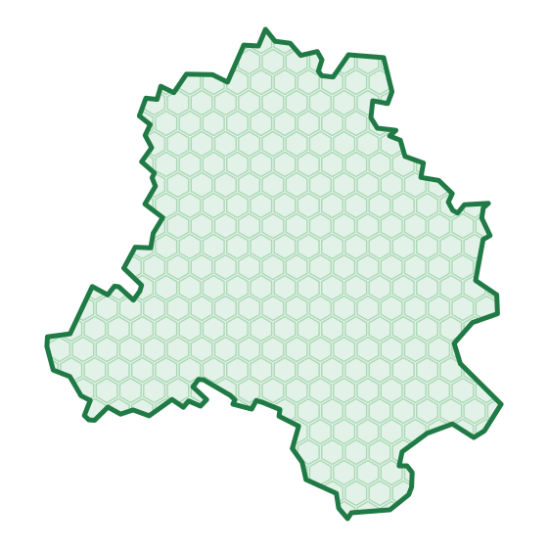
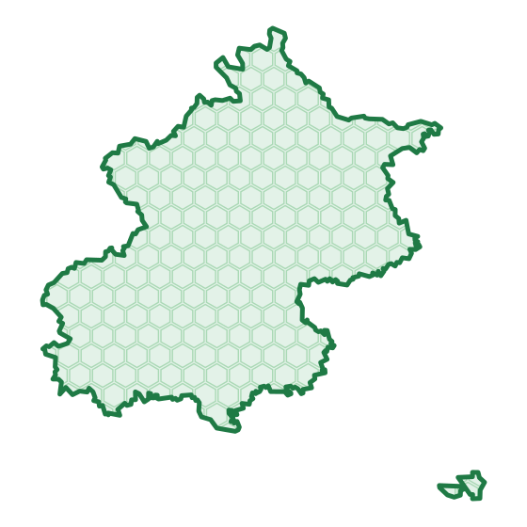

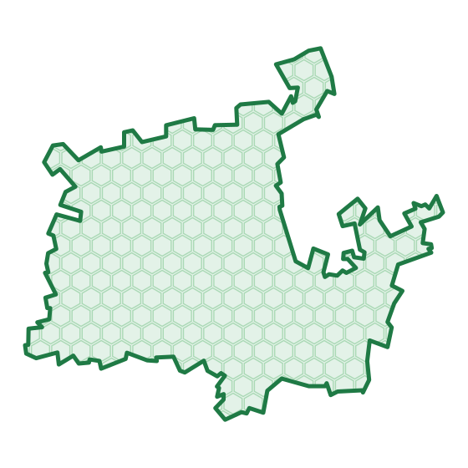

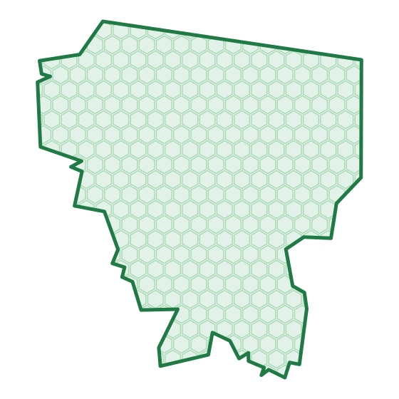

BUILT FOR INDIA AND BRICS
Twelve cities, seven legal limits, one engine
137
ground stations live across 12 cities
53 of 55
hotspots raised automatically
≈71,838
residents counted near one Beijing landmark
Indian cities
Beijing
Moscow
Pretoria
Abu Dhabi
Jakarta
Brasília
60 µg/m³
PM2.5 24 h, all six
75 µg/m³
PM2.5 24 h limit
35 µg/m³
PM2.5 24 h limit
40 µg/m³
PM2.5 24 h limit
60 µg/m³
PM2.5 24 h limit
55 µg/m³
PM2.5 24 h limit
50 µg/m³
PM2.5 24 h limit
Live counts, 29 Sep 2026. The Indian cities card covers Delhi, Mumbai, Kolkata, Chennai, Bengaluru and Hyderabad.
11 / 12
Notes:
INDIA + BRICS (40 s): Twelve cities in two groups. Six Indian cities share India's NAAQS (PM2.5 60 ug/m3); the six other BRICS capitals keep their own national limits (75, 35, 40, 60, 55, 50 ug/m3). 137 stations live, 53 of 55 hotspots automatic. A new city is one configuration entry. Live counts from 29 Sep 2026.

Slide 12
WHAT'S NEXT
Clean air, street by street, across India and BRICS.
Citizens
report in their language and see what happened
Next 90 days
Operators
01
Pilot with one municipal team
act on ranked, evidence-backed hotspots
Real dispatches and their response targets, instead of our placeholders.
02
Alerts near you
Nations
A WhatsApp message when a hotspot is confirmed within 1 km.
share one engine and keep their own rules
03
Proof of the fix
An after-photo from the crew, checked by Gemini against the report.
Thank you
Built on Google Cloud
Gemini
Earth Engine
BigQuery ML
Firebase
Maps Platform
Air Quality API
Cloud Scheduler
12 / 12
Notes:
CLOSE (40 s): Next 90 days: pilot with one municipal team; alerts near you on WhatsApp; after-photo proof of the fix. Citizens get a voice, operators an evidence-backed list, nations one engine with their own rules. Clean air, verified street by street, across India and BRICS. Thank you.

