Slide 1

SAMSUNG PRISM
Generative AI
Hackathon
3rd Edition 2026 – 27
Project - Keel: voice assistants that act only when you've finished
Theme ID - Theme 05: Interruptible Real-Time Agents
Team Name -
College Name -
Member Name & Email 1- Harshit Aryan
Member Name & Email 2-
Member Name & Email 3-
Member Name & Email 4-
Submission Github link - github.com/PROSTLE/samsung
Notes:
Team name, college and member e-mails are left for the team to fill in.

Slide 2




Theme
People don’t talk in clean sentences.
We pause, say “um”, start again and change our minds halfway through. An assistant that acts on the first thing it hears books the wrong day, searches the wrong city, or does the same thing twice.
Theme 05 asks for three things
Respond quickly
spoken feedback within a few hundred milliseconds, no dead air
Illustration, AI-generated
Keep talking while it works
tools run in the background, never blocking the conversation
“Looking at flights to Miami on October 5th. Oh, wait. My schedule just changed… so actually make it October 7th instead.”
A real caller from the benchmark’s recordings. Many assistants run the October 5th search before the caller has finished, and a search or booking that has already gone out can’t be taken back.
Recover cleanly
drop what the user took back, and never repeat an action
Our answer: let the assistant think fast, but act only once you’ve finished.
Problem
Gaps
Solution
How it works
Demo
Tech
Use case
Results
Next
Extras
Notes:
Quote: FDB-v3 recording travel_10 (as transcribed in our run). The three capabilities are from the Theme 05 participant guide, section 1. Picture: AI-generated illustration (Juggernaut XL via AI Horde).

Slide 3



Existing Solutions & Gaps
When people correct themselves, assistants fail
Pass rate on the self-correction recordings, as published in the benchmark paper
Speech-to-text commits too early
In the classic pipeline the transcript is final before the correction arrives, so the AI never hears it.
Realtime models act before you finish
The paper caught Gemini Live 3.1 calling a tool 2.27 s before the user had finished correcting, locking in the wrong city.
Frameworks leave it to every developer
Voice frameworks either cancel on any interruption or keep going. Each team has to add safety rules tool by tool.
Highlighted: the two systems our set-ups build on. Source: Full-Duplex-Bench v3 paper, Table 3.
Even the best system passes only 60% of the whole benchmark.
Problem
Gaps
Solution
How it works
Demo
Tech
Use case
Results
Next
Extras
Notes:
FDB-v3 paper (arXiv 2604.04847): Table 3 self-correction Pass@1; Table 2 best overall Pass@1 0.600 (GPT-Realtime); quotes on Whisper finalising early and Gemini Live's -2.27 s tool call. Frameworks: Pipecat function-calling guide (cancel_on_interruption) and LiveKit tool docs (disallow_interruptions), see SOURCES.md.

Slide 4





Our Solutions & Architecture Diagram
Keel: think fast, act carefully
Waits until you’re done
An action the AI plans while you’re still talking is held until you finish.
Keel sits between the assistant’s brain (the language model) and its hands (the tools). The model can plan as early as it likes; Keel decides when an action is allowed to happen.
Drops what you take back
Keep talking or correct yourself, and the held action is thrown away. It never runs.
Does it only once
Asking twice never books twice: the first result is reused.
Illustration, AI-generated
A real recording, step by step
0:09 “Miami, October 5th”
0:11 “Oh, wait.”
0:21 “make it October 7th”
Never fakes success
If it can’t confirm an action worked, it says so instead of saying “done”.
held
dropped
runs once
Problem
Gaps
Solution
How it works
Demo
Tech
Use case
Results
Next
Extras
Notes:
Keel's four rules: README.md 'An interruption-safe execution layer'. Real example: benchmark recording travel_10, Gemini Live run 20260927T083931Z (both October 5th searches dropped before they were sent; October 7th sent once at 0:22).

Slide 5










How it works, end to end
1 Hearing you
2 Deciding and acting safely
You speak
LiveKit
Listening
Speech-to-text
Language model
Keel
phone, laptop or a benchmark recording
live audio room in the cloud
spots when you start and stop talking
Whisper · faster-whisper
GPT-4o · Gemini Live · Qwen3
Still talking → wait
Changed your mind → drop it
Asked before → reuse the answer
Can’t confirm → say so
With Gemini Live
one model does the listening, understanding and speaking. In the other set-ups each step is a separate model.
reply
“Is the user still talking?”
one live room, both directions
3 Answering you
runs only when safe;
result back to the model
the reply, as a voice
You hear it
LiveKit
Text-to-speech
Tools
and can interrupt at any time
streams the voice back
OpenAI TTS · Kokoro
flights, orders, bills… or the washer helper
Every step is recorded
Replay it in the web app
Scored by Full-Duplex-Bench v3
Tools are either the benchmark’s services (flights, orders, bills, homes) or Show & Fix (camera → vision model → Samsung error codes → booking).
Problem
Gaps
Solution
How it works
Demo
Tech
Use case
Results
Next
Extras
Notes:
README.md Architecture and 'Pipelines'; docs/ARCHITECTURE.md (LiveKit events -> KeelGate -> kernel). Listening = LiveKit's voice activity detection and end-of-turn model where the pipeline uses them. Models per set-up are on the tech stack slide.

Slide 6
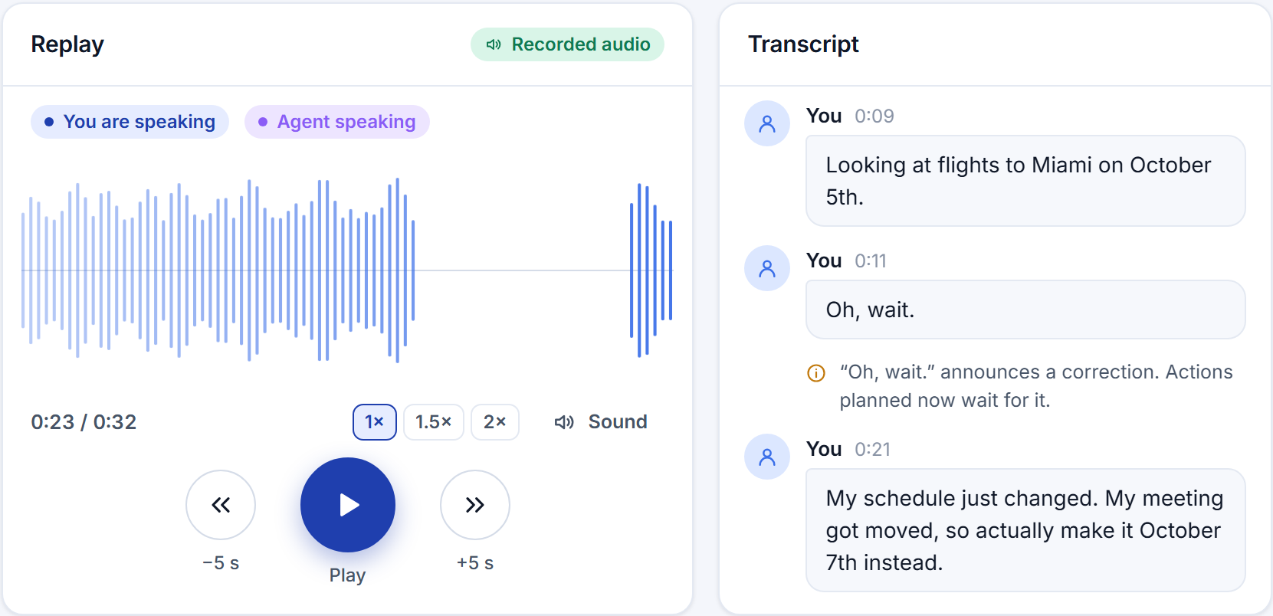
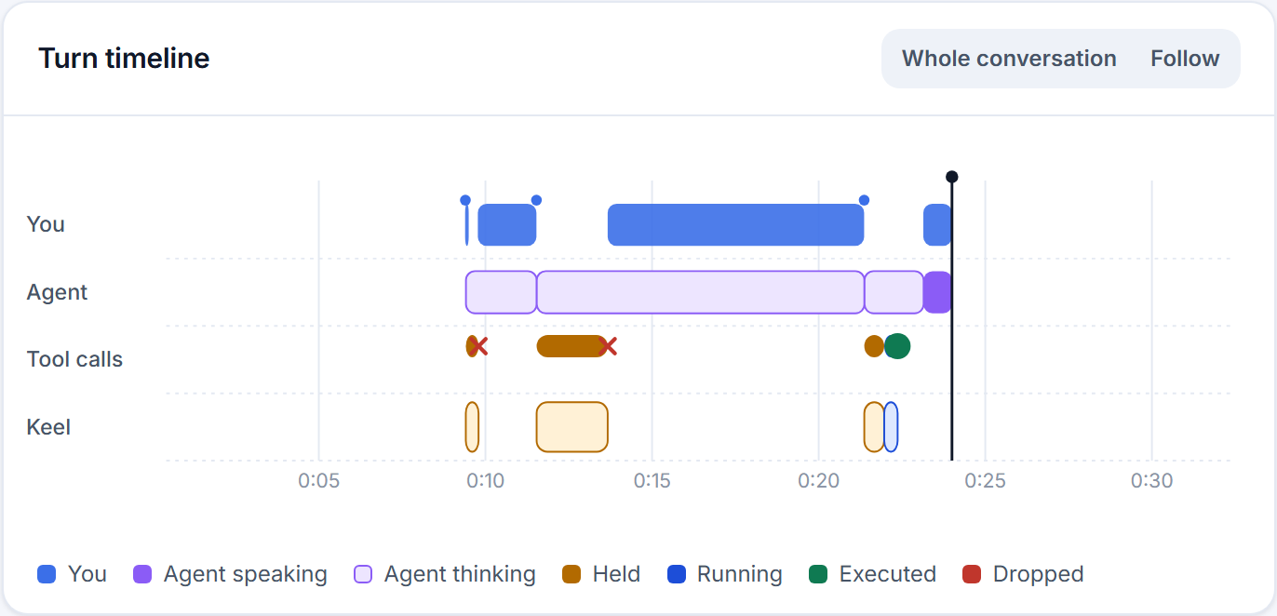
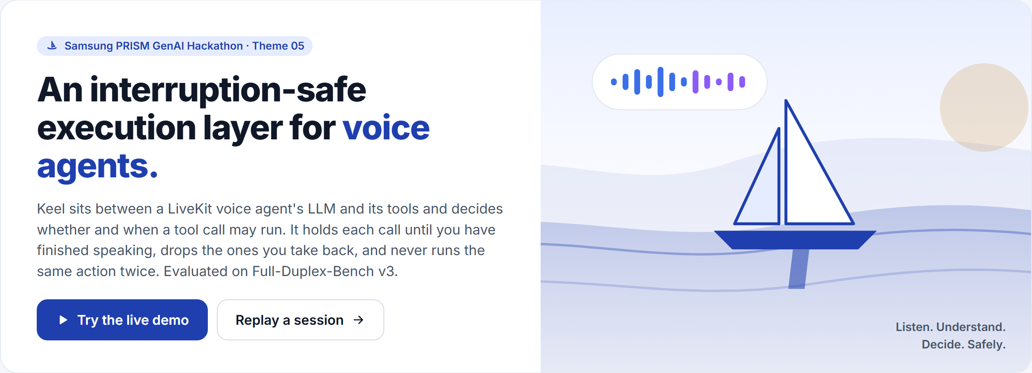
Demo & Product Walkthrough
Turn timeline: the two October 5th searches (orange) are dropped; the October 7th one runs once (green).
Replay of a real benchmark call: the recorded audio, the words, and what Keel did, in sync.
Talk to it live
microphone and camera, right in the browser
Replay any conversation
with its real audio, second by second
Read the results
every benchmark scenario, pass or fail, and why
Check the setup
which models and keys are ready, never the keys
Home page: what Keel does, in one line, with a button to try it live.
Problem
Gaps
Solution
How it works
Demo
Tech
Use case
Results
Next
Extras
Notes:
Screenshots of the Keel web app (keel/web): replay of session eval-f08d114c (travel_10) and the Benchmark page for run 20260927T083931Z_keel_gemini_realtime.

Slide 7

Tools and tech stack used
Three ways to run the same assistant. Keel works the same under all of them.
Hearing
Thinking
Speaking
Seeing
Cost
Cascaded
the organisers’ default
OpenAI Whisper
GPT-4o
OpenAI TTS
GPT-4o
Paid API
Gemini Live
free, one model
Gemini Live 3.1 hears, thinks and speaks in one model
Gemini 2.5 Flash
Free tier
Fully local
open models, no key
faster-whisper
Qwen3 4B (Ollama)
Kokoro
Qwen3-VL 2B
Free
Shared by all three
Seeing: how Show & Fix reads the washer’s display.
LiveKit
live audio rooms
Keel
our safety layer, in Python
Web app
live demo and replays
Full-Duplex-Bench v3
the test we’re scored on
Problem
Gaps
Solution
How it works
Demo
Tech
Use case
Results
Next
Extras
Notes:
README.md 'Pipelines, and what each costs'; config/keel.toml [providers]. Versions: LiveKit Agents 1.8.3, Ollama 0.34.4, Qwen3-4B-Instruct-2507, Kokoro-82M, faster-whisper small.en, FDB-v3 commit 3e799c45.

Slide 8
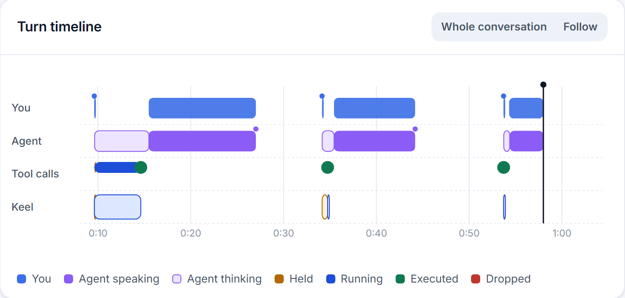
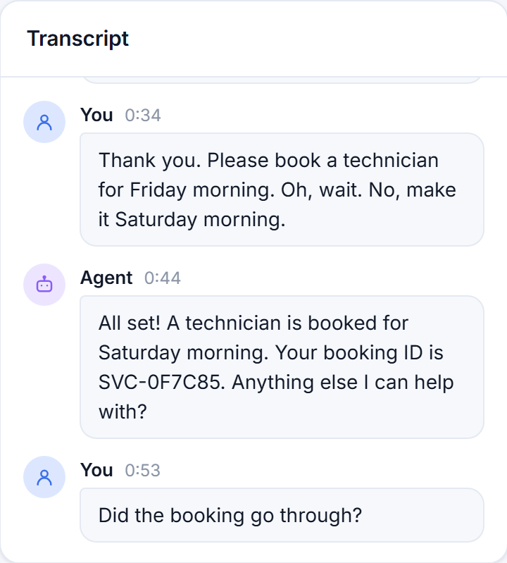
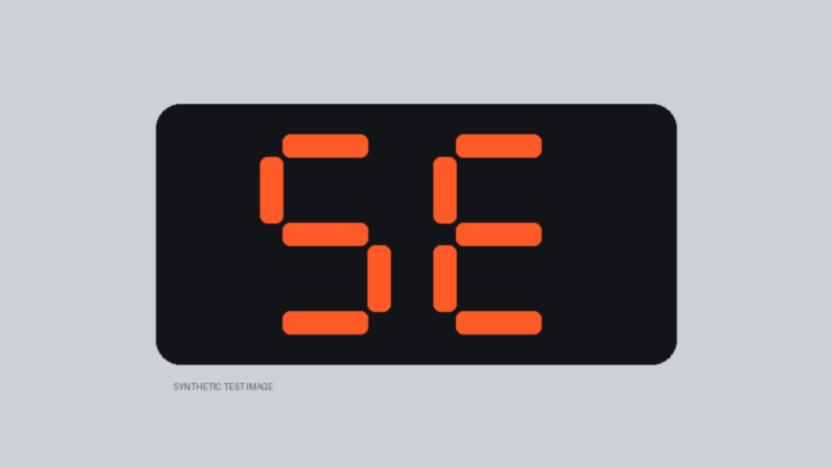




Impact & Use case
Show & Fix
Our extension: a washer helper that can see
Test display used as the camera (labelled synthetic)
Read the code as 5E, though the display showed “SE”
The same live session on Keel’s timeline: the display is read, then the booking is held until the user finishes “Friday… oh, wait, Saturday”, then made once.
Booked Saturday once after “Friday… oh, wait, Saturday”
Checked before answering “did it go through?”
Point your camera
at the washer’s display
It reads the code
with a vision model
It explains the fix
from Samsung’s own code table
It books a technician
once, on the right day
A live session, recorded end to end on Gemini Live
Where else this matters
In-car: change the destination mid-sentence
Support lines: change a booking without double-booking
Problem
Gaps
Solution
How it works
Demo
Tech
Use case
Results
Next
Extras
Notes:
Live session keel-live-a473a90e (gemini_realtime): read_error_display -> code 5E (displayed as SE); book_technician Saturday morning once; list_technician_bookings answered 'did it go through?'. Samsung code table from samsung.com/sg (SOURCES.md). The in-car and support-line examples are the theme guide's own. Washer picture: AI-generated illustration.

Slide 9
Innovation highlights, results and limitations
48/100
strict pass, measured
answers must match word for word
66/100
compared by meaning
our estimate; the official run uses a judge
100%
turns answered
same model in the paper: 78%
5%
talks over the user
same model in the paper: 19%
89%
right tool chosen
on answered turns
4.2 s
first reply, median
fix in progress: an instant “one moment”
Full run of all 100 benchmark recordings on Gemini Live 3.1 after this week’s fixes (run 20260928T211335). Our first full run, before them, scored 43/100 strict.
Same model, same test
Before and after our fixes
What’s new
Acts on the final intent
actions wait for the user, and taken-back ones never run
Knows what “oh, wait” means
it waits for the correction that follows
Works with any model
cascaded, realtime or fully local
Where we’re still weak →
Problem
Gaps
Solution
How it works
Demo
Tech
Use case
Results
Next
Extras
Notes:
Numbers are read from the run folders by the deck builder. This run: results/fdb_v3/20260928T211335Z_keel_gemini_realtime. Previous: results/fdb_v3/20260927T083931Z_keel_gemini_realtime. 'Compared by meaning' is eval/form_equivalence.py on the strict report (same date written differently, equal numbers, case, punctuation, plural s), an estimate and not a score. Paper Table 2: Gemini Live 3.1 take-turn 78.0%, interrupt 19.2%.

Slide 10





What’s next
What we’re still working on
Speed The first reply comes after 5.1 s on average; the paper’s Gemini Live 3.1 manages 3.95 s. Keel’s own wait is 0.6 s of it (median).
We’re working on: Say a short “one moment” straight away, and find out why the end of a turn is reported late.
Right answers, written differently 18 of our misses are correct answers in another format, like “2026-07-15” for “July 15”, the format the tool itself asks for.
What to expect: The official judge compares by meaning and accepts other date formats; counting those gives 66/100.
Illustration, AI-generated
Coming up
The organisers’ official, judged run
Silent turns Every conversation got a reply in our latest run (first run: 16 silent; the paper: 22 on the same model).
What we did: In our first run 9 were our network: the agent joined after the caller had finished. We stopped the background uploads competing with the audio and let the agent take calls while the machine is busy. Since then: no late joins.
A full run on local models, on a proper GPU
A real washer and a real camera
Self-corrections Now 53% with word-for-word matching (first run: 24%).
We’re working on: Measuring how long to wait after “oh, wait” on fresh recordings, never on the test set.
The 3–5 minute demo video
Problem
Gaps
Solution
How it works
Demo
Tech
Use case
Results
Next
Extras
Notes:
Latency: FDB-v3 latency report, first response mean 6.665 s; paper Table 6 Gemini Live 3.1 first word 3.95 s; Keel hold median 593 ms. Argument formats: docs/reports/UI_AND_FREE_MODELS_2026-09-27.md 5b; the paper says its judge accommodates date formats (section 4.1). Silent turns: same report; paper: 22 scenarios without response. Open items: section 6 of the same report. Picture: AI-generated illustration.

Slide 11
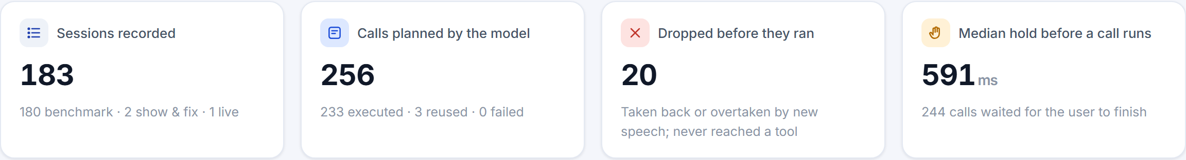

Brownie points (differentiation)
Counted by Keel’s web app across every session we recorded: benchmark, Show & Fix and live.
Every decision can be replayed
Free to run
Stress-tested
Play any conversation with its real audio and see when each action was held, dropped or run.
Runs on Gemini’s free tier, or fully offline on open models. No paid key needed.
3,072 simulated timing and failure cases: no double bookings, no fake “done”.
Honest numbers
No benchmark tricks
One command to reproduce
Every failure is explained, scenario by scenario. We never claim a score we didn’t measure.
Keel’s rules are general, and its timings come from published research on conversation.
Pinned versions and seeds, so the organisers run exactly what we ran.
Problem
Gaps
Solution
How it works
Demo
Tech
Use case
Results
Next
Extras
Notes:
README.md (Web app, Tests, Honesty notes); eval/grid_self_repair.py (3,072 combinations); SOURCES.md for timings.

Slide 12
Checklist- Updated on Public GitHub
Working prototype code — public GitHub repo: Y github.com/PROSTLE/samsung
README with reproducible setup instructions: Y one command sets up and runs the benchmark
Demo video, max 5 minutes (YouTube or Drive link): to be added
Presentation file (PPT or PDF): Y this deck
Notes:
Demo video not recorded yet (docs/DEMO_SCRIPT.md has the shot list).

Slide 13
Thank you
Organised by the Language AI Team and the PRISM Team, Samsung R&D Institute India
Notes:
Closing slide. Add the Google Form URL and a contact email before sharing. Edition 2 organising team for reference: Language AI - Sourabh Tiwari, Gaurav, Sanjeeth Pothireddy, Gorang Maniar; PRISM - Binny Lakra, Prakhar Chandrakar, Vishu Kumar; Kick-off and mentors - Giridhar Jakki, Deepraj Prabhakar Patkar (Language AI), Srimanu Prasad Nagaraju, Ashish Kumar (Tech Strategy).

