Slide 1
BCA 5TH SEMESTER FINAL PROJECT
DreamNest Real Estate Portal
A Modern Web-Based Property Discovery & Management Platform
Technology Stack: PHP 8.x | MySQL 8.0 | HTML5 & CSS3 | JavaScript (ES6+) | Apache
Department of Computer Science & Applications

Slide 2
DREAMNEST REAL ESTATE PORTAL
Project Index & Agenda
1. Introduction
7. System Design (Modules & Use Cases)
2. Limitation of Existing System
8. Screenshots Showcase (7 Core Screens)
3. Objectives
9. ER-Diagram
4. Scope (Functional & Technical)
10. Software Testing & Test Cases
5. Technology Stack Detailed Analysis
11. References
6. Advantages
12. Bibliography
BCA 5th Semester Final Project | DreamNest Real Estate Web Application

Slide 3
DREAMNEST REAL ESTATE PORTAL
1. Introduction
Project Overview:
• DreamNest is a comprehensive real estate management portal designed to revolutionize property discovery, buying, renting, and administration.
• Replaces fragmented, offline property transactions with an automated, database-driven web platform.
• Features an inventory of 80+ verified residential, commercial, villa, and plot listings across major Gujarat urban centers.
• Integrates dynamic multi-parameter search, favorite bookmarking, online visit requests, property submission forms, and a secure admin control panel.
• Built strictly adhering to responsive design principles, clean architecture, and robust database security.
BCA 5th Semester Final Project | DreamNest Real Estate Web Application

Slide 4
DREAMNEST REAL ESTATE PORTAL
2. Limitations of Existing System
❌ Manual Property Screening
Property seekers must make physical visits or endless phone calls to brokers just to get basic specs.
❌ No Real-Time Dynamic Search
Conventional paper ads lack instant filtering by budget, location, property type, or bedroom count.
❌ High Communication Delay
Manual enquiry forms lead to communication gaps, mislaid customer records, and delayed follow-ups.
❌ Data Security & Scalability Risks
Spreadsheet-based records lack role-based access controls, session persistence, and data normalization.
❌ Lack of User Personalization
Traditional systems offer no user dashboards to save favorite listings or monitor lead status.
BCA 5th Semester Final Project | DreamNest Real Estate Web Application

Slide 5
DREAMNEST REAL ESTATE PORTAL
3. Project Objectives
🎯 Centralized Web Hub
Create a single platform connecting buyers, renters, owners, and admins.
🎯 Dynamic Multi-Criteria Search
Enable real-time parameter filtering by city, property type, mode (buy/rent), and bedrooms.
🎯 Role-Based Security
Implement secure session-managed user authentication and admin access control.
🎯 Admin CRUD Control
Provide administrators full control to add, edit, and delete property listings and customer enquiries.
🎯 Responsive UI Aesthetics
Deliver an ultra-modern Teal & Amber responsive theme optimized across all screen sizes.
BCA 5th Semester Final Project | DreamNest Real Estate Web Application

Slide 6
DREAMNEST REAL ESTATE PORTAL
4. Scope (Functional & Technical)
4.1 Functional Scope
✔ User Registration & Session Authentication
✔ Browse 80+ properties across 5 categories
✔ Multi-parameter dynamic search & filtering
✔ Personalized User Dashboard & Saved Favorites
✔ Property Visit Requests & Sell Property submission
✔ Admin Analytics Dashboard & Property CRUD
✔ Customer Enquiry management & User registry
4.2 Technical Scope
⚡ Modular PHP File Architecture
⚡ MySQL Relational Database Schema (5 tables)
⚡ Zero-Trust SQL Injection protection via Prepared Statements
⚡ SHA-256 password hashing algorithm
⚡ Responsive CSS Custom Variables & Flexbox/Grid
⚡ Session-based Role-Based Access Control (RBAC)
⚡ XAMPP / Apache web server deployment
BCA 5th Semester Final Project | DreamNest Real Estate Web Application

Slide 7
DREAMNEST REAL ESTATE PORTAL
5. Technology Stack Detailed Analysis
HTML5 & CSS3 — [Frontend]
Semantic markup, CSS Flexbox/Grid layout, and responsive custom theme variables (`--navy: #0F3D3E`).
JavaScript (ES6) — [Client Logic]
DOM manipulation, dynamic property search filtering, mobile navigation drawer toggle, and favorite UI updates.
PHP 8.x — [Backend Server]
Modular server scripting, session persistence, secure HTTP routing, prepared SQL statement execution, and page template inclusion.
MySQL 8.0 — [Database Engine]
ACID-compliant relational storage, InnoDB engine, foreign keys (`ON DELETE CASCADE` / `SET NULL`), auto-increments, and indexes.
Apache (XAMPP) — [Web Server]
Local web hosting environment managing PHP module execution and MySQL daemon service.
BCA 5th Semester Final Project | DreamNest Real Estate Web Application

Slide 8
DREAMNEST REAL ESTATE PORTAL
6. Key Advantages of DreamNest
✨ High Performance & Lightweight
Native PHP & CSS implementation ensures ultra-fast page load speeds under 1 second without framework overhead.
✨ Robust SQL Injection Protection
Parameterized prepared statements across all database queries guarantee top-tier security against web exploits.
✨ Scalable Inventory
Easily handles 80+ properties with high-resolution imagery, full specification matrix, and detailed descriptions.
✨ Seamless Responsiveness
Optimized viewport rules deliver smooth UI layout adaptation across mobile phones, tablets, and wide monitors.
✨ Automated Lead Capture
Customer enquiries automatically save property context and user details into MySQL for admin review.
BCA 5th Semester Final Project | DreamNest Real Estate Web Application

Slide 9
DREAMNEST REAL ESTATE PORTAL
7. System Design — 7.1 Modules & Architecture
⚙ Authentication Module
Manages user registration, password hashing, session validation, and admin authentication guards (`admin/auth.php`).
⚙ Property Catalog Module
Handles SQL multi-parameter dynamic query building, property detail rendering, and property card grid components.
⚙ User Interaction Module
Powers user dashboard analytics, favorite property bookmarks, enquiry form submissions, and sell listing requests.
⚙ Admin Control Module
Provides executive dashboard metrics, complete property CRUD interface, user accounts list, and customer lead management.
BCA 5th Semester Final Project | DreamNest Real Estate Web Application

Slide 10
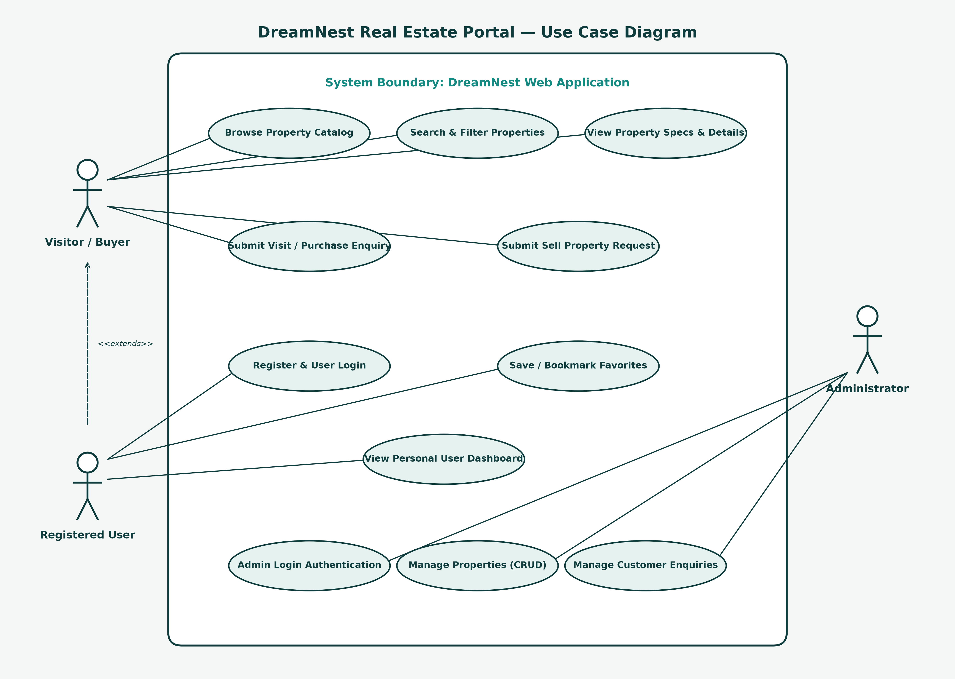
DREAMNEST REAL ESTATE PORTAL
7.1 System Design — Use Case Diagram
BCA 5th Semester Final Project | DreamNest Real Estate Web Application

Slide 11
DREAMNEST REAL ESTATE PORTAL
7. System Design — 7.2 Database Schema
🗄 Table: users (id (PK))
Fields: name, email, phone, password, role, created_at
Purpose: Stores user & admin accounts with SHA256 passwords
🗄 Table: properties (id (PK))
Fields: title, description, type, listing_type, price, city, address, area, beds, baths, image
Purpose: Stores 80+ property listings & specs
🗄 Table: favorites (id (PK))
Fields: user_id (FK), property_id (FK), created_at
Purpose: Junction table mapping saved user properties
🗄 Table: enquiries (id (PK))
Fields: user_id (FK), property_id (FK), name, email, phone, subject, message, status
Purpose: Stores customer visit & purchase enquiries
🗄 Table: agents (id (PK))
Fields: name, designation, experience, phone, email, image
Purpose: Stores real estate agent consultant profiles
BCA 5th Semester Final Project | DreamNest Real Estate Web Application

Slide 12
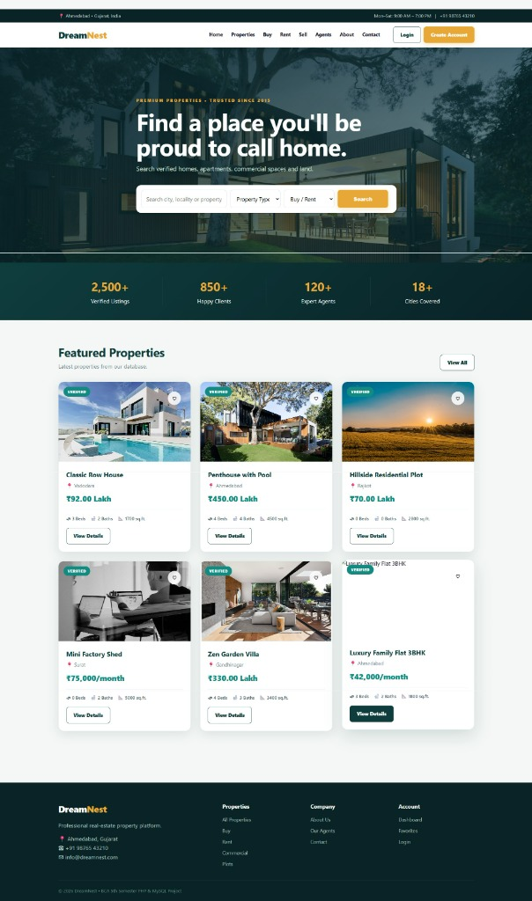
DREAMNEST REAL ESTATE PORTAL
8. Screenshots — Public Homepage (`index.php`)
Homepage Highlights:
• Brand logo & topbar contact
• Hero background banner
• Dynamic rapid search box
• Key metric stat counters
• Featured property card grid
• Responsive footer links
BCA 5th Semester Final Project | DreamNest Real Estate Web Application

Slide 13
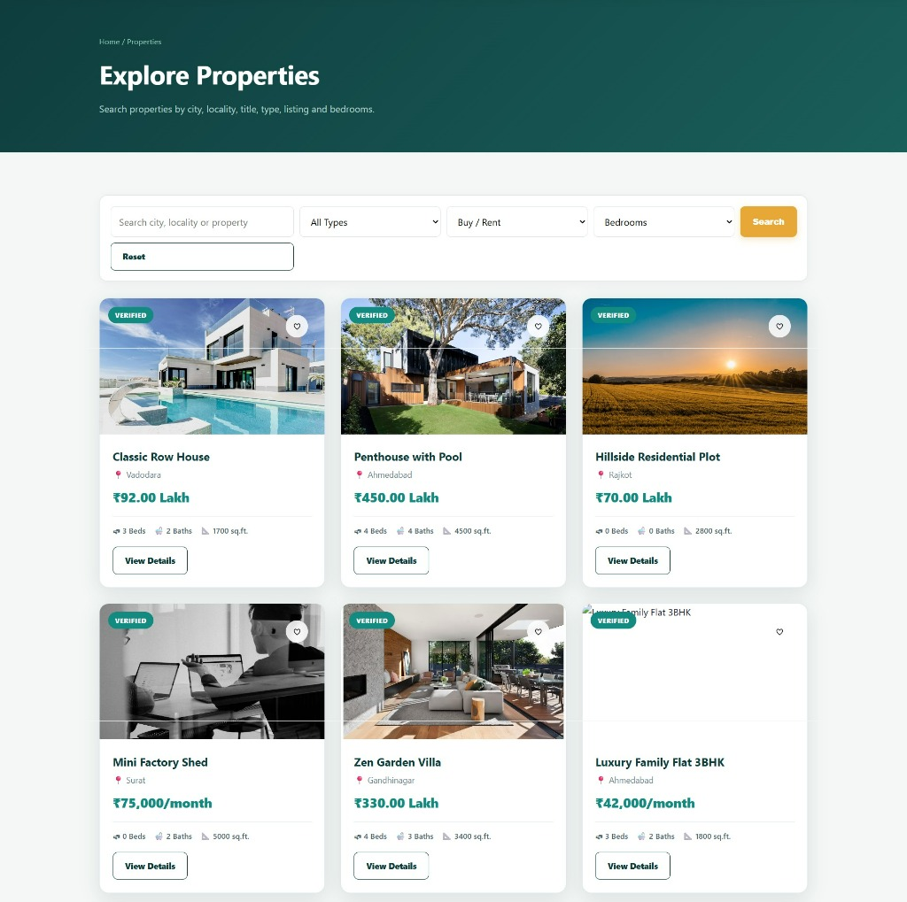
DREAMNEST REAL ESTATE PORTAL
8. Screenshots — Explore Properties Catalog (`properties.php`)
Properties Catalog:
• Page hero header banner
• Multi-parameter filter bar
• Search & Reset action buttons
• 3-column responsive card grid
• Verified badge on properties
• Price & dimension specs
BCA 5th Semester Final Project | DreamNest Real Estate Web Application

Slide 14
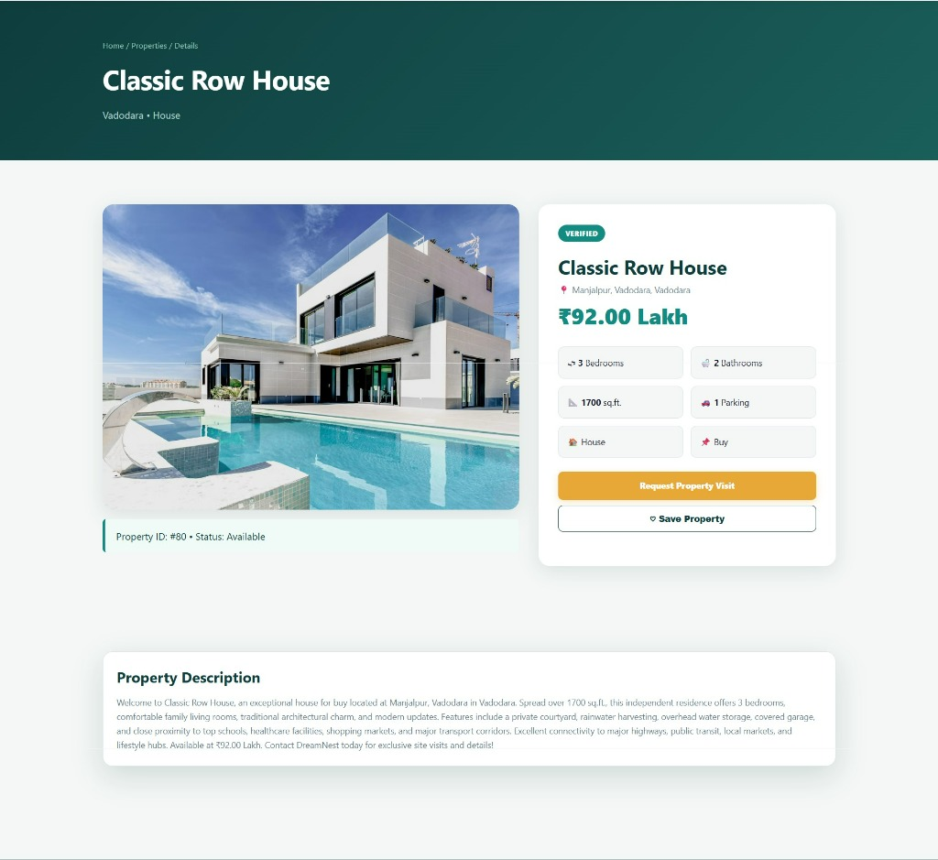
DREAMNEST REAL ESTATE PORTAL
8. Screenshots — Property Details (`property-details.php`)
Property Details:
• High-res gallery image
• Price display (₹92.00 Lakh)
• Verified status badge
• Specification matrix (Beds/Baths)
• Request Property Visit CTA
• Save Property (♡) button
• Property Description section
BCA 5th Semester Final Project | DreamNest Real Estate Web Application

Slide 15
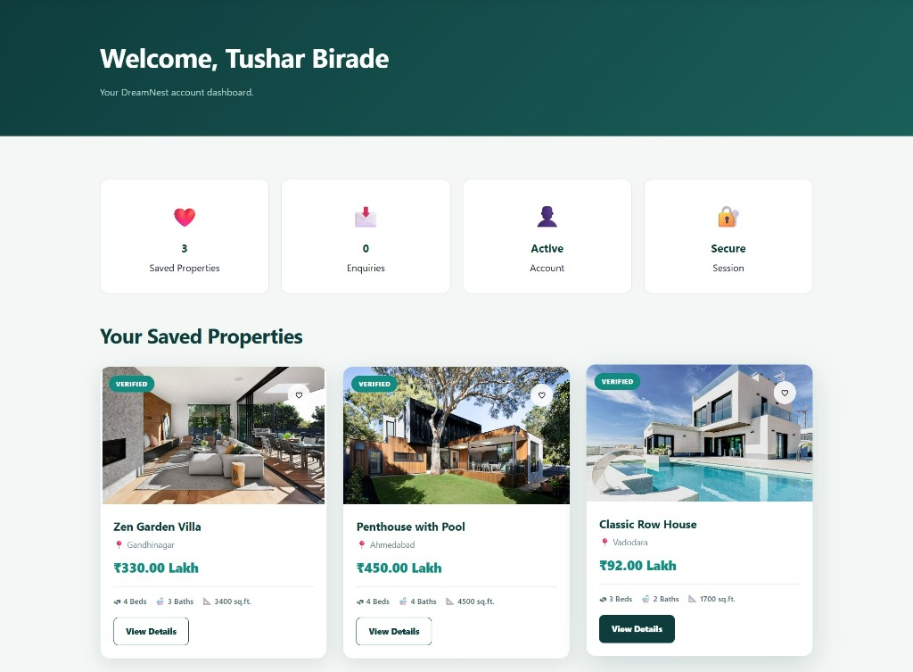
DREAMNEST REAL ESTATE PORTAL
8. Screenshots — User Dashboard (`dashboard.php`)
User Dashboard:
• User session greeting ('Welcome, Tushar Birade')
• Saved Properties counter card
• Total Enquiries counter card
• Active Account & Session pills
• Personalized Saved Favorites property grid
BCA 5th Semester Final Project | DreamNest Real Estate Web Application

Slide 16
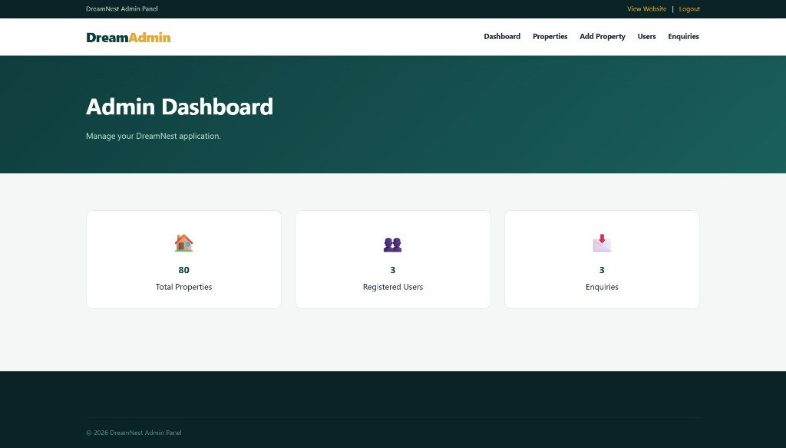
DREAMNEST REAL ESTATE PORTAL
8. Screenshots — Admin Dashboard (`admin/index.php`)
Admin Analytics:
• Protected admin session guard
• Total Properties Counter (80)
• Registered Users Counter (3)
• Incoming Enquiries Counter (3)
• Admin topbar navigation bar
BCA 5th Semester Final Project | DreamNest Real Estate Web Application

Slide 17
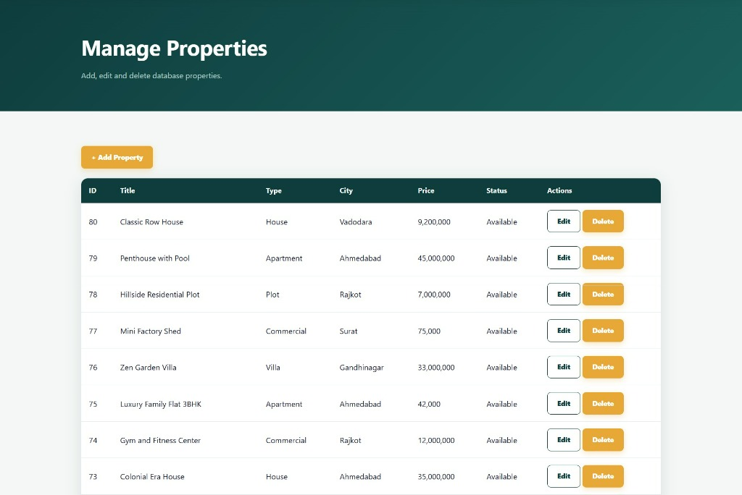
DREAMNEST REAL ESTATE PORTAL
8. Screenshots — Admin Manage Properties (`admin/properties.php`)
Property CRUD Table:
• '+ Add Property' action CTA
• Tabular data overview
• Property ID, Title, Type, City
• Price & Availability status
• Edit property modal button
• Delete trigger with confirmation
BCA 5th Semester Final Project | DreamNest Real Estate Web Application

Slide 18
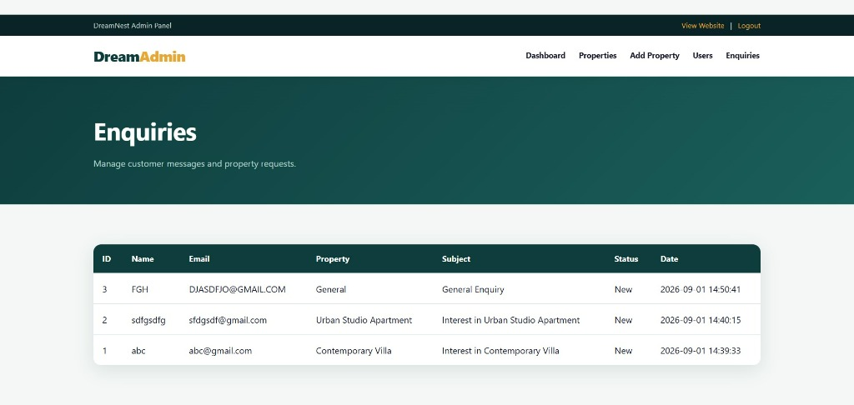
DREAMNEST REAL ESTATE PORTAL
8. Screenshots — Admin Enquiries Registry (`admin/enquiries.php`)
Customer Leads:
• Enquiry ID & Customer Name
• Contact Email address
• Linked Property Title reference
• Message Subject & Context
• Status badge indicator ('New')
• Date & Time timestamp
BCA 5th Semester Final Project | DreamNest Real Estate Web Application

Slide 19
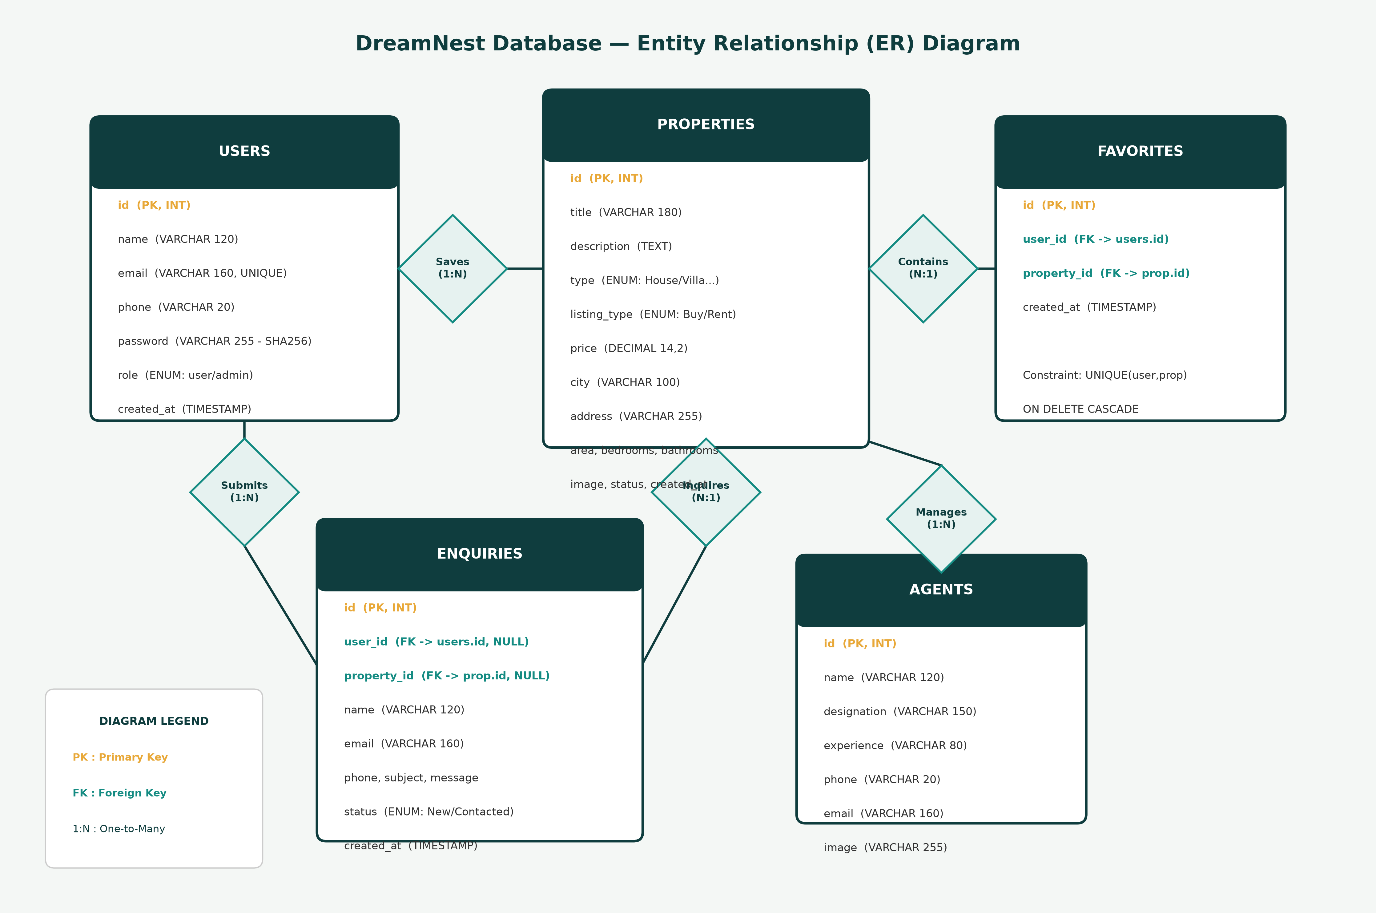
DREAMNEST REAL ESTATE PORTAL
9. Entity-Relationship (ER) Diagram
BCA 5th Semester Final Project | DreamNest Real Estate Web Application

Slide 20
DREAMNEST REAL ESTATE PORTAL
10. Software Testing & 10.1 Detailed Test Cases
🧪 TC01: User Registration | Status: PASS
Action: Submit registration form with valid inputs --> Result: Account created in DB, password hashed
🧪 TC02: User Authentication | Status: PASS
Action: Login with registered credentials --> Result: Session user_id set, redirect to dashboard
🧪 TC03: Dynamic Search | Status: PASS
Action: Filter by city='Surat', type='Villa' --> Result: Prepared SQL query returns matching villas
🧪 TC04: Save Favorites | Status: PASS
Action: Click ♡ button on property card --> Result: Inserted into `favorites` table, shown in dashboard
🧪 TC05: Submit Enquiry | Status: PASS
Action: Fill contact enquiry form --> Result: Inserted into `enquiries` table with status=New
🧪 TC06: Admin Security | Status: PASS
Action: Direct URL access to `admin/index.php` --> Result: Blocked by `admin/auth.php`, redirect to login
BCA 5th Semester Final Project | DreamNest Real Estate Web Application

Slide 21
DREAMNEST REAL ESTATE PORTAL
11. References & 12. Bibliography
11. References
🔗 PHP Manual: Official Documentation on PDO, MySQLi, and Session Security (php.net)
🔗 MySQL 8.0 Reference Manual: InnoDB Relational Architecture & Indexing (dev.mysql.com)
🔗 MDN Web Docs: HTML5 Standards, CSS Flexbox/Grid, and JavaScript ES6+ (developer.mozilla.org)
🔗 XAMPP Stack Documentation: Apache Web Server & Environment Configuration (apachefriends.org)
12. Bibliography
📚 Welling, L. and Thomson, L. (2016) 'PHP and MySQL Web Development', 5th Ed., Addison-Wesley Professional.
📚 Nixon, R. (2021) 'Learning PHP, MySQL & JavaScript: With JQuery, CSS & HTML5', 6th Ed., O'Reilly Media.
📚 Duckett, J. (2014) 'Web Design with HTML, CSS, JavaScript and jQuery Set', Wiley Publishing.
BCA 5th Semester Final Project | DreamNest Real Estate Web Application

Slide 22
Thank You!
Questions & Demonstration
DreamNest Real Estate Portal — BCA 5th Semester Final Project

