Slide 1
Phylogenetic techniques for nomenclature acceptance
International PRRSV-2 Nomenclature Committee
2026.02.14

Slide 2
Motivation
These slides aim to
Provide a framework for classification
Standardize the workflow
Put forward a standard criteria for acceptance of new nomenclature
These slides do not cover
Phylogenetics for genomic epidemiology
Advanced analytical phylogenetic i.e. phylodynamics/phylogeography
The information in these slides will be further refined in the future by the white paper put forward by the IPNC

Slide 3
Basic process
The following slides will walk through the process of assessing if a set of sequences forms a unique lineage/sublineage. These steps include:
Curation and quality control of data
Alignment and reference set
Phylogenetic reconstruction
Checking for recombination
Assessing Relevance

Slide 4
1.1 Is your sequence quality good?
Check your sequences
Is the complete open reading frame 5 present?
Are the 5’ and 3’ ends trimmed?
Is the coding region divisible by 3?
If any of the above are missing, reanalysis or resequencing may be needed
Is the length 603 nt, or are their insertions/deletions?
This may be either a unique feature or a mistake, proceed with caution

Slide 5
1.2 Are your samples unique?
Can you classify them well on current tools?
PRRSLoom (https://stemma.shinyapps.io/PRRSLoom/)
Nextclade (https://clades.nextstrain.org/?dataset-name=community/isuvdl/mazeller/prrsv2/orf5/yimim2023) - where not red/flagged for private mutations
NCBI BLAST (https://blast.ncbi.nlm.nih.gov/Blast.cgi) where no hit is > 94% similar
If there are sequences >95% similar, how are those classified on PRRSLoom and Nextclade (they also may be poorly classified)
If they are able to be assigned with the current classification tools or on prior data, they may already be represented in the current nomenclature

Slide 6
2.1 Did you use a good reference set
The IPNC will maintain and update a reference set to aid in these studies
The foundation of this dataset is Yim-im et. al, 2023. This dataset will be updated as new information is presented (i.e. L1K, L1L, L12).
When making an alignment, you should use at least a minimal reference set
Are all contemporary and recent historical PRRSV-2 sublineages included in the reference set?
Are each lineage represented by more than 15 sequences?
Is reasonable diversity of that lineage sampled?
Is the reference set less than 2 years old?
If the above is not met, you may need to consider updating your reference set to accurately characterize the diversity of PRRSV-2

Slide 7
2.2 Do your sequences align well?
Align your sequences with the IPNC reference set
(available at https://github.com/PRRSV-2-Nomenclature-Consortium/International-PRRSV-2-Nomenclature-Consortium/)
MAFFT is a common and reliable tool for alignments (https://mafft.cbrc.jp/alignment/server/index.html)
Did you include representation from all other PRRSV-2 sublineages?
Do you have unusual insertions/deletions in your alignment?
If so, are they clustered in groups divisible by 3?
PRRSV-2 ORF5 typically aligns very well with minimal gaps. If you find multiple gaps that are not clearly amino acid insertions/deletions, you may need to reassess your sequencing
mafft --auto [unaligned.fasta] > [aligned.fasta]
(recommended)

Slide 8
2.3. Assessing distance to known sub-lineages
Calculate genetic distance or homology to other sub-lineages.
If this is a new sub-lineage or lineage, is there 8-11% difference to nearest lineage?
Report average and Interquartile Range
Report this in a table format

Slide 9
3.1 Constructing a phylogenetic tree
IQ-TREE V2 or V3 (https://iqtree.github.io/) is a robust and standard maximum-likelihood tool well adapted to this task
Did you construct a maximum-likelihood tree?
Did you use at least 1,000 bootstraps?
Ultrafast bootstraps are suitable and the suggested default
Did you use an appropriate base model (TIM2+e/TIM3+e/GTR)
Are the bootstraps viewable with 3rd party programs like FigTree or ggtree?
If your tree building step does not match these standard, it may not be considered robust for designating a new lineage/sublineage
iqtree –s [alignment.fasta] –m GTR+F+R4 –B 1000
(recommended)

Slide 10
3.2 Assessing your phylogenetics
To assess if you have a new nomenclature, when viewing your tree via FigTree
Are your sequences forming a monophyletic group?
Is the bootstrap support of ancestral node >70?
Are the bootstrap supports for other known lineages substantially high (indicating a robust tree)?
Is there good division of the new clade from recognized sub-lineages in terms of average branch length?
If all these conditions are met, there is likely strong evidence of a new lineage or sublineage.

Slide 11
4. Recombination
Did this clade emerge from apparent recombination between viruses belonging to other lineages?
Recombination breakpoints are rarely inside of ORF5
Recombination analysis should be performed using RDP4, RDP5, or other modern program, and tested against the provided reference set
Recombination events should have high confidence to avoid false positive
Supported by more than 80% of the RDP4/5 methods and Shimodaira-Hasegawa statistical signifigance
If so, then nearly all sequences within the clade would share the same recombination profile

Slide 12
5. Assessing relevance
The international nomenclature focuses on lineages with demonstrated epidemiological relevance and broader geographic circulation.
Are the new sequences found in numerous farms from different locations?
Are they found in multiple regions of the country?
If only found in one region/production system, how representative of the country’s swine industry is the region/production system?
Do these sequences represent a substantial percentage of sequences from the country?
Viruses with limited or localized transmission might not warrant a naming designation

Slide 13
FINAL CHECKLIST AND FORMAT OF PROPOSAL
Template available online
https://github.com/PRRSV-2-Nomenclature-Consortium/International-PRRSV-2-Nomenclature-Consortium
Fill in all sections
Refer to previous proposals if needed

Slide 14
Steering committee contact
If need additional help, consider reaching out
Kim VanderWaal - kvw@umn.edu
Tavis Anderson - tavis.anderson@usda.gov
Mariana Kikuti - mkikuti@umn.edu
Jianqiang Zhang - jqzhang@iastate.edu
Michael Zeller – mazeller@iastate.edu

Slide 15
Auxiliary Information
The proceeding slides provide additional information as a reference for nuanced data assessment

Slide 16
Recommended Criteria for establishing nomenclature
Alignments should be conducted with MAFFT or a Needleman-Wunsch algorithm
MAFFT will produce worse scores than NW, but NW will find a true optima
For nomenclature consideration, sequences must be trimmed to the ORF5.
Sequences should be complete, from methionine to stop codon

Slide 17
Acceptable tree building strategies
Trees should be built using either
Maximum-likelihood phylogenetics
IQTree (v2/v3) (preferred)
RAxML
RAxML-ng
Bayesian phylogenetics
Mr.Bayes
BEAST
Compared to a minimal reference set
These reference sets should include adequate diversity of all contemporary sublineages

Slide 18
Recommended Criteria for establishing nomenclature
Classification in current webtools
Undetermined classification further supports possible new lineage
PRRSLoom - https://stemma.shinyapps.io/PRRSLoom/
Nextclade - https://clades.nextstrain.org/?dataset-name=community/isuvdl/mazeller/prrsv2/orf5/yimim2023
Phylogenetic tree (maximum-likelihood)
Bootstrap support of ancestral node
Bootstrap support of ancestral node should be >70
Relation to existing sub-lineages
Genetic distances of new clade from recognized sub-lineages
On average expecting 11% difference between lineages

Slide 19
Maximum Likelihood Methods

Slide 20
IQ-Tree
iqtree –s [alignment.fasta] –m GTR+F+R4 –B 1000
(recommended)
At minimum, use 1000 bootstraps
Base models that are useful
GTR
TIM2/TIM3
SYM
Base frequences (optional)
+F (empirical)
Invariance (optional)
Valid, useful for estimating invariant sites
Rate models (optional)
+G4 or +R4 is okay
Wide array of models are functional and produce similar results
Avoid JC and F81, models that fail to capture transition/transversion well perform poorly

Slide 21
IQ-Tree models
High ranking models produce similar tree topologies/branch support, using ModelFinder Plus
PRRSV is an RNA virus, and can typically fit high parameter models
Top 15 models relative to a subset of 200 sequences
No. | Model | -LnL | df | AIC | AICc | BIC | BIC diff | num
267 | SYM+R4 | 11088.16 | 396 | 22968.31 | 24423.98 | 24717.98 | 0 | 1
215 | TIM3e+R4 | 11096.45 | 394 | 22980.89 | 24408.69 | 24721.73 | 3.744 | 2
189 | TIM2e+R4 | 11096.59 | 394 | 22981.18 | 24408.98 | 24722.01 | 4.03 | 3
59 | TNe+R4 | 11102.59 | 393 | 22991.18 | 24405.26 | 24727.6 | 9.613 | 4
163 | TIMe+R4 | 11100.18 | 394 | 22988.36 | 24416.15 | 24729.19 | 11.208 | 5
241 | TVMe+R4 | 11097.14 | 395 | 22984.28 | 24425.94 | 24729.53 | 11.547 | 6
268 | SYM+R5 | 11088.08 | 398 | 22972.15 | 24456.28 | 24730.66 | 12.678 | 7
216 | TIM3e+R5 | 11096.41 | 396 | 22984.81 | 24440.48 | 24734.49 | 16.501 | 8
190 | TIM2e+R5 | 11096.55 | 396 | 22985.09 | 24440.76 | 24734.76 | 16.779 | 9
124 | TPM2u+F+R4 | 11096.75 | 396 | 22985.5 | 24441.16 | 24735.17 | 17.186 | 10
111 | TPM2+F+R4 | 11096.91 | 396 | 22985.81 | 24441.48 | 24735.48 | 17.5 | 11
202 | TIM2+F+R4 | 11094.14 | 397 | 22982.28 | 24452.1 | 24736.37 | 18.384 | 12
254 | TVM+F+R4 | 11091.01 | 398 | 22978.02 | 24462.15 | 24736.53 | 18.541 | 13
280 | GTR+F+R4 | 11088.54 | 399 | 22975.07 | 24473.67 | 24738 | 20.017 | 14
33 | K2P+R4 | 11111.06 | 392 | 23006.13 | 24406.63 | 24738.12 | 20.14 | 15
Poor fit models
(JC/F81)
+F+I
+R2

Slide 22
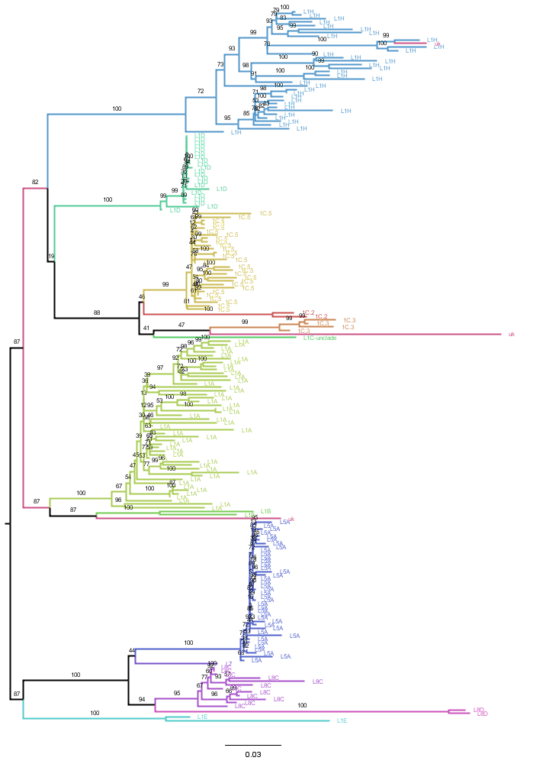
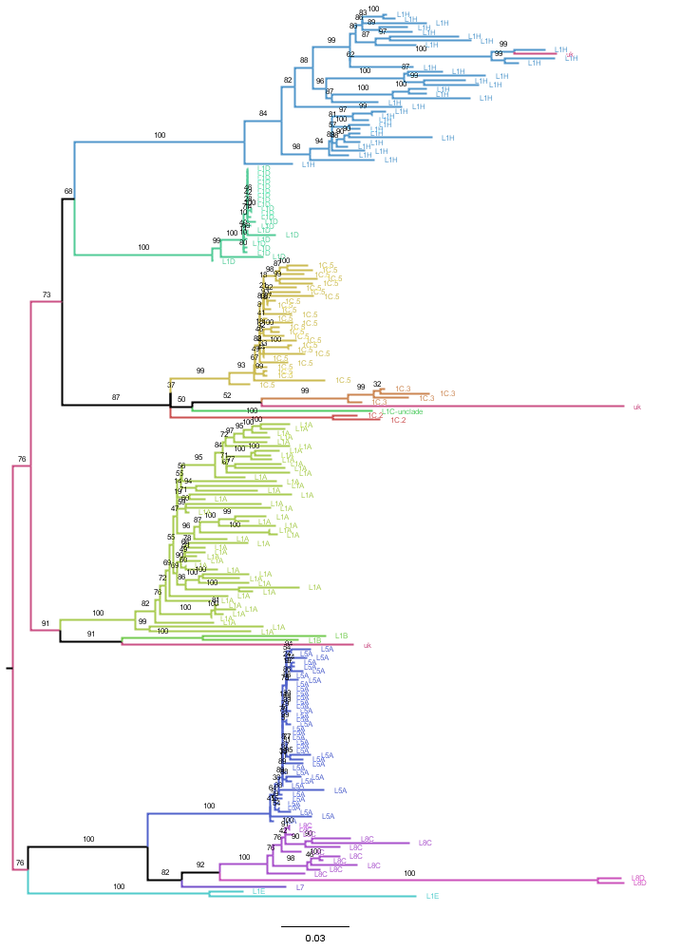
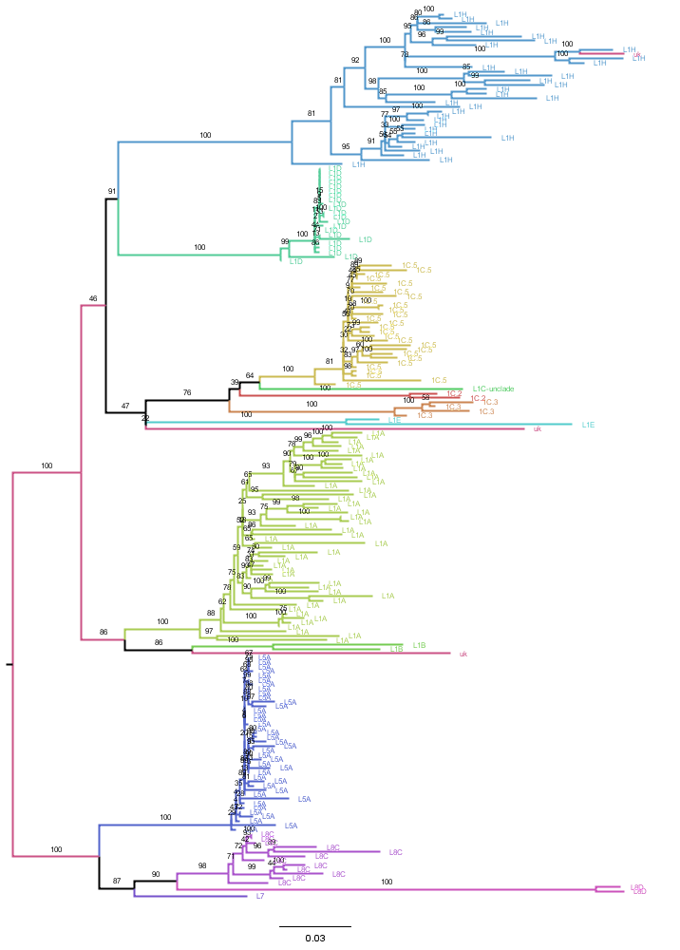
Comparison of tree topology and bootstraps
Different models produce very similar topology
At the lineage level, boot strap support remains strong
BIC (Lower the better)
24717.984
24827.766
24738.001
24757.577
SYM+R4
GTR+F+G4
GTR+F+R4
TIM2+F+I+G4
100
100
100
100
100
100
100
100
99
99
99
100
88
87
87
76
100
100
100
100
100
100
100
100
100
100
95
100
100
100
100
98

Slide 23
Additional information on models
ModelFinder Plus is a quantitative method for validating models
Most high-parameter base models will produce trees with similar bootstrap support and topology
It is up to journal reviewers to determine if model selection was appropriately validated

Slide 24
RAxML and RAxML-NG
Differing ML method
Implements related substitution models
Comparable results
If you maintain the >70 bootstrap and metrics related to sequence similarity, this is also a valid method

Slide 25
Bayesian methods

Slide 26
Using Bayesian methods
Statistical support for Bayesian methods is noted as posterior branch support
Standard convergence metrics should be met
BEAST – ESS > 200
Posterior branch support for clades should be > 70
Bayesian methods typically take longer to run and are more computationally expensive

Slide 27
Non-recommended methods

Slide 28
Methods to avoid
Neighbor-joining methods
Compresses genetic information into single metric
Parsimony methods
Not widely supported

