Slide 1
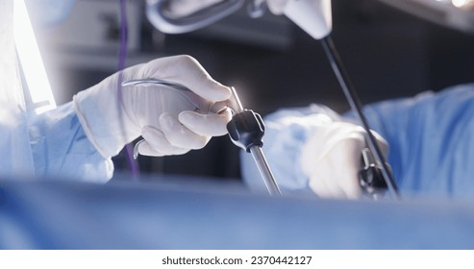
Presented by Group-9:
Arshi Saxena
Norbert Oliver
Pranjali Sonawane
Sharvesh Subhash
Guided by : Prof Tiang Jing
Development and Evaluation of an AI Model for Identifying Critical Anatomical Structures in Surgical Operation Video

Slide 2
SPONSOR
Sponsor:
Lai Yufu Jarrell (jarelllai@u.nus.edu), NUS Medicine Role of Stakeholders:
Provide curated laparoscopic image dataset (TEP inguinal hernia repairs)
Supply expert-annotated data for anatomical structure detection
Validate AI model outputs through domain feedback
Ensure clinical relevance, safety, and practical applicability

Slide 3

Medical Background
Inguinal Hernia
TEP
Abdominal tissue protrudes through weak groin muscles which causes pain/discomfort
Totally Extraperitoneal
Repair
Minimally invasive laparoscopic technique

Slide 4
Medical background
Key Anatomical Areas Encountered
Why These Areas Matter
Triangle of pain
Testicular vessels
Vas deferens
Inferior epigastric vessels
Triangle of doom
Pubic bone
Surgeons must identify them to avoid nerve & vessel damage during TEP

Slide 5
CHALLENGE
Training often uses real surgical videos for observation.
​
Proper learning requires annotations/labels on these anatomical regions.​
Manual labeling is time-consuming and labor-intensive.​
Opportunity: Automated detection can save time and improve learning efficiency.​

Slide 6
EXISTING SOLUTION
Previous model developed for automated annotation of anatomical areas in TEP videos.​
Used YOLOv8 (released Jan 2023) → now considered outdated.​
Newer models like YOLOv11 offer higher mAP and faster inference speed.​
Motivation: Build an improved solution to surpass prior model performance.​

Slide 7



OBJECTIVES
Evaluate Model Performance
Develop an object detection model
Compare performance against previous models

Slide 8
DATASET
A curated set of laparoscopic images from TEP inguinal hernia repairs.​
Each image is annotated by an experienced surgeon to highlight key anatomical structures​
Annotations are made using Coco Annotator.​
Dataset size 5200 images, with the 6 class annotations provided by the client.​

Slide 9
WORKFLOW – PHASE-1
Dataset
Data Preprocessing
Model Training
Select YOLO Version
Train model with annotated dataset
Tune hyperparameters, optimize performance
Sources:
Provided by Client
Data Cleaning
Data Augmentation
Deliverables
Model Deployment
Model Evaluation
Input: Laparoscopic video clips
Frame Extraction: Converts videos into frames
Detection: Identifies anatomical classes with OBB
Output: Displays annotated frames via UI
Docker
Streamlit or Flask
mAP
IOU
Confusion Matrix

Slide 10
WORKFLOW – PHASE-2
Phase 1 Model
Model Training
Model Evaluation
The model evaluation will be based on the accuracy of the tools/organs being detected using OBB
Use VLM for detecting the Operative Tools with the help of Zero shot prompt method and YOLOv11 for detecting the 6 organs
Fine Tune hyperparameters, optimize performance
Deliverables
Model Deployment
A model that will be able to detect the organs and tools in a video
Docker
Streamlit or Flask

Slide 11
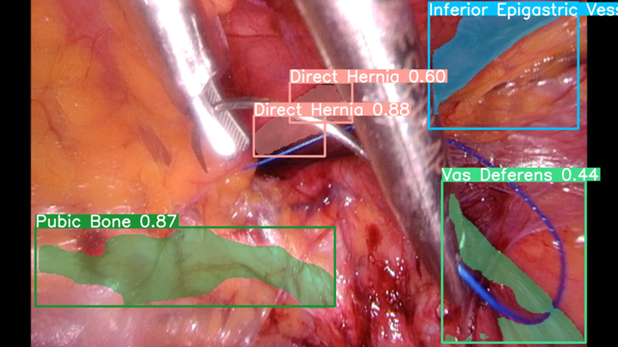
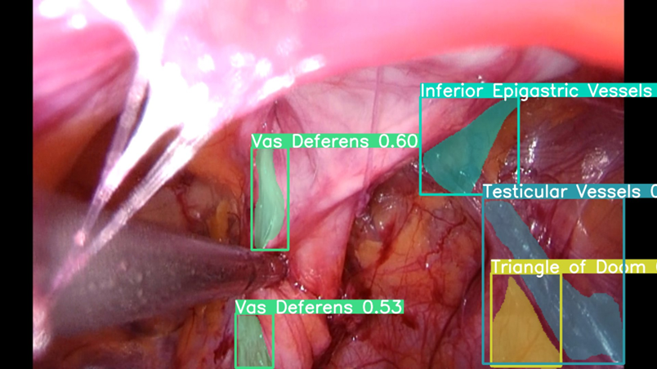
PREVIOUS WORK RESULTS(PHASE –1)

Slide 12
THANK YOU!

