Slide 1
Multilayer perceptron
Team red
Shushan
Julia
Cornelis
Lars
Joel
Mili

Slide 2
Libraries
numpy
matplotlib.pyplot
sklearn

Slide 3
sklearn
Scikit-learn
Supervised and unsupervised learning
  Classification, regression, clustering, preprocessing, dimensionality reduction

Slide 4
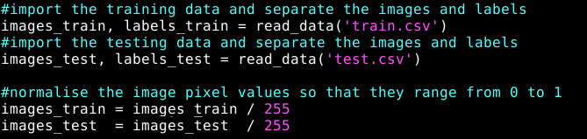
The data

Slide 5
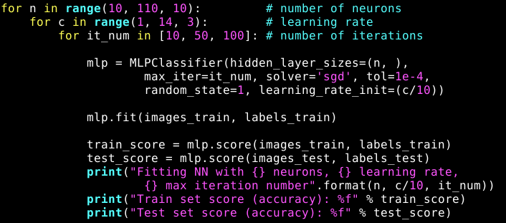
The main loop

Slide 6
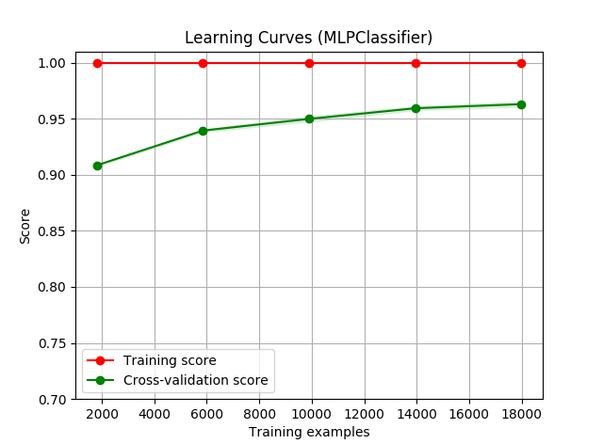

Slide 7
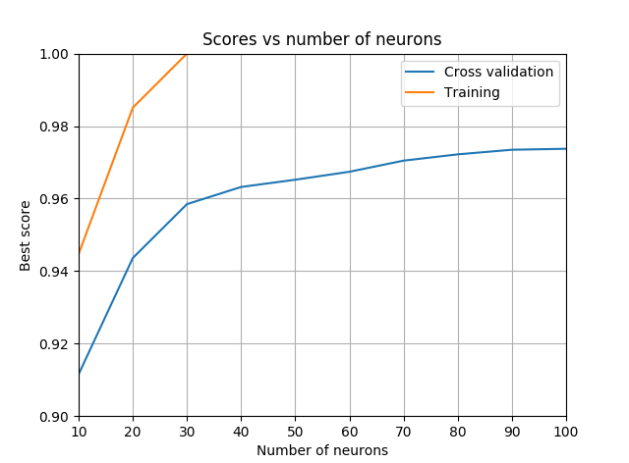

Slide 8
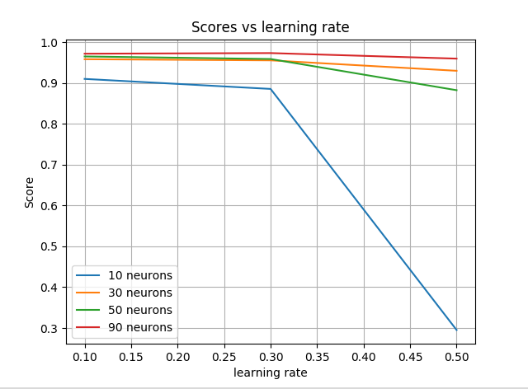

Slide 9
Conclusions
More neurons, more accurate results
Lower learning rate is better
Number of iterations
  Low learning rate: use more iterations
  High learning rate: use fewer iterations

