Slide 1
TeamRed
Cornelis Doorenbos, Mili Biswas, Julia Eigenmann, Lars Vögtlin, Niklaus Joel, Shushan Toneyan

Slide 2
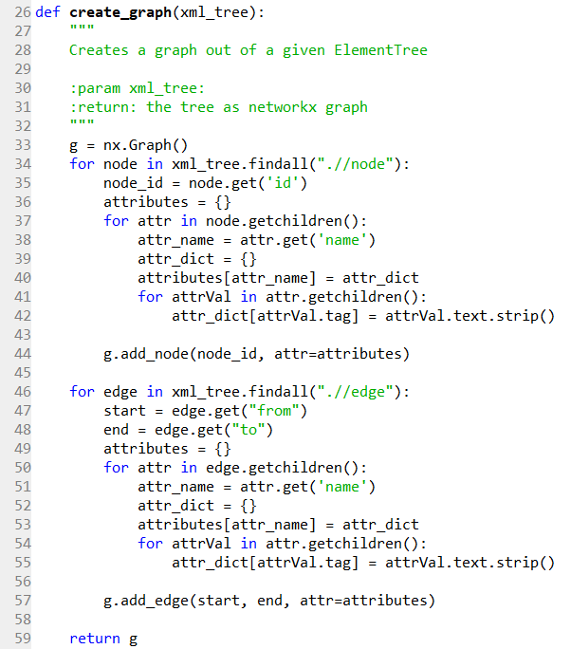
Molecules Task using GED

Slide 3
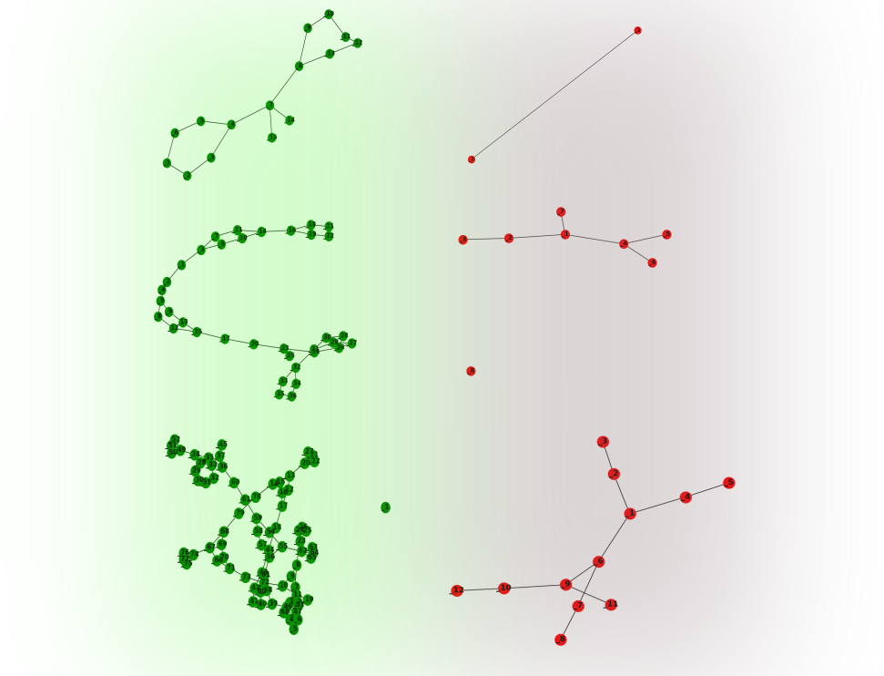
Package ged4py for implementing GED by:
Creating and normalising the cost matrix
Performing linear sum assignment using scipy.optimize function
Computing the GED value

Slide 4
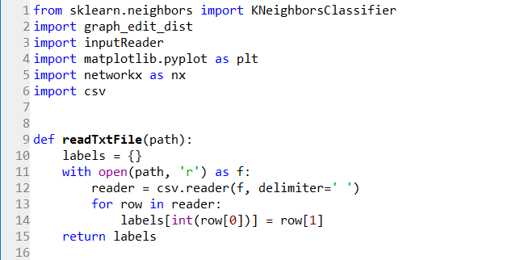
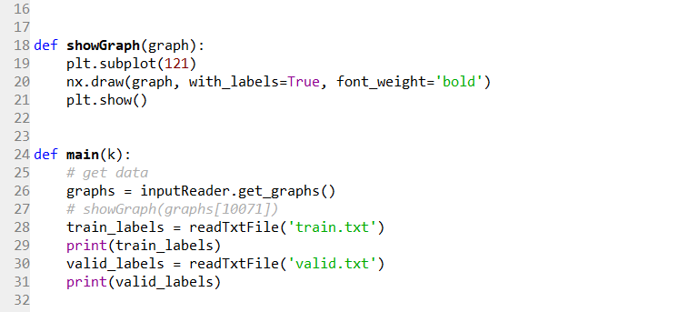
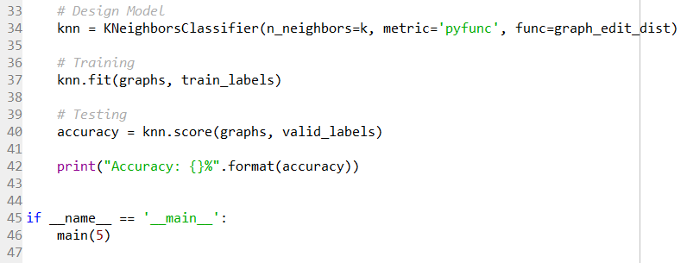
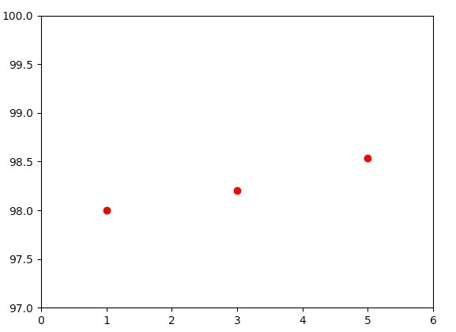
KNN Implementation

Slide 5
Signatures Task using DTW

Slide 7
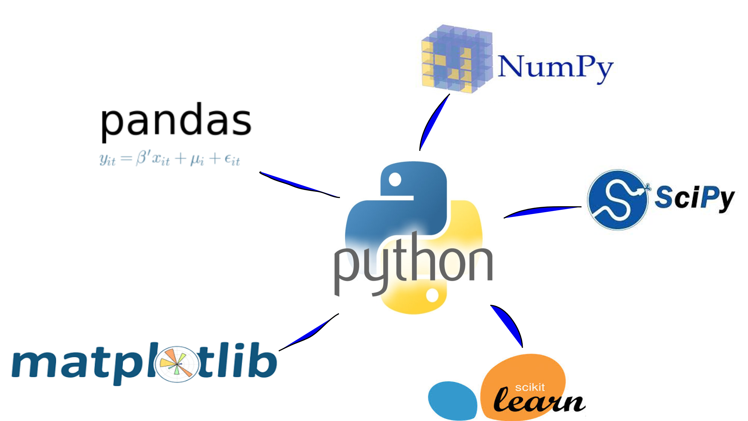
Team and Software Organization
Liberal selection (and execution) of subtasks on first come first served basis.
Suboptimal overall group management
United over the use of Python for solving the tasks

Slide 8
Lessons learnt
Implementation of many concepts discussed during the lectures:
Graph Edit Distance
Dynamic Time Warping
Multi Layer Perceptron
Support Vector Machine
Practical skills in making choices of optimization parameters for each
Group work and management:
Optimal division of labour on time
Making sure the nodes are interlinked

Slide 9
Thank you for your attention!

