Slide 1
Team Red SVM
Lars Vögtlin, Joel Niklaus, Mili Biswas

Slide 2
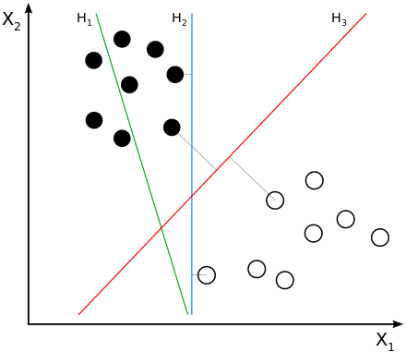
What is SVM again?
Constructs hyperplane between points
Goal: Maximize margin
H1: not separating classes
H2: separating but with small margin
H3: separating with maximum margin

Slide 3
Library Version
Python 3.6.4
Scikit Learn (sklearn)
Numpy
Pickle → Serialization of training datasets for faster development

Slide 4
GridSearch
Automatic Search for best hyperparameters
Search for C and gamma
Logarithmic scales
C: 10-2 – 1010
Gamma: 10-9 – 103
Usually from 10-3 – 103 is sufficient

Slide 5
GridSearch
Improve GridSearch iteratively
If on boundary: shift range
Example: range (1, 10, 100) → 100 → (10, 100, 1000)
If not: zoom in around found value
Example: range (1, 10, 100) → 10 → (5, 10, 20)

Slide 6
GridSearch
C_range = np.logspace(-2, 10, 13) gamma_range = np.logspace(-9, 3, 13) param_grid = dict(gamma=gamma_range, C=C_range) cv = StratifiedShuffleSplit(n_splits=5, test_size=0.2, random_state=42) grid = GridSearchCV(model, param_grid=param_grid, cv=cv) grid.fit(**train_set) print("The best parameters are %s with a score of %0.2f" % (grid.best_params_, grid.best_score_))

Slide 7
Own Implementation
Mili?

Slide 8
Questions???

