Slide 1
Team Red SVM
Lars Vögtlin, Joel Niklaus, Mili Biswas

Slide 2
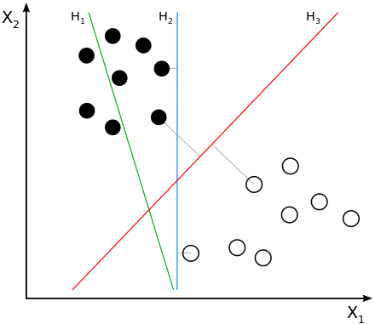
What is SVM again?
Constructs hyperplane between points
Goal: Maximize margin
H1: not separating classes
H2: separating but with small margin
H3: separating with maximum margin

Slide 3
Used Libaries
Python 3.6.4
Scikit Learn (sklearn)
Numpy
Pickle → Serialization of training datasets for faster development

Slide 4
Grid Search
Automatic Search for best hyperparameters
Search for C and gamma
Logarithmic scales
C: 10-2 – 1010
Gamma: 10-9 – 103
Usually from 10-3 – 103 is sufficient
Notes:
The C parameter tells the SVM optimization how much you want to avoid misclassifying each training example. For large values of C, the optimization will choose a smaller-margin hyperplane if that hyperplane does a better job of getting all the training points classified correctly. Conversely, a very small value of C will cause the optimizer to look for a larger-margin separating hyperplane, even if that hyperplane misclassifies more points. For very tiny values of C, you should get misclassified examples, often even if your training data is linearly separable.
The gamma parameter defines how far the influence of a single training example reaches, with low values meaning ‘far’ and high values meaning ‘close’. The gamma parameters can be seen as the inverse of the radius of influence of samples selected by the model as support vectors. If gamma is too large, the radius of the area of influence of the support vectors only includes the support vector itself and no amount of regularization with C will be able to prevent overfitting.
When gamma is very small, the model is too constrained and cannot capture the complexity or “shape” of the data. The region of influence of any selected support vector would include the whole training set. The resulting model will behave similarly to a linear model with a set of hyperplanes that separate the centers of high density of any pair of two classes

Slide 5
Grid Search
Improve GridSearch iteratively
If on boundary: shift range
Example: range (1, 10, 100) → 100 → (10, 100, 1000)
If not: zoom in around found value
Example: range (1, 10, 100) → 10 → (5, 10, 20)

Slide 6
Grid Search Code
C_range = np.logspace(-2, 10, 13) gamma_range = np.logspace(-9, 3, 13) param_grid = dict(gamma=gamma_range, C=C_range) cv = StratifiedShuffleSplit(n_splits=5, test_size=0.2, random_state=42) grid = GridSearchCV(model, param_grid=param_grid, cv=cv) grid.fit(**train_set) print("The best parameters are %s with a score of %0.2f" % (grid.best_params_, grid.best_score_))

Slide 7
Questions???

