Slide 1
Signatures
Team Red

Slide 2
Libraries used
scipy
pprint (file handling)
pandas
Sklearn
multiprocessing

Slide 3
DTW Implementation
Own implementation, as discussed before
Sakoe Chiba band: 20% of width

Slide 4
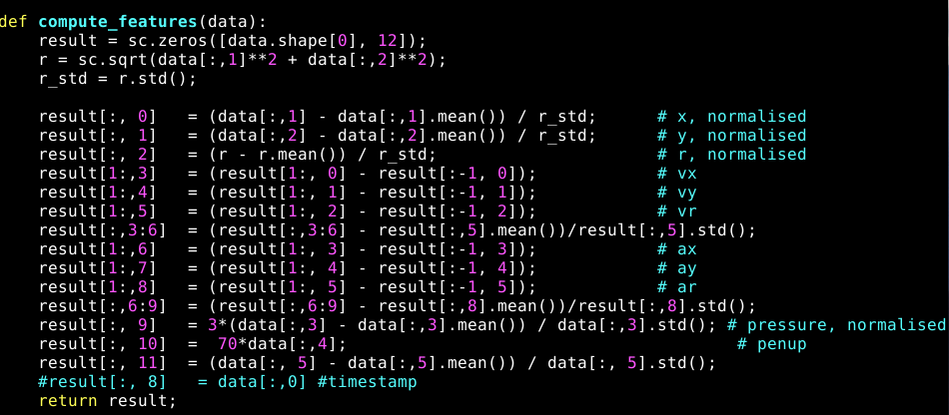
Features

Slide 5
Statistics from enrollment signatures
Mean minimum distance
Mean maximum distance
Mean distance
Root mean squared distance: sqrt( sum(distances)^2 ) / N

Slide 6
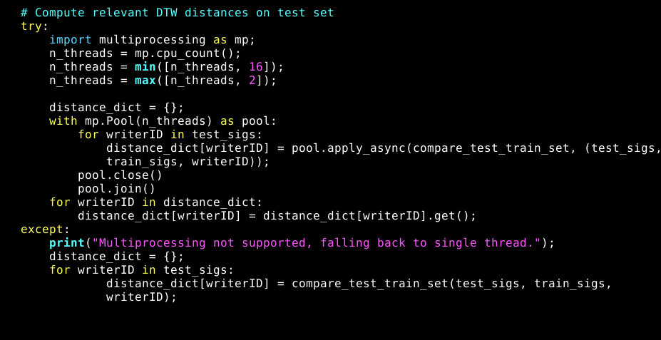
Distance computation loop

Slide 7
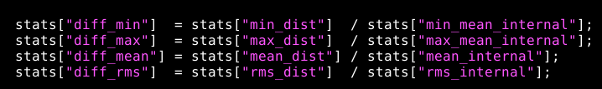
Prediction model
Linear regression model
Multi level perceptron
Monte Carlo cross validation
Search the best parameters
Turned out to be root mean square difference

Slide 8
Performance
Linear regression model
1 parameter: root mean square distance divided by internal root mean square distance
Cross validated score: 81.6 %

